Slide 1
Earth System History Review Game
IN THE NICK OF TIME | UNITS OF TIME | PICTURES IN TIME | ANYTHING EARTH HISTORY | -BONUS- DINOSAURS
1 | 6 | 11 | 16 | *21
2 | 7 | 12 | 17 | *22
3 | 8 | 13 | 18 | *23
4 | 9 | 14 | 19 | *24
5 | 10 | 15 | 20 | *25
Copyright © 2010 Ryan P. Murphy

Slide 2
How to play…
  Don’t play like Jeo_ _ _ _ y.
  Class should be divided into several small groups.
  Groups should use science journal (red slide notes), homework, and other available materials to assist you.
  Groups can communicate quietly with each other but no sharing answers between groups.
    Practice quietly communicating right now?
    Practice Communication Question:
    Your group gets to order one pizza, and you can have two toppings. What does your group want?

Slide 3

Questions 1-20 = 5pts Each
Final Category (Bonus) = 1pt Each
Final Questions = 5 pt wager
If you wager 5 on the last question and get it wrong you lose 5 pts. Wager 5 and get it right you get 5 pts.
Find the Owl =
Secretly write “Owl” in the correct box worth 1pt.
“I’ll be about this big.”

Slide 4
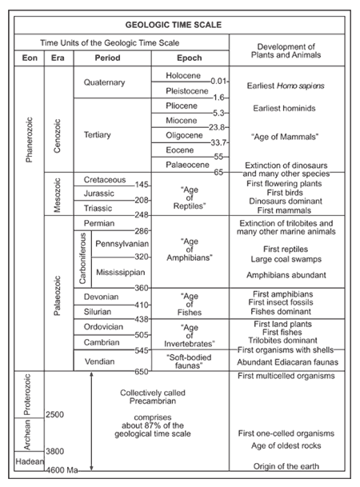
Have this sheet handy as you will be using it frequently during this review game.
Copyright © 2010 Ryan P. Murphy

Slide 5

Is your name on the review sheet?
Name

Slide 6
Is your name on the review sheet?
Add the categories
along the top
on the next slide.

Slide 7
Earth System History Review Game
IN THE NICK OF TIME | UNITS OF TIME | PICTURES IN TIME | ANYTHING EARTH HISTORY | -BONUS- DINOSAURS
1 | 6 | 11 | 16 | *21
2 | 7 | 12 | 17 | *22
3 | 8 | 13 | 18 | *23
4 | 9 | 14 | 19 | *24
5 | 10 | 15 | 20 | *25
Copyright © 2010 Ryan P. Murphy

Slide 8
Earth System History Review Game
IN THE NICK OF TIME | UNITS OF TIME | PICTURES IN TIME | ANYTHING EARTH HISTORY | -BONUS- DINOSAURS
1 | 6 | 11 | 16 | *21
2 | 7 | 12 | 17 | *22
3 | 8 | 13 | 18 | *23
4 | 9 | 14 | 19 | *24
5 | 10 | 15 | 20 | *25
Copyright © 2010 Ryan P. Murphy

Slide 9

The appearance of early humans is best represented by which picture on the 12 hour Earth calendar.
1
A
B
C
D
Copyright © 2010 Ryan P. Murphy

Slide 10
The appearance of the earliest forms of basic life is best represented by which picture on the 12 hour Earth calendar.
2
A
B
C
D
Copyright © 2010 Ryan P. Murphy

Slide 11
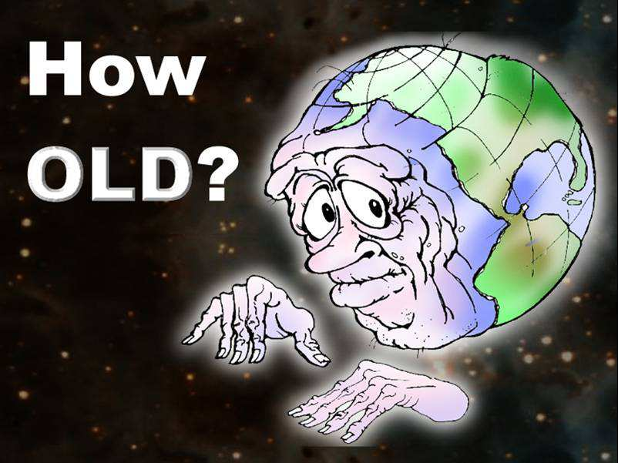
3
Roughly, How old is the earth?

Slide 12
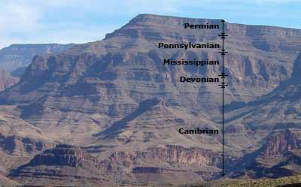
This describes how layers of Earth that are on the bottom are usually older and contain older fossils.
4

Slide 13
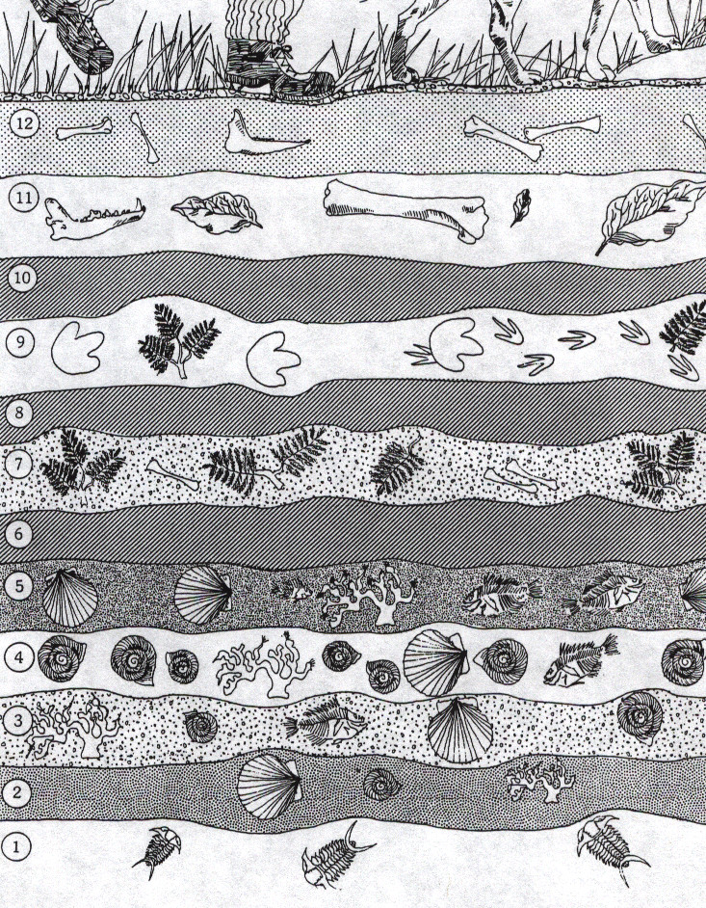
What may have occurred at numbers 6, 8, and 10?
5
Copyright © 2010 Ryan P. Murphy

Slide 14
Earth System History Review Game
IN THE NICK OF TIME | UNITS OF TIME | PICTURES IN TIME | ANYTHING EARTH HISTORY | -BONUS- DINOSAURS
1 | 6 | 11 | 16 | *21
2 | 7 | 12 | 17 | *22
3 | 8 | 13 | 18 | *23
4 | 9 | 14 | 19 | *24
5 | 10 | 15 | 20 | *25
Copyright © 2010 Ryan P. Murphy

Slide 15
This is the correct order for the units of time from the formation of the earth to present?
6
Copyright © 2010 Ryan P. Murphy

Slide 16
This is the correct order for the units of time from the formation of the earth to present?
  A.) Mesozoic Era, Archean Eon, Cenozoic Era, Cambrian Period
  B.) Precambrian Supereon, Paleozoic Era, Mesozoic Era, Cenozoic Era
  C.) Quaternary Period, Tertiary Period, Devonian Period, Cretaceous Period.
  D.) Jurassic Period, Triassic Period, Cretaceous Period, Carboniferous Period
  E.) Paleocene Epoch, Holocene Epoch, Hadean Eon, Proterozoic Eon
6
Copyright © 2010 Ryan P. Murphy

Slide 17
This is the correct order for the units of time from the formation of the earth to present?
  A.) Mesozoic Era, Archean Eon, Cenozoic Era, Cambrian Period
  B.) Precambrian Super-Eon, Paleozoic Era, Mesozoic Era, Cenozoic Era
  C.) Quaternary Period, Tertiary Period, Devonian Period, Cretaceous Period.
  D.) Jurassic Period, Triassic Period, Cretaceous Period, Carboniferous Period
  E.) Paleocene Epoch, Holocene Epoch, Hadean Eon, Proterozoic Eon
6
Copyright © 2010 Ryan P. Murphy

Slide 18
This is the correct order for the units of time from the formation of the earth to present?
  A.) Mesozoic Era, Archean Eon, Cenozoic Era, Cambrian Period
  B.) Precambrian Super-Eon, Paleozoic Era, Mesozoic Era, Cenozoic Era
  C.) Quaternary Period, Tertiary Period, Devonian Period, Cretaceous Period.
  D.) Jurassic Period, Triassic Period, Cretaceous Period, Carboniferous Period
  E.) Paleocene Epoch, Holocene Epoch, Hadean Eon, Proterozoic Eon
6
Copyright © 2010 Ryan P. Murphy

Slide 19
This is the correct order for the units of time from the formation of the earth to present?
  A.) Mesozoic Era, Archean Eon, Cenozoic Era, Cambrian Period
  B.) Precambrian Super-Eon, Paleozoic Era, Mesozoic Era, Cenozoic Era
  C.) Quaternary Period, Tertiary Period, Devonian Period, Cretaceous Period.
  D.) Jurassic Period, Triassic Period, Cretaceous Period, Carboniferous Period
  E.) Paleocene Epoch, Holocene Epoch, Hadean Eon, Proterozoic Eon
6
Copyright © 2010 Ryan P. Murphy

Slide 20
This is the correct order for the units of time from the formation of the earth to present?
  A.) Mesozoic Era, Archean Eon, Cenozoic Era, Cambrian Period
  B.) Precambrian Super-Eon, Paleozoic Era, Mesozoic Era, Cenozoic Era
  C.) Quaternary Period, Tertiary Period, Devonian Period, Cretaceous Period.
  D.) Jurassic Period, Triassic Period, Cretaceous Period, Carboniferous Period
  E.) Paleocene Epoch, Holocene Epoch, Hadean Eon, Proterozoic Eon
6
Copyright © 2010 Ryan P. Murphy

Slide 21
Which of the following units of time is the longest?
7
Copyright © 2010 Ryan P. Murphy

Slide 22
Which of the following units of time is the longest?
  A.) Phanerzoic Eon
7
Copyright © 2010 Ryan P. Murphy

Slide 23
Which of the following units of time is the longest?
  A.) Phanerzoic Eon
  B.) Mesozoic Era
7
Copyright © 2010 Ryan P. Murphy

Slide 24
Which of the following units of time is the longest?
  A.) Phanerzoic Eon
  B.) Mesozoic Era
  C.) Jurassic Period
7
Copyright © 2010 Ryan P. Murphy

Slide 25
Which of the following units of time is the longest?
  A.) Phanerzoic Eon
  B.) Mesozoic Era
  C.) Jurassic Period
  D.) Pliocene Epoch
7
Copyright © 2010 Ryan P. Murphy

Slide 26
Which of the following units of time is the longest?
  A.) Phanerzoic Eon
  B.) Mesozoic Era
  C.) Jurassic Period
  D.) Pliocene Epoch
  E.) Science Class
7
Copyright © 2010 Ryan P. Murphy

Slide 27

Mass extinction events occurred at the end of these two periods.
8
Copyright © 2010 Ryan P. Murphy

Slide 28
Mass extinction events occurred at the end of these two periods.
  A.) Cambrian and Tertiary Periods
8
Copyright © 2010 Ryan P. Murphy

Slide 29
Mass extinction events occurred at the end of these two periods.
  A.) Cambrian and Tertiary Periods
  B.) Mississippian and Pennsylvanian Periods
8
Copyright © 2010 Ryan P. Murphy

Slide 30
Mass extinction events occurred at the end of these two periods.
  A.) Cambrian and Tertiary Periods
  B.) Mississippian and Pennsylvanian Periods
  C.) Permian and Cretaceous Periods
8
Copyright © 2010 Ryan P. Murphy

Slide 31
Mass extinction events occurred at the end of these two periods.
  A.) Cambrian and Tertiary Periods
  B.) Mississippian and Pennsylvanian Periods
  C.) Permian and Cretaceous Periods
  D.) Vendian and Silurian Periods
8
Copyright © 2010 Ryan P. Murphy

Slide 32
Mass extinction events occurred at the end of these two periods.
  A.) Cambrian and Tertiary Periods
  B.) Mississippian and Pennsylvanian Periods
  C.) Permian and Cretaceous Periods
  D.) Vendian and Silurian Periods
  E.) No mass extinction events have ever occurred.
8
Copyright © 2010 Ryan P. Murphy

Slide 33
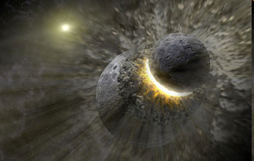
Which unit of Geologic Time best represents the formation of the moon?
9
Copyright © 2010 Ryan P. Murphy

Slide 34
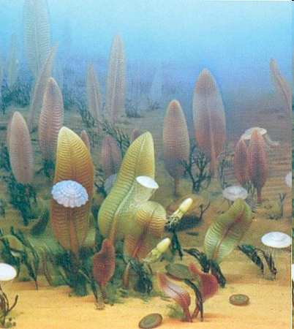
This picture best represents which Era on the Geologic Time Scale?
10
Copyright © 2010 Ryan P. Murphy

Slide 35
Earth System History Review Game
IN THE NICK OF TIME | UNITS OF TIME | PICTURES IN TIME | ANYTHING EARTH HISTORY | -BONUS- DINOSAURS
1 | 6 | 11 | 16 | *21
2 | 7 | 12 | 17 | *22
3 | 8 | 13 | 18 | *23
4 | 9 | 14 | 19 | *24
5 | 10 | 15 | 20 | *25
Copyright © 2010 Ryan P. Murphy

Slide 36
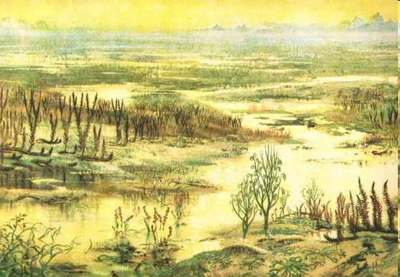
This picture best represents which Period on the Geologic Time Scale?
11
Copyright © 2010 Ryan P. Murphy

Slide 37
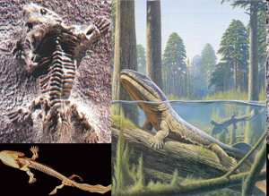
This picture best represents which Period on the Geologic Time Scale?
11
12
Copyright © 2010 Ryan P. Murphy

Slide 38
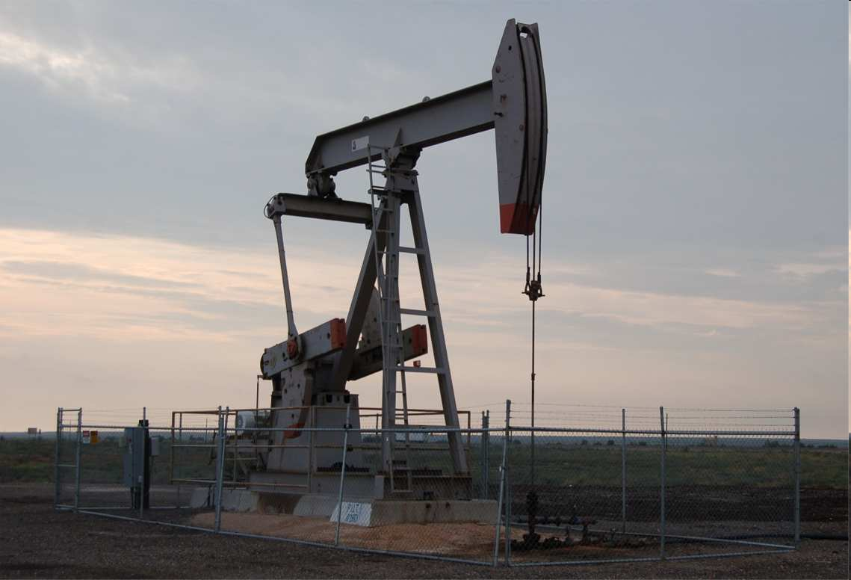
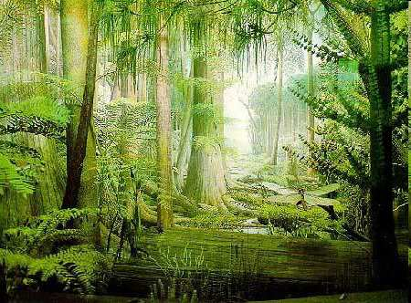
Most of the coal and other forms of fossil fuel are the carbon rich remains of plants and animals that lived during this period?
11
12
13
Copyright © 2010 Ryan P. Murphy

Slide 39
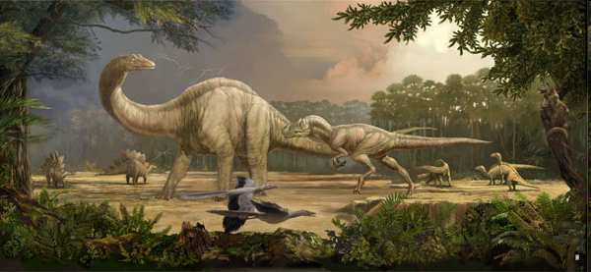

This picture best represents which Period on the Geologic Time Scale?
  Note: Emergence of Birds
11
12
14
Copyright © 2010 Ryan P. Murphy

Slide 40
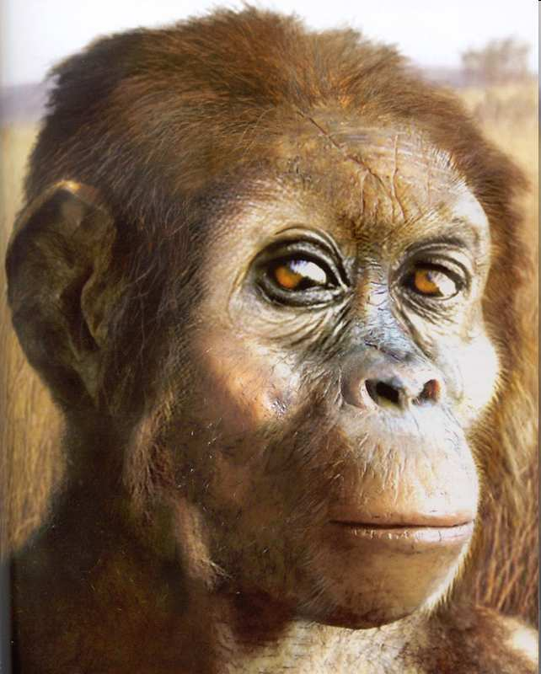
This picture best represents which Period on the Geologic Time Scale?
11
12
15
Copyright © 2010 Ryan P. Murphy

Slide 41
Earth System History Review Game
IN THE NICK OF TIME | UNITS OF TIME | PICTURES IN TIME | ANYTHING EARTH HISTORY | -BONUS- DINOSAURS
1 | 6 | 11 | 16 | *21
2 | 7 | 12 | 17 | *22
3 | 8 | 13 | 18 | *23
4 | 9 | 14 | 19 | *24
5 | 10 | 15 | 20 | *25
Copyright © 2010 Ryan P. Murphy

Slide 42
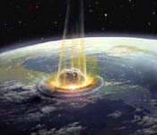
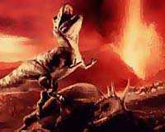
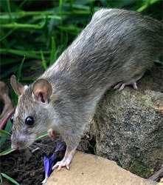
What is the K and the T in the K-T Mass Extinction Event that wiped out the dinosaurs and allowed the age of the mammals to begin.
16
Copyright © 2010 Ryan P. Murphy

Slide 43
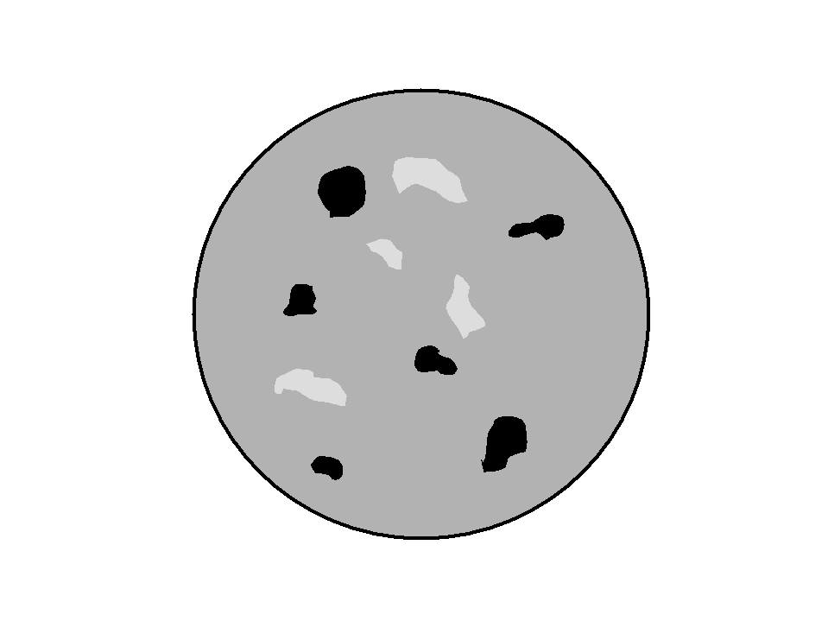
What is this an animation of? When did it happen?
17
Copyright © 2010 Ryan P. Murphy

Slide 44
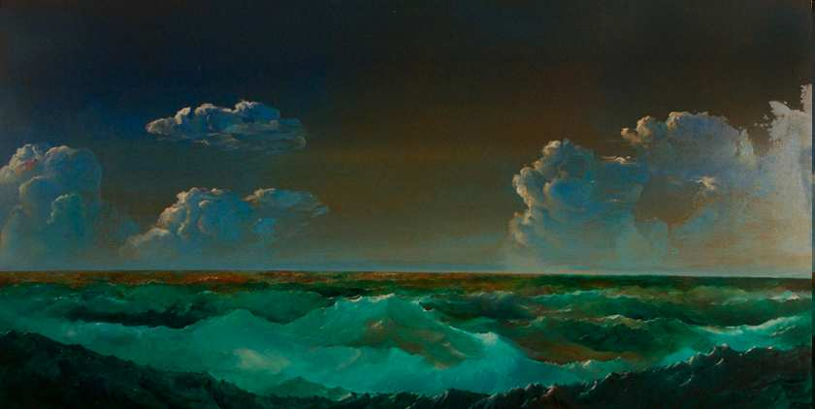
How did the oceans form on early Earth?
18
17

Slide 45
All of the following are similarities between birds and bird-like dinosaurs (Theropods) except…
19
Copyright © 2010 Ryan P. Murphy

Slide 46
All of the following are similarities between birds and bird-like dinosaurs (Theropods) except…
  A.) Three toed foot.
19
Copyright © 2010 Ryan P. Murphy

Slide 47
All of the following are similarities between birds and bird-like dinosaurs (Theropods) except…
  A.) Three toed foot.
  B.) Walk on two legs.
19
Copyright © 2010 Ryan P. Murphy

Slide 48
All of the following are similarities between birds and bird-like dinosaurs (Theropods) except…
  A.) Three toed foot.
  B.) Walk on two legs.
  C.) Dense heavy bones.
19
Copyright © 2010 Ryan P. Murphy

Slide 49
All of the following are similarities between birds and bird-like dinosaurs (Theropods) except…
  A.) Three toed foot.
  B.) Walk on two legs.
  C.) Dense heavy bones.
  D.) Wishbone.
19
Copyright © 2010 Ryan P. Murphy

Slide 50
All of the following are similarities between birds and bird-like dinosaurs (Theropods) except…
  A.) Three toed foot.
  B.) Walk on two legs.
  C.) Dense heavy bones.
  D.) Wishbone.
  E.) Backward pointing pelvis.
19
Copyright © 2010 Ryan P. Murphy

Slide 51
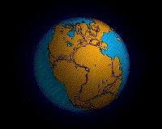
What supercontinent that is shown below began to break apart during the early Jurassic Period?
20

Slide 52
End of Preview
Hundreds of more
slides, activities,
video links,
homework, notes,
and much more
on the full version.

Slide 53
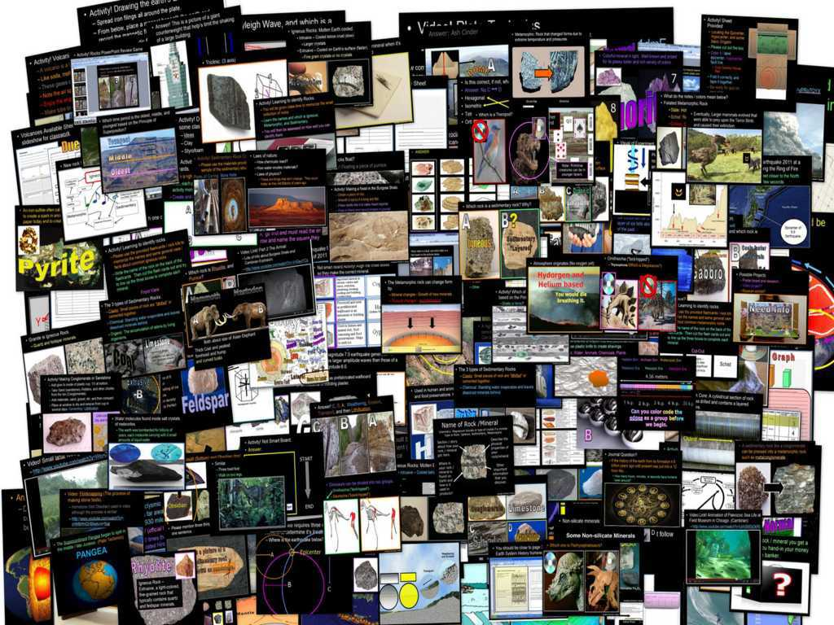
Geology Topics Unit

Slide 54
Geology Topics Unit
Areas of Focus within The Geology Topics Unit:
Plate Tectonics, Evidence for Plate Tectonics, Pangea, Energy Waves,
Layers of the earth, Heat Transfer, Types of Crust, Plate Boundaries, Hot Spots, Volcanoes, Positives and Negatives of Volcanoes, Types of
Volcanoes, Parts of a Volcano, Magma, Types of Lava, Viscosity,
Earthquakes, Faults, Folds, Seismograph, Richter Scale,Seismograph,
Tsunami’s, Rocks, Minerals, Crystals, Uses of Minerals, Types of
Crystals, Physical Properties of Minerals, Rock Cycle, Common Igneous Rocks, Common Sedimentary Rocks, Common Metamorphic Rocks.
http://sciencepowerpoint.com/Geology_Unit.html

Slide 55

More Units Available at…
Earth Science: The Soil Science and Glaciers Unit, The Geology Topics Unit, The Astronomy Topics Unit, The Weather and Climate Unit, and The River Unit, The Water Molecule Unit.
Physical Science: The Laws of Motion and Machines Unit, The Atoms and Periodic Table Unit, The Energy and the Environment Unit, and The Introduction to Science / Metric Unit.
Life Science: The Diseases and Cells Unit, The DNA and Genetics Unit, The Life Topics Unit, The Plant Unit, The Taxonomy and Classification Unit, Ecology: Feeding Levels Unit, Ecology: Interactions Unit, Ecology: Abiotic Factors, The Evolution and Natural Selection Unit and The Human Body and Health Topics Unit.
Copyright © 2010 Ryan P. Murphy

Slide 56

The entire four year curriculum can be found at... http://sciencepowerpoint.com/ Please feel free to contact me with any questions you may have. Thank you for your interest in this curriculum.
Sincerely,
Ryan Murphy M.Ed
www.sciencepowerpoint@gmail.com

