Slide 1
Minerals Review Game
Minerals 101 | SHAPE-UP | PRETTY COLORS | PRIVATE PROPERTY | -BONUS- MINERALS IN THE MOVIES
1 | 6 | 11 | 16 | *21
2 | 7 | 12 | 17 | *22
3 | 8 | 13 | 18 | *23
4 | 9 | 14 | 19 | *24
5 | 10 | 15 | 20 | *25
Copyright © 2010 Ryan P. Murphy

Slide 2
How to play…
  Don’t play like Jeo_ _ _ _ y.
  Class should be divided into several small groups.
  Groups should use science journal (red slide notes), homework, and other available materials to assist you.
  Groups can communicate quietly with each other but no sharing answers between groups.
    Practice quietly communicating right now?
    Practice Communication Question:
    Your group gets to order one pizza, and you can have two toppings. What does your group want?

Slide 3

Questions 1-20 = 5pts Each
Final Category (Bonus) = 1pt Each
Final Questions = 5 pt wager
If you wager 5 on the last question and get it wrong you lose 5 pts. Wager 5 and get it right you get 5 pts.
Find the Owl =
Secretly write “Owl” in the correct box worth 1pt.
“I’ll be about this big.”

Slide 4

Is your name on the review sheet?
Name

Slide 5
Is your name on the review sheet?
Add the categories
along the top
on the next slide.

Slide 6
Minerals Review Game
Minerals 101 | SHAPE-UP | PRETTY COLORS | PRIVATE PROPERTY | -BONUS- MINERALS IN THE MOVIES
1 | 6 | 11 | 16 | *21
2 | 7 | 12 | 17 | *22
3 | 8 | 13 | 18 | *23
4 | 9 | 14 | 19 | *24
5 | 10 | 15 | 20 | *25
Copyright © 2010 Ryan P. Murphy

Slide 7
Minerals Review Game
Minerals 101 | SHAPE-UP | PRETTY COLORS | PRIVATE PROPERTY | -BONUS- MINERALS IN THE MOVIES
1 | 6 | 11 | 16 | *21
2 | 7 | 12 | 17 | *22
3 | 8 | 13 | 18 | *23
4 | 9 | 14 | 19 | *24
5 | 10 | 15 | 20 | *25
Copyright © 2010 Ryan P. Murphy

Slide 8
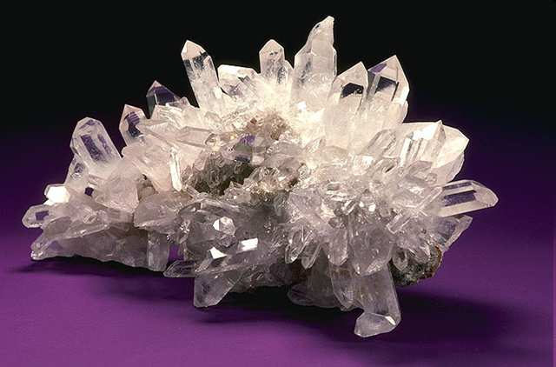
Minerals are natural inorganic solids that join together in crystals to make unique compositions.
1

Slide 9
Minerals are made from which of the following…
2

Slide 10
Minerals are made from which of the following…
  A.) Weathering of rock over long periods of time.
2

Slide 11
Minerals are made from which of the following…
  A.) Weathering of rock over long periods of time.
  B.) Cooling of Magma
2

Slide 12
Minerals are made from which of the following…
  A.) Weathering of rock over long periods of time.
  B.) Cooling of Magma
  C.) Organic deposits in the sediment
2

Slide 13
Minerals are made from which of the following…
  A.) Weathering of rock over long periods of time.
  B.) Cooling of Magma
  C.) Organic deposits in the sediment
  D.) Dissolved minerals in a liquid and through evaporation
2

Slide 14
Minerals are made from which of the following…
  A.) Weathering of rock over long periods of time.
  B.) Cooling of Magma
  C.) Organic deposits in the sediment
  D.) Dissolved minerals in a liquid and through evaporation
  E.) Cubic Zirconia
2

Slide 15
Minerals are made from which of the following…
  A.) Weathering of rock over long periods of time.
  B.) Cooling of Magma
  C.) Organic deposits in the sediment
  D.) Dissolved minerals in a liquid and through evaporation
  E.) Cubic Zirconia
  F.) A and C
2

Slide 16
Minerals are made from which of the following…
  A.) Weathering of rock over long periods of time.
  B.) Cooling of Magma
  C.) Organic deposits in the sediment
  D.) Dissolved minerals in a liquid and through evaporation
  E.) Cubic Zirconia
  F.) A and C
  G.) B and D
2

Slide 17
Minerals are made from which of the following…
  A.) Weathering of rock over long periods of time.
  B.) Cooling of Magma
  C.) Organic deposits in the sediment
  D.) Dissolved minerals in a liquid and through evaporation
  E.) Cubic Zirconia
  F.) A and C
  G.) B and D
  H.) E and H
2

Slide 18
Minerals are made from which of the following…
  A.) Weathering of rock over long periods of time.
  B.) Cooling of Magma
  C.) Organic deposits in the sediment
  D.) Dissolved minerals in a liquid and through evaporation
  E.) Cubic Zirconia
  F.) A and C
  G.) B and D
  H.) E and H
  I.) K and L
2

Slide 19

A crystal is a solid in which the atoms are arranged in a repeating pattern.
3

Slide 20
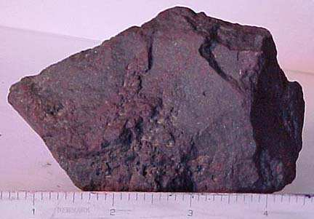


What use of minerals is shown below?

Slide 21
Or

Slide 22
This is a use for minerals?

Slide 23
Or

Slide 24
This is one of the main uses for minerals?

Slide 25
Or

Slide 26
Minerals can be used for this purpose?

Slide 27
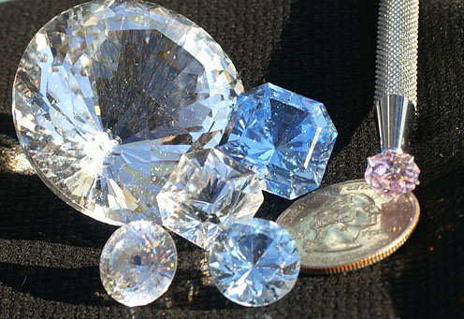
This is another use of minerals?
5

Slide 28
Minerals Review Game
Minerals 101 | SHAPE-UP | PRETTY COLORS | PRIVATE PROPERTY | -BONUS- MINERALS IN THE MOVIES
1 | 6 | 11 | 16 | *21
2 | 7 | 12 | 17 | *22
3 | 8 | 13 | 18 | *23
4 | 9 | 14 | 19 | *24
5 | 10 | 15 | 20 | *25
Copyright © 2010 Ryan P. Murphy

Slide 29
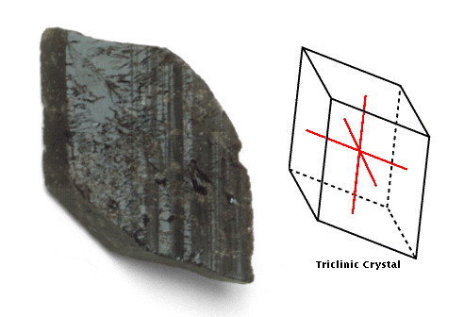
Name this type of crystal?
6

Slide 30
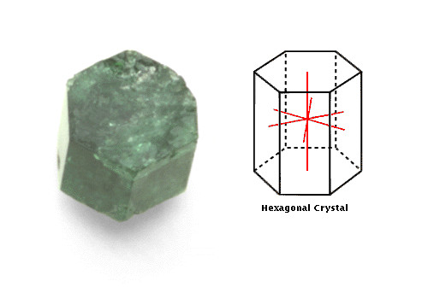
Name this type of crystal?
7

Slide 31
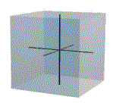
Name this type of crystal?
8

Slide 32
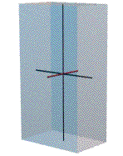
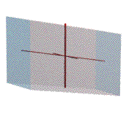
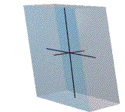
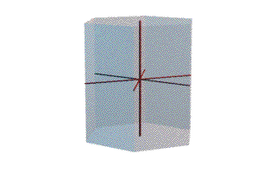
Which crystal below is Orthorhombic:
  (All axis unequal in length, and 90° degrees from each other)?
A
B
9
D
C

Slide 33
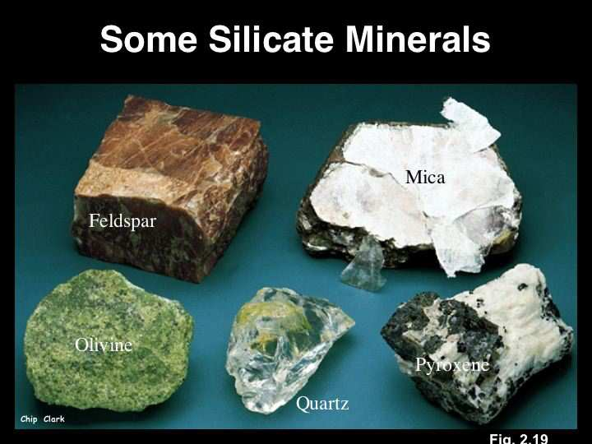
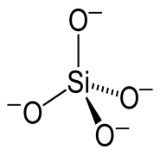
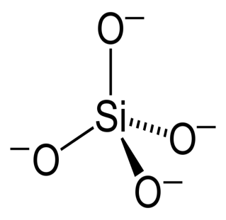
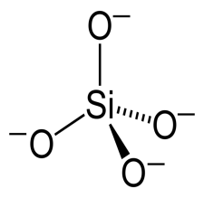

What type of minerals are shown below?
10

Slide 34
Minerals Review Game
Minerals 101 | SHAPE-UP | PRETTY COLORS | PRIVATE PROPERTY | -BONUS- MINERALS IN THE MOVIES
1 | 6 | 11 | 16 | *21
2 | 7 | 12 | 17 | *22
3 | 8 | 13 | 18 | *23
4 | 9 | 14 | 19 | *24
5 | 10 | 15 | 20 | *25
Copyright © 2010 Ryan P. Murphy

Slide 35
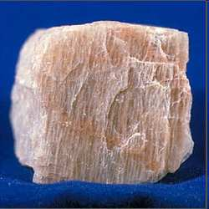
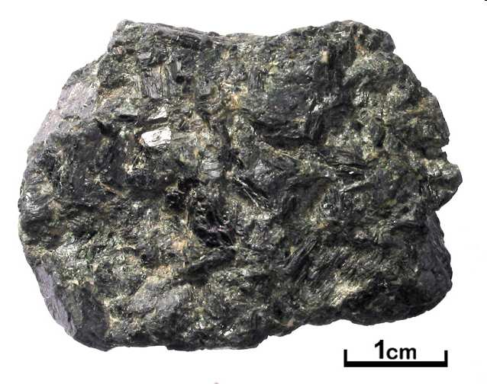
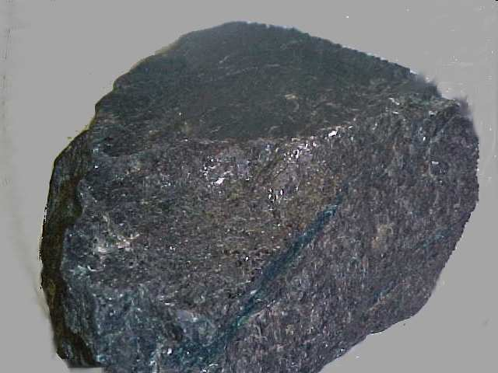
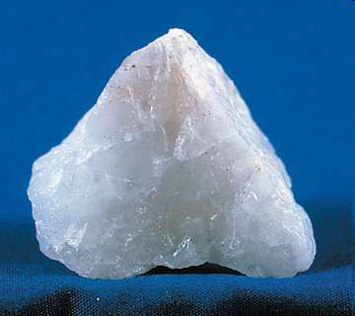
Which minerals are characterized as felsic based on the pictures below.
11
A
B
C
D

Slide 36
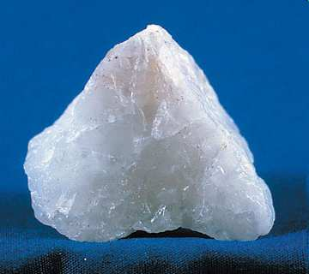
Name this mineral. It is the most abundant mineral on the face of the Earth?
12

Slide 37
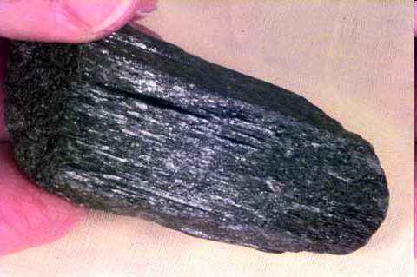
Name this common mineral that is in all Igneous rocks?
13
Starts with an… A

Slide 38
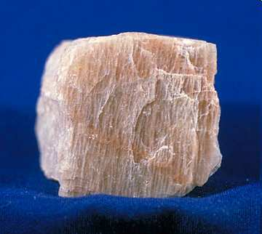
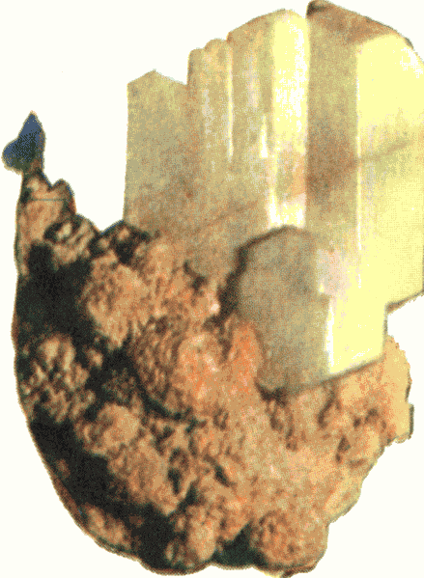
A rock-forming mineral (Aluminum and Silica) industrially important in glass. Primary Mineral
14

Slide 39
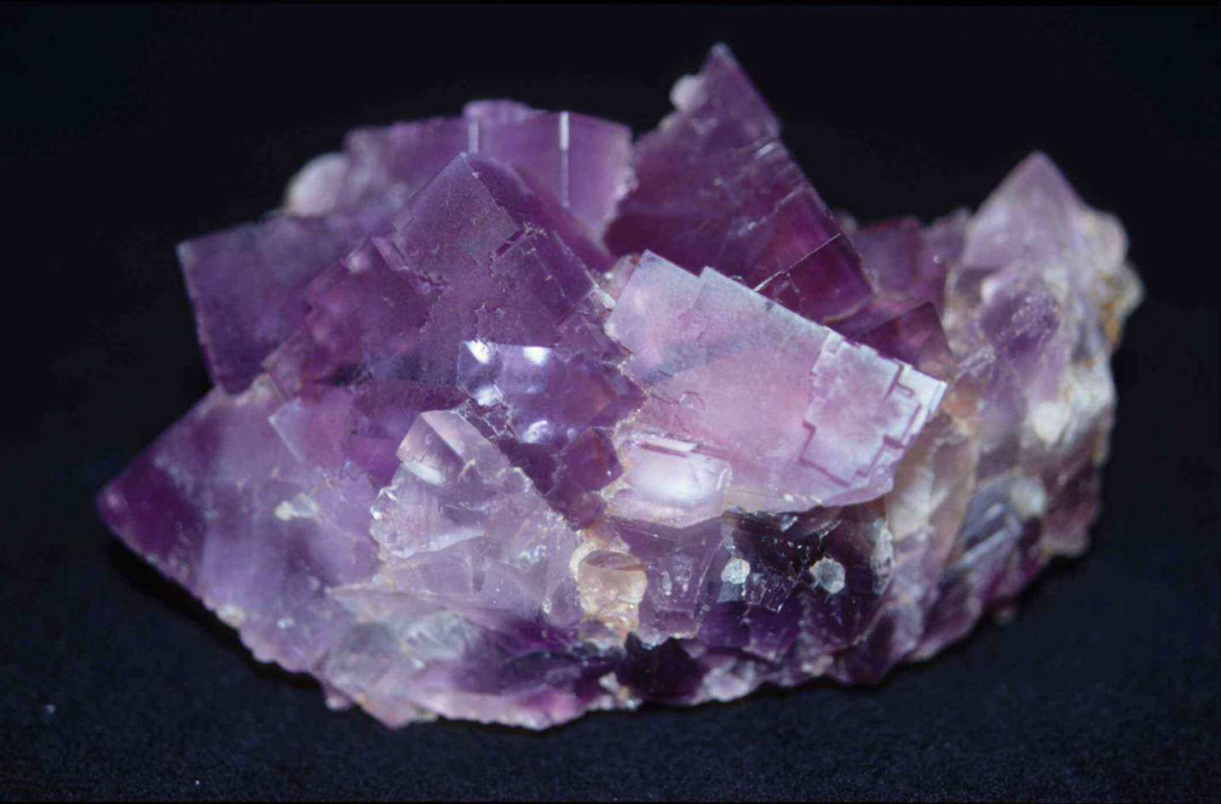
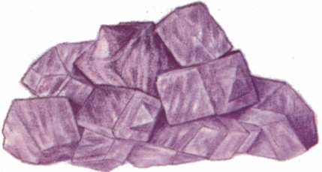
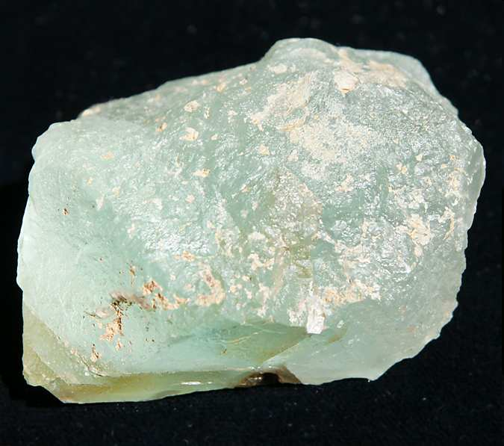
Colorful mineral in light. Well known and prized for its glassy luster and rich variety of colors.
15
7

Slide 40
Minerals Review Game
Minerals 101 | SHAPE-UP | PRETTY COLORS | PRIVATE PROPERTY | -BONUS- MINERALS IN THE MOVIES
1 | 6 | 11 | 16 | *21
2 | 7 | 12 | 17 | *22
3 | 8 | 13 | 18 | *23
4 | 9 | 14 | 19 | *24
5 | 10 | 15 | 20 | *25
Copyright © 2010 Ryan P. Murphy

Slide 41
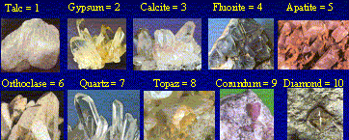
This describes how easily a mineral can be scratched?
16

Slide 42
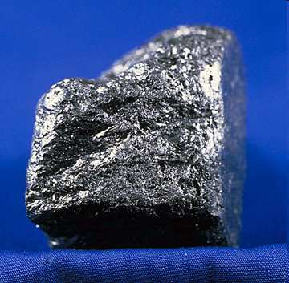
This property of minerals can be seen below?
17

Slide 43
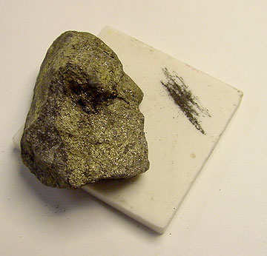
What physical property can be seen below?
18

Slide 44
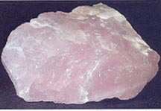
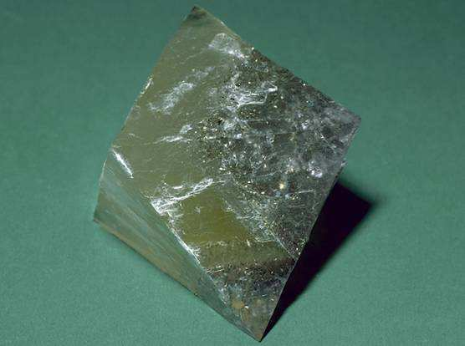
Which mineral below exhibits cleavage, and which exhibits fracture?
A
B
19
Copyright © 2010 Ryan P. Murphy

Slide 45
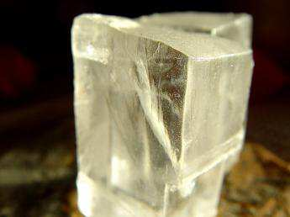
This mineral has many unique properties. Name the mineral and at least one property.
20

Slide 46
End of Preview
Hundreds of more
slides, activities,
video links,
homework, notes,
and much more
on the full version.

Slide 47

Geology Topics Unit

Slide 48
Geology Topics Unit
Areas of Focus within The Geology Topics Unit:
Plate Tectonics, Evidence for Plate Tectonics, Pangea, Energy Waves,
Layers of the earth, Heat Transfer, Types of Crust, Plate Boundaries, Hot Spots, Volcanoes, Positives and Negatives of Volcanoes, Types of
Volcanoes, Parts of a Volcano, Magma, Types of Lava, Viscosity,
Earthquakes, Faults, Folds, Seismograph, Richter Scale,Seismograph,
Tsunami’s, Rocks, Minerals, Crystals, Uses of Minerals, Types of
Crystals, Physical Properties of Minerals, Rock Cycle, Common Igneous Rocks, Common Sedimentary Rocks, Common Metamorphic Rocks.
http://sciencepowerpoint.com/Geology_Unit.html

Slide 49

More Units Available at…
Earth Science: The Soil Science and Glaciers Unit, The Geology Topics Unit, The Astronomy Topics Unit, The Weather and Climate Unit, and The River Unit, The Water Molecule Unit.
Physical Science: The Laws of Motion and Machines Unit, The Atoms and Periodic Table Unit, The Energy and the Environment Unit, and The Introduction to Science / Metric Unit.
Life Science: The Diseases and Cells Unit, The DNA and Genetics Unit, The Life Topics Unit, The Plant Unit, The Taxonomy and Classification Unit, Ecology: Feeding Levels Unit, Ecology: Interactions Unit, Ecology: Abiotic Factors, The Evolution and Natural Selection Unit and The Human Body and Health Topics Unit.
Copyright © 2010 Ryan P. Murphy

Slide 50

The entire four year curriculum can be found at... http://sciencepowerpoint.com/ Please feel free to contact me with any questions you may have. Thank you for your interest in this curriculum.
Sincerely,
Ryan Murphy M.Ed
www.sciencepowerpoint@gmail.com

