Slide 1
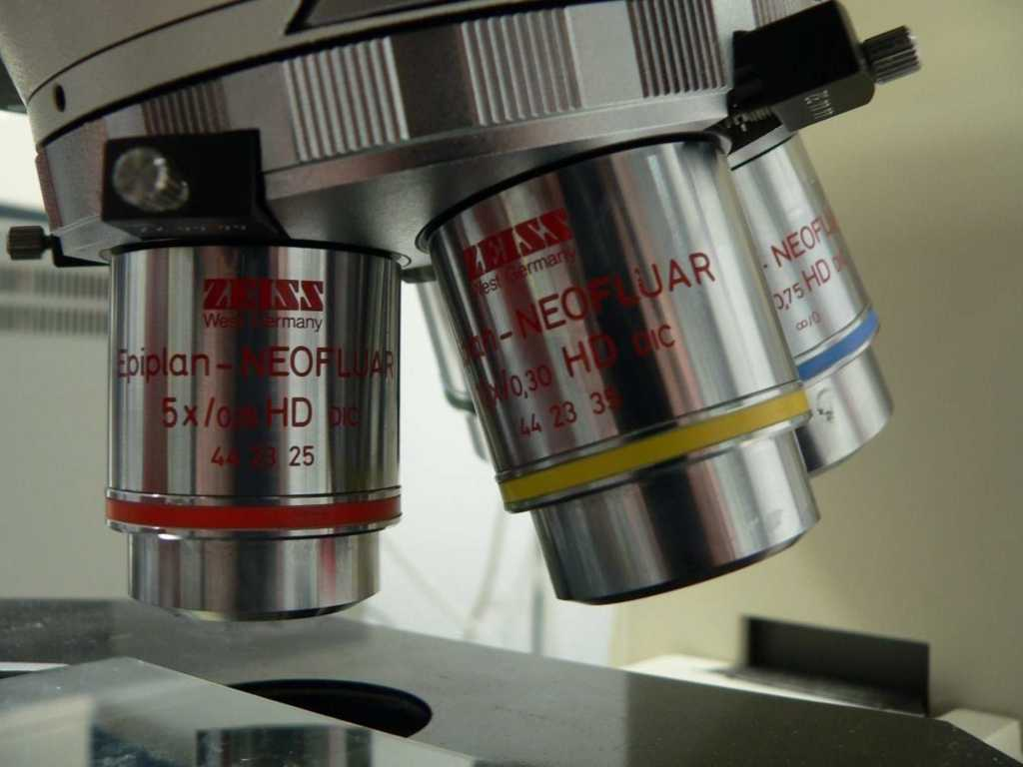
Lab Safety and Magnification
PREVIEW
Part 1 of 4

Slide 2
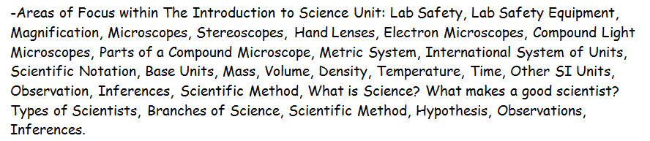
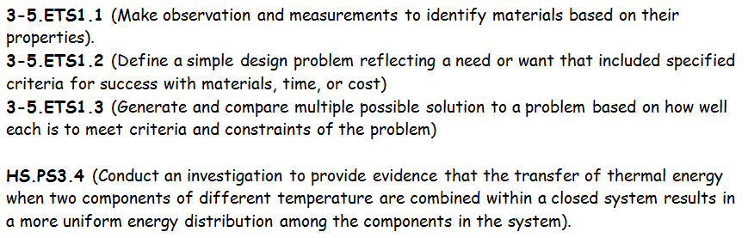
Topics addressed in this Unit Part I
NGSS Standards

Slide 3
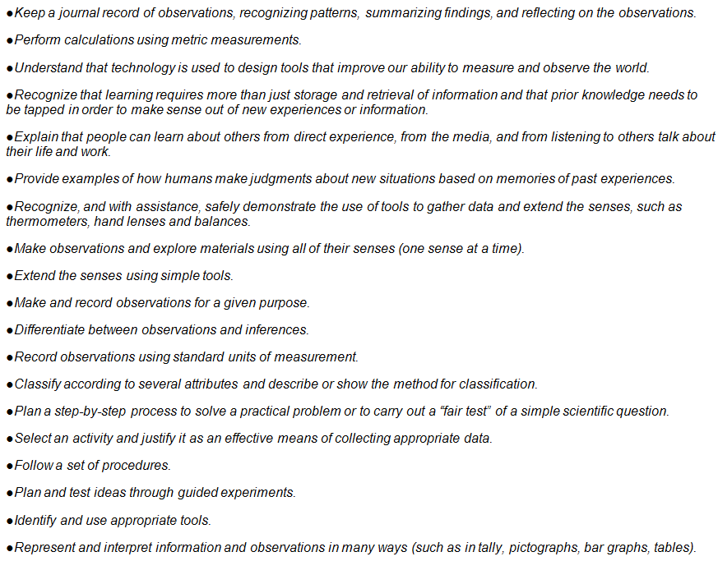
Additional Standards Addressed

Slide 4
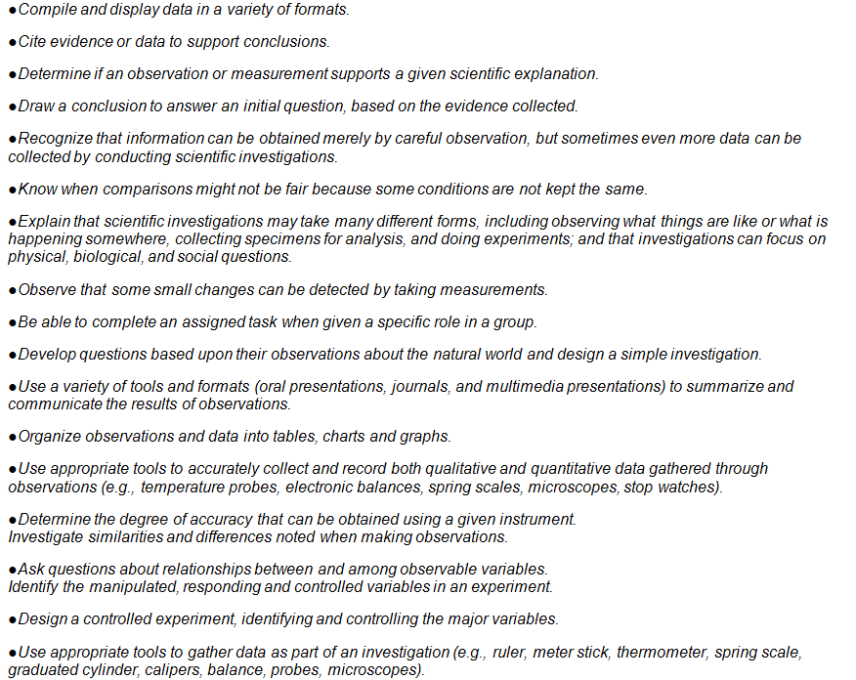
Additional Standards Addressed

Slide 5

Copyright © 2010 Ryan P. Murphy
Listen to the teacher and others.
Please no
shout outs.
One speaker at a
time. Please
raise your
hand.
Respect
First,
Last,
and Always.
Safety
Make
Good
Choices
Be Present
Never
Give
Up!
Responsibility
Stay
Organized
Help
others
Focus on
Task completion
Avoid
Distractions

Slide 6
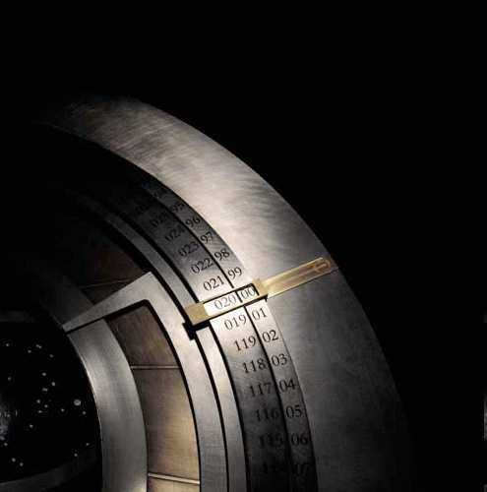
Science Skills Unit
Copyright © 2010 Ryan P. Murphy

Slide 7
This unit will cover…
  Safety and lab skills.
  Magnification and Microscopes
  The Metric System / SI Units
  Metric Units
  Scientific Notation
  Mass, Volume, Density
  Temperature and other SI Units
  Observation, Inferences, and the Scientific Method.
Copyright © 2010 Ryan P. Murphy

Slide 8
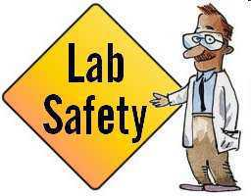
This unit will cover…
  Lab safety and skills.
  Magnification and Microscopes
  The Metric System / SI Units
  Metric Units
  Scientific Notation
  Mass, Volume, Density
  Temperature and other SI Units
  Observation, Inferences, and the Scientific Method.
Copyright © 2010 Ryan P. Murphy

Slide 9
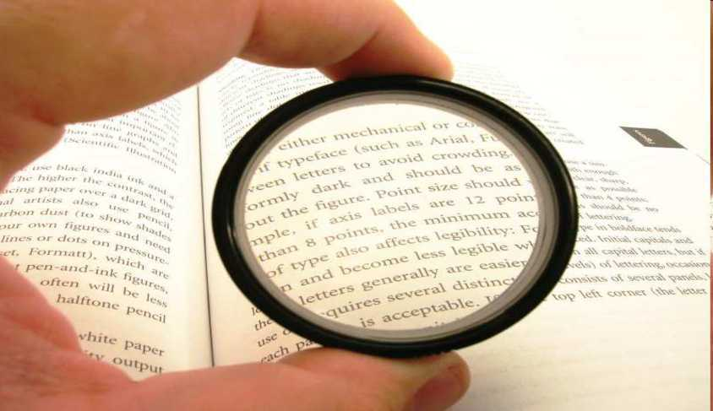
This unit will cover…
  Lab safety and skills.
  Magnification and Microscopes.
  The Metric System / SI Units
  Metric Units
  Scientific Notation
  Mass, Volume, Density
  Temperature and other SI Units
  Observation, Inferences, and the Scientific Method.
Copyright © 2010 Ryan P. Murphy

Slide 10
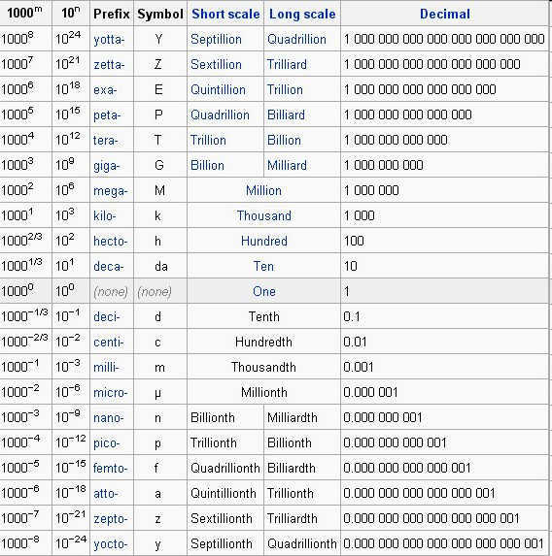
This unit will cover…
  Lab safety and skills.
  Magnification and Microscopes.
  The Metric System / SI Units.
  Metric Units
  Scientific Notation
  Mass, Volume, Density
  Temperature and other SI Units
  Observation, Inferences, and the Scientific Method.
Copyright © 2010 Ryan P. Murphy

Slide 11
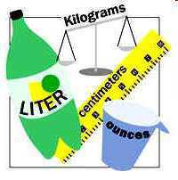
This unit will cover…
  Lab safety and skills.
  Magnification and Microscopes.
  The Metric System
  Metric Units.
  Scientific Notation.
  Mass, Volume, Density.
  Temperature and other SI Units.
  Observation, Inferences, and the Scientific Method.
Copyright © 2010 Ryan P. Murphy

Slide 12

This unit will cover…
  Lab safety and skills.
  Magnification and Microscopes.
  The Metric System
  Metric Units.
  Scientific Notation.
  Mass, Volume, Density.
  Temperature and other SI Units
  Observation, Inferences, and the Scientific Method.
Copyright © 2010 Ryan P. Murphy

Slide 13
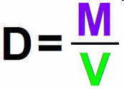
This unit will cover…
  Lab safety and skills.
  Magnification and Microscopes.
  The Metric System
  Metric Units.
  Scientific Notation.
  Mass, Volume, Density.
  Temperature and other SI Units
  Observation, Inferences, and the Scientific Method.
Copyright © 2010 Ryan P. Murphy

Slide 14
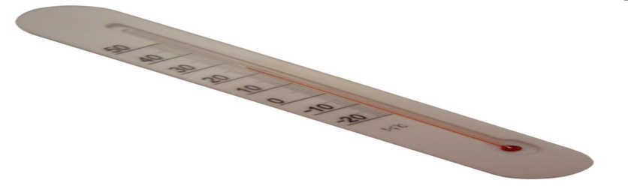
This unit will cover…
  Lab safety and skills.
  Magnification and Microscopes.
  The Metric System
  Metric Units.
  Scientific Notation.
  Mass, Volume, Density.
  Temperature and other SI Units.
  Observation, Inferences, and the Scientific Method.
Copyright © 2010 Ryan P. Murphy

Slide 15
This unit will cover…
  Lab safety and skills.
  Magnification and Microscopes.
  The Metric System
  Metric Units.
  Scientific Notation.
  Mass, Volume, Density.
  Temperature and other SI Units.
  Observation, Inferences, and the Scientific Method.
Copyright © 2010 Ryan P. Murphy

Slide 16

RED SLIDE: These are notes that are very important and should be recorded in your science journal.
Copyright © 2010 Ryan P. Murphy

Slide 17
RED SLIDE: These are notes that are very important and should be recorded in your science journal.
BLACK SLIDE: Pay attention, follow directions, complete projects as described and answer required questions neatly.
Copyright © 2010 Ryan P. Murphy

Slide 18


Slide 19
Please use this red line

Slide 20
Please use this red line
-Please make notes legible and use indentations when appropriate.

Slide 21
-Please make notes legible and use indentations when appropriate. -Example of indent.

Slide 22
-Please make notes legible and use indentations when appropriate. -Example of indent. -Skip a line between topics

Slide 23
-Please make notes legible and use indentations when appropriate. -Example of indent. -Skip a line between topics -Don’t skip pages

Slide 24
-Please make notes legible and use indentations when appropriate. -Example of indent. -Skip a line between topics -Don’t skip pages -Make visuals clear and well drawn.

Slide 25
-Please make notes legible and use indentations when appropriate. -Example of indent. -Skip a line between topics -Don’t skip pages -Make visuals clear and well drawn.

Slide 26
-Please make notes legible and use indentations when appropriate. -Example of indent. -Skip a line between topics -Don’t skip pages -Make visuals clear and well drawn. Please label
Convex Lens
Focal Point
Focal Length

Slide 27
-Please make notes legible and use indentations when appropriate. -Example of indent. -Skip a line between topics -Don’t skip pages -Make visuals clear and well drawn. Please label
Convex Lens
Focal Point
Focal Length

Slide 28
-Please make notes legible and use indentations when appropriate. -Example of indent. -Skip a line between topics -Don’t skip pages -Make visuals clear and well drawn. Please label
Convex Lens
Focal Point
Not like this…
Focal Length

Slide 29
-Please make notes legible and use indentations when appropriate. -Example of indent. -Skip a line between topics -Don’t skip pages -Make visuals clear and well drawn. Please label
Convex Lens
Focal Point
Focal Length

Slide 30

Keep an eye out for “The-Owl” and raise your hand as soon as you see him.
  He will be hiding somewhere in the slideshow
Copyright © 2010 Ryan P. Murphy

Slide 31
“Hoot, Hoot”
“Good Luck!”
Copyright © 2010 Ryan P. Murphy

Slide 32
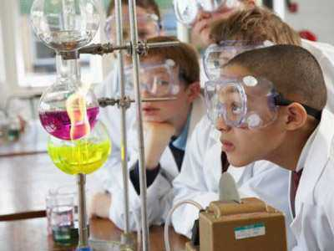
Area of Focus: Lab Safety.
Copyright © 2010 Ryan P. Murphy

Slide 33
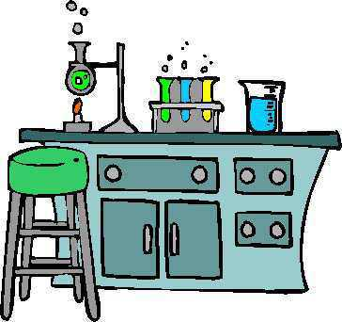
Studying science can be a lot of fun, but it can also be dangerous unless some common lab safety procedures are followed.
This is the product of Ryan P. Murphy Copyright 2010
www.sciencepowerpoint.com
Copyright © 2010 Ryan P. Murphy

Slide 34

Here are a few lab safety rules that should be followed.
Copyright © 2010 Ryan P. Murphy

Slide 35
Here are a few lab safety rules that should be followed.
“Lab Safety is no joke, so pay attention and use common sense.”
Copyright © 2010 Ryan P. Murphy

Slide 36

A safety quiz follows this short presentation.
Copyright © 2010 Ryan P. Murphy

Slide 37
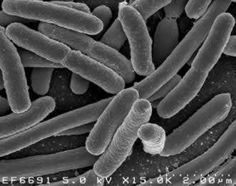
Handle everything as if it's pathogenic.
  Pathogenic means that what your handling could be an infective agent that could cause disease.
  Clean work station periodically with proper disinfectant.
Copyright © 2010 Ryan P. Murphy

Slide 38
Handle everything as if it's pathogenic.
  Pathogenic means that what your handling could be an infective agent that could cause disease.
  Clean work station periodically with proper disinfectant.
Copyright © 2010 Ryan P. Murphy

Slide 39
Handle everything as if it's pathogenic.
  Pathogenic means that what your handling could be an infective agent that could cause disease.
  Clean work station periodically with proper disinfectant.
Copyright © 2010 Ryan P. Murphy

Slide 40
Handle everything as if it's pathogenic.
  Pathogenic means that what your handling could be an infective agent that could cause disease.
  Clean work station periodically with proper disinfectant.
Copyright © 2010 Ryan P. Murphy

Slide 41
Handle everything as if it's pathogenic.
  Pathogenic means that what your handling could be an infective agent that could cause disease.
  Clean work station periodically with proper disinfectant.
“Oh-no!”
Copyright © 2010 Ryan P. Murphy

Slide 42
Handle everything as if it's pathogenic.
  Pathogenic means that what your handling could be an infective agent that could cause disease.
  Clean work station periodically with proper disinfectant.
“Oh-no!”
Copyright © 2010 Ryan P. Murphy

Slide 43
Handle everything as if it's pathogenic.
  Pathogenic means that what your handling could be an infective agent that could cause disease.
  Clean work station periodically with proper disinfectant.
“Oh-no!”
Copyright © 2010 Ryan P. Murphy

Slide 44
Handle everything as if it's pathogenic.
  Pathogenic means that what your handling could be an infective agent that could cause disease.
  Clean work station periodically with proper disinfectant.
“Ahhhh”
Copyright © 2010 Ryan P. Murphy

Slide 45
Handle everything as if it's pathogenic.
  Pathogenic means that what your handling could be an infective agent that could cause disease.
  Clean work station periodically with proper disinfectant.
“Ahhhh”
Copyright © 2010 Ryan P. Murphy

Slide 46
Handle everything as if it's pathogenic.
  Pathogenic means that what your handling could be an infective agent that could cause disease.
  Clean work station periodically with proper disinfectant.
Clean Work Station!
Copyright © 2010 Ryan P. Murphy

Slide 47
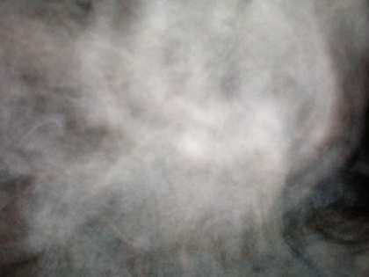
Do not breathe vapors or put anything close to your nose to smell unless instructed.
  When smelling, do not hold the object below your nose, make a pass from one side to the other.
Copyright © 2010 Ryan P. Murphy

Slide 48
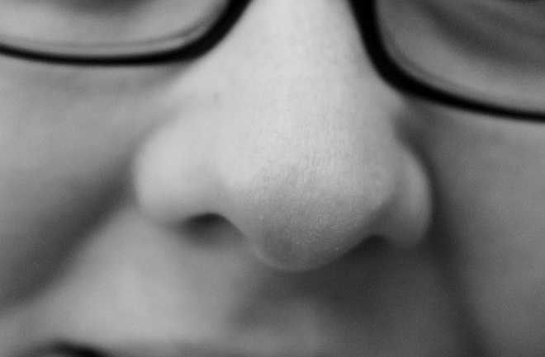
Do not breathe vapors or put anything close to your nose to smell unless instructed.
  When smelling, do not hold the object below your nose,
Copyright © 2010 Ryan P. Murphy

Slide 49
Do not breathe vapors or put anything close to your nose to smell unless instructed.
  When smelling, do not hold the object below your nose, make a pass from one side to the other.
Copyright © 2010 Ryan P. Murphy

Slide 50
Do not breathe vapors or put anything close to your nose to smell unless instructed.
  When smelling, do not hold the object below your nose, make a pass from one side to the other.
Copyright © 2010 Ryan P. Murphy

Slide 51
Avoid blood and other bodily fluid.
  If you are bleeding then please contact teacher immediately to get wound cleaned and covered.

Slide 52

Avoid blood and other bodily fluid.
  If you are bleeding then please contact teacher immediately to get wound cleaned and covered.

Slide 53
Avoid blood and other bodily fluid.
  If you are bleeding then please contact teacher immediately to get wound cleaned and covered.

Slide 54
Avoid blood and other bodily fluid.
  If you are bleeding then please contact teacher immediately to get wound cleaned and covered.

Slide 55
Avoid blood and other bodily fluid.
  If you are bleeding then please contact teacher immediately to get wound cleaned and covered.

Slide 57
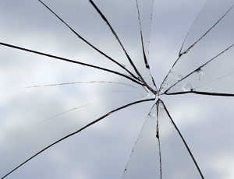
Please check glassware for cracks or chips prior to use.
Copyright © 2010 Ryan P. Murphy

Slide 58
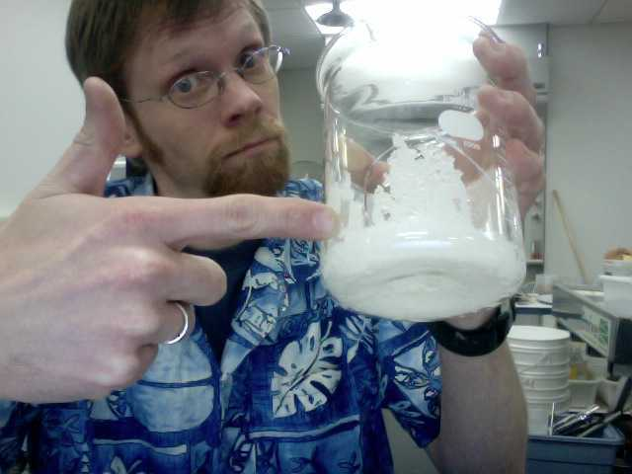
Please check glassware for cracks or chips prior to use.
  If glassware is broken please contact teacher.
Copyright © 2010 Ryan P. Murphy

Slide 59
Please check glassware for cracks or chips prior to use.
  If glassware is broken please contact teacher.
  Please be safe with glassware to avoid dropping and breaking.
Copyright © 2010 Ryan P. Murphy

Slide 60
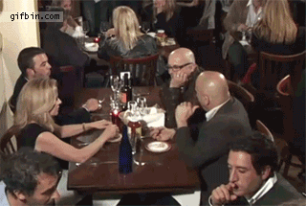
Please check glassware for cracks or chips prior to use.
  If glassware is broken please contact teacher.
  Please be safe with glassware to avoid dropping and breaking. Clean immediately.
This should
not happen
in the lab.
Copyright © 2010 Ryan P. Murphy

Slide 61

Clean spills from the outside in.
  Apply paper towels over the spill, then, carefully starting from the outside, wipe in.
Copyright © 2010 Ryan P. Murphy

Slide 62
Clean spills from the outside in.
  Apply paper towels over the spill, then, carefully starting from the outside, wipe in.
“Let’s practice our skills with a simulated spill.”
Copyright © 2010 Ryan P. Murphy

Slide 63

Please do not eat food or drink in the classroom.
  No gum
  Cough drops
  Or putting strange things in your mouth.
Copyright © 2010 Ryan P. Murphy

Slide 64
Please do not eat food or drink in the classroom.
  No gum.
  Cough drops
  Or putting strange things in your mouth.
Copyright © 2010 Ryan P. Murphy

Slide 65
Please do not eat food or drink in the classroom.
  No gum.
  Cough drops unless prescribed.
  Or putting strange things in your mouth.
Copyright © 2010 Ryan P. Murphy

Slide 66

Please do not eat food or drink in the classroom.
  No gum.
  Cough drops unless prescribed.
  Or putting strange things in your mouth.
Copyright © 2010 Ryan P. Murphy

Slide 67
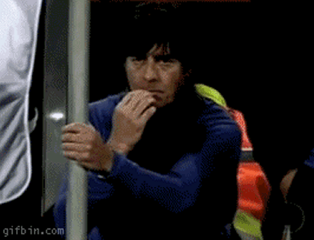
Please do not eat food or drink in the classroom.
  No gum.
  Cough drops unless prescribed.
  Or putting strange things in your mouth.
Copyright © 2010 Ryan P. Murphy

Slide 68


Keep flammable solutions away from flame.
Copyright © 2010 Ryan P. Murphy

Slide 69
Keep flammable solutions away from flame.
Copyright © 2010 Ryan P. Murphy

Slide 70
Keep flammable solutions away from flame.
Copyright © 2010 Ryan P. Murphy

Slide 71
Keep flammable solutions away from flame.
Copyright © 2010 Ryan P. Murphy

Slide 72
Keep flammable solutions away from flame.
Copyright © 2010 Ryan P. Murphy

Slide 73
Keep flammable solutions away from flame.
Copyright © 2010 Ryan P. Murphy

Slide 74
Keep flammable solutions away from flame.
Copyright © 2010 Ryan P. Murphy

Slide 75
Keep flammable solutions away from flame.
Copyright © 2010 Ryan P. Murphy

Slide 76
Keep flammable solutions away from flame.
Copyright © 2010 Ryan P. Murphy

Slide 77
If you have long hair then please arrange it so that it will not hang down and catch on fire on lab days.
Copyright © 2010 Ryan P. Murphy

Slide 78
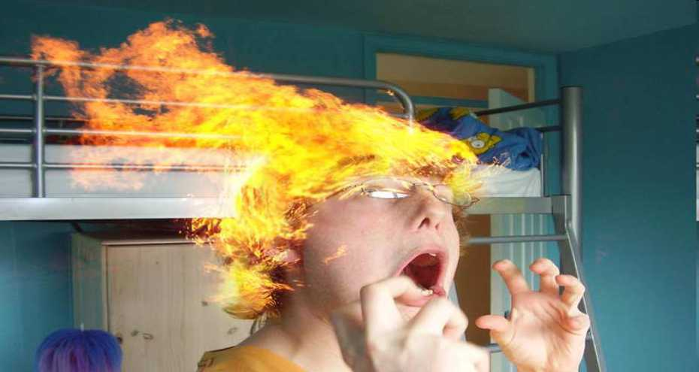
If you have long hair then please arrange it so that it will not hang down and catch on fire on lab days.
Copyright © 2010 Ryan P. Murphy

Slide 79
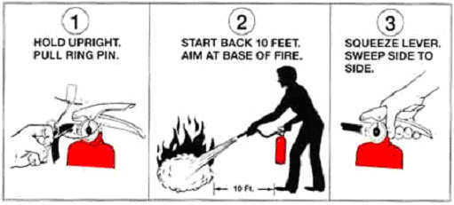
Know where the fire extinguisher is and how to use it.
Copyright © 2010 Ryan P. Murphy

Slide 80
Know where the fire extinguisher is and how to use it.
  We have a Carbon Dioxide all purpose fire extinguisher.
Copyright © 2010 Ryan P. Murphy

Slide 81
Know where the fire extinguisher is and how to use it.
  We have a Carbon Dioxide all purpose fire extinguisher.
    Find key.
Copyright © 2010 Ryan P. Murphy

Slide 82
Know where the fire extinguisher is and how to use it.
  We have a Carbon Dioxide all purpose fire extinguisher.
    Find key.
    Pull it out. (Stand back)
Copyright © 2010 Ryan P. Murphy

Slide 83
Know where the fire extinguisher is and how to use it.
  We have a Carbon Dioxide all purpose fire extinguisher.
    Find key.
    Pull it out. (Stand back)
    Pull handle / trigger.
Copyright © 2010 Ryan P. Murphy

Slide 84
Know where the fire extinguisher is and how to use it.
  We have a Carbon Dioxide all purpose fire extinguisher.
    Find key.
    Pull it out. (Stand back)
    Pull handle / trigger.
    Point at the fire until extinguished.
Copyright © 2010 Ryan P. Murphy

Slide 85
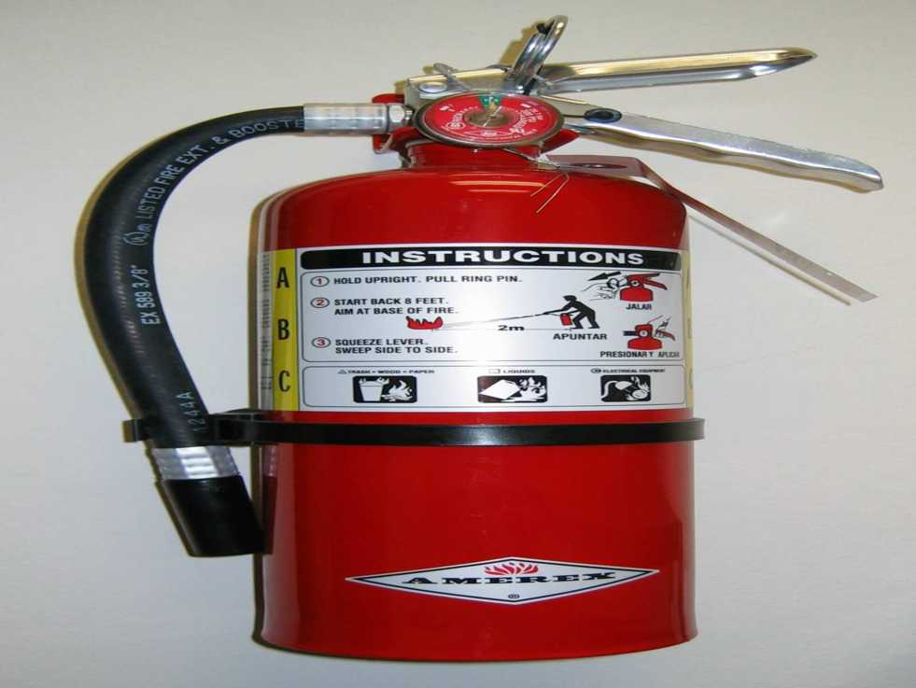
Copyright © 2010 Ryan P. Murphy

Slide 86
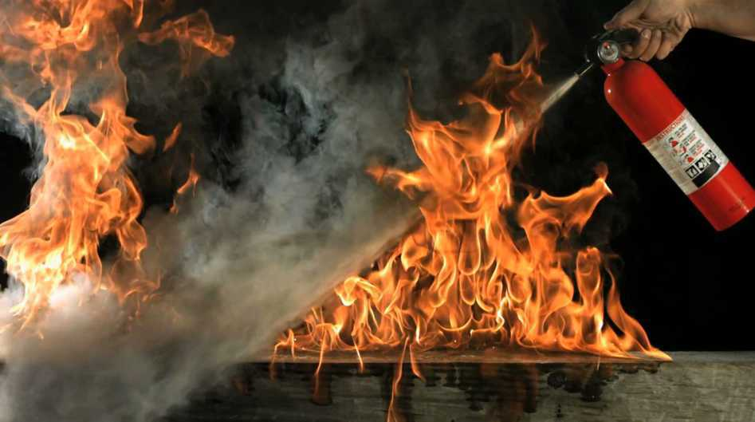
Demonstration / Activity.
  Making our own fire extinguisher and demonstration lab safety.

Slide 87

Materials
  Clear pitcher / container.
  Baking Soda
  Vinegar
  Several candles (smaller votive type)
  Lighter.
Video link if needed. https://www.youtube.com/watch?v=91CQL90gRkc

Slide 88
Light row of votive candles.

Slide 89
Light row of votive candles.
  Add baking soda to bottom of container.

Slide 90
Light row of votive candles.
  Add baking soda to bottom of container.
  Add enough vinegar to create foam that goes close to top.

Slide 91
Light row of votive candles.
  Add baking soda to bottom of container.
  Add enough vinegar to create foam that goes close to top.

Slide 92
Light row of votive candles.
  Add baking soda to bottom of container.
  Add enough vinegar to create foam that goes close to top.
  Let the foam settle.

Slide 93
Light row of votive candles.
  Add baking soda to bottom of container.
  Add enough vinegar to create foam that goes close to top.
  Let the foam settle.
See if lighter will work in here…

Slide 94
Light row of votive candles.
  Add baking soda to bottom of container.
  Add enough vinegar to create foam that goes close to top.
  Let the foam settle.
  Pour out the invisible carbon dioxide gas onto the votive candles without spilling the liquid.

Slide 95
Light row of votive candles.
  Add baking soda to bottom of container.
  Add enough vinegar to create foam that goes close to top.
  Let the foam settle.
  Pour out the invisible carbon dioxide gas onto the votive candles without spilling the liquid.

Slide 96
Light row of votive candles.
  Add baking soda to bottom of container.
  Add enough vinegar to create foam that goes close to top.
  Let the foam settle.
  Pour out the invisible carbon dioxide gas onto the votive candles without spilling the liquid.

Slide 97
Light row of votive candles.
  Add baking soda to bottom of container.
  Add enough vinegar to create foam that goes close to top.
  Let the foam settle.
  Pour out the invisible carbon dioxide gas onto the votive candles without spilling the liquid.
Sodium bicarbonate and vinegar => Sodium acetate and water and carbon dioxide
NaHCO₃ + CH₃COOH => CH₃COO⁻Na⁺ + H₂O + CO_{2 (g)}

Slide 98
Light row of votive candles.
  Add baking soda to bottom of container.
  Add enough vinegar to create foam that goes close to top.
  Let the foam settle.
  Pour out the invisible carbon dioxide gas onto the votive candles without spilling the liquid.
Which put out the fire?
Sodium bicarbonate and vinegar => Sodium acetate and water and carbon dioxide
NaHCO₃ + CH₃COOH => CH₃COO⁻Na⁺ + H₂O + CO_{2 (g)}

Slide 99
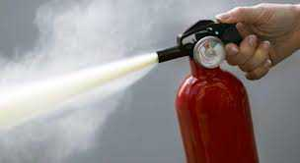
Light row of votive candles.
  Add baking soda to bottom of container.
  Add enough vinegar to create foam that goes close to top.
  Let the foam settle.
  Pour out the invisible carbon dioxide gas onto the votive candles without spilling the liquid.
Which put out the fire?
Sodium bicarbonate and vinegar => Sodium acetate and water and carbon dioxide
NaHCO₃ + CH₃COOH => CH₃COO⁻Na⁺ + H₂O + CO_{2 (g)}

Slide 100
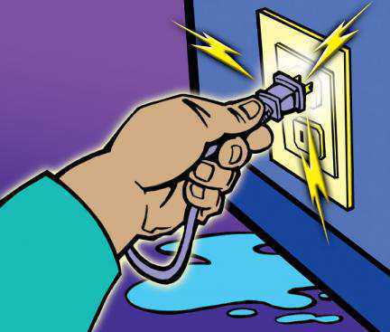
Keep electrical equipment away from water and vice versa.
Copyright © 2010 Ryan P. Murphy

Slide 101
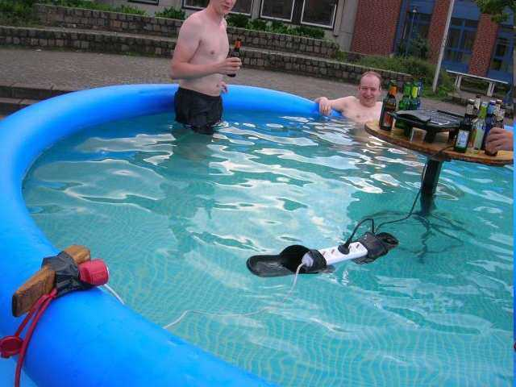

Slide 102
“Hey Joey” “Are you sure this is safe?”

Slide 103
“For sure” “What could possibly happen?”

Slide 104


Slide 106
Use proper safety protection.
Copyright © 2010 Ryan P. Murphy

Slide 107
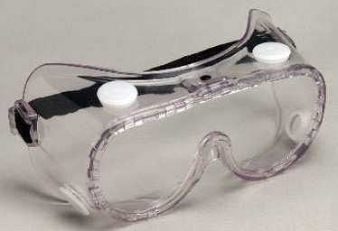
Use proper safety protection.
  Goggles covering eyes.
Copyright © 2010 Ryan P. Murphy

Slide 108
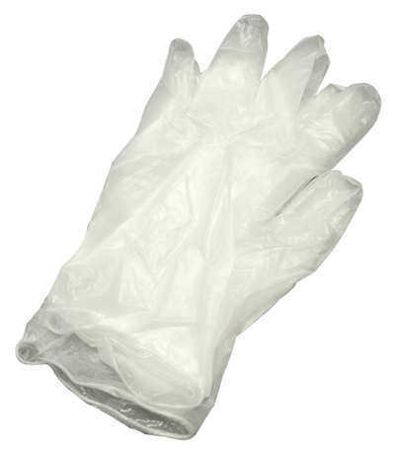
Use proper safety protection.
  Goggles covering eyes.
  Gloves (Non-latex) for allergy reasons.
Copyright © 2010 Ryan P. Murphy

Slide 109

Do not do this!
You will now see it and don’t need to do it ever.

Slide 110
Do not do this!
You will now see it and don’t need to do it ever.
Copyright © 2010 Ryan P. Murphy

Slide 111
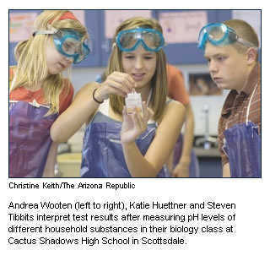
Which of the students is being unsafe in the lab and will requiring talking too?

Slide 112
Answer! These students are not wearing their goggles properly and they’re not wearing gloves.

Slide 113
Let’s see what acid
burns look like…
Face / Skin
Eye
Feet if wearing
open toed footwear
Hands if not
wearing gloves

Slide 114
Let’s see what acid
burns look like…
Face / Skin
Eye
Feet if wearing
open toed footwear
Hands if not
wearing gloves

Slide 115
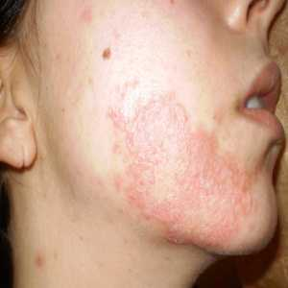
Let’s see what acid
burns look like…
Face / Skin
Eye
Feet if wearing
open toed footwear
Hands if not
wearing gloves

Slide 116
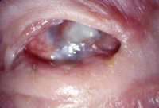
Let’s see what acid
burns look like…
Face / Skin
Eye
Feet if wearing
open toed footwear
Hands if not
wearing gloves

Slide 117
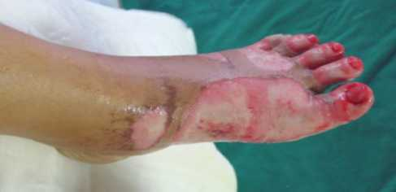
Let’s see what acid
burns look like…
Face / Skin
Eye
Feet if wearing
open toed footwear
Hands if not
wearing gloves

Slide 118
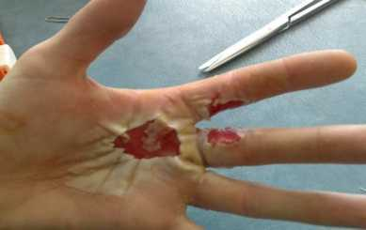
Let’s see what acid
burns look like…
Face / Skin
Eye
Feet if wearing
open toed footwear
Hands if not
wearing gloves

Slide 119
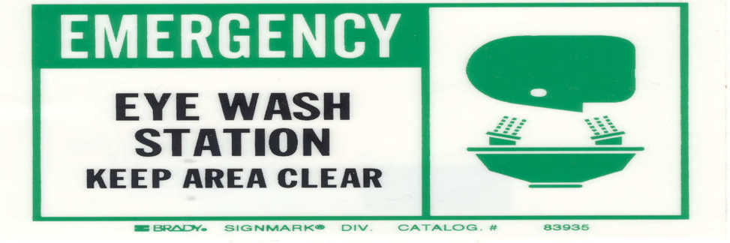
Know where the eyewash station is and how to use it. Where is the station?
  If you get something in your eye.
    Get it out now! Includes under your eyelids.
    Hold eyelid open!
    Gently run water over your eyes.
    Remove contact lenses if you have them.
Copyright © 2010 Ryan P. Murphy

Slide 120
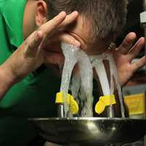
Know where the eyewash station is and how to use it. Where is the station?
NOT FUN! Prevent this
by wearing your googles.
Copyright © 2010 Ryan P. Murphy

Slide 121
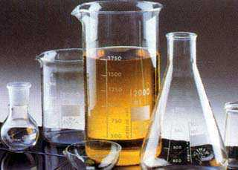
Clean glassware before and after use to avoid harmful residue.
Copyright © 2010 Ryan P. Murphy

Slide 122
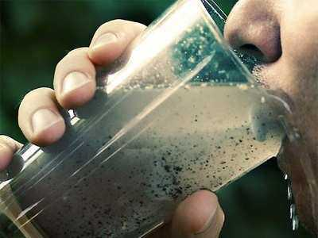
Clean glassware before and after use to avoid harmful residue.
Don’t drink
from science
equipment
Copyright © 2010 Ryan P. Murphy

Slide 123
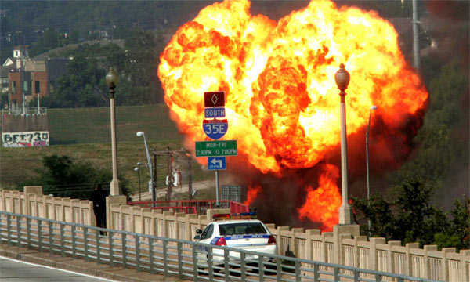
Be precise in your measuring of reagents and chemicals.
Copyright © 2010 Ryan P. Murphy

Slide 124

Be precise in your measuring of reagents and chemicals.
Copyright © 2010 Ryan P. Murphy

Slide 125
Be precise in your measuring of reagents and chemicals.
Copyright © 2010 Ryan P. Murphy

Slide 126
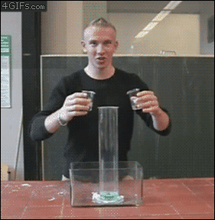
Safety Equipment?

Slide 127
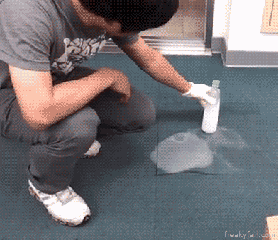
Safety Equipment?

Slide 128
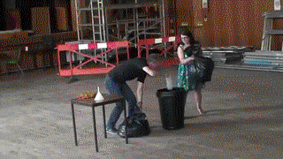
Safety Equipment?

Slide 129
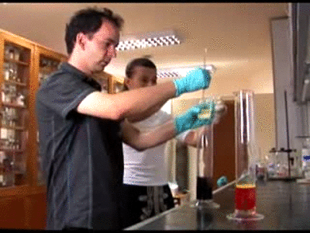
Safety Equipment?

Slide 130
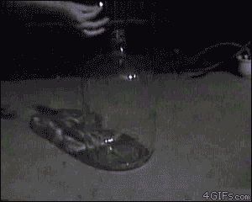
Safety Equipment?

Slide 131
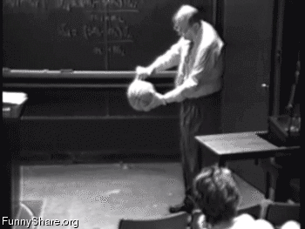
Safety Equipment?

Slide 132
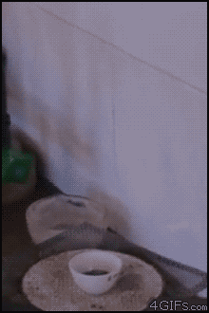
Safety Equipment?

Slide 133
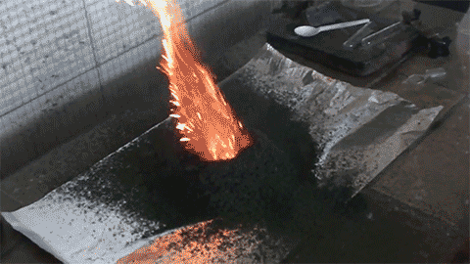
Safety Equipment?

Slide 134

Safety Equipment?

Slide 135
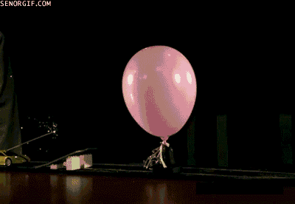
Safety Equipment?

Slide 136

Safety Equipment?

Slide 137
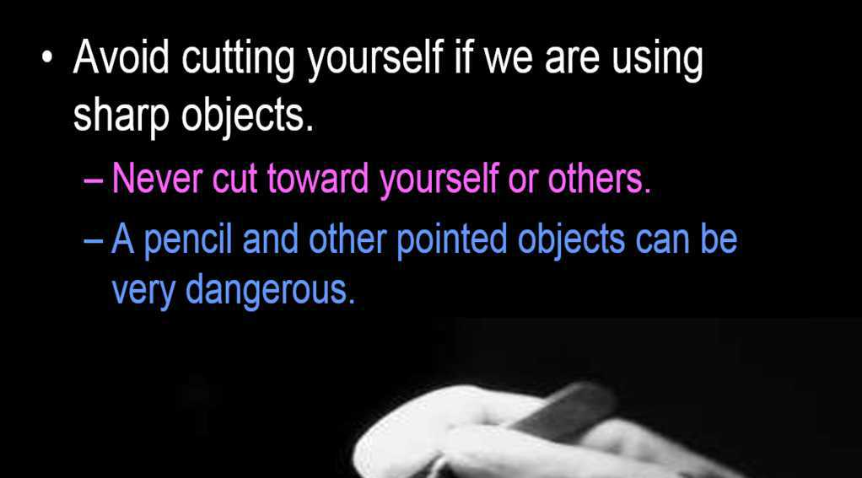


Slide 139


Slide 140
Use common sense at all times.
  No horseplay.
  No pushing.
  No running.
  No squirting with droppers.
  No throwing things.
  Basically use common sense.

Slide 141

Use common sense at all times.

Slide 142


Slide 143


Slide 144


Slide 145


Slide 146

Activity! Video- Lab Safety
  Visit: http://www.youtube.com/watch?v=cr7roogzM8c
Learn more about lab safety at… http://carnegiescience.edu/first_light_case/horn/labsafety.html

Slide 147

Safety Quiz! 1-10
Copyright © 2010 Ryan P. Murphy

Slide 148

#1.) You should treat everything as if it pathogenic means…

Slide 149
#1.) You should treat everything as if it pathogenic means…
  A.) It is okay to touch and taste lab materials.

Slide 150
#1.) You should treat everything as if it pathogenic means…
  A.) It is okay to touch and taste lab materials.
  B.) You should place materials directly under your nose to make sure they are safe.

Slide 151
#1.) You should treat everything as if it pathogenic means…
  A.) It is okay to touch and taste lab materials.
  B.) You should place materials directly under your nose to make sure they are safe.
  C.) Keep a clean work station and do everything possible to avoid contact with pathogens.

Slide 152
#1.) You should treat everything as if it pathogenic means…
  A.) It is okay to touch and taste lab materials.
  B.) You should place materials directly under your nose to make sure they are safe.
  C.) Keep a clean work station and do everything possible to avoid contact with pathogens.
  D.) Pathogenic refers to the emergency exit that connects to the adjacent room.

Slide 153

#2) If you break glassware or see chipped / cracked glassware.
  A.) Don’t say anything because you will get in trouble.
  B.) Report broken glassware to the teacher so it can be safely removed and the area cleaned.
  C.) Use the cracked glassware for today’s lab and then alert the teacher.
  D.) Blame your lab partner and then make up lies.
Copyright © 2010 Ryan P. Murphy

Slide 154
#2) If you break glassware or see chipped / cracked glassware.
  A.) Don’t say anything because you will get in trouble.
  B.) Report broken glassware to the teacher so it can be safely removed and the area cleaned.
  C.) Use the cracked glassware for today’s lab and then alert the teacher.
  D.) Blame your lab partner and then make up lies.
Copyright © 2010 Ryan P. Murphy

Slide 155
#2) If you break glassware or see chipped / cracked glassware.
  A.) Don’t say anything because you will get in trouble.
  B.) Report broken glassware to the teacher so it can be safely removed and the area cleaned.
  C.) Use the cracked glassware for today’s lab and then alert the teacher.
  D.) Blame your lab partner and then make up lies.
Copyright © 2010 Ryan P. Murphy

Slide 156
#2) If you break glassware or see chipped / cracked glassware.
  A.) Don’t say anything because you will get in trouble.
  B.) Report broken glassware to the teacher so it can be safely removed and the area cleaned.
  C.) Use the cracked glassware for today’s lab and then alert the teacher.
  D.) Blame your lab partner and then make up lies.
Copyright © 2010 Ryan P. Murphy

Slide 157
#2) If you break glassware or see chipped / cracked glassware.
  A.) Don’t say anything because you will get in trouble.
  B.) Report broken glassware to the teacher so it can be safely removed and the area cleaned.
  C.) Use the cracked glassware for today’s lab and then alert the teacher.
  D.) Blame your lab partner and then make up lies.
Copyright © 2010 Ryan P. Murphy

Slide 158
#3.) If you spot bodily fluid in the room you should?
Copyright © 2010 Ryan P. Murphy

Slide 159
#3.) If you spot bodily fluid in the room you should?
  A.) Stay away from it and alert the teacher so that he / she can clean the area.
Copyright © 2010 Ryan P. Murphy

Slide 160
#3.) If you spot bodily fluid in the room you should?
  A.) Stay away from it and alert the teacher so that he / she can clean the area.
  B.) Immediately assist the injured by applying pressure to the wound with your hand.
Copyright © 2010 Ryan P. Murphy

Slide 161

#3.) If you spot bodily fluid in the room you should?
  A.) Stay away from it and alert the teacher so that he / she can clean the area.
  B.) Immediately assist the injured by applying pressure to the wound with your hand.
  C.) Get some paper towels to clean the area immediately.
Copyright © 2010 Ryan P. Murphy

Slide 162


#3.) If you spot bodily fluid in the room you should?
  A.) Stay away from it and alert the teacher so that he / she can clean the area.
  B.) Immediately assist the injured by applying pressure to the wound with your hand.
  C.) Get some paper towels to clean the area immediately.
  D.) Don’t interrupt the lesson, wait for a good time near the end of the class.
Copyright © 2010 Ryan P. Murphy

Slide 163
#3.) If you spot bodily fluid in the room you should?
  A.) Stay away from it and alert the teacher so that he / she can clean the area.
  B.) Immediately assist the injured by applying pressure to the wound with your hand.
  C.) Get some paper towels to clean the area immediately.
  D.) Don’t interrupt the lesson, wait for a good time near the end of the class.
Copyright © 2010 Ryan P. Murphy

Slide 164
#4.) If you spill chemicals or other materials on the table or floor you should…
  A.) Add bleach to the spill to avoid contamination.
Copyright © 2010 Ryan P. Murphy

Slide 165
#4.) If you spill chemicals or other materials on the table or floor you should…
  A.) Add bleach to the spill to avoid contamination.
  B.) Pour water on the spill to dilute the chemicals.
Copyright © 2010 Ryan P. Murphy

Slide 166
#4.) If you spill chemicals or other materials on the table or floor you should…
  A.) Add bleach to the spill to avoid contamination.
  B.) Pour water on the spill to dilute the chemicals.
  C.) Place a paper towel over the spill and then wipe up the spill from the outside in.
Copyright © 2010 Ryan P. Murphy

Slide 167
  D.) A chemical spill is very dangerous so immediately evacuate the room in an absolute panic and proceed to the nearest available exit.

Slide 168
#4.) If you spill chemicals or other materials on the table or floor you should…
  A.) Add bleach to the spill to avoid contamination.
  B.) Pour water on the spill to dilute the chemicals.
  C.) Place a paper towel over the spill and then wipe up the spill from the outside in.
  D.) A chemical spill is very dangerous so immediately evacuate the room in an absolute panic and proceed to the nearest available exit.

Slide 169
#5.) Do not bring ________ or _________ into the lab.
Copyright © 2010 Ryan P. Murphy

Slide 170
#5.) Do not bring ________ or _________ into the lab.
  A.) Pens and Pencils.
Copyright © 2010 Ryan P. Murphy

Slide 171
#5.) Do not bring ________ or _________ into the lab.
  A.) Pens and Pencils.
  B.) Goggles and gloves.
Copyright © 2010 Ryan P. Murphy

Slide 172
#5.) Do not bring ________ or _________ into the lab.
  A.) Pens and Pencils.
  B.) Goggles and gloves.
  C.) Food and Drink.
Copyright © 2010 Ryan P. Murphy

Slide 173
#5.) Do not bring ________ or _________ into the lab.
  A.) Pens and Pencils.
  B.) Goggles and gloves.
  C.) Food and Drink.
  D.) Commonsense and a safe attitude.
Copyright © 2010 Ryan P. Murphy

Slide 174
#5.) Do not bring ________ or _________ into the lab.
  A.) Pens and Pencils.
  B.) Goggles and gloves.
  C.) Food and Drink.
  D.) Commonsense and a safe attitude.
Copyright © 2010 Ryan P. Murphy

Slide 175

#6.) This happened because…
Copyright © 2010 Ryan P. Murphy

Slide 176
#6.) This happened because…
  A.) Spontaneous combustion.
Copyright © 2010 Ryan P. Murphy

Slide 177
#6.) This happened because…
  A.) Spontaneous combustion.
  B.) Flammable materials were not set away from the flame.
Copyright © 2010 Ryan P. Murphy

Slide 178
#6.) This happened because…
  A.) Spontaneous combustion.
  B.) Flammable materials were not set away from the flame.
  C.) Increase in the Friction Coefficient.
Copyright © 2010 Ryan P. Murphy

Slide 179
#6.) This happened because…
  A.) Spontaneous combustion.
  B.) Flammable materials were not set away from the flame.
  C.) Increase in the Friction Coefficient.
  D.) Muppets are silly.
Copyright © 2010 Ryan P. Murphy

Slide 180
#6.) This happened because…
  A.) Spontaneous combustion.
  B.) Flammable materials were not set away from the flame.
  C.) Increase in the Friction Coefficient.
  D.) Muppets are silly.
Copyright © 2010 Ryan P. Murphy

Slide 181

#7) Which of the following the correct sequence to use a fire extinguisher.
Copyright © 2010 Ryan P. Murphy

Slide 182
#7) Which of the following the correct sequence to use a fire extinguisher.
  A.) Get close to the fire, pull handle, pull out key.
Copyright © 2010 Ryan P. Murphy

Slide 183
#7) Which of the following the correct sequence to use a fire extinguisher.
  A.) Get close to the fire, pull handle, pull out key.
  B.) Grab the fire blanket and wrap it around yourself before fighting the fire.
Copyright © 2010 Ryan P. Murphy

Slide 184
#7) Which of the following the correct sequence to use a fire extinguisher.
  A.) Get close to the fire, pull handle, pull out key.
  B.) Grab the fire blanket and wrap it around yourself before fighting the fire.
  C.) Find key, pull it out, stand back, pull handle, point and shoot until fire is extinguished.
Copyright © 2010 Ryan P. Murphy

Slide 185
#7) Which of the following the correct sequence to use a fire extinguisher.
  A.) Get close to the fire, pull handle, pull out key.
  B.) Grab the fire blanket and wrap it around yourself before fighting the fire.
  C.) Find key, pull it out, stand back, pull handle, point and shoot until fire is extinguished.
  D.) Check to see if extinguisher is full, and pull the handle hard.
Copyright © 2010 Ryan P. Murphy

Slide 186
#7) Which of the following the correct sequence to use a fire extinguisher.
  A.) Get close to the fire, pull handle, pull out key.
  B.) Grab the fire blanket and wrap it around yourself before fighting the fire.
  C.) Find key, pull it out, stand back, pull handle, point and shoot until fire is extinguished.
  D.) Check to see if extinguisher is full, and pull the handle hard.
Copyright © 2010 Ryan P. Murphy

Slide 187

#8.) What is wrong with these test tubes?
  A.) The glassware appears all chipped and cracked.
  B.) The glassware should be cleaned prior to use.
  C.) Don’t use chemicals as these test tubes do not meet safety standards.
  D.) Test tubes should never be lined up next to each other.
Copyright © 2010 Ryan P. Murphy

Slide 188
#8.) What is wrong with these test tubes?
  A.) The glassware appears all chipped and cracked.
  B.) The glassware should be cleaned prior to use.
  C.) Don’t use chemicals as these test tubes do not meet safety standards.
  D.) Test tubes should never be lined up next to each other.
Copyright © 2010 Ryan P. Murphy

Slide 189
#8.) What is wrong with these test tubes?
  A.) The glassware appears all chipped and cracked.
  B.) The glassware should be cleaned prior to use.
  C.) Don’t use chemicals as these test tubes do not meet safety standards.
  D.) Test tubes should never be lined up next to each other.
Copyright © 2010 Ryan P. Murphy

Slide 190
#8.) What is wrong with these test tubes?
  A.) The glassware appears all chipped and cracked.
  B.) The glassware should be cleaned prior to use.
  C.) Don’t use chemicals as these test tubes do not meet safety standards.
  D.) Test tubes should never be lined up next to each other.
Copyright © 2010 Ryan P. Murphy

Slide 191
#8.) What is wrong with these test tubes?
  A.) The glassware appears all chipped and cracked.
  B.) The glassware should be cleaned prior to use.
  C.) Don’t use chemicals as these test tubes do not meet safety standards.
  D.) Test tubes should never be lined up next to each other.
Copyright © 2010 Ryan P. Murphy

Slide 192

#9.) The invisible lab person below is missing what two pieces of lab equipment.
Copyright © 2010 Ryan P. Murphy

Slide 193
#9.) The invisible lab person below is missing what two pieces of lab equipment.
  A.) Goggles and Gloves.
Copyright © 2010 Ryan P. Murphy

Slide 194
#9.) The invisible lab person below is missing what two pieces of lab equipment.
  A.) Goggles and Gloves.
  B.) Fire Blanket and Squirt Bottle.
Copyright © 2010 Ryan P. Murphy

Slide 195
#9.) The invisible lab person below is missing what two pieces of lab equipment.
  A.) Goggles and Gloves.
  B.) Fire Blanket and Squirt Bottle.
  C.) Cell Phone and iPod
Copyright © 2010 Ryan P. Murphy

Slide 196
#9.) The invisible lab person below is missing what two pieces of lab equipment.
  A.) Goggles and Gloves.
  B.) Fire Blanket and Squirt Bottle.
  C.) Cell Phone and iPod
  D.) Underwear
Copyright © 2010 Ryan P. Murphy

Slide 197
#10) The following are safety procedures that should be followed except…
Copyright © 2010 Ryan P. Murphy

Slide 198
#10) The following are safety procedures that should be followed except…
  A.) Keep water and electrical equipment apart.
Copyright © 2010 Ryan P. Murphy

Slide 199
#10) The following are safety procedures that should be followed except…
  A.) Keep water and electrical equipment apart.
  B.) Avoid cutting toward yourself.
Copyright © 2010 Ryan P. Murphy

Slide 200
#10) The following are safety procedures that should be followed except…
  A.) Keep water and electrical equipment apart.
  B.) Avoid cutting toward yourself.
  C.) Avoid Commonsense whenever possible.
Copyright © 2010 Ryan P. Murphy

Slide 201
#10) The following are safety procedures that should be followed except…
  A.) Keep water and electrical equipment apart.
  B.) Avoid cutting toward yourself.
  C.) Avoid Commonsense whenever possible.
  D.) Be precise in your measuring of reagents and chemicals, and know how to use the eyewash station.
Copyright © 2010 Ryan P. Murphy

Slide 202
#10) The following are safety procedures that should be followed except…
  A.) Keep water and electrical equipment apart.
  B.) Avoid cutting toward yourself.
  C.) Avoid Commonsense whenever possible.
  D.) Be precise in your measuring of reagents and chemicals, and know how to use the eyewash station.
Copyright © 2010 Ryan P. Murphy

Slide 203

Bonus: Who am I?
Copyright © 2010 Ryan P. Murphy

Slide 204
Bonus: Who am I?
“Prevention is the best way to avoid a dangerous situation.”
Copyright © 2010 Ryan P. Murphy

Slide 205

Answers 1-10. Safety Quiz.
Copyright © 2010 Ryan P. Murphy

Slide 206
#1.) You should treat everything as if it pathogenic means…
  A.) It is okay to touch and taste lab materials.
  B.) You should place materials directly under your nose to make sure they are safe.
  C.) Keep a clean work station and do everything possible to avoid contact with pathogens.
  D.) Pathogenic refers to the emergency exit that connects to the adjacent room.
Copyright © 2010 Ryan P. Murphy

Slide 207
#1.) You should treat everything as if it pathogenic means…
  A.) It is okay to touch and taste lab materials.
  B.) You should place materials directly under your nose to make sure they are safe.
  C.) Keep a clean work station and do everything possible to avoid contact with pathogens.
  D.) Pathogenic refers to the emergency exit that connects to the adjacent room.
Copyright © 2010 Ryan P. Murphy

Slide 208
#2) If you break glassware or see chipped / cracked glassware.
  A.) Don’t say anything because you will get in trouble.
  B.) Report broken glassware to the teacher so it can be safely removed and the area cleaned.
  C.) Use the cracked glassware for today’s lab and then alert the teacher.
  D.) Blame your lab partner and then make up lies.
Copyright © 2010 Ryan P. Murphy

Slide 209
#2) If you break glassware or see chipped / cracked glassware.
  A.) Don’t say anything because you will get in trouble.
  B.) Report broken glassware to the teacher so it can be safely removed and the area cleaned.
  C.) Use the cracked glassware for today’s lab and then alert the teacher.
  D.) Blame your lab partner and then make up lies.
Copyright © 2010 Ryan P. Murphy

Slide 210
#3.) If you spot bodily fluid in the room you should?
  A.) Stay away from it and alert the teacher so that he / she can clean the area.
  B.) Immediately assist the injured by applying pressure to the wound with your hand.
  C.) Get some paper towels to clean the area immediately.
  D.) Don’t interrupt the lesson, wait for a good time near the end of the class.
Copyright © 2010 Ryan P. Murphy

Slide 211
#3.) If you spot bodily fluid in the room you should?
  A.) Stay away from it and alert the teacher so that he / she can clean the area.
Copyright © 2010 Ryan P. Murphy

Slide 212
#4.) If you spill chemicals or other materials on the table or floor you should…
  A.) Add bleach to the spill to avoid contamination.
  B.) Pour water on the spill to dilute the chemicals.
  C.) Place a paper towel over the spill and then wipe up the spill from the outside in.
  D.) A chemical spill is very dangerous so immediately evacuate the room.
Copyright © 2010 Ryan P. Murphy

Slide 213
#4.) If you spill chemicals or other materials on the table or floor you should…
  A.) Add bleach to the spill to avoid contamination.
  B.) Pour water on the spill to dilute the chemicals.
  C.) Place a paper towel over the spill and then wipe up the spill from the outside in.
  D.) A chemical spill is very dangerous so immediately evacuate the room.
Copyright © 2010 Ryan P. Murphy

Slide 214
#5.) Do not bring ________ or _________ into the lab.
  A.) Pens and Pencils.
  B.) Goggles and gloves.
  C.) Food and Drink.
  D.) Commonsense and a safe attitude.
Copyright © 2010 Ryan P. Murphy

Slide 215
#5.) Do not bring ________ or _________ into the lab.
  A.) Pens and Pencils.
  B.) Goggles and gloves.
  C.) Food and Drink.
  D.) Commonsense and a safe attitude.
Copyright © 2010 Ryan P. Murphy

Slide 216
#6.) This happened because…
  A.) Spontaneous combustion.
  B.) Flammable materials were not set away from the flame.
  C.) Increase in the Friction Coefficient.
  D.) Muppets are silly.
Copyright © 2010 Ryan P. Murphy

Slide 217

#6.) This happened because…
  A.) Spontaneous combustion.
  B.) Flammable materials were not set away from the flame.
  C.) Increase in the Friction Coefficient.
  D.) Muppets are silly.
Copyright © 2010 Ryan P. Murphy

Slide 218
Preview will skip ahead
to magnification

Slide 219

Area of Focus: Magnification
Copyright © 2010 Ryan P. Murphy

Slide 220
Area of Focus: Magnification
Copyright © 2010 Ryan P. Murphy

Slide 221

Magnification: The act of expanding something in apparent size.
Copyright © 2010 Ryan P. Murphy

Slide 222

Magnification: The act of expanding something in apparent size.
  The object doesn’t change in size.
Actual Size
Copyright © 2010 Ryan P. Murphy

Slide 223

De-magnification: To make something smaller in appearance.
Copyright © 2010 Ryan P. Murphy

Slide 224
De-magnification: To make something smaller in appearance.
Copyright © 2010 Ryan P. Murphy

Slide 225
De-magnification: To make something smaller in appearance.
Copyright © 2010 Ryan P. Murphy

Slide 226

How is magnification useful?
  In what applications do we use it.
Copyright © 2010 Ryan P. Murphy

Slide 227

The following slides will show some of the various applications of magnification.
Copyright © 2010 Ryan P. Murphy

Slide 228

Eyeglasses to help us see.
Copyright © 2010 Ryan P. Murphy

Slide 229

To help us see smaller things in science class. (Education)
Copyright © 2010 Ryan P. Murphy

Slide 230

To see the very small (Scientific)
Copyright © 2010 Ryan P. Murphy

Slide 231

Surgical and medical applications.
Copyright © 2010 Ryan P. Murphy

Slide 232
Surgical and medical applications.
“Hoot” “Hoot” “Did anybody see me hiding.”
Copyright © 2010 Ryan P. Murphy

Slide 233
Surgical and medical applications.
Copyright © 2010 Ryan P. Murphy

Slide 234

Crime investigation
  Two different bullets shot from the same gun shown below.
Copyright © 2010 Ryan P. Murphy

Slide 235
Crime investigation
  Two different bullets shot from the same gun shown below.
Copyright © 2010 Ryan P. Murphy

Slide 236

Which of the bills below is counterfeit?
A
B
Copyright © 2010 Ryan P. Murphy

Slide 237
Which of the bills below is counterfeit?
A
B
Copyright © 2010 Ryan P. Murphy

Slide 238

Military use.
Copyright © 2010 Ryan P. Murphy

Slide 239

Space exploration (telescope)
Copyright © 2010 Ryan P. Murphy

Slide 240


The Movies
Copyright © 2010 Ryan P. Murphy

Slide 241

Cameras and recording devices.
Copyright © 2010 Ryan P. Murphy

Slide 242

Magnification works because of light. Without light, you would not be able to see any image, magnified or not.
Copyright © 2010 Ryan P. Murphy

Slide 243
Copyright © 2010 Ryan P. Murphy

Slide 244
Magnification works because of light. Without light, you would not be able to see any image, magnified or not.
Copyright © 2010 Ryan P. Murphy

Slide 245

Activity! Hand Lens
  Use a hand lens to practice focusing on a US $1 dollar bill. Record two pictures of neat things that you find.
  Try and find the hidden owl.
Copyright © 2010 Ryan P. Murphy

Slide 246
Copyright © 2010 Ryan P. Murphy

Slide 247

Copyright © 2010 Ryan P. Murphy

Slide 248

Picture of microprint on 20$ Bill.
Copyright © 2010 Ryan P. Murphy

Slide 249

Convex lens: A convex lens bends the light that goes through it toward a focal point.
e
Copyright © 2010 Ryan P. Murphy

Slide 250
Convex lens: A convex lens bends the light that goes through it toward a focal point.
  The light spreads out again past this focal point. (Image reverses)
e
e
Copyright © 2010 Ryan P. Murphy

Slide 251


Slide 252

Although magnification is possible with only one lens, it also can be achieved by using more than one.
Copyright © 2010 Ryan P. Murphy

Slide 253
Although magnification is possible with only one lens, it also can be achieved by using more than one.
Copyright © 2010 Ryan P. Murphy

Slide 254
Although magnification is possible with only one lens, it also can be achieved by using more than one.
Copyright © 2010 Ryan P. Murphy

Slide 255
Although magnification is possible with only one lens, it also can be achieved by using more than one.
Copyright © 2010 Ryan P. Murphy

Slide 256
A magnifying lens uses a single lens to magnify the specimen.
Copyright © 2010 Ryan P. Murphy

Slide 257
A magnifying lens uses a single lens to magnify the specimen.
  Focusing can occur by moving the object or the lens.
Copyright © 2010 Ryan P. Murphy

Slide 258

Just a little bit about light…

Slide 259

Magnification deals with light.
  Light travels in a straight line (transmission) until it hits something.
Copyright © 2010 Ryan P. Murphy

Slide 260
Magnification deals with light.
  Light travels in a straight line (transmission) until it hits something.
  Light can do a few things such as be absorbed, reflected / scattered, interference.
Copyright © 2010 Ryan P. Murphy

Slide 261

Activity! Disappearing Coin.

Slide 262
Activity! Disappearing Coin.

Slide 263


Activity! Disappearing Coin.
  Place a coin under an empty glass and cover with a plate or board and observe.
Plate

Slide 264

Activity! Disappearing Coin.
  Place a coin under an empty glass and cover with a plate or board and observe.
  Try again and this time fill the glass ¾ of the way with water and cover with plate or board.
Plate

Slide 265

Refraction: The bending of a wave when it enters a medium where its speed is changed.
Copyright © 2010 Ryan P. Murphy

Slide 266
Refraction: The bending of a wave when it enters a medium where its speed is changed.
This is the basis
of the coin trick.
Copyright © 2010 Ryan P. Murphy

Slide 267

Refraction, Diffraction, Reflection. Learn more:
http://www.msnucleus.org/membership/html/k-6/as/physics/5/asp5_2a.htm

Slide 268

The moving arrow. Magic or refraction?
  Draw an arrow on a sheet of white paper.
  Place a clear empty glass in front of the arrow.
  Fill the glass with water and observe from the front view
Rather just see the 1 minute video. https://www.youtube.com/watch?v=o08jgkut7e8
Copyright © 2010 Ryan P. Murphy

Slide 269

How did it work?
  Light was bent (refraction) as it traveled through the glass, through the water, through the glass again, and then through the air.
Copyright © 2010 Ryan P. Murphy

Slide 270

How did it work?
  Light was bent (refraction) as it traveled through the glass, through the water, through the glass again, and then through the air.
Copyright © 2010 Ryan P. Murphy

Slide 271

An eagle must compensate for refraction when catching a fish.
Copyright © 2010 Ryan P. Murphy

Slide 272

An eagle must compensate for refraction when catching a fish.
Copyright © 2010 Ryan P. Murphy

Slide 273

An eagle must compensate for refraction when catching a fish.
Copyright © 2010 Ryan P. Murphy

Slide 274

Light can be bent by gravity.

Slide 275

White Light

Slide 276
White Light
Dispersion

Slide 277

Wave reflection.
Copyright © 2010 Ryan P. Murphy

Slide 278
Wave reflection.
  Reflection occurs when light or ocean waves change directions as a result of "bouncing off" a surface like a mirror.
Copyright © 2010 Ryan P. Murphy

Slide 279
Wave reflection.
  Reflection occurs when light or ocean waves change directions as a result of "bouncing off" a surface like a mirror.
Copyright © 2010 Ryan P. Murphy

Slide 280

Wave reflection.
  Reflection occurs when light or ocean waves change directions as a result of "bouncing off" a surface like a mirror.
Copyright © 2010 Ryan P. Murphy

Slide 281


Slide 282

  Diffraction: Bending of waves.
  Scattering: Bouncing off of something
Copyright © 2010 Ryan P. Murphy

Slide 283


Slide 284


Slide 285
Light waves could be absorbed by the object, in which case its energy is converted to heat

Slide 286

Light waves could be absorbed by the object, in which case its energy is converted to heat

Slide 287
Light waves could be absorbed by the object, in which case its energy is converted to heat

Slide 288
Light waves could be absorbed by the object, in which case its energy is converted to heat

Slide 289
Light waves could be absorbed by the object, in which case its energy is converted to heat

Slide 290
Light waves could be absorbed by the object, in which case its energy is converted to heat

Slide 291
Light waves could be absorbed by the object, in which case its energy is converted to heat

Slide 292

Why is the sky blue?
Copyright © 2010 Ryan P. Murphy

Slide 293
The sky is blue because…
  Nitrogen and Oxygen are small atoms.
  Red light (long wavelength) from the sun passes by Nitrogen and Oxygen without hitting them.
  Blue light (shorter wavelength) hits Nitrogen and Oxygen and is scattered.
  You see this blue.
  It is a bit more complicated than this but hopefully you get the idea.
Copyright © 2010 Ryan P. Murphy

Slide 294
The sky is blue because…
  Nitrogen and Oxygen are small atoms.
  Red light (long wavelength) from the sun passes by Nitrogen and Oxygen without hitting them.
  Blue light (shorter wavelength) hits Nitrogen and Oxygen and is scattered.
  You see this blue.
  It is a bit more complicated than this but hopefully you get the idea.
Copyright © 2010 Ryan P. Murphy

Slide 295
The sky is blue because…
  Nitrogen and Oxygen are small atoms.
  Red light (long wavelength) from the sun passes by Nitrogen and Oxygen without hitting them.
  Blue light (shorter wavelength) hits Nitrogen and Oxygen and is scattered.
  You see this blue.
  It is a bit more complicated than this but hopefully you get the idea.
Copyright © 2010 Ryan P. Murphy

Slide 296
The sky is blue because…
  Nitrogen and Oxygen are small atoms.
  Red light (long wavelength) from the sun passes by Nitrogen and Oxygen without hitting them.
  Blue light (shorter wavelength) hits Nitrogen and Oxygen and is scattered.
  You see this blue.
  It is a bit more complicated than this but hopefully you get the idea.
Copyright © 2010 Ryan P. Murphy

Slide 297
The sky is blue because…
  Nitrogen and Oxygen are small atoms.
  Red light (long wavelength) from the sun passes by Nitrogen and Oxygen without hitting them.
  Blue light (shorter wavelength) hits Nitrogen and Oxygen and is scattered.
  You see this blue.
  It is a bit more complicated than this but hopefully you get the idea.
Copyright © 2010 Ryan P. Murphy

Slide 298
The sky is blue because…
  Nitrogen and Oxygen are small atoms.
  Red light (long wavelength) from the sun passes by Nitrogen and Oxygen without hitting them.
  Blue light (shorter wavelength) hits Nitrogen and Oxygen and is scattered.
  You see this blue.
  It is a bit more complicated than this but hopefully you get the idea.
Copyright © 2010 Ryan P. Murphy

Slide 299

Shorter wave-lengths
longer wave-lengths
Copyright © 2010 Ryan P. Murphy

Slide 300

Which letter represents the blue light that we see, and which represents the red light?
B
A
Copyright © 2010 Ryan P. Murphy

Slide 301
Answer! B represents the smaller wave length of light scattering off of N2 and O2.
B
A
Copyright © 2010 Ryan P. Murphy

Slide 302

Why then, are sunsets red, yellow, and orange?
Copyright © 2010 Ryan P. Murphy

Slide 303

Answer! The sun is not directly overhead and passes across the atmosphere. The blue light is scattered out, leaving the longer reds, oranges, and yellows.
Copyright © 2010 Ryan P. Murphy

Slide 304

Wave interference.
Copyright © 2010 Ryan P. Murphy

Slide 305

Wave interference.
Copyright © 2010 Ryan P. Murphy

Slide 306

Ripple tank simulator.
    http://www.falstad.com/ripple/
Identify some properties of waves, include reflection, interference and diffraction (refraction?).
Copyright © 2010 Ryan P. Murphy

Slide 307

Video! Ripple Tank (Interference)
  http://www.youtube.com/watch?v=-8a61G8Hvi0

Slide 308

Lens: A transparent optical device used to converge or diverge transmitted light.
Copyright © 2010 Ryan P. Murphy

Slide 309

Lens: A transparent optical device used to converge or diverge transmitted light.
Which lens is diverging light?
B
Copyright © 2010 Ryan P. Murphy

Slide 310
Lens: A transparent optical device used to converge or diverge transmitted light.
B
Diverging Light
Copyright © 2010 Ryan P. Murphy

Slide 311
Lens: A transparent optical device used to converge or diverge transmitted light.
B
Diverging Light
Copyright © 2010 Ryan P. Murphy

Slide 312
Lens: A transparent optical device used to converge or diverge transmitted light.
Converging light
B
Copyright © 2010 Ryan P. Murphy

Slide 313
Lens: A transparent optical device used to converge or diverge transmitted light.
Converging light
B
Copyright © 2010 Ryan P. Murphy

Slide 314


Please sketch the following.
  Please use a straight edge.
  Complete diagrams of both from the videos.

Slide 315

Video Link! Concave and Convex Lens
  http://www.youtube.com/watch?v=DPvvjjnKs4k&feature=results_main&playnext=1&list=PL64DF1909345AF984

Slide 316


Activity! Sketching Converging light. (Optional)
  Please view the video and sketch / copy what you see. – Note: this is difficult.
  You will need a straight edge (ruler).

Slide 317

Video Link! Ray Box and Optics.
  http://www.youtube.com/watch?v=8gyGfiiC3ms&feature=related
Copyright © 2010 Ryan P. Murphy

Slide 318

Activity Simulator:
http://phet.colorado.edu/en/simulation/geometric-optics

Slide 319

Activity! Converging light sketch / lens
  http://www.youtube.com/watch?v=BrNB_BacIkA&feature=related
  Sketch this starting template (double convex)

Slide 320

Activity! Diverging light sketch / lens
  http://www.youtube.com/watch?v=8fUygzGO3b4&feature=related
  Sketch this starting template (double concave)

Slide 321

Copyright © 2010 Ryan P. Murphy

Slide 322
Copyright © 2010 Ryan P. Murphy

Slide 323


Copyright © 2010 Ryan P. Murphy

Slide 324
Which lens is converging light?
Copyright © 2010 Ryan P. Murphy

Slide 325
Which lens is converging light?
Copyright © 2010 Ryan P. Murphy

Slide 326
Convex
Copyright © 2010 Ryan P. Murphy

Slide 327
Convex
Concave
Copyright © 2010 Ryan P. Murphy

Slide 328

Convex
Concave
Copyright © 2010 Ryan P. Murphy

Slide 329
Convex
“Get out of my cave.”
Concave
Copyright © 2010 Ryan P. Murphy

Slide 330

Concavo-convex

Slide 331
Concavo-convex

Slide 332



Which a concave polygon?

Slide 333

Which a concave polygon?

Slide 334
Which a concave polygon?
Learn more about light, optics, and lenses at: lhttp://www.nightlase.com.au/education/optics/lenses.htm

Slide 335


Adjusting the lens, adjusts the focus and will allow you to see clearly.

Slide 336
Adjusting the lens, adjusts the focus and will allow you to see clearly.

Slide 337
Adjusting the lens, adjusts the focus and will allow you to see clearly.

Slide 338

Activity!
  On next slide teacher minimizes out of slide show.
  Teachers assists the students as they drag focal point to the correct location using teachers computer.

Slide 339

Activity! Place the four dots on the focal point of each picture below.

Slide 340
Activity! Place the four dots on the focal point of each picture below.

Slide 341
Activity! Place the four dots on the focal point of each picture below.

Slide 342
Answer:

Slide 343
Reminder to teacher!
Reset focal points for next group.

Slide 344

Copyright © 2010 Ryan P. Murphy

Slide 345

Which is double convex?
B
Copyright © 2010 Ryan P. Murphy

Slide 346
Which is double convex?
B
Copyright © 2010 Ryan P. Murphy

Slide 347
Which is double concave?
B
Copyright © 2010 Ryan P. Murphy

Slide 348


Concave Mirror
Copyright © 2010 Ryan P. Murphy

Slide 349


Convex mirror
Copyright © 2010 Ryan P. Murphy

Slide 350


Slide 351

Which mirror is convex, and which mirror is concave?

Slide 352
Which mirror is convex, and which mirror is concave?

Slide 353

Which mirror is convex, and which mirror is concave?

Slide 354
Which mirror is convex, and which mirror is concave?

Slide 355

Which mirror is convex, and which mirror is concave?

Slide 356

For those who wear eyeglasses, the shape of the lens in the eye glasses help to correct the focus point.
Copyright © 2010 Ryan P. Murphy

Slide 357
These eyeglasses are double_________?
Copyright © 2010 Ryan P. Murphy

Slide 358
Concave
These eyeglasses are double_________?
Copyright © 2010 Ryan P. Murphy

Slide 359
Concave
These eyeglasses are double_________?
Copyright © 2010 Ryan P. Murphy

Slide 360

Nearsighted
Copyright © 2010 Ryan P. Murphy

Slide 361

Nearsighted
Copyright © 2010 Ryan P. Murphy

Slide 362


Slide 364

Farsighted
Copyright © 2010 Ryan P. Murphy

Slide 365

Farsighted
Copyright © 2010 Ryan P. Murphy

Slide 366


Slide 367
Which is nearsightedness, and which is far sightedness?
A
B

Slide 368
A

Slide 369
Farsightedness
A

Slide 370
Farsightedness Nearsightedness

Slide 371
Farsightedness Nearsightedness

Slide 372

Is this person nearsighted or far sighted?
Copyright © 2010 Ryan P. Murphy

Slide 373
Answer! Farsighted
Copyright © 2010 Ryan P. Murphy

Slide 374
Answer! Farsighted
Copyright © 2010 Ryan P. Murphy

Slide 375

Activity! Vision test. Second from the bottom row from the back of the room.
Copyright © 2010 Ryan P. Murphy

Slide 376

Hubble Space Telescope.

Slide 377


Slide 378


Slide 379

Raise your hand when you think you know the picture beneath the boxes.
  You only get one guess.
Copyright © 2010 Ryan P. Murphy

Slide 380


Slide 389


Slide 390


Slide 391


Slide 393


Slide 394

Activity! Stations Carousel.
  Lens types, focal points, and color paddles.
  5 minutes at each station. Total of 6 stations.
  Handout will be supplied with directions for all of the stations in the activities folder.
Copyright © 2010 Ryan P. Murphy

Slide 395

Demonstration and Activity! Riv Ray Box.
  (Optional Activity) Simulator next slide.
  Each table needs to adjust the lens types to focus on the dot taped to the table.
  Must use a convex, and a concave lens.
Copyright © 2010 Ryan P. Murphy

Slide 396

Activity! Lens Optics Simulation
  http://phet.colorado.edu/en/simulation/geometric-optics
Copyright © 2010 Ryan P. Murphy

Slide 397

Copyright © 2010 Ryan P. Murphy

Slide 398

Copyright © 2010 Ryan P. Murphy

Slide 399

Copyright © 2010 Ryan P. Murphy

Slide 400
Which microscope should be used to view a bumble bee, living cell, and deep into a dead cell?
Copyright © 2010 Ryan P. Murphy

Slide 401
Which microscope should be used to view a bumble bee, living cell, and deep into a dead cell?
Copyright © 2010 Ryan P. Murphy

Slide 402
Which microscope should be used to view a bumble bee, living cell, and deep into a dead cell?
Copyright © 2010 Ryan P. Murphy

Slide 403
Which microscope should be used to view a bumble bee, living cell, and deep into a dead cell?
Copyright © 2010 Ryan P. Murphy

Slide 404
Which microscope should be used to view a bumble bee, living cell, and deep into a dead cell?
Copyright © 2010 Ryan P. Murphy

Slide 405
Which microscope should be used to view a bumble bee, living cell, and deep into a dead cell?
Copyright © 2010 Ryan P. Murphy

Slide 406
Which microscope should be used to view a bumble bee, living cell, and deep into a dead cell?
Copyright © 2010 Ryan P. Murphy

Slide 407

Which device should we use to look at the specimen on the left?
Copyright © 2010 Ryan P. Murphy

Slide 408
Copyright © 2010 Ryan P. Murphy

Slide 409
Copyright © 2010 Ryan P. Murphy

Slide 410
The device in the middle, called a stereoscope is used for large objects?
Copyright © 2010 Ryan P. Murphy

Slide 411

Which device should we use to look at the specimen on the left?
Copyright © 2010 Ryan P. Murphy

Slide 412
Copyright © 2010 Ryan P. Murphy

Slide 413
Copyright © 2010 Ryan P. Murphy

Slide 414
The microscope on the right is a compound light microscope and is used for very small specimens that light can pass through.
Copyright © 2010 Ryan P. Murphy

Slide 415
This is stereoscopic microscope.
It looks at things in which light cannot pass like a bumble bee.
  Lets you see the image in 3D.
Copyright © 2010 Ryan P. Murphy
Copyright © 2010 Ryan P. Murphy

Slide 416
This is stereoscopic microscope.
It looks at things in which light cannot pass like a bumble bee.
  Lets you see the image in 3D.
Copyright © 2010 Ryan P. Murphy
Copyright © 2010 Ryan P. Murphy

Slide 417

This is stereoscopic microscope.
It looks at things in which light cannot pass like a bumble bee.
  Lets you see the image in 3D.
Copyright © 2010 Ryan P. Murphy
Copyright © 2010 Ryan P. Murphy

Slide 418
This is a light microscope.
  It lets you magnify images that light can pass through. Uses a glass slide and cover slip.
Copyright © 2010 Ryan P. Murphy

Slide 419

This is a light microscope.
  It lets you magnify images that light can pass through. Uses a glass slide and cover slip.
Copyright © 2010 Ryan P. Murphy

Slide 420

This is a light microscope.
  It lets you magnify images that light can pass through. Uses a glass slide and coverslip.
Copyright © 2010 Ryan P. Murphy

Slide 421
Glass Slide

Slide 422
Glass Slide
Coverslip

Slide 423
Drop of water for a wet mount slide.
Glass Slide
Coverslip

Slide 424
Drop of water for a wet mount slide.
Glass Slide
Coverslip
Learn more about wet mount slides, oil immersion, and more at…
http://www.microbehunter.com/2010/08/13/making-a-wet-mount-microscope-slide/

Slide 425


Slide 429
Copyright © 2010 Ryan P. Murphy

Slide 430
Copyright © 2010 Ryan P. Murphy

Slide 431
You do not put large objects under a light microscope such as a rock, pencil, finger, etc.
Copyright © 2010 Ryan P. Murphy

Slide 432
You do not put large objects under a light microscope such as a rock, pencil, finger, etc.
  Specimens need to be incredibly thin and light must pass through.
Copyright © 2010 Ryan P. Murphy

Slide 433

You do not put large objects under a light microscope such as a rock, pencil, finger, etc.
  Specimens need to be incredibly thin and light must pass through. Uses Slides!
Copyright © 2010 Ryan P. Murphy

Slide 434
This is an electron microscope.
Copyright © 2010 Ryan P. Murphy

Slide 435
This is an electron microscope. It can magnify specimens much smaller than a light, or stereoscope,
Copyright © 2010 Ryan P. Murphy

Slide 436
This is an electron microscope. It can magnify specimens much smaller than a light, or stereoscope, but doesn’t usually view live cells or specimens.
Copyright © 2010 Ryan P. Murphy

Slide 437
This is an electron microscope. It can magnify specimens much smaller than a light, or stereoscope, but doesn’t usually view live cells or specimens.
Electron Microscopes.: Learn more at.. http://www.jic.ac.uk/microscopy/intro_em.html
Copyright © 2010 Ryan P. Murphy

Slide 438

Scanning electron microscope.
  Lets you see small specimens in 3-D.
Copyright © 2010 Ryan P. Murphy

Slide 439

Video! A look at the atoms in steel. Look closely to get a good look atom ☺.
  May use an electron microscope.
  http://www.youtube.com/watch?v=dNvdrpEmS48
Copyright © 2010 Ryan P. Murphy

Slide 440

Head of a flea under an electron microscope.
Copyright © 2010 Ryan P. Murphy

Slide 441

What is this a picture of?
  Hint, It’s on your homework.
Copyright © 2010 Ryan P. Murphy

Slide 442

What is this a picture of?
  Hint, It’s on your homework.
Copyright © 2010 Ryan P. Murphy

Slide 443
What is this a picture of?
  Hint, It’s on your homework.
Copyright © 2010 Ryan P. Murphy

Slide 444

What is this a picture of? Hint, It’s on your lunch?
Copyright © 2010 Ryan P. Murphy

Slide 445
What is this a picture of? Hint, It’s on your lunch? Grain of Table Salt.
Copyright © 2010 Ryan P. Murphy

Slide 446

What is this a picture of? Hint- It may be on your person.
Copyright © 2010 Ryan P. Murphy

Slide 447
What is this a picture of? Hint- It may be on your person.
Copyright © 2010 Ryan P. Murphy

Slide 448
What is this a picture of? Hint- It may be on your person.
Soft
Copyright © 2010 Ryan P. Murphy

Slide 449
What is this a picture of? Hint- It may be on your person. Answer: Velcro
Soft
Scratchy
Copyright © 2010 Ryan P. Murphy

Slide 450

Mascara brush.
Copyright © 2010 Ryan P. Murphy

Slide 451

Diatom (Protista) Shell made of glass.
Copyright © 2010 Ryan P. Murphy

Slide 452

Cross section of a leaf.
Copyright © 2010 Ryan P. Murphy

Slide 453

Clam gills.
Copyright © 2010 Ryan P. Murphy

Slide 454


Eye of a fruit fly.

Slide 455
Eye of a fruit fly.

Slide 456

Variety of Pollen Grains.
Copyright © 2010 Ryan P. Murphy

Slide 457

Human hair.
Copyright © 2010 Ryan P. Murphy

Slide 458


Slide 459


Slide 460

Toilet Paper
Copyright © 2010 Ryan P. Murphy

Slide 461

Electric Guitar String.
Copyright © 2010 Ryan P. Murphy

Slide 462

Nylon stockings.
Copyright © 2010 Ryan P. Murphy

Slide 463

Microorganisms on a sheet of paper.
Copyright © 2010 Ryan P. Murphy

Slide 464


Slide 465
TICK

Slide 466

Head of Tick

Slide 467

Aquatic skin parasites on fish.

Slide 468

Reptile Scales.

Slide 469

Microscopic Spider.
Copyright © 2010 Ryan P. Murphy

Slide 470


Slide 471

Dust mite.
Copyright © 2010 Ryan P. Murphy

Slide 472
Dust mite. If you are allergic to dust, it is most likely the feces of the dust mite.
Copyright © 2010 Ryan P. Murphy

Slide 473
Dust mite. If you are allergic to dust, it is most likely the feces of the dust mite.
Copyright © 2010 Ryan P. Murphy

Slide 474


Slide 475


Slide 476


Slide 477

Porcupine quill.

Slide 478

Claw of Black Widow Spider

Slide 479

Video! (Optional) More Magnified Images.
  http://www.youtube.com/watch?v=SIOOLXbwWME

Slide 480

Activity! Link to a quick activity that has students match specimens to the correct term using a virtual electron microscope.
  http://school.discoveryeducation.com/lessonplans/interact/vemwindow.html

Slide 481

An atomic force microscope lets you see all the way to the atom.
Copyright © 2010 Ryan P. Murphy

Slide 482

Quiz! Parts of the Microscope.
Copyright © 2010 Ryan P. Murphy

Slide 483
This is a quiz on something you haven’t been taught.

Slide 484

This is a quiz on something you haven’t been taught.

Slide 485
This is a quiz on something you haven’t been taught.
“This is unfair!”

Slide 486
This is a quiz on something you haven’t been taught.
  You can get an easy 100% if you use logic.

Slide 487
Please record the following word bank 1-14 of the terms for the quiz.
  Base, Eyepiece, Light Source, Arm, Body Tube, Stage, Stage Clips, Coarse Adjustment Knob, Diaphragm, Revolving Nose piece, Fine Adjustment knob , Low Power Objective Lens, Medium Power Lens, High Power Lens
  -Note: Word document of word bank enclosed in the activities folder.
Copyright © 2010 Ryan P. Murphy

Slide 488
Use the word bank and logic to match the words to the picture?
I got this…

Slide 489

Quiz Sheet Available.

Slide 490
Base, Eyepiece, Light Source, Arm, Body Tube, Stage, Stage Clips, Coarse Adjustment Knob, Diaphragm, Revolving Nose piece, Fine Adjustment knob , Low Power Objective Lens, Medium Power Lens, High Power Lens
Copyright © 2010 Ryan P. Murphy

Slide 491
Copyright © 2010 Ryan P. Murphy

Slide 492
Body Tube
Copyright © 2010 Ryan P. Murphy

Slide 493
Body Tube
Revolving Nose Piece
Copyright © 2010 Ryan P. Murphy

Slide 494
Body Tube
Revolving Nose Piece
Low Power lens
Copyright © 2010 Ryan P. Murphy

Slide 495
Body Tube
Revolving Nose Piece
Low Power lens
Med Power lens
Copyright © 2010 Ryan P. Murphy
Copyright © 2010 Ryan P. Murphy

Slide 496
Body Tube
Revolving Nose Piece
Low Power lens
Med Power lens
High Power lens

Slide 497
Body Tube
Revolving Nose Piece
Low Power lens
Med Power lens
High Power lens
Stage Clips
Copyright © 2010 Ryan P. Murphy

Slide 498
End of Preview
Hundreds of slides,
videos, HW, notes, quizzes,
games, and much more
on the full version.

Slide 499

“AYE” Advance Your Exploration ELA and Literacy Opportunity Worksheet
  Visit some of the many provided links or..
  Articles can be found at (w/ membership to NABT and NSTA)
    http://www.nabt.org/websites/institution/index.php?p=1
    http://learningcenter.nsta.org/browse_journals.aspx?journal=tst
Please visit at least one of the “learn more” educational links provided in this unit and complete this worksheet

Slide 500
“AYE” Advance Your Exploration ELA and Literacy Opportunity Worksheet
  Visit some of the many provided links or..
  Articles can be found at (w/ membership to and NSTA)
    http://www.sciencedaily.com/
    http://www.sciencemag.org/
    http://learningcenter.nsta.org/browse_journals.aspx?journal=tst

Slide 501
Resources, embedded links
In order of appearance. Note: In text citations not present in slideshow. Part I
Laboratory Safety Links. (n.d.). Laboratory Safety for Schools. Retrieved July 16, 2014, from http://carnegiescience.edu/first_light_case/horn/labsafety.html
Lab Safety. (n.d.). Lab Safety. Retrieved July 16, 2014, from http://nobel.scas.bcit.ca/debeck_pt/science/safety.htm
. (n.d.). . Retrieved July 16, 2014, from http://www.nsta.org/docs/SafetyInTheScienceClassroom.pdf
Laboratory Safety. (n.d.). LAB SAFETY. Retrieved July 16, 2014, from http://www.csun.edu/science/ref/laboratory/safety/safety.html
Simple Magnifier. (n.d.). Magnification. Retrieved July 16, 2014, from http://hyperphysics.phy-astr.gsu.edu/hbase/geoopt/simmag.html
Magnification. (n.d.). Magnification. Retrieved July 16, 2014, from http://www.cas.miamioh.edu/mbi-ws/microscopes/Magnification.html
The Concept of Magnification. (n.d.). Olympus Microscopy Resource Center. Retrieved July 16, 2014, from http://www.olympusmicro.com/primer/anatomy/magnification.html
Optics For Kids. (n.d.). Optics for Kids. Retrieved July 16, 2014, from http://optics.synopsys.com/learn/kids/optics-kids-lenses.html
Lenses And Simple Optics. (n.d.). Lenses And Simple Optics. Retrieved July 16, 2014, from http://www.nightlase.com.au/education/optics/lenses.htm
Lenses and Geometrical Optics. (n.d.). Optics For Kids. Retrieved July 16, 2014, from http://www.optics4kids.org/home/content/other-resources/articles/lenses-and-geometrical-optics/

Slide 502
Resources, embedded links
In order of appearance. Note: In text citations not present in slideshow. Part I cont.
. (n.d.). . Retrieved July 16, 2014, from http://faculty.clintoncc.suny.edu/faculty/michael.gregory/files/bio%20101/Bio%20101%20Laboratory/Metric%20System/Metric_System.htm
Fiegl, A. (2013, October 16). Red Sky at Night: The Science of Sunsets. National Geographic. Retrieved July 16, 2014, from http://news.nationalgeographic.com/news/2013/10/131027-sunset-sky-change-color-red-clouds-science/
Eye Conditions & Problems. (n.d.). Conditions : What Is Nearsightedness, Farsightedness, And AstigmatismQQ. Retrieved July 16, 2014, from http://www.eugeneeyecare.com/conditions/What_is_Nearsightedness,_Farsightedness,_and_AstigmatismQQ.html
Types of Microscopes. (n.d.). Types of Microscopes RSS. Retrieved July 16, 2014, from http://typesofmicroscopes.net/
UNM Biology Undergraduate Labs. (n.d.). Untitled 1. Retrieved July 16, 2014, from http://biology.unm.edu/ccouncil/Biology_203/Summaries/Microscopes.htm
Virtual Electron Microscope - Discovery Channel School. (n.d.). Virtual Electron Microscope - Discovery Channel School. Retrieved July 16, 2014, from http://school.discoveryeducation.com/lessonplans/interact/vemwindow.html
UD Virtual Compound Microscope. (n.d.). UD Virtual Compound Microscope. Retrieved July 16, 2014, from http://www.udel.edu/biology/ketcham/microscope/scope.html

Slide 503
Resources, embedded links
In order of appearance. Note: In text citations not present in slideshow. Part II.
Visionlearning.com. (n.d.). Visionlearning. Retrieved July 16, 2014, from http://www.visionlearning.com/en/library/General-Science/3/The-Metric-System/47
. (n.d.). . Retrieved July 16, 2014, from http://www.nist.gov/pml/wmd/metric/upload/1136a.pdf
International System of Units from NIST. (n.d.). International System of Units from NIST. Retrieved July 16, 2014, from http://physics.nist.gov/cuu/Units/
Units: The International System. (n.d.). Units: The International System. Retrieved July 16, 2014, from http://www.unc.edu/~rowlett/units/sipm.html
Why teach the metric system (SI)?. (n.d.). Why teach the metric system (SI)?. Retrieved July 17, 2014, from http://lamar.colostate.edu/~hillger/whyteach.htm
Metric 4 US - Why Metric is the Better System. (n.d.). Metric 4 US - Why Metric is the Better System. Retrieved July 17, 2014, from http://www.metric4us.com/why.html
Cancelling Units. (n.d.). Cancelling Units. Retrieved July 17, 2014, from http://www.purplemath.com/modules/units.htm
Khan Academy. (n.d.). Khan Academy. Retrieved July 17, 2014, from https://www.khanacademy.org/math/cc-fifth-grade-math/cc-5th-measurement-topic/cc-5th-unit-conversion/e/converting-units
How to Safely Convert From One Unit to Another. (n.d.). How to Safely Convert From One Unit to Another. Retrieved July 17, 2014, from http://www.mathsisfun.com/measure/unit-conversion-method.html

Slide 504
Resources, embedded links
In order of appearance. Note: In text citations not present in slideshow. Part II Cont.
How to Convert Units. (n.d.). wikiHow. Retrieved July 17, 2014, from http://www.wikihow.com/Convert-Units
How do I convert units of measure?. (n.d.). How do I convert units of measure?. Retrieved July 17, 2014, from http://www.ecy.wa.gov/programs/hwtr/waste-report/convert_measure.htm
Scientific Notation. (n.d.). Scientific Notation. Retrieved July 17, 2014, from http://www.mathsisfun.com/numbers/scientific-notation.html
Scientific notation examples. (n.d.). Khan Academy. Retrieved July 17, 2014, from https://www.khanacademy.org/math/cc-eighth-grade-math/cc-8th-numbers-operations/cc-8th-scientific-notation/v/scientific-notation-examples
Rounding and Significant Digits. (n.d.). Rounding and Significant Digits. Retrieved July 17, 2014, from http://www.purplemath.com/modules/rounding2.htm
Scientific Notation Worksheets. (n.d.). Scientific Notation Worksheets. Retrieved July 17, 2014, from http://www.mathworksheets4kids.com/scientific-notations.html

Slide 505
Resources, embedded links
In order of appearance. Note: In text citations not present in slideshow. Part III.
Essentials of the SI: Base & derived units. (n.d.). Essentials of the SI: Base & derived units. Retrieved July 17, 2014, from http://physics.nist.gov/cuu/Units/units.html
What Are the Base Metric Units?. (n.d.). About.com Chemistry. Retrieved July 17, 2014, from http://chemistry.about.com/od/chemistry101/a/metricbases.htm
The Metric System. (n.d.). The Metric System. Retrieved July 17, 2014, from http://www.montereyinstitute.org/courses/DevelopmentalMath/COURSE_TEXT_RESOURCE/U06_L2_T1_text_final.html
Balancing Act. (n.d.). PhET. Retrieved July 17, 2014, from http://phet.colorado.edu/en/simulation/balancing-act
Volume Formulas. (n.d.). Volume Formulas. Retrieved July 17, 2014, from http://www.math.com/tables/geometry/volumes.htm
Calculating the Volume of Cuboids. (n.d.). Calculate Volume. Retrieved July 17, 2014, from http://www.helpingwithmath.com/by_subject/geometry/geo_volume.htm
How to Find the Volume of an Irregular Object Using a Graduated Cylinder. (n.d.). wikiHow. Retrieved July 17, 2014, from http://www.wikihow.com/Find-the-Volume-of-an-Irregular-Object-Using-a-Graduated-Cylinder
Metric system temperature(kelvin and degree Celsius). (n.d.). Metric System Temperature (kelvin and degree Celsius). Retrieved July 17, 2014, from http://lamar.colostate.edu/~hillger/temps.htm
Temperature - Kelvin Scale. (n.d.). Temperature - Kelvin Scale. Retrieved July 17, 2014, from http://www.windows2universe.org/earth/Atmosphere/temperature/kelvin.html

Slide 506
Resources, embedded links
In order of appearance. Note: In text citations not present in slideshow. Part III cont.
KELVIN TEMPERATURE SCALE - Chemistry Glossary. (n.d.). KELVIN TEMPERATURE SCALE - Chemistry Glossary. Retrieved July 17, 2014, from http://www.enchantedlearning.com/chemistry/glossary/Kelvin.shtml
Conversion of Temperature. (n.d.). - Celsius to Fahrenheit. Retrieved July 17, 2014, from http://www.mathsisfun.com/temperature-conversion.html
Fahrenheit to celsius conversion. (n.d.). Fahrenheit to celsius conversion. Retrieved July 17, 2014, from http://www.fahrenheittocelsius.com/
Convert seconds to decade - Conversion of Measurement Units. (n.d.). Convert seconds to decade. Retrieved July 17, 2014, from http://www.convertunits.com/from/seconds/to/decade
Scalars and Vectors. (n.d.). Scalars and Vectors. Retrieved July 17, 2014, from http://www.physicsclassroom.com/class/1DKin/Lesson-1/Scalars-and-Vectors
. (n.d.). BBC News. Retrieved July 17, 2014, from http://www.bbc.co.uk/bitesize/higher/physics/mech_matt/vectors/revision/3/
Introduction to Scalars and Vectors - Boundless Open Textbook. (n.d.). Boundless. Retrieved July 17, 2014, from https://www.boundless.com/physics/kinematics/basics-of-kinematics/introduction-to-scalars-and-vectors/
Speed and Velocity. (n.d.). Speed and Velocity. Retrieved July 17, 2014, from http://www.physicsclassroom.com/class/1DKin/Lesson-1/Speed-and-Velocity
Calculating average velocity or speed. (n.d.). Khan Academy. Retrieved July 17, 2014, from https://www.khanacademy.org/science/physics/one-dimensional-motion/displacement-velocity-time/v/calculating-average-velocity-or-speed

Slide 507
Resources, embedded links
In order of appearance. Note: In text citations not present in slideshow. Part III cont.
How to Calculate Velocity. (n.d.). wikiHow. Retrieved July 17, 2014, from http://www.wikihow.com/Calculate-Velocity
Speed & Velocity. (n.d.). - The Physics Hypertextbook. Retrieved July 17, 2014, from http://physics.info/velocity/
Velocity, Speed, and Motion... Oh My!. (n.d.). Physics4Kids.com: Motion: Velocity & Acceleration. Retrieved July 17, 2014, from http://www.physics4kids.com/files/motion_velocity.html
Displacement from time and velocity example. (n.d.). Khan Academy. Retrieved July 17, 2014, from https://www.khanacademy.org/science/physics/one-dimensional-motion/displacement-velocity-time/v/displacement-from-time-and-velocity-example
Acceleration. (n.d.). Acceleration. Retrieved July 17, 2014, from http://www.physicsclassroom.com/class/1DKin/Lesson-1/Acceleration
How to Calculate Acceleration. (n.d.). wikiHow. Retrieved July 17, 2014, from http://www.wikihow.com/Calculate-Acceleration
Momentum and Collisions. (n.d.). Momentum and Collisions. Retrieved July 17, 2014, from http://www.physicsclassroom.com/calcpad/momentum
Calculating the Amount of Work Done by Forces. (n.d.). Calculating the Amount of Work Done by Forces. Retrieved July 17, 2014, from http://www.physicsclassroom.com/class/energy/Lesson-1/Calculating-the-Amount-of-Work-Done-by-Forces

Slide 508
Resources, embedded links
In order of appearance. Note: In text citations not present in slideshow. Part IV.
Reasoning in Science. (n.d.). Biology4Kids.com: Scientific Studies: Scientific Method. Retrieved July 17, 2014, from http://www.biology4kids.com/files/studies_scimethod.html
Harris, W. (2008, January 14). How the Scientific Method Works. HowStuffWorks. Retrieved July 17, 2014, from http://science.howstuffworks.com/innovation/scientific-experiments/scientific-method6.htm
Martyn Shuttleworth (Jun 26, 2009). What is the Scientific Method?. Retrieved Jul 17, 2014 from Explorable.com: https://explorable.com/what-is-the-scientific-method
Scientific Method. (n.d.). bozemanscience. Retrieved July 17, 2014, from http://www.bozemanscience.com/scientific-method/
Working on a Science Project? Start With the Scientific Method. (n.d.). About.com Chemistry. Retrieved July 17, 2014, from http://chemistry.about.com/od/lecturenotesl3/a/sciencemethod.htm
The Major Branches of Science. (n.d.). The Major Branches of Science. Retrieved July 17, 2014, from http://www.teach-nology.com/teachers/subject_matter/science/
Science Experiments: What Are Variables?. (n.d.). About.com Chemistry. Retrieved July 17, 2014, from http://chemistry.about.com/od/sciencefairprojects/a/What-Is-A-Variable-In-Science.htm
Controlled Variables. (n.d.). - The Scientists Tries to Avoid Interference. Retrieved July 17, 2014, from https://explorable.com/controlled-variables

Slide 509
Resources, embedded links
In order of appearance. Note: In text citations not present in slideshow. Part IV Cont.
Observation beyond our eyes. (n.d.). Observation beyond our eyes. Retrieved July 17, 2014, from http://undsci.berkeley.edu/article/0_0_0/howscienceworks_05
Goldenrod Gall Fly. (n.d.). Goldenrod Gall Fly. Retrieved July 17, 2014, from http://www.fcps.edu/islandcreekes/ecology/goldenrod_gall_fly.htm
Goldenrod Gall Fly. (n.d.). Goldenrod Gall Fly. Retrieved July 17, 2014, from http://www.naturenorth.com/winter/gallfly/gallfly1.html
Sinking and Floating Cans Experiment. (n.d.). Sinking and Floating Cans Experiment. Retrieved July 17, 2014, from http://scifun.chem.wisc.edu/homeexpts/cans.htm
Standard Deviation and Variance. (n.d.). Standard Deviation and Variance. Retrieved July 17, 2014, from http://www.mathsisfun.com/data/standard-deviation.html
Range, variance and standard deviation as measures of dispersion. (n.d.). Khan Academy. Retrieved July 17, 2014, from https://www.khanacademy.org/math/probability/descriptive-statistics/variance_std_deviation/v/range--variance-and-standard-deviation-as-measures-of-dispersion

Slide 510
Lab Safety and Magnification
Part 1

Slide 512



Life Science Curriculum Link
Physical Science Curriculum Link
Earth Science Curriculum Link

Slide 513


Slide 514


Slide 515

Earth Science Curriculum
Earth Science Curriculum Link
Earth Science Units | Purchase Individual Unit Link on TpT
Geology Topics Unit | Geology Unit on TpT
Astronomy Topics Unit | Astronomy Unit on TpT
Weather and Climate Unit | Weather and Climate Unit on TpT
Soil Science, Weathering, More | Weathering, Soil Science, Ice-Ages, Glaciers Unit on TpT
Water Unit | Water Unit on TpT
Rivers Unit | Rivers, Lakes, and Water Quality Unit on TpT

Slide 516
Life Science Curriculum
Life Science Curriculum Link
Life Science Units | Purchase Individual Unit Link on TpT
DNA and Genetics Unit | DNA and Genetics Unit on TpT
Cell Biology Unit | Cell Biology Unit on TpT
Infectious Diseases Unit | Virus, Bacteria, Parasites, Diseases Unit
Taxonomy and Classification Unit | Taxonomy and Classification Unit
Evolution / Natural Selection Unit | Evolution and Natural Selection Unit on TpT
Botany Topics Unit | Botany Unit
Ecology Feeding Levels Unit | Ecology Feeding Levels Unit on TpT
Ecology Interactions Unit | Ecology Interactions Unit on TpT
Ecology Abiotic Factors Unit | Ecology Abiotic Factors Unit on TpT
Anatomy, Human Body Systems | Human Body Systems and Health Topics Unit

Slide 517

Physical Science Curriculum
Physical Science Units | Purchase Individual Unit Link on TpT
Science Skills Unit | Science Skills Unit on TpT
Motion and Machines Unit | Newton's Laws of Motion, Forces in Motion and Simple Machines Unit
Matter, Energy, Envs. Unit | Matter, Energy, and the Environment Unit
Atoms and Periodic Table Unit | Atoms and Periodic Table of the Elements Unit on TpT
Physical Science Curriculum Link

Slide 518

Follow my TpT store, get notifications about flash freebies, curriculum updates, great classroom ideas, pins, and much more by following me on Facebook , Twitter, and Pinterest.

Slide 519

Curriculum Tour Link (190mb)
Thank you for your time and interest in this curriculum. The link above will take you to my curriculum tour that includes many PowerPoint previews, unit notes, bundled homework packages, curriculum information and much more. Please feel free to contact me with questions. Thanks again and best wishes.
Sincerely,
Ryan Murphy M.Ed
ryemurf@gmail.com

Slide 520


Entire Science Curriculum Link

