Slide 1
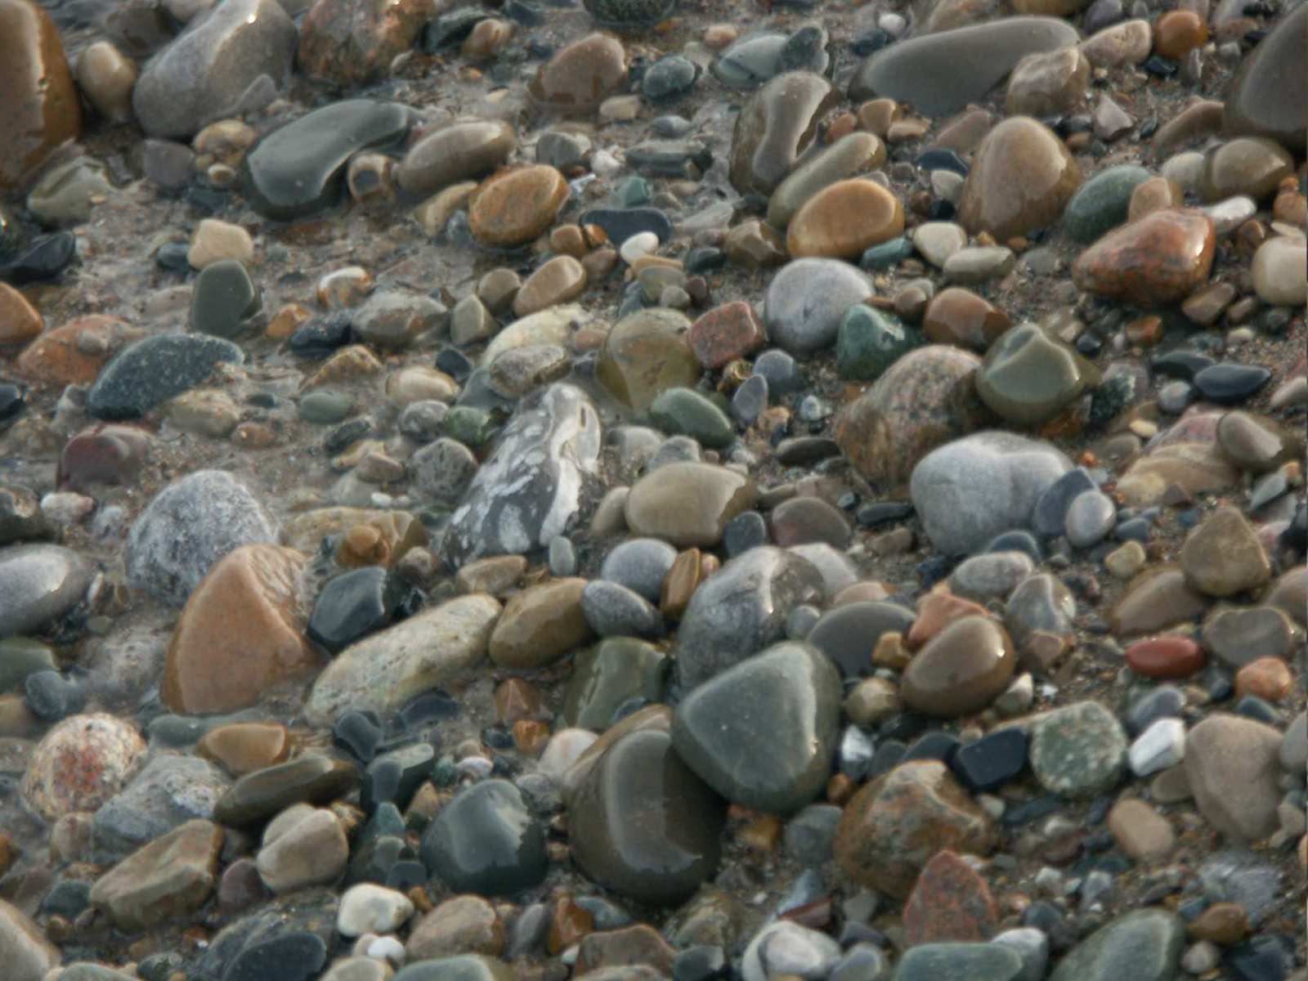
Rocks
Part V

Slide 2

RED SLIDE: These are notes that are very important and should be recorded in your science journal.
Copyright © 2010 Ryan P. Murphy

Slide 3

-Nice neat notes that are legible and use indentations when appropriate. .

Slide 4
-Nice neat notes that are legible and use indentations when appropriate. -Example of indent.

Slide 5
-Nice neat notes that are legible and use indentations when appropriate. -Example of indent. -Skip a line between topics

Slide 6
-Nice neat notes that are legible and use indentations when appropriate. -Example of indent. -Skip a line between topics -Don’t skip pages

Slide 7
-Nice neat notes that are legible and use indentations when appropriate. -Example of indent. -Skip a line between topics -Don’t skip pages -Make visuals clear and well drawn.

Slide 8
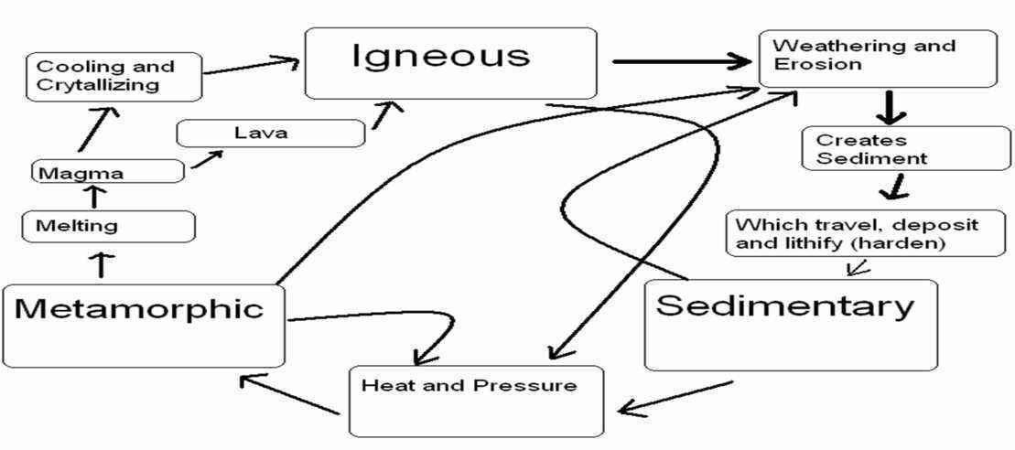
-Nice neat notes that are legible and use indentations when appropriate. -Example of indent. -Skip a line between topics -Don’t skip pages -Make visuals clear and well drawn.

Slide 9
RED SLIDE: These are notes that are very important and should be recorded in your science journal.
BLACK SLIDE: Pay attention, follow directions, complete projects as described and answer required questions neatly.
Copyright © 2010 Ryan P. Murphy

Slide 10

Keep an eye out for “The-Owl” and raise your hand as soon as you see him.
  He will be hiding somewhere in the slideshow
Copyright © 2010 Ryan P. Murphy

Slide 11
Keep an eye out for “The-Owl” and raise your hand as soon as you see him.
  He will be hiding somewhere in the slideshow
“Hoot, Hoot”
“Good Luck!”
Copyright © 2010 Ryan P. Murphy

Slide 13
Rocks
Part V

Slide 14
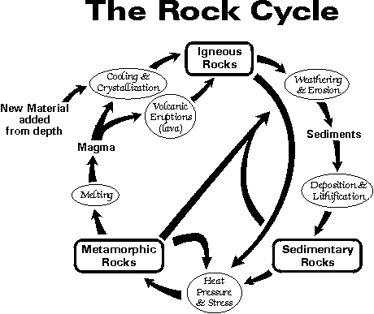
New Area of Focus. The Rock Cycle
Copyright © 2010 Ryan P. Murphy

Slide 15
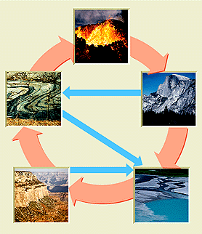
The rock cycle: How one rock changes into another.
  -
Copyright © 2010 Ryan P. Murphy

Slide 16
The rock cycle: How one rock changes into another.
  Driven by plate tectonics.
Copyright © 2010 Ryan P. Murphy

Slide 17
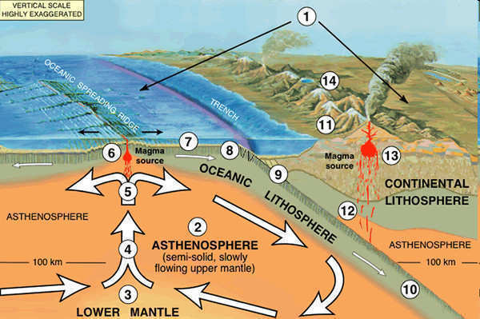

Slide 18
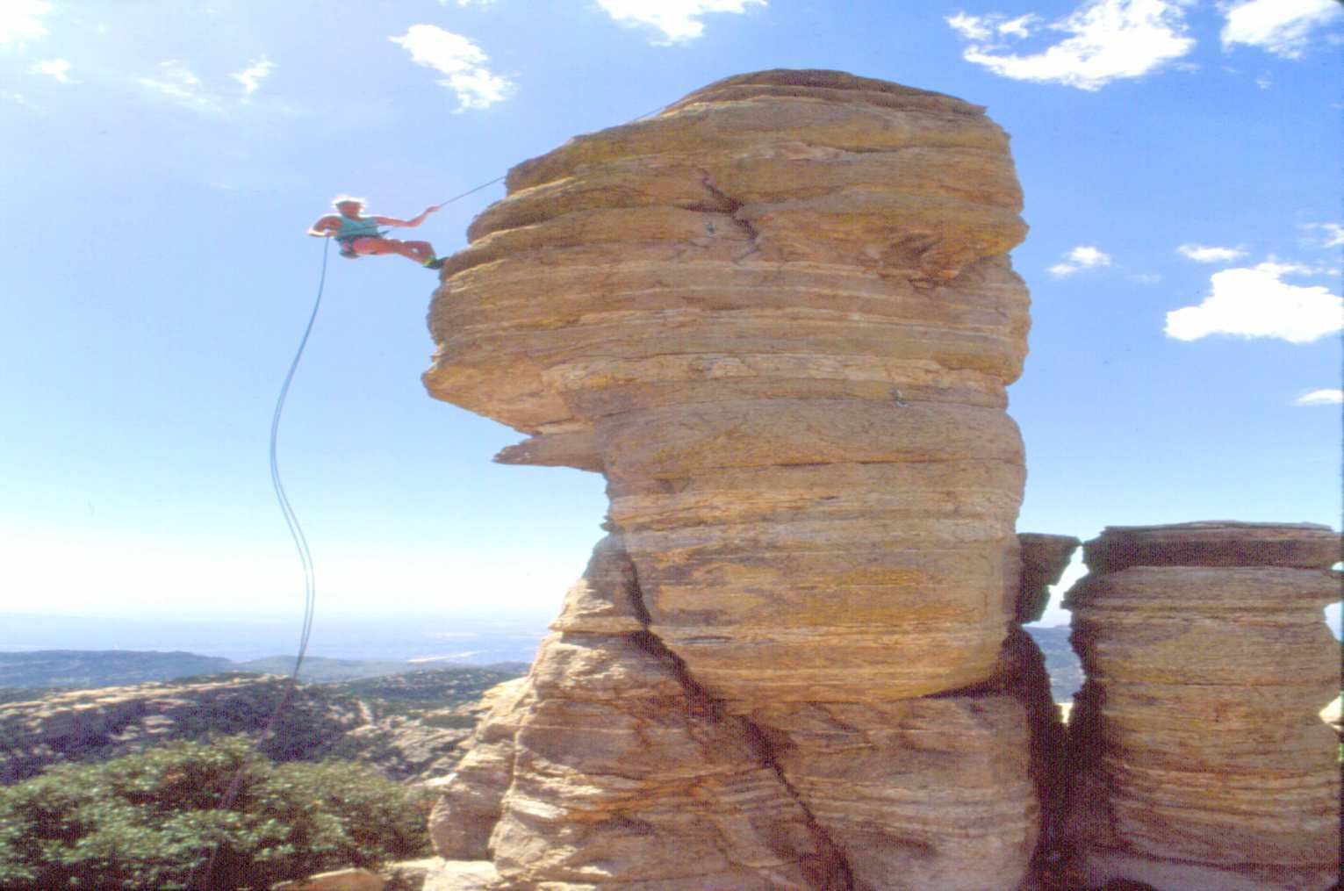
Review: Rock: A mixture of Minerals

Slide 19
Activity! Recording notes of the Rock Cycle /
Copyright © 2010 Ryan P. Murphy

Slide 20

Activity! Recording notes of the Rock Cycle / Musical Dance Number.
  Whole page needed in journal.
Copyright © 2010 Ryan P. Murphy

Slide 21


The class will be divided into 3 groups.
  The teacher will assign each group a rock to create a singing name for. Ex -“Igggggneeous”
  They must sing (dance?) the name of that rock when signaled in slideshow. (10 sec)
  Igneous. Sedimentary. Metamorphic.
Copyright © 2010 Ryan P. Murphy

Slide 22

Copyright © 2010 Ryan P. Murphy

Slide 23
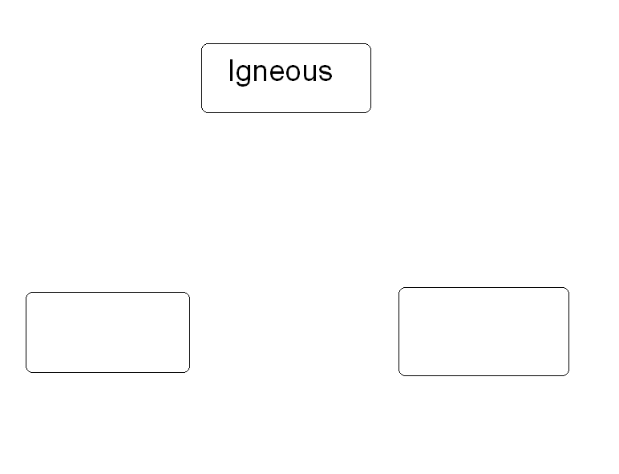
Copyright © 2010 Ryan P. Murphy

Slide 24
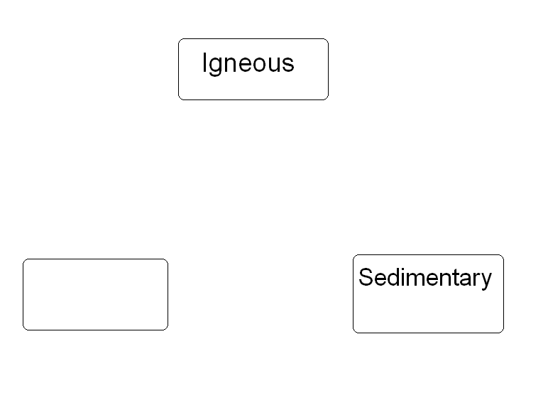
Copyright © 2010 Ryan P. Murphy

Slide 25
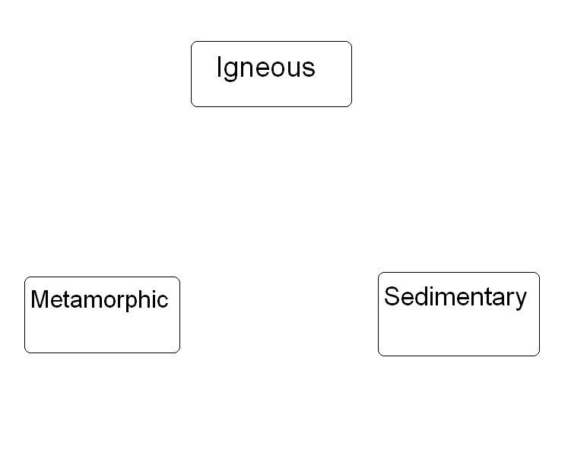
Copyright © 2010 Ryan P. Murphy

Slide 26
Copyright © 2010 Ryan P. Murphy

Slide 27
Copyright © 2010 Ryan P. Murphy

Slide 28
Copyright © 2010 Ryan P. Murphy

Slide 29
Copyright © 2010 Ryan P. Murphy

Slide 30
Copyright © 2010 Ryan P. Murphy

Slide 31
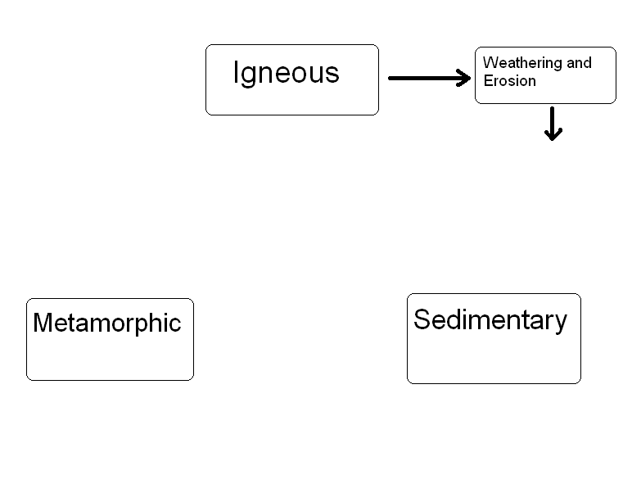
Copyright © 2010 Ryan P. Murphy

Slide 32
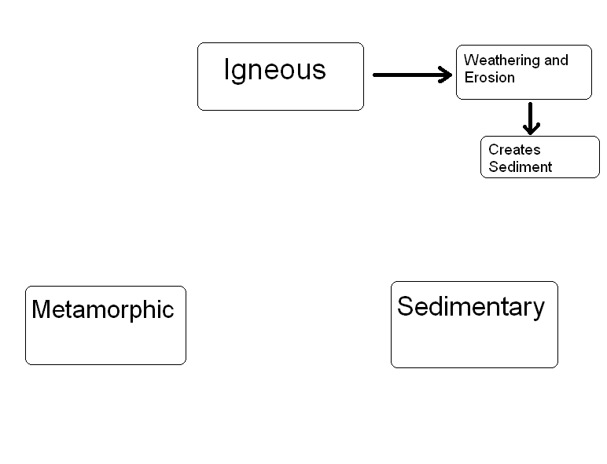
Copyright © 2010 Ryan P. Murphy

Slide 33
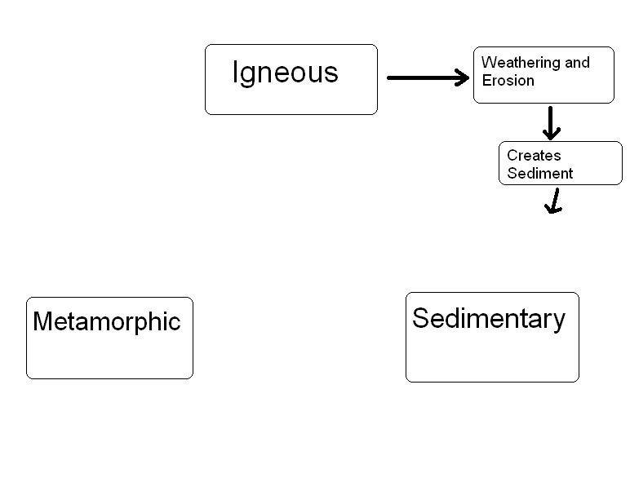
Copyright © 2010 Ryan P. Murphy

Slide 34
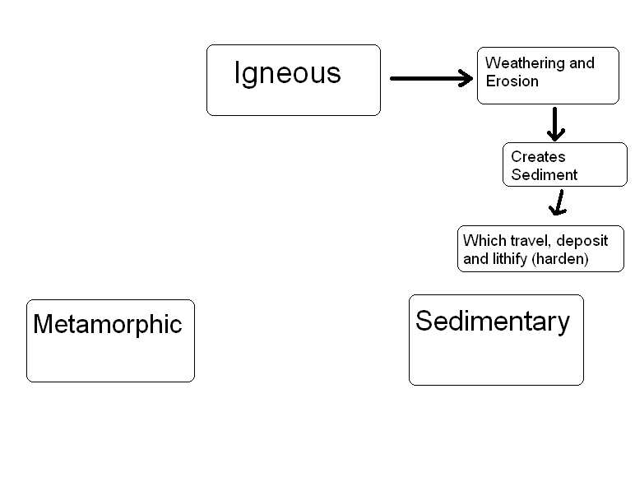
Copyright © 2010 Ryan P. Murphy

Slide 35
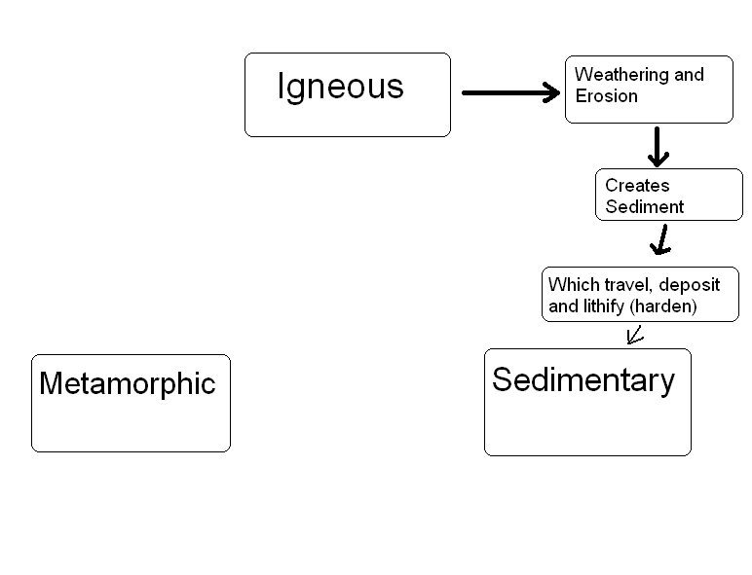
Copyright © 2010 Ryan P. Murphy

Slide 36
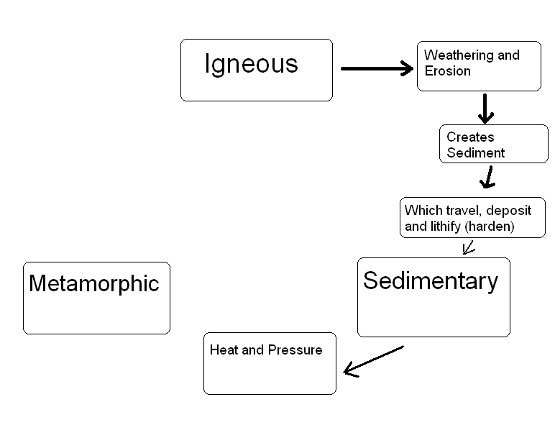
Copyright © 2010 Ryan P. Murphy

Slide 37
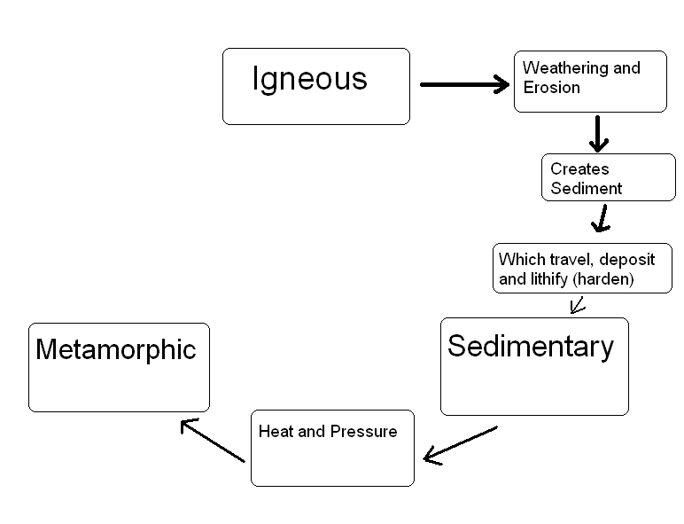
Copyright © 2010 Ryan P. Murphy

Slide 38
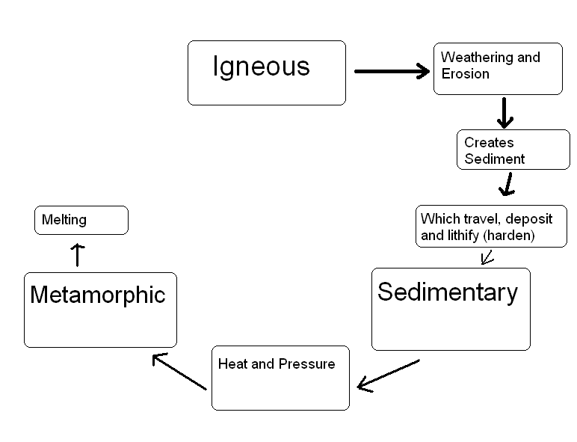
Copyright © 2010 Ryan P. Murphy

Slide 39
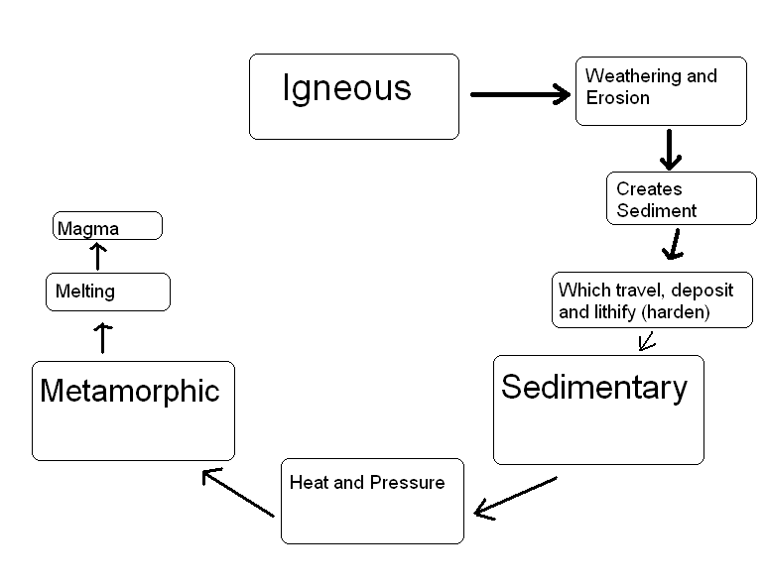
Copyright © 2010 Ryan P. Murphy

Slide 40
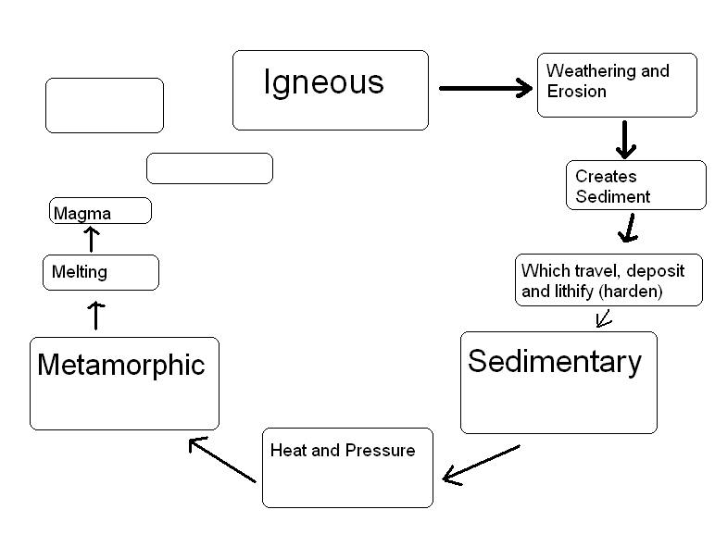
Copyright © 2010 Ryan P. Murphy

Slide 41
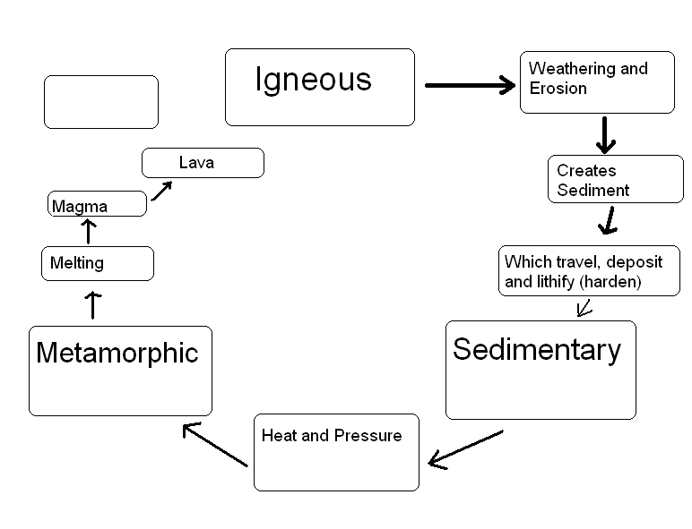
Copyright © 2010 Ryan P. Murphy

Slide 42
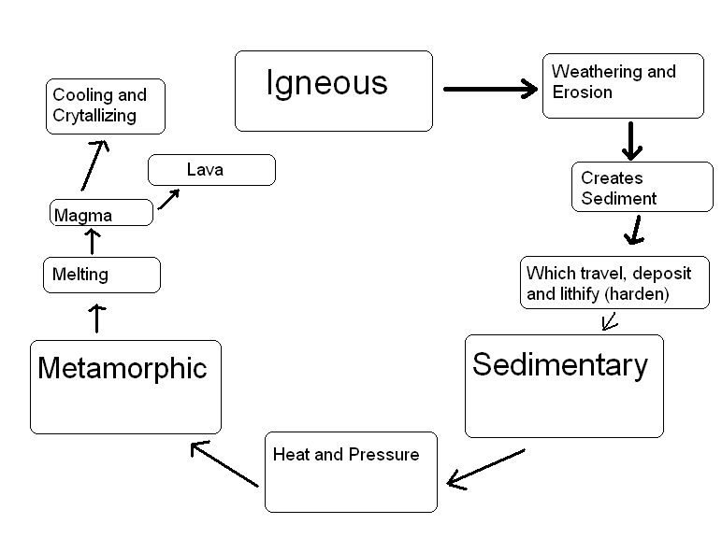
Copyright © 2010 Ryan P. Murphy

Slide 43
New Material Added From Mantle
Copyright © 2010 Ryan P. Murphy

Slide 44
Copyright © 2010 Ryan P. Murphy

Slide 45
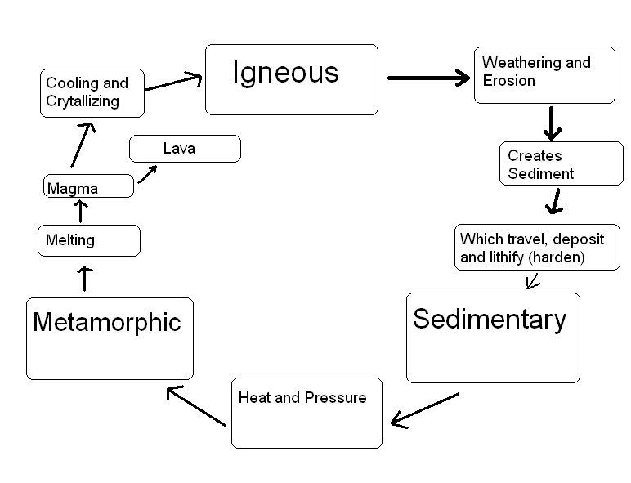
Copyright © 2010 Ryan P. Murphy

Slide 46

Copyright © 2010 Ryan P. Murphy

Slide 47
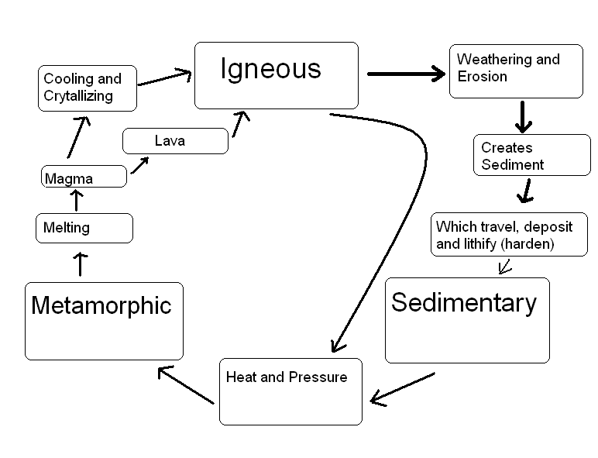
Copyright © 2010 Ryan P. Murphy

Slide 48
Copyright © 2010 Ryan P. Murphy

Slide 49
Copyright © 2010 Ryan P. Murphy

Slide 50
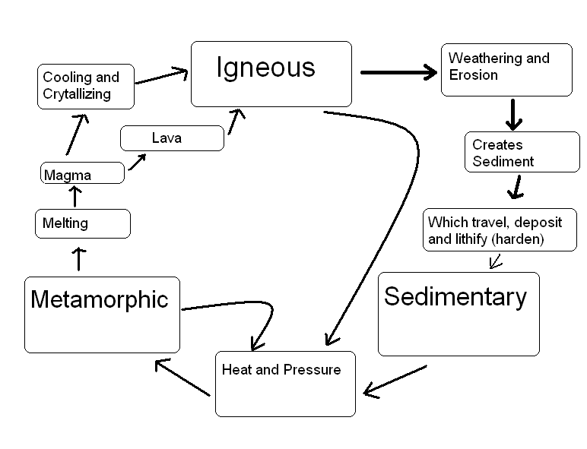
Copyright © 2010 Ryan P. Murphy

Slide 51
Copyright © 2010 Ryan P. Murphy

Slide 52
Copyright © 2010 Ryan P. Murphy

Slide 53
Copyright © 2010 Ryan P. Murphy

Slide 54
Copyright © 2010 Ryan P. Murphy

Slide 55
Copyright © 2010 Ryan P. Murphy

Slide 56
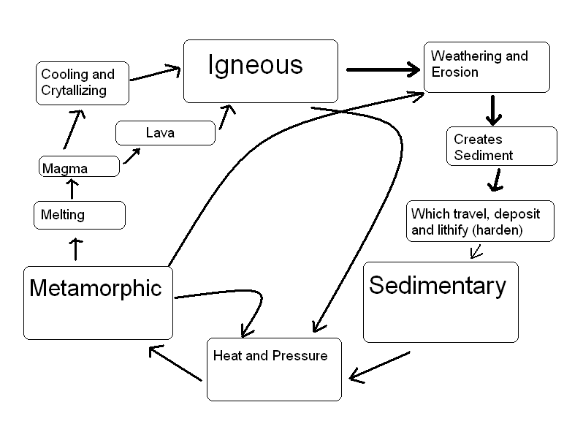
Copyright © 2010 Ryan P. Murphy

Slide 57
Copyright © 2010 Ryan P. Murphy

Slide 58
Copyright © 2010 Ryan P. Murphy

Slide 59
Copyright © 2010 Ryan P. Murphy

Slide 60
Copyright © 2010 Ryan P. Murphy

Slide 61
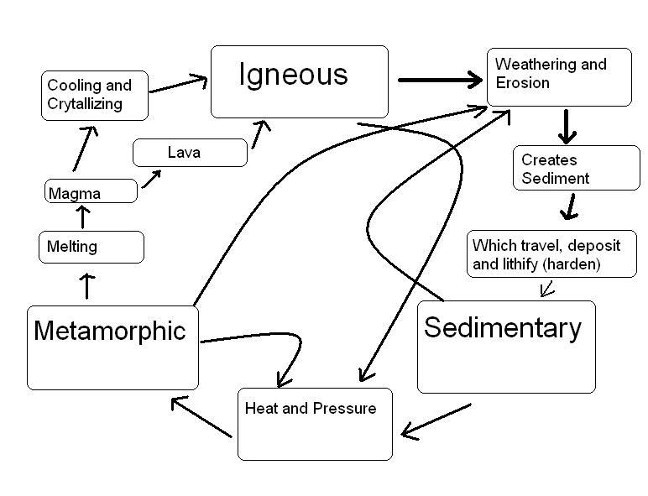
Copyright © 2010 Ryan P. Murphy

Slide 62
Copyright © 2010 Ryan P. Murphy

Slide 63
Copyright © 2010 Ryan P. Murphy

Slide 64
Copyright © 2010 Ryan P. Murphy

Slide 65
Copyright © 2010 Ryan P. Murphy

Slide 66
Copyright © 2010 Ryan P. Murphy

Slide 67
Copyright © 2010 Ryan P. Murphy

Slide 68
Copyright © 2010 Ryan P. Murphy

Slide 69
Copyright © 2010 Ryan P. Murphy

Slide 70
Copyright © 2010 Ryan P. Murphy

Slide 71
Copyright © 2010 Ryan P. Murphy

Slide 72
Copyright © 2010 Ryan P. Murphy

Slide 73
Copyright © 2010 Ryan P. Murphy

Slide 74
Copyright © 2010 Ryan P. Murphy

Slide 75
Copyright © 2010 Ryan P. Murphy

Slide 76
Rock Cycle. Learn more at… http://www.learner.org/interactives/rockcycle/diagram.html
Copyright © 2010 Ryan P. Murphy

Slide 77
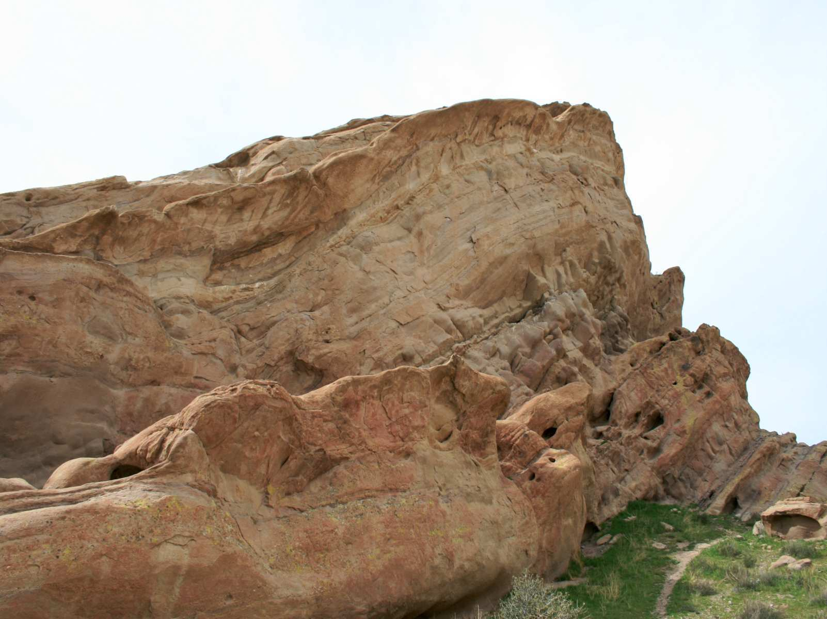
Can you say it with me?

Slide 78
Can you say it with me?
The Earth is…

Slide 79
Can you say it with me?
OLD
The Earth is…

Slide 80
Can you say it with me?
OLD
Changing
The Earth is…

Slide 81
Can you say it with me?
OLD
Changing
Cycling
The Earth is…

Slide 82
Can you say it with me?
OLD
Changing
Cycling
Resourceful
The Earth is…

Slide 83
Can you say it with me?
OLD
Changing
Cycling
Resourceful
The Earth is…
and..

Slide 84
Can you say it with me?
OLD
Changing
Cycling
Resourceful
The Earth is…
and..
The present holds the
key to the past

Slide 85

Can you say it with me?
OLD
Changing
Cycling
Resourceful
The Earth is…
and..
The Big Ideas with the rock cycle are…
The present holds the
key to the past

Slide 86
Can you say it with me?
Changing
Cycling
The Earth is…
and..
The present holds the
key to the past

Slide 87
Can you say it with me?
Changing
Cycling
The Earth is…
and..
The rock cycle has been cycling and changing rocks form for millions of years.
The present holds the
key to the past

Slide 88

Activity! Making the Rock Cycle
Can also work as demonstration

Slide 89
Activity! Making the Rock Cycle
  Table groups need to complete the following.
Step 1: Igneous rock (Birth of the rock)

Slide 90
Activity! Making the Rock Cycle
  Table groups need to complete the following.
Step 1: Igneous rock (Birth of the rock)
  Volcano erupts chunks of crayons (unwrapped) that pile on top of the earth (Large piece of aluminum foil).

Slide 91
Activity! Making the Rock Cycle
  Wear Safety Goggles.

Slide 92
Activity! Making the Rock Cycle
  Wear Safety Goggles.
Step 2: Weathering and Erosion

Slide 93
Activity! Making the Rock Cycle
  Wear Safety Goggles.
Step 2: Weathering and Erosion
  Break chunks of crayon into tiny pieces as well as use plastic knife to create shavings.

Slide 94
Activity! Making the Rock Cycle
  Wear Safety Goggles.
Step 2: Weathering and Erosion
  Break chunks of crayon into tiny pieces as well as use plastic knife to create shavings.
  Wind, Water, Animals, Chemicals, Plants.

Slide 95
Step 3: Deposition
  Move sediments (tiny chunks and shavings around on tin foil to create a pile in the middle).
Water
Wind
Organic Matter
Human Activity
Animal Activity
Plants

Slide 96
Step 3: Deposition
  Move sediments (tiny chunks and shavings around on tin foil to create a pile in the middle).

Slide 97
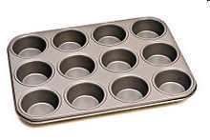
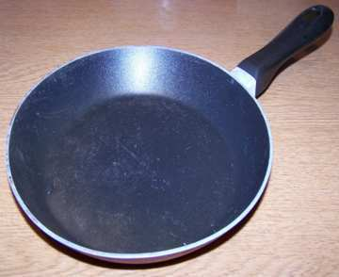
Step 4: Lithification / Cementation
  Place sediment (with foil) into cupcake tin and pack the sediment together as best you can manually.
or

Slide 98
Step 4: Lithification / Cementation
  Place sediment (with foil) into cupcake tin and pack the sediment together as best you can manually.
Cover

Slide 99
Step 4: Lithification / Cementation
  Place sediment (with foil) into cupcake tin and pack the sediment together as best you can manually.
Note! – Teacher shouldn’t melt wax to a liquid. Looking for semi-solid state. Very Low Heat! Watch Out for Liquid wax!
Cover

Slide 100
Step 5: Creating a metamorphic rock:
  Teacher gently warms the compacted sediment over a heat source.
  Teacher safely adds some pressure and temperature together to the packet.
  Teacher removes with kitchen mitts (check temp for safety) and places at students tables inside tray.
  Let cool a bit so that it’s not dangerously hot / liquid wax. (Discuss intrusive vs. extrusive)
  Students compress softly using textbooks again while rock is still warm. (Not liquid Wax)
  Let rocks cool slowly for an extended period before opening them up. (Repeat these steps if necessary until rock appears metamorphic.)

Slide 101
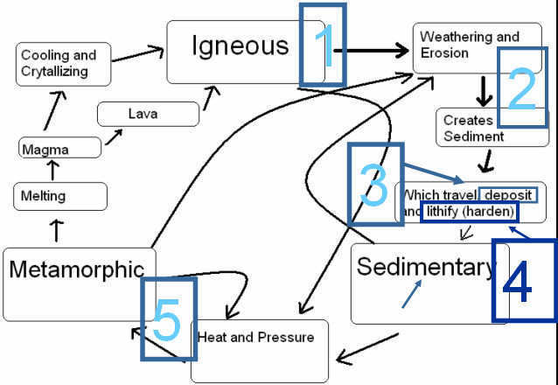
When safe! Open up foil, make some observation about the rocks and then answer the following.
  Sketch rock and describe each step 1 -5 in your journal as it relates to the rock cycle.

Slide 102



1
2
3
4
5

Slide 103

1
2
3
4
5

Slide 104

1
2
3
4
5

Slide 105

1
2
3
4
5

Slide 106
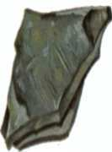
Activity! Learning to identify rocks.
  Please use the provided flashcards / rock kits to memorize the names and some general uses / facts about common igneous rocks.
Sedimentary, A fine-grained rock that forms from the compaction of silt and clay-size mineral particles → “Mud”
Shale

Slide 107
Activity! Learning to identify rocks.
  Please use the provided flashcards / rock kits to memorize the names and some general uses / facts about common igneous rocks.
  Write the name of the rock on the back of the flashcards. Then cut the flash cards out and try to line up the three boxes to complete each mineral.
Sedimentary, A fine-grained rock that forms from the compaction of silt and clay-size mineral particles → “Mud”
Shale

Slide 108
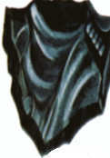
Activity! Learning to identify rocks.
  Please use the provided flashcards / rock kits to memorize the names and some general uses / facts about common igneous rocks.
  Write the name of the rock on the back of the flashcards. Then cut the flash cards out and try to line up the three boxes to complete each mineral.
Front View
Igneous Rock - Forms when molten rock material cools so rapidly. The result is a volcanic glass
Obsidian

Slide 109
Activity! Learning to identify rocks.
  Please use the provided flashcards / rock kits to memorize the names and some general uses / facts about common igneous rocks.
  Write the name of the rock on the back of the flashcards. Then cut the flash cards out and try to line up the three boxes to complete each mineral.
Back View
Obsidian
Obsidian
Obsidian

Slide 110
Activity! Learning to identify rocks.
  Please use the provided flashcards / rock kits to memorize the names and some general uses / facts about common igneous rocks.
  Write the name of the rock on the back of the flashcards. Then cut the flash cards out and try to line up the three boxes to complete each mineral.
Cut-Out
Igneous Rock - Forms when molten rock material cools so rapidly. The result is a volcanic glass
Obsidian

Slide 111
NOTE!
  Start small with only a few, get really good at those, and then add another rock into your practice. Each time you master a small set add another rock in until they are all mastered.

Slide 112
NOTE!
  Start small with only a few, get really good at those, and then add another rock into your practice. Each time you master a small set add another rock in until they are all mastered.
  Moving the cards around on a table / clean surface is how these will help you. Just staring at them / trying to memorize them without moving and jumbling will not be as helpful.

Slide 113
New rock from the rock cycle
Copyright © 2010 Ryan P. Murphy

Slide 114
New rock from the rock cycle
Copyright © 2010 Ryan P. Murphy

Slide 115
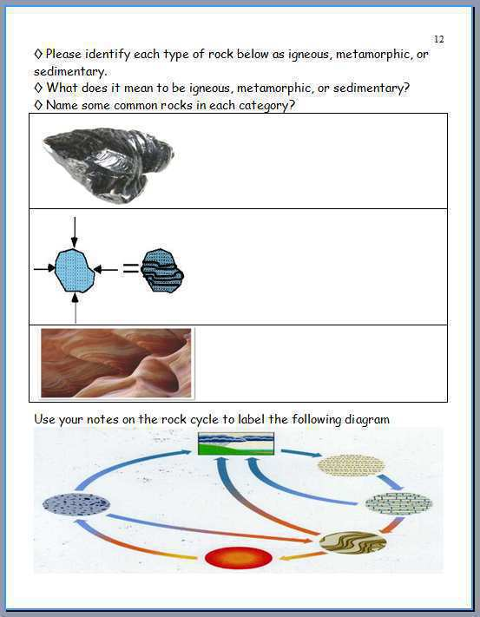
Please complete this question.

Slide 116
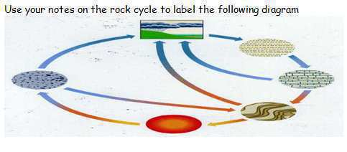
Note that the diagram is opposite of the one from your notes.

Slide 117
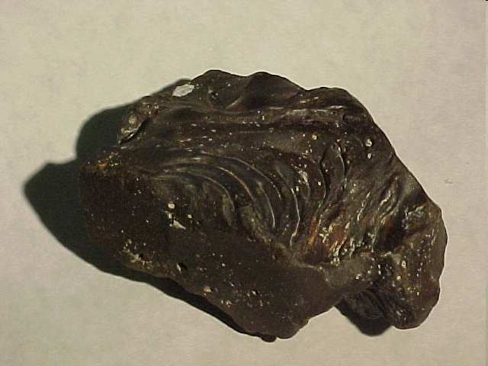
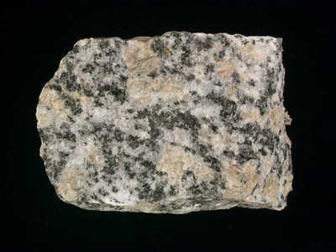
Igneous Rocks: Molten Earth cooled.
    -
      -
    -
      -
Copyright © 2010 Ryan P. Murphy

Slide 118
Igneous Rocks: Molten Earth cooled.
    INtrusive – Cooled below crust (slow)
      -
    -
      -
Copyright © 2010 Ryan P. Murphy

Slide 119
Igneous Rocks: Molten Earth cooled.
    Intrusive – Cooled below crust (slow)
      -
    -
      -
Copyright © 2010 Ryan P. Murphy

Slide 120
Igneous Rocks: Molten Earth cooled.
    Intrusive – Cooled below crust (slow)
      -
    -
      -
Granites
Copyright © 2010 Ryan P. Murphy

Slide 121
Igneous Rocks: Molten Earth cooled.
    Intrusive – Cooled below crust (slow)
      Larger crystals
    -
      -
Granites
Copyright © 2010 Ryan P. Murphy

Slide 122
Igneous Rocks: Molten Earth cooled.
    Intrusive – Cooled below crust (slow)
      Larger crystals
    -
      -
Granites
Copyright © 2010 Ryan P. Murphy

Slide 123
Igneous Rocks: Molten Earth cooled.
    Intrusive – Cooled below crust (slow)
      Larger crystals
    -
      -
Granites
Copyright © 2010 Ryan P. Murphy

Slide 124
Igneous Rocks: Molten Earth cooled.
    Intrusive – Cooled below crust (slow)
      Larger crystals
    -
      -
Granites
Copyright © 2010 Ryan P. Murphy

Slide 125
Igneous Rocks: Molten Earth cooled.
    Intrusive – Cooled below crust (slow)
      Larger crystals
    -
      -
Copyright © 2010 Ryan P. Murphy

Slide 126
Igneous Rocks: Molten Earth cooled.
    Intrusive – Cooled below crust (slow)
      Larger crystals
    -
      -
Coarse Texture
Copyright © 2010 Ryan P. Murphy

Slide 127
Igneous Rocks: Molten Earth cooled.
    Intrusive – Cooled below crust (slow)
      Larger crystals
    -
      -
Coarse Texture
Copyright © 2010 Ryan P. Murphy

Slide 128
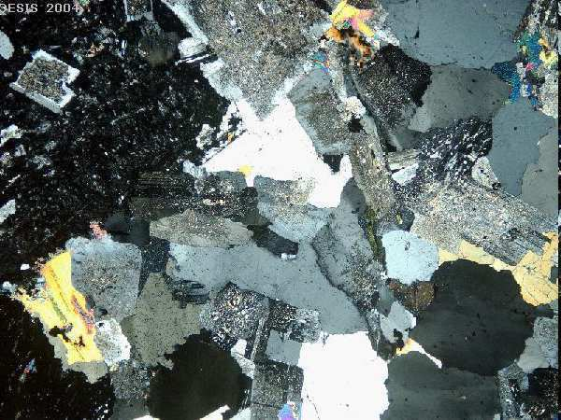

Slide 129
Igneous Rocks: Molten Earth cooled.
    Intrusive – Cooled below crust (slow)
      Larger crystals
    Extrusive – Cooled on Earth’s surface (faster).
Copyright © 2010 Ryan P. Murphy

Slide 130
Igneous Rocks: Molten Earth cooled.
    Intrusive – Cooled below crust (slow)
      Larger crystals
    Extrusive – Cooled on Earth’s surface (faster).
Can be minutes to seconds.
Granites
Copyright © 2010 Ryan P. Murphy

Slide 131
Igneous Rocks: Molten Earth cooled.
    Intrusive – Cooled below crust (slow)
      Larger crystals
    Extrusive – Cooled on Earth’s surface (faster).
Granites
Basalts
Copyright © 2010 Ryan P. Murphy

Slide 132
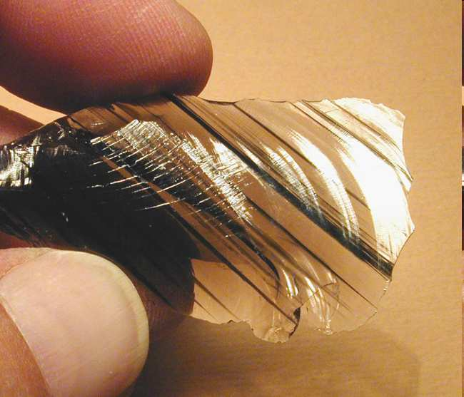
Igneous Rocks: Molten Earth cooled.
    Intrusive – Cooled below crust (slow)
      Larger crystals
    Extrusive – Cooled on Earth’s surface (faster).
      Fine grain crystals or no crystals.
Granites
Basalts
Copyright © 2010 Ryan P. Murphy

Slide 133
Igneous Rocks: Molten Earth cooled.
    Intrusive – Cooled below crust (slow)
      Larger crystals
    Extrusive – Cooled on Earth’s surface (faster).
      Fine grain crystals or no crystals.
Fine Texture Smooth
Granites
Basalts
Copyright © 2010 Ryan P. Murphy

Slide 134
Igneous Rocks: Molten Earth cooled.
    Intrusive – Cooled below crust (slow)
      Larger crystals
    Extrusive – Cooled on Earth’s surface (faster).
      Fine grain crystals or no crystals.
Granites
No Crystals Here
Copyright © 2010 Ryan P. Murphy

Slide 135
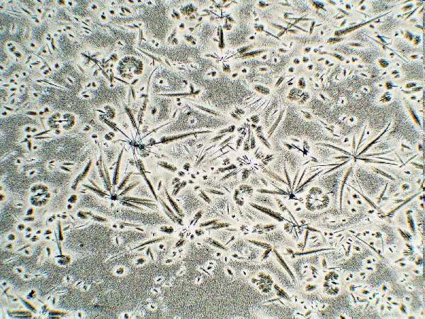
Igneous Rocks: Molten Earth cooled.
    Intrusive – Cooled below crust (slow)
      Larger crystals
    Extrusive – Cooled on Earth’s surface (faster).
      Fine grain crystals or no crystals.
Fine Texture Smooth
Granites
Basalts
Copyright © 2010 Ryan P. Murphy

Slide 136
Igneous Rocks: Molten Earth cooled.
    Intrusive – Cooled below crust (slow)
      Larger crystals
    Extrusive – Cooled on Earth’s surface (faster).
      Fine grain crystals or no crystals.
Granites
Copyright © 2010 Ryan P. Murphy

Slide 137
Igneous Rocks: Molten Earth cooled.
    Intrusive – Cooled below crust (slow)
      Larger crystals
    Extrusive – Cooled on Earth’s surface (faster).
      Fine grain crystals or no crystals
Granites
Intrusive
Copyright © 2010 Ryan P. Murphy

Slide 138
Igneous Rocks: Molten Earth cooled.
    Intrusive – Cooled below crust (slow)
      Larger crystals
    Extrusive – Cooled on Earth’s surface (faster).
      Fine grain crystals or no crystals
Coarse-grained /
large crystals
Granites
Intrusive
Copyright © 2010 Ryan P. Murphy

Slide 139
Igneous Rocks: Molten Earth cooled.
    Intrusive – Cooled below crust (slow)
      Larger crystals
    Extrusive – Cooled on Earth’s surface (faster).
      Fine grain crystals or no crystals
Coarse-grained /
large crystals
Granites
Extrusive
Intrusive
Copyright © 2010 Ryan P. Murphy

Slide 140
Igneous Rocks: Molten Earth cooled.
    Intrusive – Cooled below crust (slow)
      Larger crystals
    Extrusive – Cooled on Earth’s surface (faster).
      Fine grain crystals or no crystals
Coarse-grained /
large crystals
Basalts
Granites
Extrusive
Intrusive
Copyright © 2010 Ryan P. Murphy

Slide 141
Igneous Rocks: Molten Earth cooled.
    Intrusive – Cooled below crust (slow)
      Larger crystals
    Extrusive – Cooled on Earth’s surface (faster).
      Fine grain crystals or no crystals
Fine Texture Smooth
Coarse-grained /
large crystals
Basalts
Granites
Extrusive
Intrusive
Copyright © 2010 Ryan P. Murphy

Slide 142
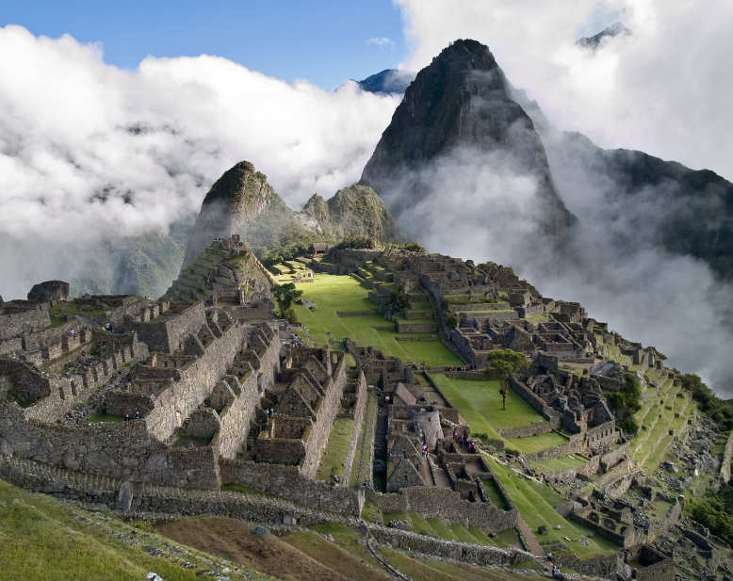

machu picchu

Slide 143
machu picchu

Slide 144
machu picchu

Slide 145
machu picchu
Fine grained
white granite

Slide 146
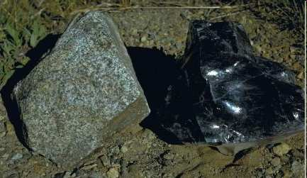
Which of the rocks below cooled quickly (Extrusive) and which cooled slowly (Intrusive)?
A
B

Slide 147
Which of the rocks below cooled quickly (Extrusive) and which cooled slowly (Intrusive)?
A
B

Slide 148
Which of the rocks below cooled quickly (Extrusive) and which cooled slowly (Intrusive)?
Extrusive
A
B

Slide 149
Which of the rocks below cooled quickly (Extrusive) and which cooled slowly (Intrusive)?
Extrusive
A
B
Obsidian

Slide 150
Which of the rocks below cooled quickly (Extrusive) and which cooled slowly (Intrusive)?
Extrusive
A
B
Obsidian

Slide 151
Which of the rocks below cooled quickly (Extrusive) and which cooled slowly (Intrusive)?
Extrusive
A
B
Obsidian

Slide 152
Which of the rocks below cooled quickly (Extrusive) and which cooled slowly (Intrusive)?
Intrusive
Extrusive
A
B
Obsidian

Slide 153
Which of the rocks below cooled quickly (Extrusive) and which cooled slowly (Intrusive)?
Intrusive
Extrusive
A
B
Granite
Obsidian

Slide 154
Which of the rocks below cooled quickly (Extrusive) and which cooled slowly (Intrusive)?
Intrusive
Extrusive
A
B
Granite
Obsidian

Slide 155
Which of the rocks below cooled quickly (Extrusive) and which cooled slowly (Intrusive)?
Intrusive
Extrusive
A
B
Granite
Obsidian

Slide 156
Which of the rocks below cooled quickly (Extrusive) and which cooled slowly (Intrusive)? Which one has large crystals?
Intrusive
Extrusive
A
B
Granite
Obsidian

Slide 157
Which of the rocks below cooled quickly (Extrusive) and which cooled slowly (Intrusive)? Which one has large crystals?
Intrusive
Extrusive
A
B
Granite
Obsidian

Slide 158
Which of the rocks below cooled quickly (Extrusive) and which cooled slowly (Intrusive)? Which one has large crystals?
Intrusive
Extrusive
A
B
Granite
Obsidian

Slide 159
Which of the rocks below cooled quickly (Extrusive) and which cooled slowly (Intrusive)? Which one has large crystals?
Intrusive
Extrusive
A
B
No Crystals
Granite
Obsidian

Slide 160
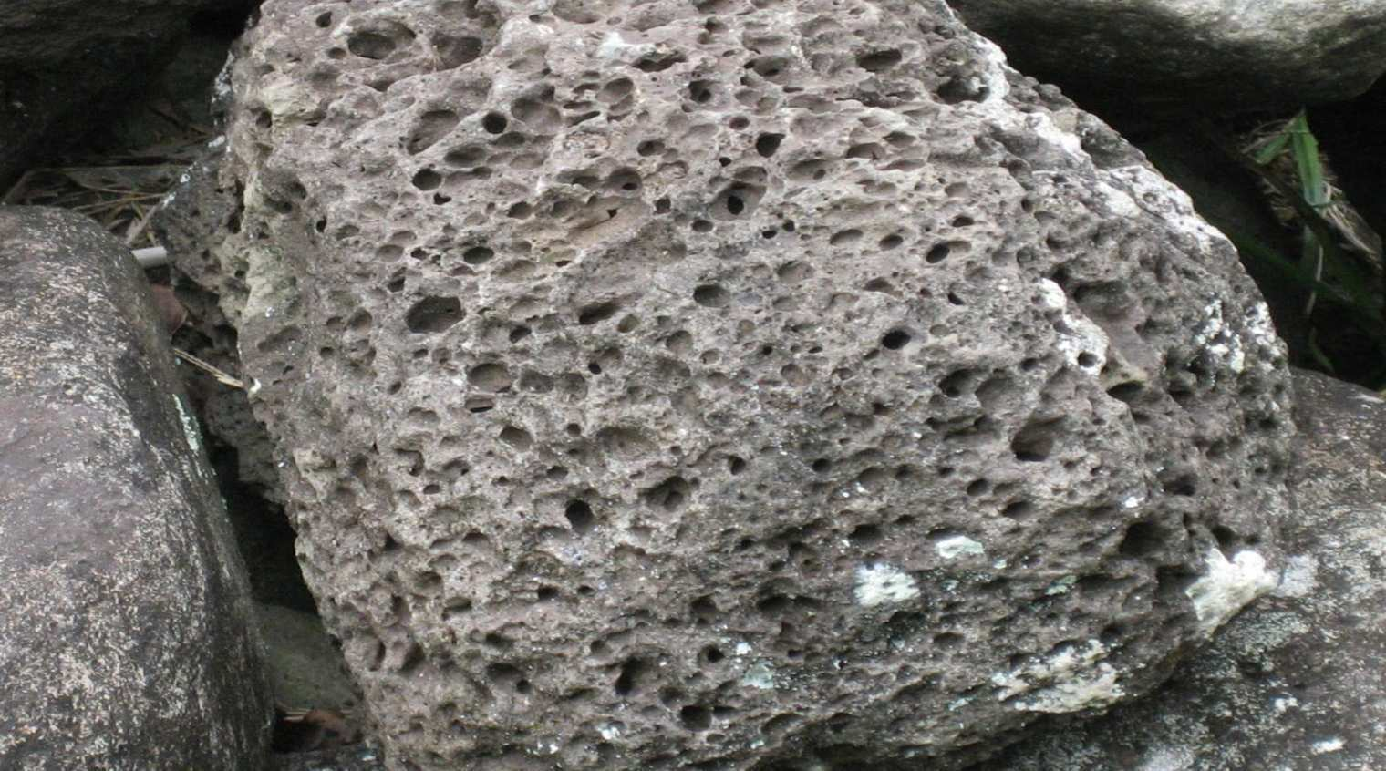
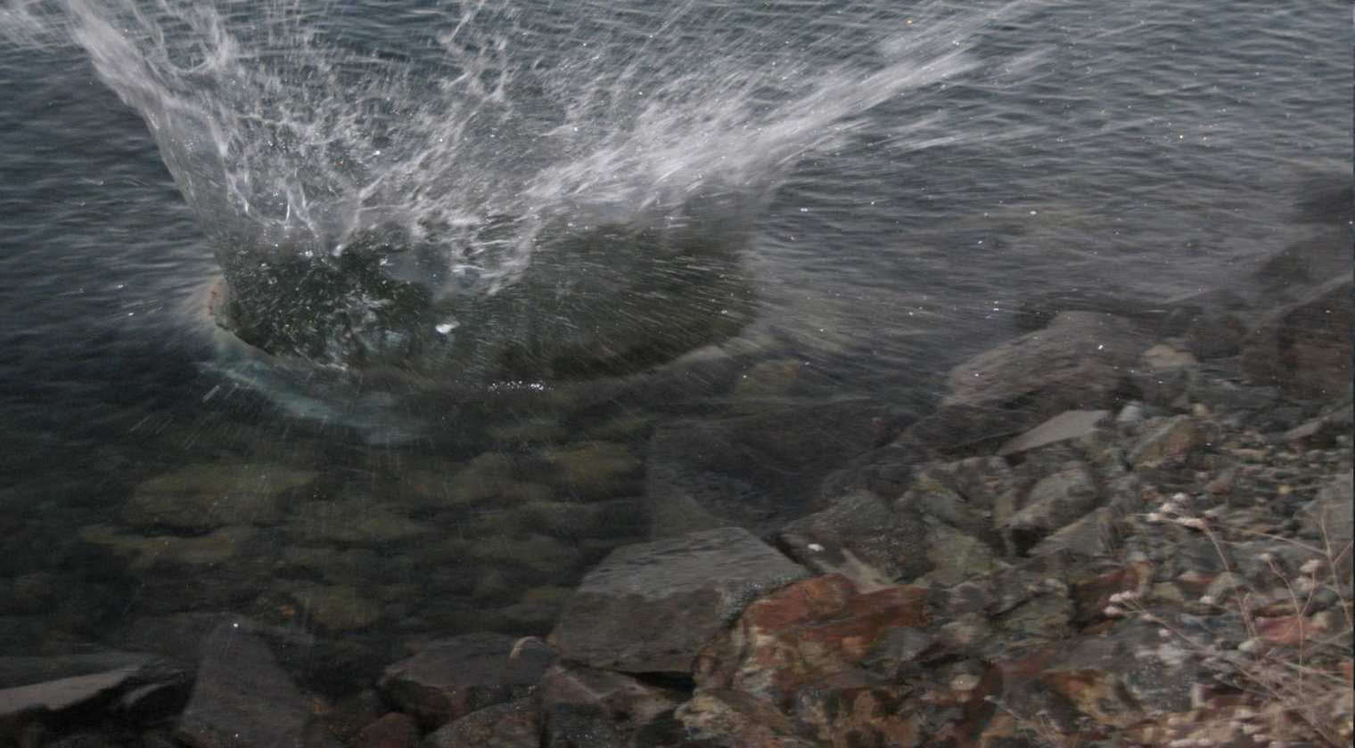
Can rocks float?

Slide 161
Can rocks float?
Activity! Floating a piece of pumice.

Slide 162
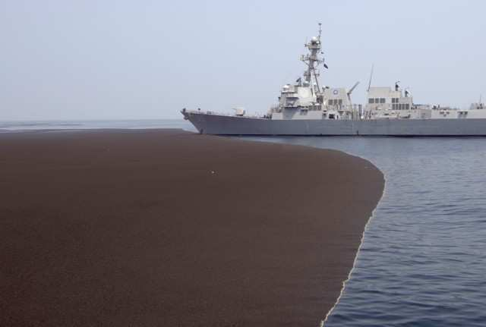
Picture of floating Pumice Island.
Copyright © 2010 Ryan P. Murphy

Slide 163
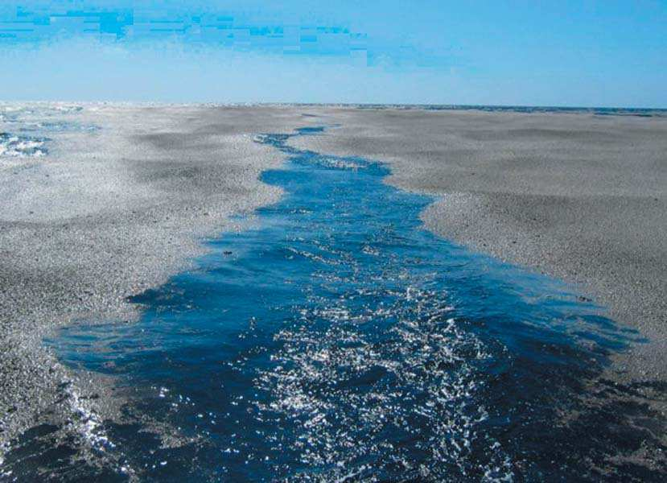

Slide 164
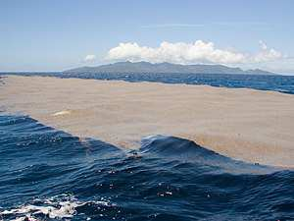

Slide 165


Slide 166


Slide 167
That floats.

Slide 168
That floats.

Slide 169
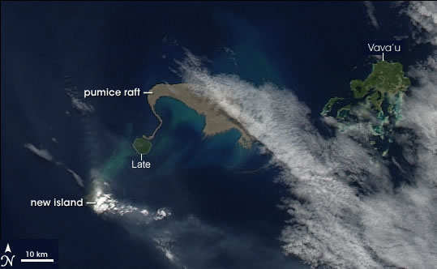

Slide 170
Volcano

Slide 171

Mafic Man

Slide 172

Fab Felsic

Slide 173
Igneous rocks
  Mafic is used for silicate minerals, magmas, and rocks which are relatively high in the heavier elements.

Slide 174
Igneous rocks
  Mafic is used for silicate minerals, magmas, and rocks which are relatively high in the heavier elements. (Magnesium and Iron)

Slide 175
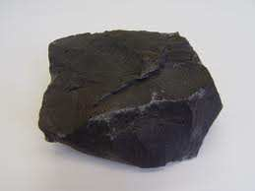
Igneous rocks
  Mafic is used for silicate minerals, magmas, and rocks which are relatively high in the heavier elements. (Magnesium and Iron)

Slide 176
Igneous rocks
  Mafic is used for silicate minerals, magmas, and rocks which are relatively high in the heavier elements. (Magnesium and Iron)
  Felsic is used for silicate minerals, magmas, and rocks which have a lower percentage of the heavier elements. Have more of the lighter elements.

Slide 177
Igneous rocks
  Mafic is used for silicate minerals, magmas, and rocks which are relatively high in the heavier elements. (Magnesium and Iron)
  Felsic is used for silicate minerals, magmas, and rocks which have a lower percentage of the heavier elements. Have more of the lighter elements. (Silicon and oxygen, aluminum, and potassium)

Slide 178
Igneous rocks
  Mafic is used for silicate minerals, magmas, and rocks which are relatively high in the heavier elements. (Magnesium and Iron)
  Felsic is used for silicate minerals, magmas, and rocks which have a lower percentage of the heavier elements. Have more of the lighter elements. (Silicon and oxygen, aluminum, and potassium)

Slide 179
Igneous rocks
  Mafic is used for silicate minerals, magmas, and rocks which are relatively high in the heavier elements. (Magnesium and Iron)
  Felsic is used for silicate minerals, magmas, and rocks which have a lower percentage of the heavier elements. Have more of the lighter elements. (Silicon and oxygen, aluminum, and potassium)

Slide 180
Igneous rocks
  Mafic is used for silicate minerals, magmas, and rocks which are relatively high in the heavier elements. (Magnesium and Iron)
  Felsic is used for silicate minerals, magmas, and rocks which have a lower percentage of the heavier elements. Have more of the lighter elements. (Silicon and oxygen, aluminum, and potassium)

Slide 181
Igneous rocks
  Mafic is used for silicate minerals, magmas, and rocks which are relatively high in the heavier elements. (Magnesium and Iron)
  Felsic is used for silicate minerals, magmas, and rocks which have a lower percentage of the heavier elements. Have more of the lighter elements. (Silicon and oxygen, aluminum, and potassium)

Slide 182
Igneous rocks
  Mafic is used for silicate minerals, magmas, and rocks which are relatively high in the heavier elements. (Magnesium and Iron)
  Felsic is used for silicate minerals, magmas, and rocks which have a lower percentage of the heavier elements. Have more of the lighter elements. (Silicon and oxygen, aluminum, and potassium) Feldspar

Slide 183
Igneous rocks

Slide 184
Igneous rocks
  Mafic – Darker in color (Heavy Elements)

Slide 185
Igneous rocks
  Mafic – Darker in color (Heavy Elements)
      Iron, Magnesium

Slide 186
Igneous rocks
  Mafic – Darker in color (Heavy Elements)
      Iron, Magnesium

Slide 187
Igneous rocks
  Mafic – Darker in color (Heavy Elements)
      Iron, Magnesium
  Felsic – Lighter in color (Lighter Elements)

Slide 188
Igneous rocks
  Mafic – Darker in color (Heavy Elements)
      Iron, Magnesium
  Felsic – Lighter in color (Lighter Elements)
      Oxygen, Silicon, Aluminum,

Slide 189
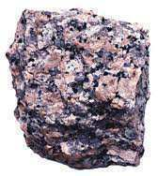
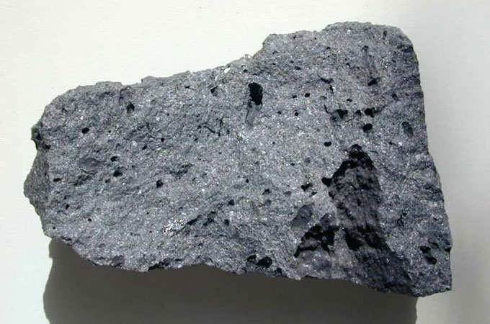
Which is considered mafic, and which is felsic?
A
B

Slide 190
Which is considered mafic, and which is felsic?
A
B

Slide 191
Which is considered mafic, and which is felsic?
A
B
Mafic

Slide 192
Which is considered mafic, and which is felsic?
A
B
Mafic
Basalt

Slide 193
Which is considered mafic, and which is felsic?
A
B
Mafic
Basalt

Slide 194
Which is considered mafic, and which is felsic?
A
B
Mafic
Basalt

Slide 195
Which is considered mafic, and which is felsic?
A
B
Mafic
Basalt

Slide 196
Which is considered mafic, and which is felsic?
A
B
Felsic
Mafic
Basalt

Slide 197
Which is considered mafic, and which is felsic?
A
B
Felsic
Mafic
Granite
Basalt

Slide 198
Which is considered mafic, and which is felsic?
A
B
Felsic
Mafic
Granite
Basalt

Slide 199
Which is considered mafic, and which is felsic?
A
B
Felsic
Mafic
Granite
Basalt

Slide 200

Note: Although Obsidian looks “Dark”

Slide 201
Note: Although Obsidian looks “Dark” It’s actually clear and Felsic in Chemistry.

Slide 202

Note: Although Obsidian looks “Dark” It’s actually clear and Felsic in Chemistry.
Obsidian consists mainly of SiO₂ (silicon dioxide), usually 70% or more

Slide 203
Note: Although Obsidian looks “Dark” It’s actually clear and Felsic in Chemistry.
Can sometimes also be an intermediate between felsic and mafic.

Slide 204
Note: Although Obsidian looks “Dark” It’s actually clear and Felsic in Chemistry.
Can sometimes also be an intermediate between felsic and mafic.
Intermediate

Slide 205




Which rocks are incorrectly labeled below?
Obsidian
Rhyolite
Felsic
Felsic
Pumice
Granite
Basalt
Pumice
Mafic
Felsic
Mafic/
Felsic
Copyright © 2010 Ryan P. Murphy

Slide 206
Which rocks are incorrectly labeled below?
Obsidian
Rhyolite
Felsic
Felsic
Pumice
Granite
Basalt
Pumice
Mafic
Felsic
Mafic/
Felsic
Copyright © 2010 Ryan P. Murphy

Slide 207
Which rocks are incorrectly labeled below?
Obsidian
Rhyolite
Felsic
Felsic
Pumice
Granite
Basalt
Pumice
Felsic
Mafic
Mafic/
Felsic
Copyright © 2010 Ryan P. Murphy

Slide 208
Fab Felsic

Slide 209
Which rock is incorrectly labeled below?
Obsidian
Rhyolite
Mafic
Felsic
Pumice
Pumice
Basalt
Granite
Basalt
Mafic/
Felsic
Felsic
Mafic
Copyright © 2010 Ryan P. Murphy

Slide 210
Which rock is incorrectly labeled below?
Obsidian
Rhyolite
Mafic
Felsic
Pumice
Pumice
Basalt
Granite
Basalt
Mafic/
Felsic
Felsic
Mafic
Copyright © 2010 Ryan P. Murphy

Slide 211
Which rock is incorrectly labeled below?
Obsidian
Rhyolite
Felsic
Felsic
Pumice
Pumice
Basalt
Granite
Basalt
Mafic/
Felsic
Felsic
Mafic
Copyright © 2010 Ryan P. Murphy

Slide 212
Which rock is incorrectly labeled below?
Obsidian
Rhyolite
Felsic
Felsic
Can be
Intermediate
Pumice
Pumice
Basalt
Granite
Basalt
Mafic/
Felsic
Felsic
Mafic
Copyright © 2010 Ryan P. Murphy

Slide 213
Classification of Igneous Rocks
  -
  -
  -
Copyright © 2010 Ryan P. Murphy

Slide 214
Basaltic: Dark, heavy (dense)
Copyright © 2010 Ryan P. Murphy

Slide 215
Basaltic: Dark, heavy (dense)
Fine Grained
Copyright © 2010 Ryan P. Murphy

Slide 216
Basaltic: Dark, heavy (dense)
Fine Grained
Cooled
Extrusive
Copyright © 2010 Ryan P. Murphy

Slide 217
Basaltic: Dark, heavy (dense)
Fine Grained
Cooled
Extrusive
Copyright © 2010 Ryan P. Murphy

Slide 218
Basaltic: Dark, heavy (dense)
Fine Grained
Cooled
Extrusive
Copyright © 2010 Ryan P. Murphy

Slide 219

Basaltic: Dark, heavy (dense)
Fine Grained
Ocean Floor
Cooled
Extrusive
Copyright © 2010 Ryan P. Murphy

Slide 220

Basaltic: Dark, heavy (dense)
Fine Grained
Ocean Floor
Cooled
Extrusive
Lava flows
Copyright © 2010 Ryan P. Murphy

Slide 221

Basaltic: Dark, heavy (dense)
Fine Grained
Ocean Floor
Cooled
Extrusive
Lava flows
Olympus Mons on
Mars is made of Basalt
Copyright © 2010 Ryan P. Murphy

Slide 222
Basaltic: Dark, heavy (dense)
Fine Grained
Ocean Floor
Cooled
Extrusive
Lava flows
Olympus Mons on
Mars is made of Basalt
Copyright © 2010 Ryan P. Murphy

Slide 223
Basaltic: Dark, heavy (dense)
Fine Grained
Ocean Floor
Cooled
Extrusive
Lava flows
Olympus Mons on
Mars is made of Basalt
Copyright © 2010 Ryan P. Murphy

Slide 224

Basaltic: Dark, heavy (dense)
Fine Grained
Ocean Floor
Lunar maria
is basalt
Cooled
Extrusive
Lava flows
Olympus Mons on
Mars is made of Basalt
Copyright © 2010 Ryan P. Murphy

Slide 225
Basaltic: Dark, heavy (dense)
Fine Grained
Ocean Floor
Basalt is fine-grained so that the individual minerals are not visible. Basalt includes pyroxene, plagioclase feldspar and olivine. These minerals are visible in the coarse-grained basalt called gabbro.
Lunar maria
is basalt
Cooled
Extrusive
Lava flows
Olympus Mons on
Mars is made of Basalt
Copyright © 2010 Ryan P. Murphy

Slide 226
Basaltic: Dark, heavy (dense)
Fine Grained
Ocean Floor
Basalt is fine-grained so that the individual minerals are not visible. Basalt includes pyroxene, plagioclase feldspar and olivine. These minerals are visible in the coarse-grained basalt called gabbro.
Lunar maria
is basalt
Cooled
Extrusive
Lava flows
Olympus Mons on
Mars is made of Basalt
Copyright © 2010 Ryan P. Murphy

Slide 227
Basaltic: Dark, heavy (dense)
Fine Grained
Ocean Floor
Basalt is fine-grained so that the individual minerals are not visible. Basalt includes pyroxene, plagioclase feldspar and olivine. These minerals are visible in the coarse-grained basalt called gabbro.
Lunar maria
is basalt
Cooled
Extrusive
Lava flows
Olympus Mons on
Mars is made of Basalt
Copyright © 2010 Ryan P. Murphy

Slide 228
Basaltic: Dark, heavy (dense)
Fine Grained
Ocean Floor
Basalt is fine-grained so that the individual minerals are not visible. Basalt includes pyroxene, plagioclase feldspar and olivine. These minerals are visible in the coarse-grained basalt called gabbro.
Lunar maria
is basalt
Cooled
Extrusive
Lava flows
Olympus Mons on
Mars is made of Basalt
Copyright © 2010 Ryan P. Murphy

Slide 229
Basaltic: Dark, heavy (dense)
Fine Grained
Ocean Floor
Basalt is fine-grained so that the individual minerals are not visible. Basalt includes pyroxene, plagioclase feldspar and olivine. These minerals are visible in the coarse-grained basalt called gabbro.
Lunar maria
is basalt
Cooled
Extrusive
Lava flows
Olympus Mons on
Mars is made of Basalt
Copyright © 2010 Ryan P. Murphy

Slide 230
Basaltic: Dark, heavy (dense)
Fine Grained
Ocean Floor
Basalt is fine-grained so that the individual minerals are not visible. Basalt includes pyroxene, plagioclase feldspar and olivine. These minerals are visible in the coarse-grained basalt called gabbro.
Lunar maria
is basalt
Cooled
Extrusive
Lava flows
Olympus Mons on
Mars is made of Basalt
Copyright © 2010 Ryan P. Murphy

Slide 231
Basaltic: Dark, heavy (dense)
Fine Grained
Ocean Floor
Basalt is fine-grained so that the individual minerals are not visible. Basalt includes pyroxene, plagioclase feldspar and olivine. These minerals are visible in the coarse-grained basalt called gabbro.
Lunar maria
is basalt
Cooled
Extrusive
Lava flows
Olympus Mons on
Mars is made of Basalt
Copyright © 2010 Ryan P. Murphy

Slide 232
Basaltic: Dark, heavy (dense)
Fine Grained
Ocean Floor
Basalt is fine-grained so that the individual minerals are not visible. Basalt includes pyroxene, plagioclase feldspar and olivine. These minerals are visible in the coarse-grained basalt called gabbro.
Lunar maria
is basalt
Cooled
Extrusive
Lava flows
Olympus Mons on
Mars is made of Basalt
Copyright © 2010 Ryan P. Murphy

Slide 233
Basaltic: Dark, heavy (dense)
Fine Grained
Ocean Floor
Basalt is fine-grained so that the individual minerals are not visible. Basalt includes pyroxene, plagioclase feldspar and olivine. These minerals are visible in the coarse-grained basalt called gabbro.
Lunar maria
is basalt
Cooled
Extrusive
Lava flows
Olympus Mons on
Mars is made of Basalt
Copyright © 2010 Ryan P. Murphy

Slide 234
Basaltic: Dark, heavy (dense)
Fine Grained
Ocean Floor
Basalt is fine-grained so that the individual minerals are not visible. Basalt includes pyroxene, plagioclase feldspar and olivine. These minerals are visible in the coarse-grained basalt called gabbro.
Lunar maria
is basalt
Cooled
Extrusive
Lava flows
Olympus Mons on
Mars is made of Basalt
Copyright © 2010 Ryan P. Murphy

Slide 235
Basaltic: Dark, heavy (dense)
Fine Grained
Ocean Floor
Basalt is fine-grained so that the individual minerals are not visible. Basalt includes pyroxene, plagioclase feldspar and olivine. These minerals are visible in the coarse-grained basalt called gabbro.
Lunar maria
is basalt
Cooled
Extrusive
Lava flows
Felsic or Mafic?
Olympus Mons on
Mars is made of Basalt
Copyright © 2010 Ryan P. Murphy

Slide 236

Basaltic: Dark, heavy (dense)
Fine Grained
Ocean Floor
Basalt is fine-grained so that the individual minerals are not visible. Basalt includes pyroxene, plagioclase feldspar and olivine. These minerals are visible in the coarse-grained basalt called gabbro.
Lunar maria
is basalt
Cooled
Extrusive
Lava flows
Mafic
Olympus Mons on
Mars is made of Basalt
Copyright © 2010 Ryan P. Murphy

Slide 237

Devils Tower, Wyoming

Slide 238
Devils Tower, Wyoming

Slide 239
Devils Tower, Wyoming

Slide 240

Svartifoss waterfall, Iceland

Slide 241


Giants Causeway, Ireland

Slide 242
Giants Causeway, Ireland

Slide 243
Giants Causeway, Ireland
“It looked bigger in the brochure Honey”

Slide 244

Bamburgh Castle, England

Slide 245
Bamburgh Castle, England
Basalt Outcrop

Slide 246
Granitic: Light colored, less heavy, filled with oxygen.
Copyright © 2010 Ryan P. Murphy

Slide 247
Granitic: Light colored, less heavy, filled with oxygen.
Cooled Intrusive
Copyright © 2010 Ryan P. Murphy

Slide 248
Granitic: Light colored, less heavy, filled with oxygen.
Cooled Intrusive
Copyright © 2010 Ryan P. Murphy

Slide 249
Granitic: Light colored, less heavy, filled with oxygen.
Cooled Intrusive
Copyright © 2010 Ryan P. Murphy

Slide 250
Granitic: Light colored, less heavy, filled with oxygen.
Cooled Intrusive
Granite is composed mainly of quartz and feldspar with minor amounts of micas, amphiboles and other minerals.
Common on Earths surface
Copyright © 2010 Ryan P. Murphy

Slide 251
Granitic: Light colored, less heavy, filled with oxygen.
Cooled Intrusive
Granite is composed mainly of quartz and feldspar with minor amounts of micas, amphiboles and other minerals.
Common on Earths surface
Copyright © 2010 Ryan P. Murphy

Slide 252
Granitic: Light colored, less heavy, filled with oxygen.
Cooled Intrusive
Granite is composed mainly of quartz and feldspar with minor amounts of micas, amphiboles and other minerals.
Common on Earths surface
Copyright © 2010 Ryan P. Murphy

Slide 253
Granitic: Light colored, less heavy, filled with oxygen.
Cooled Intrusive
Granite is composed mainly of quartz and feldspar with minor amounts of micas, amphiboles and other minerals.
Common on Earths surface
Copyright © 2010 Ryan P. Murphy

Slide 254
Granitic: Light colored, less heavy, filled with oxygen.
Cooled Intrusive
Granite is composed mainly of quartz and feldspar with minor amounts of micas, amphiboles and other minerals.
Common on Earths surface
Copyright © 2010 Ryan P. Murphy

Slide 255
Granitic: Light colored, less heavy, filled with oxygen.
Cooled Intrusive
Granite is composed mainly of quartz and feldspar with minor amounts of micas, amphiboles and other minerals.
Common on Earths surface
Copyright © 2010 Ryan P. Murphy

Slide 256
Granitic: Light colored, less heavy, filled with oxygen.
Cooled Intrusive
Granite is composed mainly of quartz and feldspar with minor amounts of micas, amphiboles and other minerals.
Common on Earths surface
Copyright © 2010 Ryan P. Murphy

Slide 257
Granitic: Light colored, less heavy, filled with oxygen.
Cooled Intrusive
Granite is composed mainly of quartz and feldspar with minor amounts of micas, amphiboles and other minerals.
Common on Earths surface
Copyright © 2010 Ryan P. Murphy

Slide 258
Granitic: Light colored, less heavy, filled with oxygen.
Cooled Intrusive
Granite is composed mainly of quartz and feldspar with minor amounts of micas, amphiboles and other minerals.
Common on Earths surface
Copyright © 2010 Ryan P. Murphy

Slide 259
Granitic: Light colored, less heavy, filled with oxygen.
Cooled Intrusive
Granite is composed mainly of quartz and feldspar with minor amounts of micas, amphiboles and other minerals.
Copyright © 2010 Ryan P. Murphy

Slide 260
Granitic: Light colored, less heavy, filled with oxygen.
Cooled Intrusive
Granite is composed mainly of quartz and feldspar with minor amounts of micas, amphiboles and other minerals.
Common on Earths surface
Copyright © 2010 Ryan P. Murphy

Slide 261
Granitic: Light colored, less heavy, filled with oxygen.
Cooled Intrusive
Granite is composed mainly of quartz and feldspar with minor amounts of micas, amphiboles and other minerals.
Coarse Grained
Common on Earths surface
Copyright © 2010 Ryan P. Murphy

Slide 262
Granitic: Light colored, less heavy, filled with oxygen.
Cooled Intrusive
Granite is composed mainly of quartz and feldspar with minor amounts of micas, amphiboles and other minerals.
Coarse Grained
Common on Earths surface
Copyright © 2010 Ryan P. Murphy

Slide 263
Granitic: Light colored, less heavy, filled with oxygen.
Cooled Intrusive
Granite is composed mainly of quartz and feldspar with minor amounts of micas, amphiboles and other minerals.
Coarse Grained
Common on Earths surface
Copyright © 2010 Ryan P. Murphy

Slide 264
Granitic: Light colored, less heavy, filled with oxygen.
Cooled Intrusive
Granite is composed mainly of quartz and feldspar with minor amounts of micas, amphiboles and other minerals.
Felsic or Mafic?
Common on Earths surface
Copyright © 2010 Ryan P. Murphy

Slide 265
Granitic: Light colored, less heavy, filled with oxygen.
Cooled Intrusive
Granite is composed mainly of quartz and feldspar with minor amounts of micas, amphiboles and other minerals.
Felsic
Common on Earths surface
Copyright © 2010 Ryan P. Murphy

Slide 266

Mount Rushmore

Slide 267
Mount Rushmore

Slide 268
Mount Rushmore

Slide 269

Half Dome

Slide 270
Half Dome

Slide 271
Half Dome

Slide 272

Half Dome
Yosemite Valley

Slide 273
Half Dome
Yosemite Valley

Slide 274
Half Dome
Yosemite Valley

Slide 275

Stone Mountain Georgia

Slide 276
Stone Mountain Georgia

Slide 277
Stone Mountain Georgia

Slide 278
Stone Mountain Georgia

Slide 279


Slide 281


Slide 282




Slide 285

Andesitic: Intermediate.
Copyright © 2010 Ryan P. Murphy

Slide 286
Andesitic: Intermediate.
Cooled Extrusive
Copyright © 2010 Ryan P. Murphy

Slide 287
Andesitic: Intermediate.
Cooled Extrusive
Copyright © 2010 Ryan P. Murphy

Slide 288
Andesitic: Intermediate.
Cooled Extrusive
Copyright © 2010 Ryan P. Murphy

Slide 289
Andesitic: Intermediate.
Cooled Extrusive
Felsic or Mafic?
Copyright © 2010 Ryan P. Murphy

Slide 290
Andesitic: Intermediate.
Cooled Extrusive
Felsic or Mafic?
(Between the two / Intermediate)
Copyright © 2010 Ryan P. Murphy

Slide 291
Andesitic: Intermediate.
Cooled Extrusive
Felsic or Mafic?
(Between the two / Intermediate)
Masic?
Felmaf?
Malsic?
Felmafic?
Mafelsic?
Copyright © 2010 Ryan P. Murphy

Slide 292
Andesitic: Intermediate.
Cooled Extrusive
Felsic or Mafic?
(Between the two / Intermediate)
Masic?
Felmaf?
Malsic?
Made up intermediate words
Felmafic?
Mafelsic?
Copyright © 2010 Ryan P. Murphy

Slide 293

Andesite is named after the
Andes Mountains

Slide 294
Andesite is named after the
Andes Mountains

Slide 295
Andesite is named after the
Andes Mountains

Slide 296

Quiz 1-10, Is it Basaltic, Granitic or Name the Rock Band.
Copyright © 2010 Ryan P. Murphy

Slide 297
Quiz 1-10, Is it Basaltic, Granitic or Name the Rock Band.
Light Colored
Granitic
Copyright © 2010 Ryan P. Murphy

Slide 298

Quiz 1-10, Is it Basaltic, Granitic or Name the Rock Band.
Light Colored
Darker Colored
Granitic
Basaltic
Copyright © 2010 Ryan P. Murphy

Slide 299
Quiz 1-10, Is it Basaltic, Granitic or Name the Rock Band.
Rock and Roll Quiz Music at… http://www.youtube.com/watch?v=5XfRjVo5wOE
Light Colored
Darker Colored
Granitic
Basaltic
Copyright © 2010 Ryan P. Murphy

Slide 300

1

Slide 301

2

Slide 302

3

Slide 303
End of Preview
Hundreds of more
slides, activities,
video links,
homework, notes,
and much more
on the full version.

Slide 304

Activity! Rocks PowerPoint Review Game
Study
Copyright © 2010 Ryan P. Murphy

Slide 305

Geology Topics Unit
http://sciencepowerpoint.com/Geology_Unit.html

Slide 306
Geology Topics Unit
Areas of Focus within The Geology Topics Unit:
Plate Tectonics, Evidence for Plate Tectonics, Pangea, Energy Waves,
Layers of the earth, Heat Transfer, Types of Crust, Plate Boundaries, Hot Spots, Volcanoes, Positives and Negatives of Volcanoes, Types of
Volcanoes, Parts of a Volcano, Magma, Types of Lava, Viscosity,
Earthquakes, Faults, Folds, Seismograph, Richter Scale,Seismograph,
Tsunami’s, Rocks, Minerals, Crystals, Uses of Minerals, Types of
Crystals, Physical Properties of Minerals, Rock Cycle, Common Igneous Rocks, Common Sedimentary Rocks, Common Metamorphic Rocks.
http://sciencepowerpoint.com/Geology_Unit.html

Slide 307
This was a very brief 5 mb tour. Please visit the links below to learn more about each of the units in this curriculum package.
  These units take me about four years to complete with my students in grades 5-10.
Earth Science Units | Extended Tour Link and Curriculum Guide
Geology Topics Unit | http://sciencepowerpoint.com/Geology_Unit.html
Astronomy Topics Unit | http://sciencepowerpoint.com/Astronomy_Unit.html
Weather and Climate Unit | http://sciencepowerpoint.com/Weather_Climate_Unit.html
Soil Science, Weathering, More | http://sciencepowerpoint.com/Soil_and_Glaciers_Unit.html
Water Unit | http://sciencepowerpoint.com/Water_Molecule_Unit.html
Rivers Unit | http://sciencepowerpoint.com/River_and_Water_Quality_Unit.html
= Easier = More Difficult = Most Difficult
5th – 7th grade 6th – 8th grade 8th – 10th grade

Slide 308
Physical Science Units | Extended Tour Link and Curriculum Guide
Science Skills Unit | http://sciencepowerpoint.com/Science_Introduction_Lab_Safety_Metric_Methods.html
Motion and Machines Unit | http://sciencepowerpoint.com/Newtons_Laws_Motion_Machines_Unit.html
Matter, Energy, Envs. Unit | http://sciencepowerpoint.com/Energy_Topics_Unit.html
Atoms and Periodic Table Unit | http://sciencepowerpoint.com/Atoms_Periodic_Table_of_Elements_Unit.html
Life Science Units | Extended Tour Link and Curriculum Guide
Human Body / Health Topics | http://sciencepowerpoint.com/Human_Body_Systems_and_Health_Topics_Unit.html
DNA and Genetics Unit | http://sciencepowerpoint.com/DNA_Genetics_Unit.html
Cell Biology Unit | http://sciencepowerpoint.com/Cellular_Biology_Unit.html
Infectious Diseases Unit | http://sciencepowerpoint.com/Infectious_Diseases_Unit.html
Taxonomy and Classification Unit | http://sciencepowerpoint.com/Taxonomy_Classification_Unit.html
Evolution / Natural Selection Unit | http://sciencepowerpoint.com/Evolution_Natural_Selection_Unit.html
Botany Topics Unit | http://sciencepowerpoint.com/Plant_Botany_Unit.html
Ecology Feeding Levels Unit | http://sciencepowerpoint.com/Ecology_Feeding_Levels_Unit.htm
Ecology Interactions Unit | http://sciencepowerpoint.com/Ecology_Interactions_Unit.html
Ecology Abiotic Factors Unit | http://sciencepowerpoint.com/Ecology_Abiotic_Factors_Unit.html

Slide 309

More Units Available at…
Earth Science: The Soil Science and Glaciers Unit, The Geology Topics Unit, The Astronomy Topics Unit, The Weather and Climate Unit, and The River Unit, The Water Molecule Unit.
Physical Science: The Laws of Motion and Machines Unit, The Atoms and Periodic Table Unit, The Energy and the Environment Unit, and The Introduction to Science / Metric Unit.
Life Science: The Diseases and Cells Unit, The DNA and Genetics Unit, The Life Topics Unit, The Plant Unit, The Taxonomy and Classification Unit, Ecology: Feeding Levels Unit, Ecology: Interactions Unit, Ecology: Abiotic Factors, The Evolution and Natural Selection Unit and The Human Body and Health Topics Unit.
Copyright © 2010 Ryan P. Murphy

Slide 310

The entire four year curriculum can be found at... http://sciencepowerpoint.com/ Please feel free to contact me with any questions you may have. Thank you for your interest in this curriculum.
Sincerely,
Ryan Murphy M.Ed
www.sciencepowerpoint@gmail.com

