Slide 1
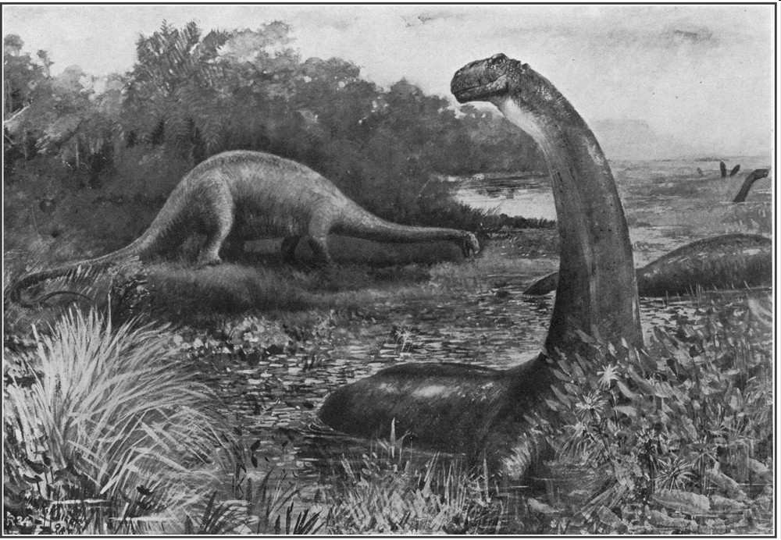
Part VI Earth System History

Slide 2
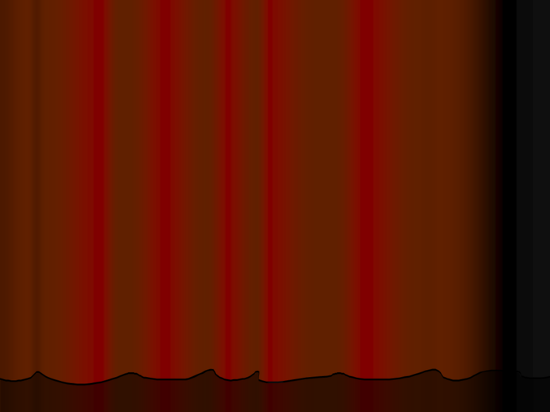
RED SLIDE: These are notes that are very important and should be recorded in your science journal.
Copyright © 2010 Ryan P. Murphy

Slide 3


Slide 4
Please use this red line

Slide 5
Please use this red line
-Please make notes legible and use indentations when appropriate.

Slide 6
-Please make notes legible and use indentations when appropriate. -Example of indent.

Slide 7
-Please make notes legible and use indentations when appropriate. -Example of indent. -Skip a line between topics

Slide 8
-Please make notes legible and use indentations when appropriate. -Example of indent. -Skip a line between topics -Don’t skip pages

Slide 9
-Please make notes legible and use indentations when appropriate. -Example of indent. -Skip a line between topics -Don’t skip pages -Make visuals clear and well drawn.

Slide 10
RED SLIDE: These are notes that are very important and should be recorded in your science journal.
BLACK SLIDE: Pay attention, follow directions, complete projects as described and answer required questions neatly.
Copyright © 2010 Ryan P. Murphy

Slide 11

Keep an eye out for “The-Owl” and raise your hand as soon as you see him.
  He will be hiding somewhere in the slideshow
Copyright © 2010 Ryan P. Murphy

Slide 12

“Hoot, Hoot”
“Good Luck!”
Copyright © 2010 Ryan P. Murphy

Slide 13
Part III Earth System History

Slide 14


Slide 15
Remember: Make the most with the time that you are given.

Slide 16
Remember: Make the most with the time that you are given. Getting a strong education is worth the time.

Slide 17
Remember: Make the most with the time that you are given. Getting a strong education is worth the time. The next few years have a huge impact on the rest of your life.

Slide 18
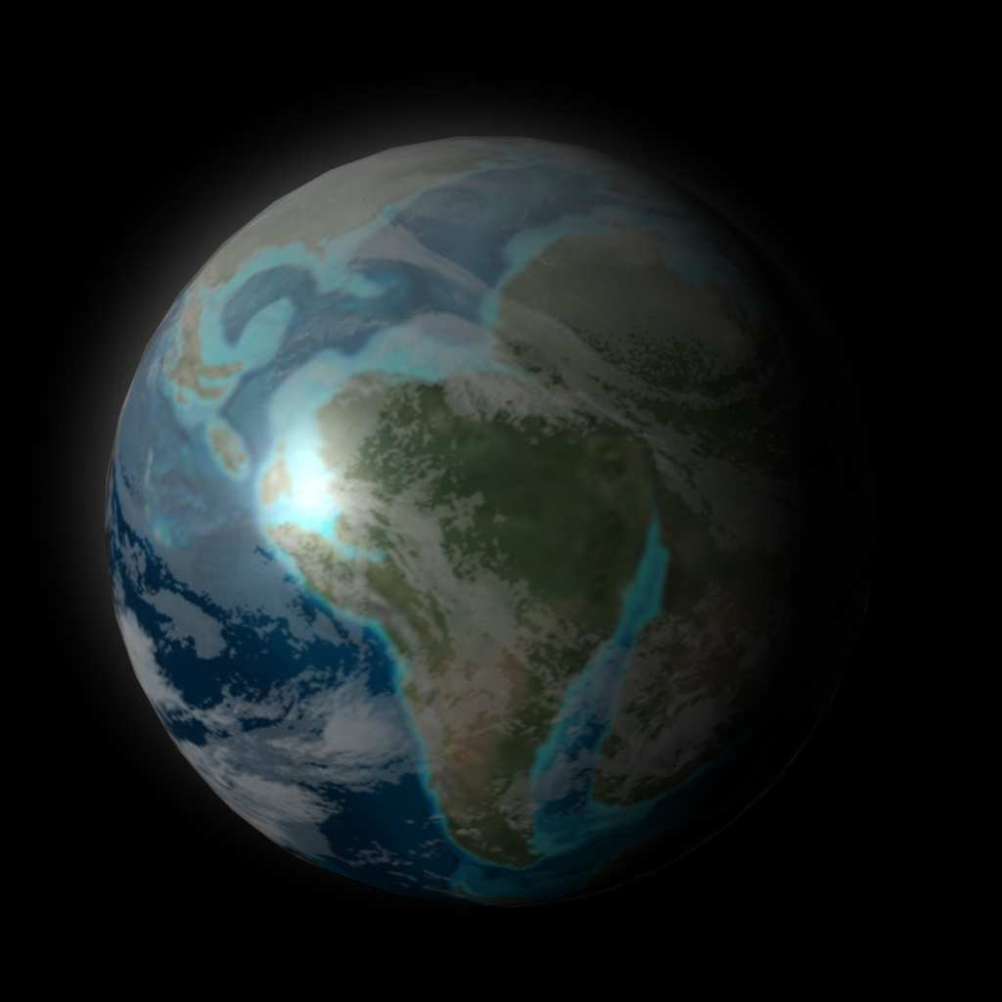
Area of Focus: Earth System History and Time.
Copyright © 2010 Ryan P. Murphy

Slide 19
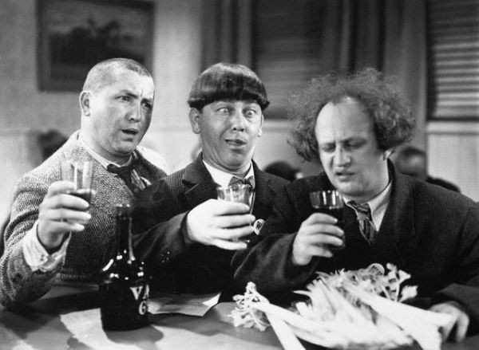
What are some things that we think of as old?
Copyright © 2010 Ryan P. Murphy

Slide 20
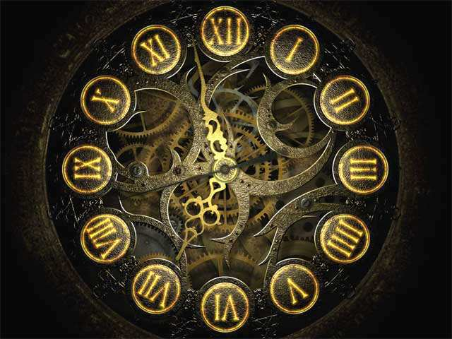
Journal Question?
  If the history of the earth from its formation 4.6 billion years ago until present was put into a 12 hour day…

Slide 21
Journal Question?
  If the history of the earth from its formation 4.6 billion years ago until present was put into a 12 hour day…
    How many hours, minutes, or seconds have humans been around?

Slide 22


Slide 23
If the entire history of the earth was a 12 hour day.

Slide 24
Earth Forms

Slide 25
Layers of the earth Form

Slide 26
Earth
Cools

Slide 27
Earth
Cools

Slide 28
Earth
Cools

Slide 29
Moon Forms

Slide 30
Earth
Cools

Slide 31
Earth

Slide 33
Earliest Crystals

Slide 34
Earliest Rocks

Slide 35
Primitive
Life Forms

Slide 44
Microbes
Begin to produce Oxygen

Slide 45
First Cells with Nucleus

Slide 46
Explosion of Ocean Life

Slide 49
Shelled creatures in oceans

Slide 52
Primitive
Fish

Slide 53
First
Insects

Slide 54
Amphibians Colonize Land

Slide 55
Age of
Amphibians

Slide 56
Age of
Reptiles

Slide 57
First Mammals

Slide 58
Dinosaurs
Dominate

Slide 59
First Flowering
Plants

Slide 60
Extinction of the
Dinosaurs

Slide 61
Age of
Mammals

Slide 62
11:59

Slide 63
11:59
Humans

Slide 64
?

Slide 65
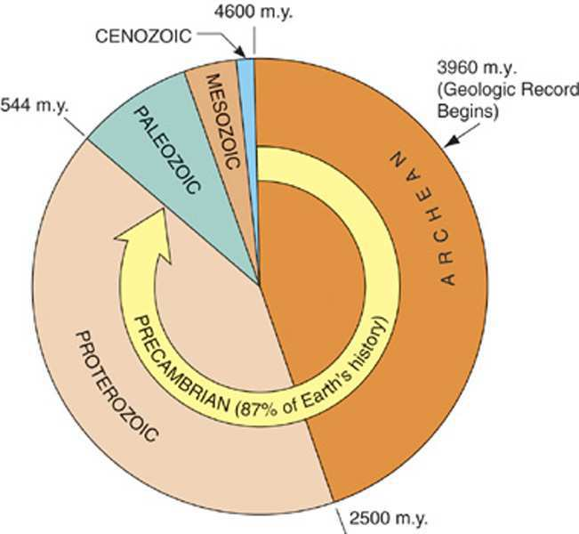
Human existence - The last few seconds of the last minute before midnight.

Slide 66
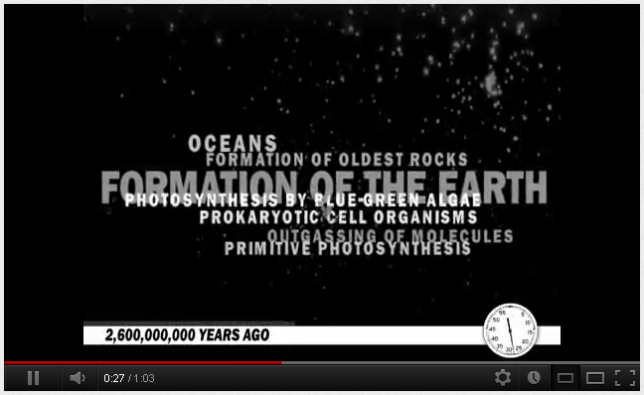
Video Link! What does this 12 hour comparison sound like in one minute.
  http://www.youtube.com/watch?v=YXSEyttblMI

Slide 67
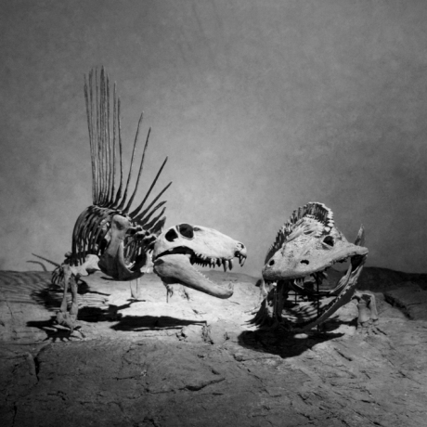
Can you say it with me?

Slide 68
Can you say it with me?
The Earth is…

Slide 69
Can you say it with me?
OLD
The Earth is…

Slide 70
Can you say it with me?
Changing
OLD
The Earth is…

Slide 71
Can you say it with me?
Changing
OLD
Cycling
The Earth is…

Slide 72
Can you say it with me?
Changing
OLD
Dangerous
Cycling
The Earth is…

Slide 73
Can you say it with me?
Changing
OLD
Dangerous
Cycling
The Earth is…
and

Slide 74
Can you say it with me?
Changing
OLD
Dangerous
Cycling
The Earth is…
and
The present holds the
Key to the past

Slide 75
Can you say it with me?
Changing
OLD
Dangerous
Cycling
What Big Idea does 4.68 Billion years represent?
The Earth is…
and
The present holds the
Key to the past

Slide 76
Can you say it with me?
Changing
OLD
The Earth is…
and
The present holds the
Key to the past

Slide 77
Can you say it with me?
Changing
OLD
The earth is very old, a lot has changed, and the processes of today happened billions of years ago.
The Earth is…
and
The present holds the
Key to the past

Slide 78
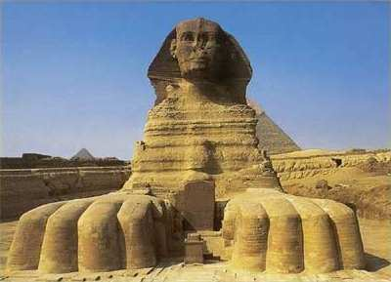
“I am only a few thousand years old.” “Incredibly young in Earth’s very long history.”

Slide 79
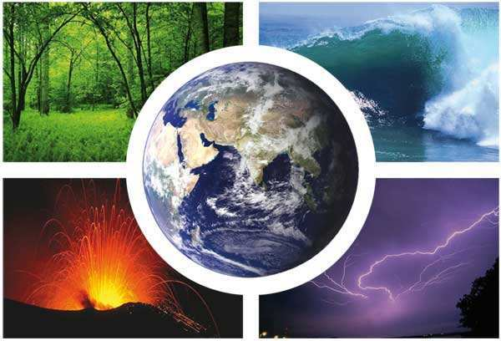
Earth system history has physical, chemical, and biological components.
Copyright © 2010 Ryan P. Murphy

Slide 80
Earth system history has physical, chemical, and biological components.
Copyright © 2010 Ryan P. Murphy

Slide 81

Earth system history has physical, chemical, and biological components.
Can you find the science teacher hero words?
Copyright © 2010 Ryan P. Murphy

Slide 82
Earth system history has physical, chemical, and biological components.
Can you find the science teacher hero words?
Copyright © 2010 Ryan P. Murphy

Slide 83
Earth system history has physical, chemical, and biological components.
Can you find the science teacher hero words?
Copyright © 2010 Ryan P. Murphy

Slide 84
Earth system history has physical, chemical, and biological components.
Can you find the science teacher hero words?
Copyright © 2010 Ryan P. Murphy

Slide 85
Earth system history has physical, chemical, and biological components.
Can you find the science teacher hero words?
Copyright © 2010 Ryan P. Murphy

Slide 86
Earth system history has physical, chemical, and biological components.
Can you find the science teacher hero words?
Copyright © 2010 Ryan P. Murphy

Slide 87
Earth system history has physical, chemical, and biological components.
System:
Copyright © 2010 Ryan P. Murphy

Slide 88
Earth system history has physical, chemical, and biological components.
System: A group of individual elements that make a whole.
Copyright © 2010 Ryan P. Murphy

Slide 89
Earth system history has physical, chemical, and biological components.
Physical:
Copyright © 2010 Ryan P. Murphy

Slide 90
Earth system history has physical, chemical, and biological components.
Physical: Laws that affect matter, energy and their interaction.
Copyright © 2010 Ryan P. Murphy

Slide 91
Earth system history has physical, chemical, and biological components.
Physical: Laws that affect matter, energy and their interaction.
-Nature and properties of non-living matter and energy.
Copyright © 2010 Ryan P. Murphy

Slide 92
Earth system history has physical, chemical, and biological components.
Physical: Laws that affect matter, energy and their interaction.
-Nature and properties of non-living matter and energy.
Copyright © 2010 Ryan P. Murphy

Slide 93
Earth system history has physical, chemical, and biological components.
Physical: Laws that affect matter, energy and their interaction.
-Nature and properties of non-living matter and energy.
- Matter:
Copyright © 2010 Ryan P. Murphy

Slide 94
Earth system history has physical, chemical, and biological components.
Physical: Laws that affect matter, energy and their interaction.
-Nature and properties of non-living matter and energy.
- Matter: Anything that has mass and takes up space.
Copyright © 2010 Ryan P. Murphy

Slide 95
Earth system history has physical, chemical, and biological components.
Chemical:
Copyright © 2010 Ryan P. Murphy

Slide 96
Earth system history has physical, chemical, and biological components.
Chemical: When a substance changes form.
-Atoms and molecules change.
Copyright © 2010 Ryan P. Murphy

Slide 97
Earth system history has physical, chemical, and biological components.
Chemical: When a substance changes form.
Copyright © 2010 Ryan P. Murphy

Slide 98
Earth system history has physical, chemical, and biological components.
Biological:
Copyright © 2010 Ryan P. Murphy

Slide 99
Earth system history has physical, chemical, and biological components.
Biological: Life and living things
Copyright © 2010 Ryan P. Murphy

Slide 100
Earth system history has physical, chemical, and biological components.
Components:
Copyright © 2010 Ryan P. Murphy

Slide 101
Earth system history has physical, chemical, and biological components.
Components: Part of something
Copyright © 2010 Ryan P. Murphy

Slide 102
Earth system history has physical, chemical, and biological components.
Summary: Earth has a group of elements working together. These elements include laws of matter, changes in atoms, and also includes living things. All of these parts working together make up earth the history of the earth.
Copyright © 2010 Ryan P. Murphy

Slide 103
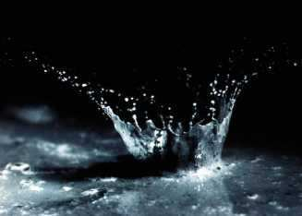
Uni for mi tar i an ism : The laws of nature have not changed over time.
Copyright © 2010 Ryan P. Murphy

Slide 104
Uni for mi tar i an ism : The laws of nature have not changed over time.
Copyright © 2010 Ryan P. Murphy

Slide 105
Uni for mi tar i an ism : The laws of nature have not changed over time.
Copyright © 2010 Ryan P. Murphy

Slide 106
Uni for mi tar i an ism : The laws of nature have not changed over time.
Copyright © 2010 Ryan P. Murphy

Slide 107
Uni for mi tar i an ism : The laws of nature have not changed over time.
Copyright © 2010 Ryan P. Murphy

Slide 108
Uni for mi tar i an ism : The laws of nature have not changed over time.
Copyright © 2010 Ryan P. Murphy

Slide 109
Uni for mi tar i an ism : The laws of nature have not changed over time.
Copyright © 2010 Ryan P. Murphy

Slide 110
Uni for mi tar i an ism : The laws of nature have not changed over time.
Copyright © 2010 Ryan P. Murphy

Slide 111
Uniformitarianism : The laws of nature have not changed over time.
Copyright © 2010 Ryan P. Murphy

Slide 112
Uniformitarianism : The laws of nature have not changed over time.
Can you say it with me…
Copyright © 2010 Ryan P. Murphy

Slide 113
Uniformitarianism : The laws of nature have not changed over time.
Can you say it with me…
The present
holds the key
to the past
Copyright © 2010 Ryan P. Murphy

Slide 114
Laws of nature:

Slide 115
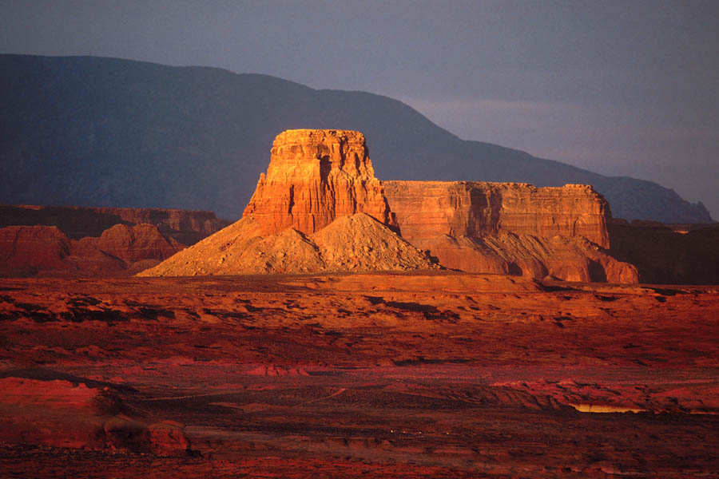
Laws of nature:
  How chemicals react?

Slide 116
Laws of nature:
  How chemicals react?
  How water erodes materials?

Slide 117
Laws of nature:
  How chemicals react?
  How water erodes materials?
  Laws of physics?

Slide 118
Laws of nature:
  How chemicals react?
  How water erodes materials?
  Laws of physics?
    These are things that don’t change. They occur today as they did Billions of years ago.

Slide 119
Evolution has also occurred during the earths long history.
  Gene Pools can change when…
  Populations can shrink
    Diseases, extinctions, introduction of new better adapted species, predators.
  Non-random mating
    Organisms choose strongest mate, ones in similar boundaries,
  Mutations in the genes
    Genes can change. Some are good, some are bad.
    The environment will decide.
  Movement in and out of the population
    Immigration, gene flow.
  Natural selection
    Adaptations to the environment that do well replace poor ones. Usually an advancement.
Study for 1 minute

Slide 120
Evolution has also occurred during the earths long history.
  Gene Pools can change when…
  Populations can shrink
    Diseases, extinctions, introduction of new better adapted species, predators.
  Non-random mating
    Organisms choose strongest mate, ones in similar boundaries,
  Mutations in the genes
    Genes can change. Some are good, some are bad.
    The environment will decide.
  Movement in and out of the population
    Immigration, gene flow.
  Natural selection
    Adaptations to the environment that do well replace poor ones. Usually an advancement.

Slide 121
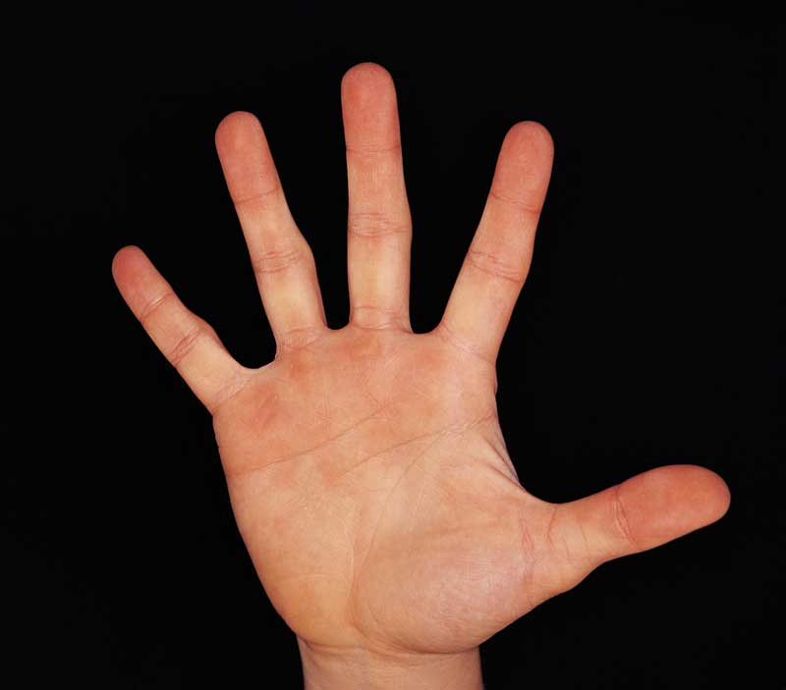

Slide 122
Evolution is the change in the gene pool overtime.
  Gene Pools can change when…
  Populations can shrink
    Diseases, extinctions, introduction of new better adapted species, predators.
  Non-random mating
    Organisms choose strongest mate, ones in similar boundaries,
  Mutations in the genes
    Genes can change. Some are good, some are bad.
    The environment will decide.
  Movement in and out of the population
    Immigration, gene flow.
  Natural selection
    Adaptations to the environment that do well replace poor ones. Usually an advancement.

Slide 123
Evolution is the change in the gene pool overtime.
  Gene Pools can change when…
  Populations can shrink
    Diseases, extinctions, introduction of new better adapted species, predators.
  Non-random mating
    Organisms choose strongest mate, ones in similar boundaries,
  Mutations in the genes
    Genes can change. Some are good, some are bad.
    The environment will decide.
  Movement in and out of the population
    Immigration, gene flow.
  Natural selection
    Adaptations to the environment that do well replace poor ones. Usually an advancement.

Slide 124
Evolution is the change in the gene pool overtime.
  Gene Pools can change when…
  Populations can shrink
    Diseases, extinctions, introduction of new better adapted species, predators.
  Non-random mating
    Organisms choose strongest mate, ones in similar boundaries,
  Mutations in the genes
    Genes can change. Some are good, some are bad.
    The environment will decide.
  Movement in and out of the population
    Immigration, gene flow.
  Natural selection
    Adaptations to the environment that do well replace poor ones. Usually an advancement.

Slide 125
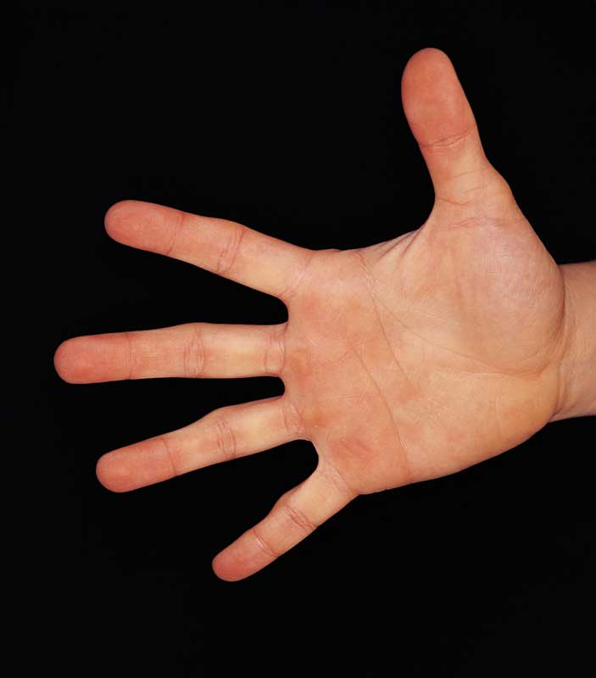
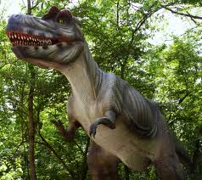

Slide 126
Evolution is the change in the gene pool overtime.
  Gene Pools can change when…
  Populations can shrink
    Diseases, extinctions, introduction of new better adapted species, predators.
  Non-random mating
    Organisms choose strongest mate, ones in similar boundaries,
  Mutations in the genes
    Genes can change. Some are good, some are bad.
    The environment will decide.
  Movement in and out of the population
    Immigration, gene flow.
  Natural selection
    Adaptations to the environment that do well replace poor ones. Usually an advancement.

Slide 127
Evolution is the change in the gene pool overtime.
  Gene Pools can change when…
  Populations can shrink
    Diseases, extinctions, introduction of new better adapted species, predators.
  Non-random mating
    Organisms choose strongest mate, ones in similar boundaries,
  Mutations in the genes
    Genes can change. Some are good, some are bad.
    The environment will decide.
  Movement in and out of the population
    Immigration, gene flow.
  Natural selection
    Adaptations to the environment that do well replace poor ones. Usually an advancement.

Slide 128
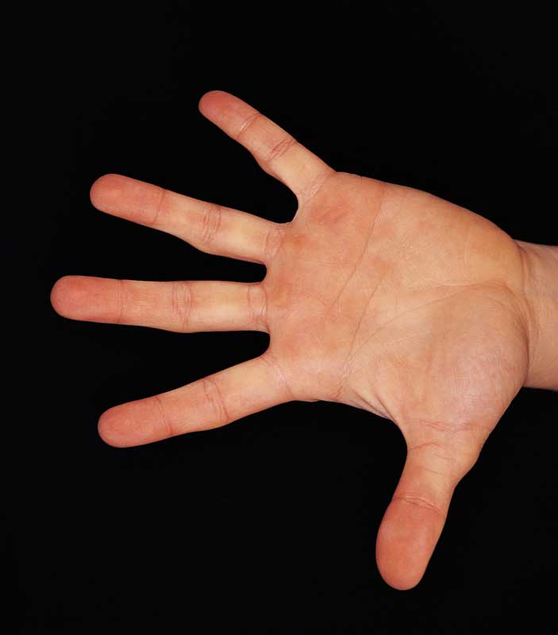
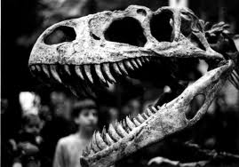

Slide 129
Evolution is the change in the gene pool overtime.
  Gene Pools can change when…
  Populations can shrink
    Diseases, extinctions, introduction of new better adapted species, predators.
  Non-random mating
    Organisms choose strongest mate, ones in similar boundaries,
  Mutations in the genes
    Genes can change. Some are good, some are bad.
    The environment will decide.
  Movement in and out of the population
    Immigration, gene flow.
  Natural selection
    Adaptations to the environment that do well replace poor ones. Usually an advancement.

Slide 130
Evolution is the change in the gene pool overtime.
  Gene Pools can change when…
  Populations can shrink
    Diseases, extinctions, introduction of new better adapted species, predators.
  Non-random mating
    Organisms choose strongest mate, ones in similar boundaries,
  Mutations in the genes
    Genes can change. Some are good, some are bad.
    The environment will decide.
  Movement in and out of the population
    Immigration, gene flow.
  Natural selection
    Adaptations to the environment that do well replace poor ones. Usually an advancement.

Slide 131
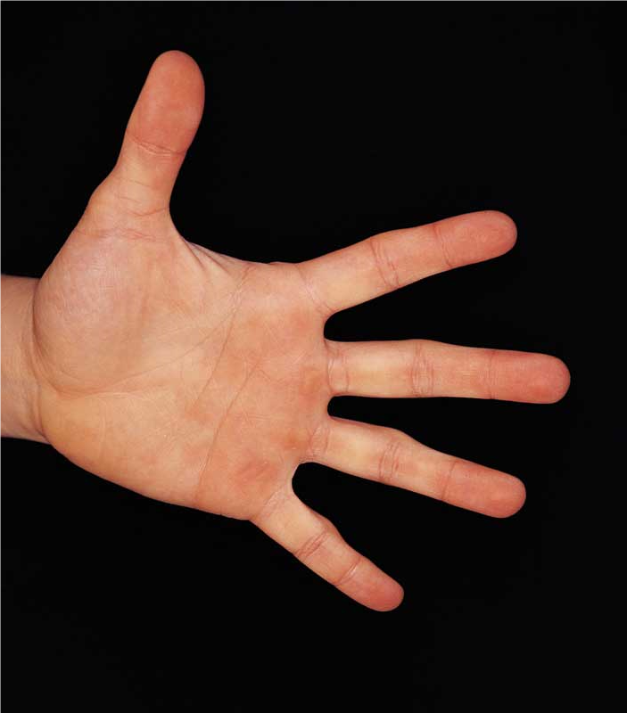
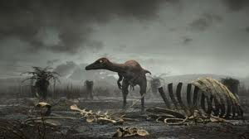

Slide 133
Evolution is the change in the gene pool overtime.
  Gene Pools can change when…
  Populations can shrink
    Diseases, extinctions, introduction of new better adapted species, predators.
  Non-random mating
    Organisms choose strongest mate, ones in similar boundaries,
  Mutations in the genes
    Genes can change. Some are good, some are bad.
    The environment will decide.
  Movement in and out of the population
    Immigration, gene flow.
  Natural selection
    Adaptations to the environment that do well replace poor ones. Usually an advancement.

Slide 134
Evolution is the change in the gene pool overtime.
  Gene Pools can change when…
  Populations can shrink
    Diseases, extinctions, introduction of new better adapted species, predators.
  Non-random mating
    Organisms choose strongest mate, ones in similar boundaries,
  Mutations in the genes
    Genes can change. Some are good, some are bad.
    The environment will decide.
  Movement in and out of the population
    Immigration, gene flow.
  Natural selection
    Adaptations to the environment that do well replace poor ones. Usually an advancement.

Slide 135
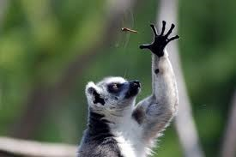

Slide 136
Evolution is the change in the gene pool overtime.
  Gene Pools can change when…
  Populations can shrink
    Diseases, extinctions, introduction of new better adapted species, predators.
  Non-random mating
    Organisms choose strongest mate, ones in similar boundaries,
  Mutations in the genes
    Genes can change. Some are good, some are bad.
    The environment will decide.
  Movement in and out of the population
    Immigration, gene flow.
  Natural selection
    Adaptations to the environment that do well replace poor ones. Usually an advancement.

Slide 137
Evolution is the change in the gene pool overtime.
  Gene Pools can change when…
  Populations can shrink
    Diseases, extinctions, introduction of new better adapted species, predators.
  Non-random mating
    Organisms choose strongest mate, ones in similar boundaries,
  Mutations in the genes
    Genes can change. Some are good, some are bad.
    The environment will decide.
  Movement in and out of the population
    Immigration, gene flow.
  Natural selection
    Adaptations to the environment that do well replace poor ones. Usually an advancement.

Slide 138
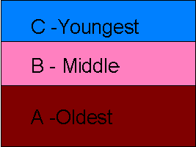
Principle of superposition: Oldest rocks and fossil are on bottom, youngest on top.

Slide 139
Principle of superposition: Oldest rocks and fossil are on bottom, youngest on top.

Slide 140
Principle of superposition: Oldest rocks and fossil are on bottom, youngest on top.

Slide 141
Principle of superposition: Oldest rocks and fossil are on bottom, youngest on top.

Slide 142
Principle of superposition: Oldest rocks and fossil are on bottom, youngest on top.

Slide 143
Principle of superposition: Oldest rocks and fossil are on bottom, youngest on top.

Slide 144
Principle of superposition: Oldest rocks and fossil are on bottom, youngest on top.

Slide 145
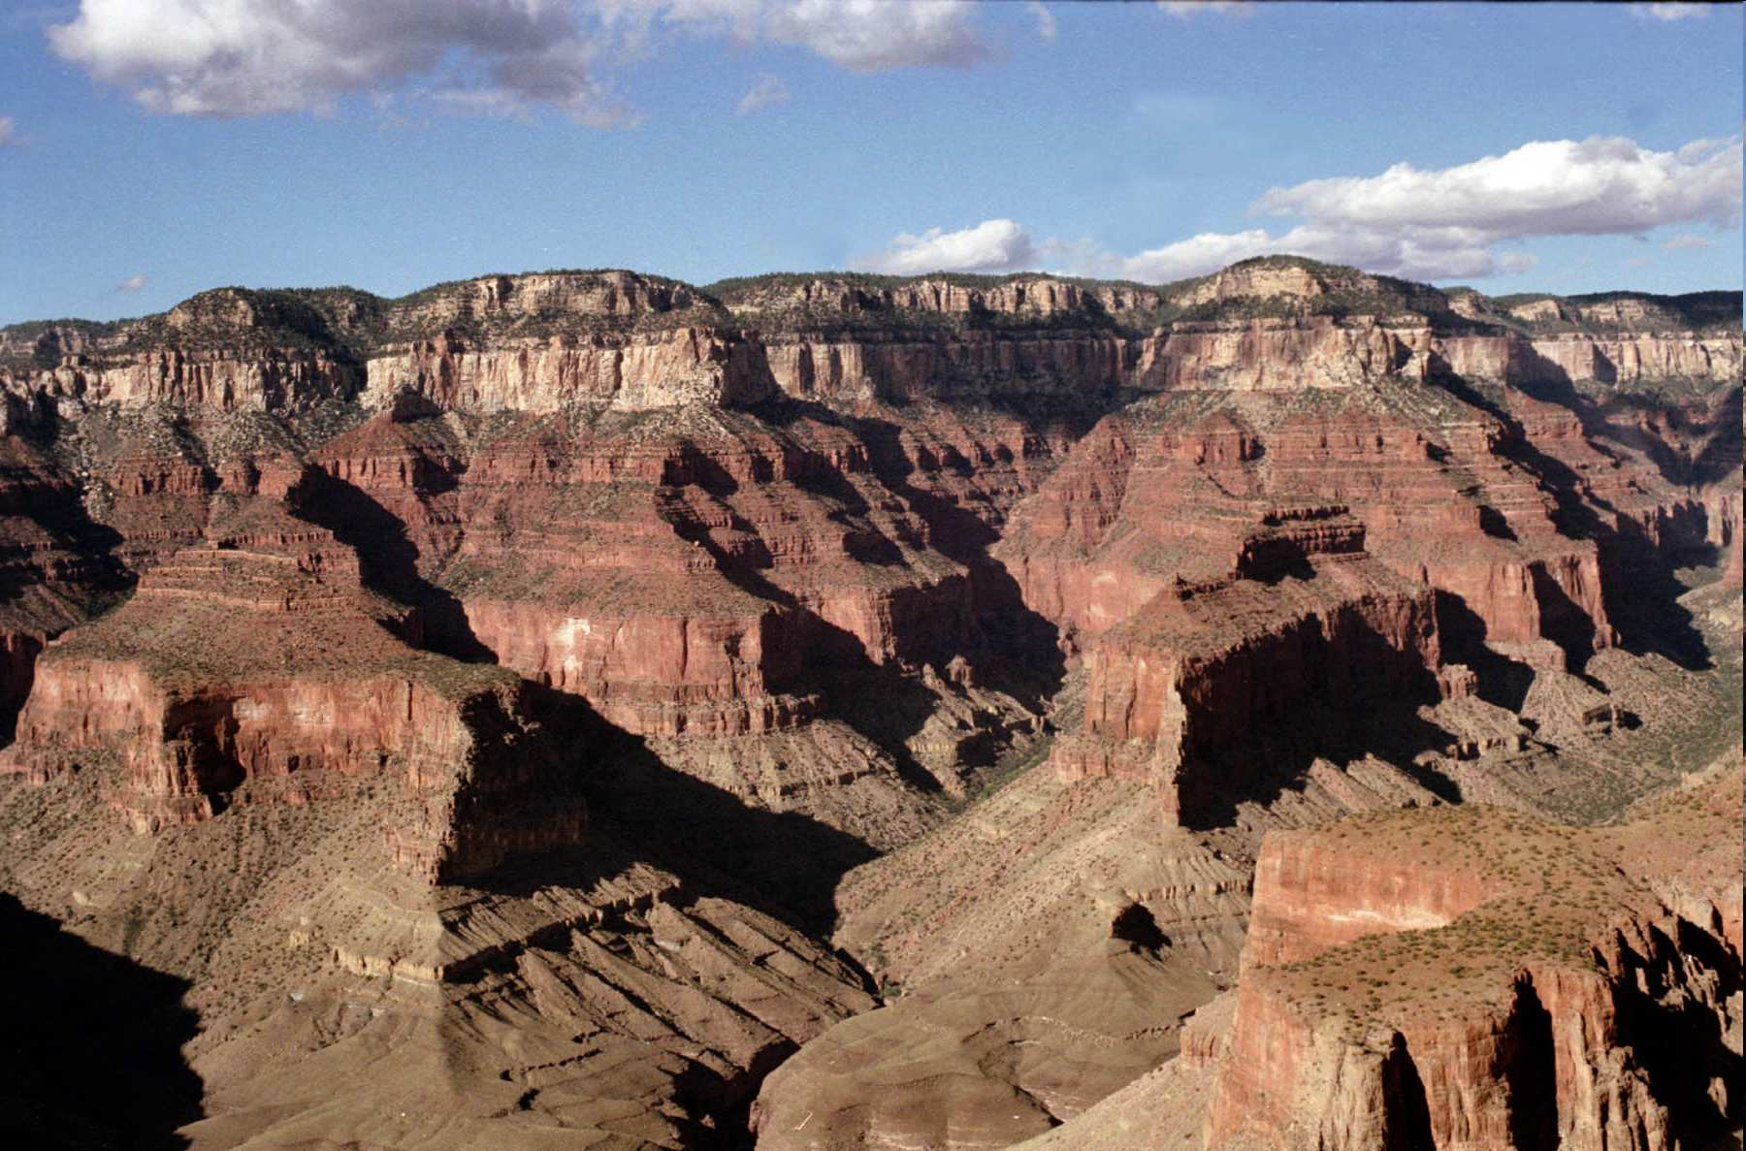

Slide 147
Oldest Rock Layers

Slide 148
Youngest Rock Layers
Oldest Rock Layers

Slide 149
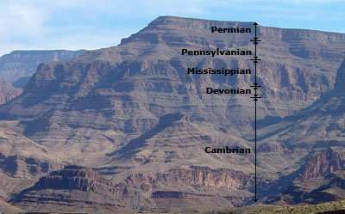
Which time period is the oldest, middle, and youngest based on the Principle of Superposition?
Copyright © 2010 Ryan P. Murphy

Slide 150
Which time period is the oldest, middle, and youngest based on the Principle of Superposition?
Oldest
Copyright © 2010 Ryan P. Murphy

Slide 151
Which time period is the oldest, middle, and youngest based on the Principle of Superposition?
Middle
Oldest
Copyright © 2010 Ryan P. Murphy

Slide 152
Which time period is the oldest, middle, and youngest based on the Principle of Superposition?
Youngest
Middle
Oldest
Copyright © 2010 Ryan P. Murphy

Slide 153
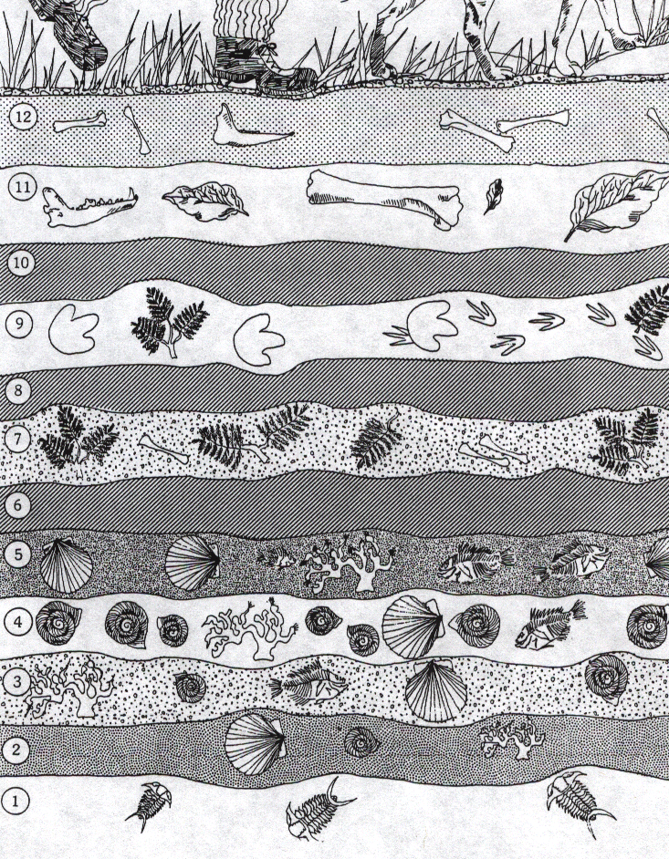
Activity! Which of the following is older based on the Principle of Superposition?
  Shells or ferns?
Copyright © 2010 Ryan P. Murphy

Slide 154
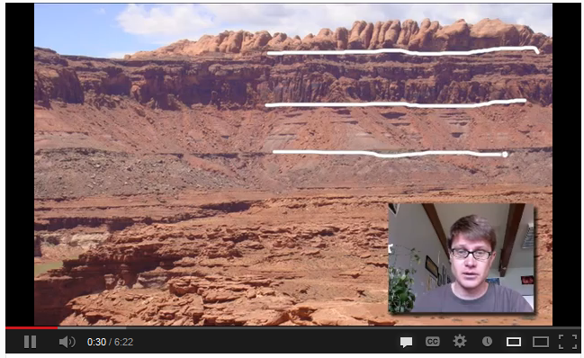
Video Link! Law of Superposition
  http://www.youtube.com/watch?v=EadTLGMu3LI
Copyright © 2010 Ryan P. Murphy

Slide 155
Activity! Which of the following is older based on the Principle of Superposition?
  Shells or ferns?
Copyright © 2010 Ryan P. Murphy

Slide 156
Activity! Which of the following is older based on the Principle of Superposition?
  Shells or ferns?
Copyright © 2010 Ryan P. Murphy

Slide 157
Answer:
  Shells
Copyright © 2010 Ryan P. Murphy

Slide 158
Which is older, Fish or Snails?
Copyright © 2010 Ryan P. Murphy

Slide 159
Which is older, Fish or Snails?
Copyright © 2010 Ryan P. Murphy

Slide 160
Which is older, Fish or Snails?
Copyright © 2010 Ryan P. Murphy

Slide 161
Which is older, Fish or Snails?
Copyright © 2010 Ryan P. Murphy

Slide 162
Which is older, Early dinosaurs or plants?
Copyright © 2010 Ryan P. Murphy

Slide 163
Which is older, Early dinosaurs or plants?
Copyright © 2010 Ryan P. Murphy

Slide 164
Which is older, Early dinosaurs or plants?
Copyright © 2010 Ryan P. Murphy

Slide 165
Which is older, Early dinosaurs or plants?
Copyright © 2010 Ryan P. Murphy

Slide 166
Which three layers of rock could have occurred after a major extinction event?
Copyright © 2010 Ryan P. Murphy

Slide 167
Which three layers of rock could have occurred after a major extinction event?
Extinction:
Copyright © 2010 Ryan P. Murphy

Slide 168
Which three layers of rock could have occurred after a major extinction event?
Extinction: No longer actively living.
Copyright © 2010 Ryan P. Murphy

Slide 169
Which three layers of rock could have occurred after a major extinction event?
Extinction: No longer actively living.
- Death of the last individual of a species.
Copyright © 2010 Ryan P. Murphy

Slide 170

Which three layers of rock could have occurred after a major extinction event?
Extinction: No longer actively living.
- Death of the last individual of a species.
Copyright © 2010 Ryan P. Murphy

Slide 171
Which three layers of rock could have occurred after a major extinction event?
Copyright © 2010 Ryan P. Murphy

Slide 172
Very few fossils in a particular rock layer may indicate an extinction event occurred just prior? Answer 10,
Copyright © 2010 Ryan P. Murphy

Slide 173
Very few fossils in a particular rock layer may indicate an extinction event occurred just prior? Answer 10, 8,
Copyright © 2010 Ryan P. Murphy

Slide 174
Very few fossils in a particular rock layer may indicate an extinction event occurred just prior? Answer 10, 8, 6
Copyright © 2010 Ryan P. Murphy

Slide 175
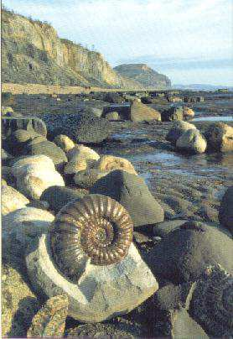
The fossil record of changes in plants and animals over millions of years.
Copyright © 2010 Ryan P. Murphy

Slide 176
The fossil record of changes in plants and animals over millions of years.
  From simple to more complicated.
Copyright © 2010 Ryan P. Murphy

Slide 177
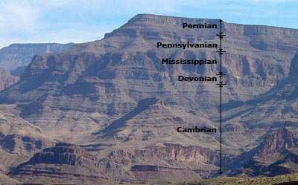
Principle of superposition. The rock layers on the bottom are older.
Copyright © 2010 Ryan P. Murphy

Slide 178
Principle of superposition. The rock layers on the bottom are older.
  More primitive creatures are seen in the older rock layers.
Copyright © 2010 Ryan P. Murphy

Slide 179
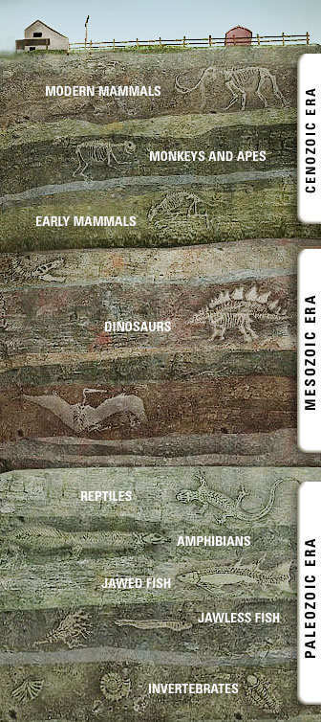
Activity! Principle of Superposition.
  Stack books one at a time.
  Teacher will place a playing card every so often into the pile. (From Complicated Top to Simple Bottom)
  Unveil the rock layers and types of cards from the most recent (top) to the oldest (bottom).
  Record a visual in journal with rocks layers and cards (fossils).
Copyright © 2010 Ryan P. Murphy

Slide 180

Simulated
Experience

Slide 181
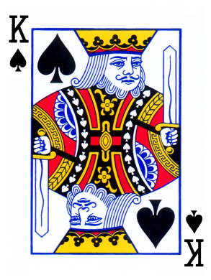



?
?
?
?
Copyright © 2010 Ryan P. Murphy

Slide 182
?
?
?
?
Copyright © 2010 Ryan P. Murphy

Slide 183
Q/J
?
?
?
Copyright © 2010 Ryan P. Murphy

Slide 184
Q/J
?
?
?
Copyright © 2010 Ryan P. Murphy

Slide 185
Q/J
10/9
?
?
Copyright © 2010 Ryan P. Murphy

Slide 186
Q/J
10/9
?
?
Copyright © 2010 Ryan P. Murphy

Slide 187
Q/J
10/9
8
?
Copyright © 2010 Ryan P. Murphy

Slide 188
Q/J
10/9
8
?
Copyright © 2010 Ryan P. Murphy

Slide 189
Q/J
10/9
8
?
Copyright © 2010 Ryan P. Murphy

Slide 190
Q/J
10/9
8
2
Copyright © 2010 Ryan P. Murphy

Slide 191
Q/J
10/9
8
2
Note: Primitive creatures can be in younger layers.
Copyright © 2010 Ryan P. Murphy

Slide 192
Not the other way around
Q/J
10/9
8
2
Note: Primitive creatures can be in younger layers.
Copyright © 2010 Ryan P. Murphy

Slide 193
Copyright © 2010 Ryan P. Murphy

Slide 194
Human remains are only found at the very top of the fossil record. We are a young species.
Copyright © 2010 Ryan P. Murphy

Slide 195
Copyright © 2010 Ryan P. Murphy

Slide 196
500 million years ago
Copyright © 2010 Ryan P. Murphy

Slide 197
Present
500 million years ago
Copyright © 2010 Ryan P. Murphy

Slide 198
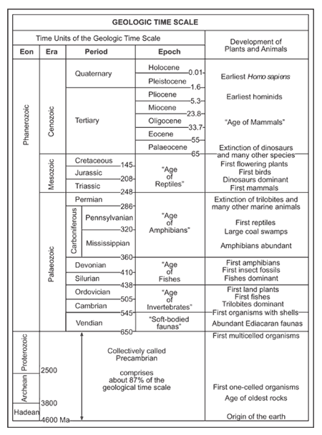
Earth’s Timeline is divided into various units of time.
Copyright © 2010 Ryan P. Murphy

Slide 199
Earth’s Timeline is divided into various units of time.
Copyright © 2010 Ryan P. Murphy

Slide 200
Earth’s Timeline is divided into various units of time.
  Eon (Longest amount of time)
Copyright © 2010 Ryan P. Murphy

Slide 201
Earth’s Timeline is divided into various units of time.
  Eon (Longest amount of time)
  Hadeon
Copyright © 2010 Ryan P. Murphy

Slide 202
Earth’s Timeline is divided into various units of time.
  Eon (Longest amount of time)
  Hadeon, Archeon
Copyright © 2010 Ryan P. Murphy

Slide 203
Earth’s Timeline is divided into various units of time.
  Eon (Longest amount of time)
  Hadeon, Archeon, Proterozoic
Copyright © 2010 Ryan P. Murphy

Slide 204
Earth’s Timeline is divided into various units of time.
  Eon (Longest amount of time)
  Hadeon, Archeon, Proterozoic
Copyright © 2010 Ryan P. Murphy

Slide 205
Earth’s Timeline is divided into various units of time.
  Eon (Longest amount of time)
  Hadeon, Archeon, Proterozoic, Phanerozoic
Copyright © 2010 Ryan P. Murphy

Slide 206
Earth’s Timeline is divided into various units of time.
  Era (Second longest unit of time)
Copyright © 2010 Ryan P. Murphy

Slide 207
Earth’s Timeline is divided into various units of time.
  Era (Second longest unit of time)
  Paleozoic,
Copyright © 2010 Ryan P. Murphy

Slide 208
Earth’s Timeline is divided into various units of time.
  Era (Second longest unit of time)
  Paleozoic, Mesozoic,
Copyright © 2010 Ryan P. Murphy

Slide 209
Earth’s Timeline is divided into various units of time.
  Era (Second longest unit of time)
  Paleozoic, Mesozoic, Cenozoic
Copyright © 2010 Ryan P. Murphy

Slide 210
Earth’s Timeline is divided into various units of time.
  Period (Third longest unit of time)
Copyright © 2010 Ryan P. Murphy

Slide 211
Earth’s Timeline is divided into various units of time.
  Period (Third longest unit of time)
Copyright © 2010 Ryan P. Murphy

Slide 212
Earth’s Timeline is divided into various units of time.
  Epoch (Shortest Unit of Geologic Time)
Copyright © 2010 Ryan P. Murphy

Slide 213
Earth’s Timeline is divided into various units of time.
  Epoch (Shortest Unit of Geologic Time)
Copyright © 2010 Ryan P. Murphy

Slide 214
What is longer, the Vendian Period or the Paleozoic Era?

Slide 215
What is longer, the Vendian Period or the Paleozoic Era?

Slide 216
What is longer, the Vendian Period or the Paleozoic Era?

Slide 217
What is longer, the Eocene Epoch or the Tertiary Period or the Paleozoic Era?

Slide 218
What is longer, the Eocene Epoch or the Tertiary Period or the Paleozoic Era?

Slide 219
What is longer, the Eocene Epoch or the Tertiary Period or the Paleozoic Era?

Slide 220
What is longer, the Mesozoic Era or the Proterozoic Eon?

Slide 221
What is longer, the Mesozoic Era or the Proterozoic Eon?

Slide 222
What is longer, the Mesozoic Era or the Proterozoic Eon?

Slide 223
The Jurassic Period belongs in what Era?

Slide 224
The Jurassic Period belongs in what Era?
Answer:
Mesozoic Era

Slide 225
The Pilocene Epoch belongs to this Period?

Slide 226
The Pliocene Epoch belongs to this Period?

Slide 227
The Pliocene Epoch belongs to this Period?
Answer:
Tertiary Period

Slide 228
The Tertiary Period belongs to this Era?

Slide 229
The Tertiary Period belongs to this Era?

Slide 230
The Tertiary Period belongs to this Era?
Answer:
Cenozoic Era

Slide 231
The Cenozoic Era belongs to this Eon?

Slide 232
The Cenozoic Era belongs to this Eon?

Slide 233
The Cenozoic Era belongs to this Eon?
Answer:
Phanerozoic Eon

Slide 234
Describe all of the units of time that the Cambrian is part of?

Slide 235
Describe all of the units of time that the Cambrian is part of?

Slide 236
Describe all of the units of time that the Cambrian is part of?
Answer:
Cambrian Period

Slide 237
Describe all of the units of time that the Cambrian is part of?
Answer:
Cambrian Period
Paleozoic Era

Slide 238
Describe all of the units of time that the Cambrian is part of?
Answer:
Cambrian Period
Paleozoic Era
Phanerozoic Eon

Slide 239
Describe all of the units of time that the Pleistocene is part of?

Slide 240
Describe all of the units of time that the Pleistocene is part of?
Pleistocene Epoch

Slide 241
Describe all of the units of time that the Pleistocene is part of?
Pleistocene Epoch
Quaternary Period

Slide 242
Describe all of the units of time that the Pleistocene is part of?
Pleistocene Epoch
Quaternary Period
Cenozoic Era

Slide 243
Describe all of the units of time that the Pleistocene is part of?
Pleistocene Epoch
Quaternary Period
Cenozoic Era
Phanerzoic Eon

Slide 244
Which time unit makes up the most of Earth’s History?

Slide 245
Which time unit makes up the most of Earth’s History?
The Precambrian Super-Eon

Slide 246
Certain events / changes on Earth mark the end of one time period, and the start of another.

Slide 247
Certain events / changes on Earth mark the end of one time period, and the start of another. Often these are extinction events.

Slide 251
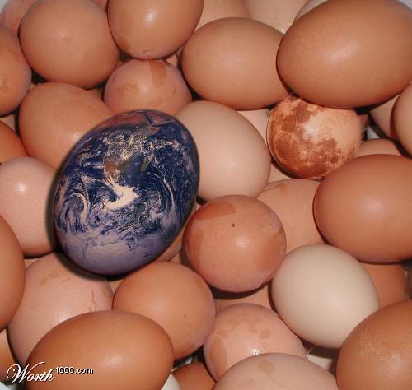
The system is fragile. Changes in living conditions for animals have been numerous throughout Earth’s history.
Copyright © 2010 Ryan P. Murphy

Slide 252
The system is fragile. Changes in living conditions for animals have been numerous throughout Earth’s history.
Copyright © 2010 Ryan P. Murphy

Slide 253
Can you say it with me?

Slide 254
Can you say it with me?
The Earth is…

Slide 255
Can you say it with me?
OLD
The Earth is…

Slide 256
Can you say it with me?
Changing
OLD
The Earth is…

Slide 257
Can you say it with me?
Changing
OLD
Cycling
The Earth is…

Slide 258
Can you say it with me?
Changing
OLD
Dangerous
Cycling
The Earth is…

Slide 259
Can you say it with me?
Changing
OLD
Dangerous
Cycling
The Earth is…
and

Slide 260
Can you say it with me?
Changing
OLD
Dangerous
Cycling
The Earth is…
and
The present holds the
Key to the past

Slide 261
Can you say it with me?
Changing
OLD
Dangerous
Cycling
The Earth is a fragile system that has…
The Earth is…
and
The present holds the
Key to the past

Slide 262
Can you say it with me?
Changing
Dangerous
The Earth is…
The earth has changed many times and most species go extinct.

Slide 263
Are you ready for the scary piece of knowledge on the next slide.

Slide 264

Are you ready for the scary piece of knowledge on the next slide.

Slide 265
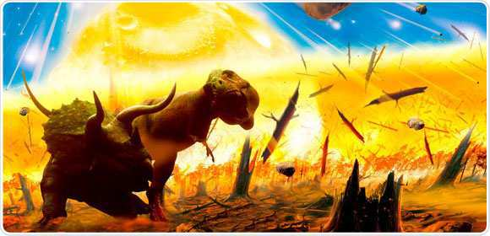
99.5% of all things that have ever lived have become extinct.
Copyright © 2010 Ryan P. Murphy

Slide 266
99.5% of all things that have ever lived have become extinct.
Copyright © 2010 Ryan P. Murphy

Slide 267
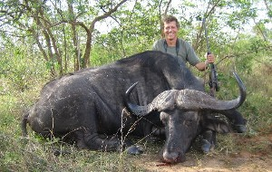

Slide 268
Top Predator

Slide 269
Top Predator
Those at the top of
the food chain are
also the most vulnerable
to extinction events.

Slide 270
Top Predator
Those at the top of
the food chain are
also the most vulnerable
to extinction events.

Slide 271
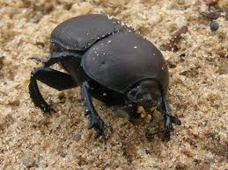

Slide 272
Can survive…

Slide 273
Can survive…
Extreme droughts.

Slide 274
Can survive…
Extreme droughts.
Extreme temperature
changes

Slide 275
Can survive…
Extreme droughts.
Extreme temperature
changes
long periods
without food

Slide 276
Can survive…
Extreme droughts.
Extreme temperature
changes
long periods
without food
Can lay thousands
of eggs…

Slide 277
Can survive…
Extreme droughts.
Extreme temperature
changes
That can survive for long periods of time through drought and extreme temperature changes.
long periods
without food
Can lay thousands
of eggs…

Slide 280
Most vulnerable
to extinction

Slide 281
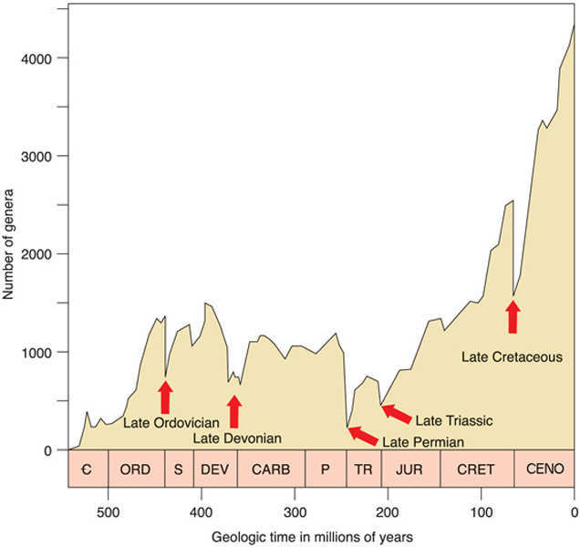
Where are the extinction events below?

Slide 282


Slide 283
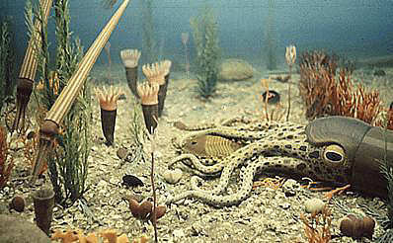

Slide 289
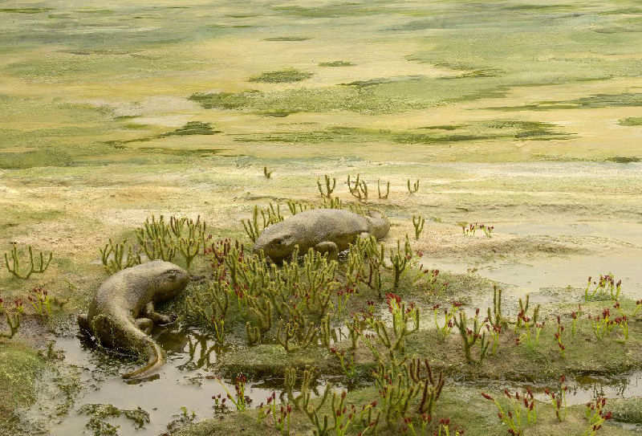

Slide 295
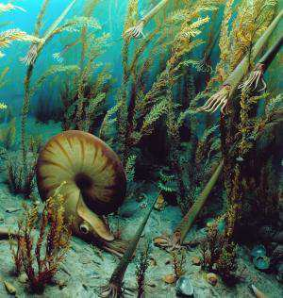

Slide 301
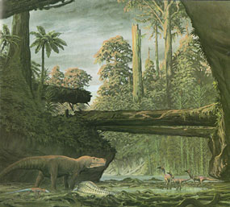

Slide 308
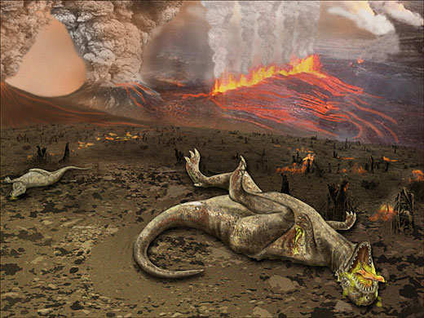
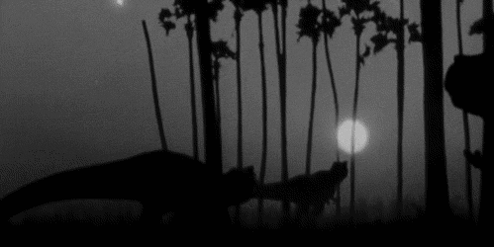

Slide 314
“I’m waiting.”
“99.5%”

Slide 315
“I’m waiting.”
“99.5%”
Learn more at
http://www.bbc.co.uk/nature/history_of_the_earth

Slide 316
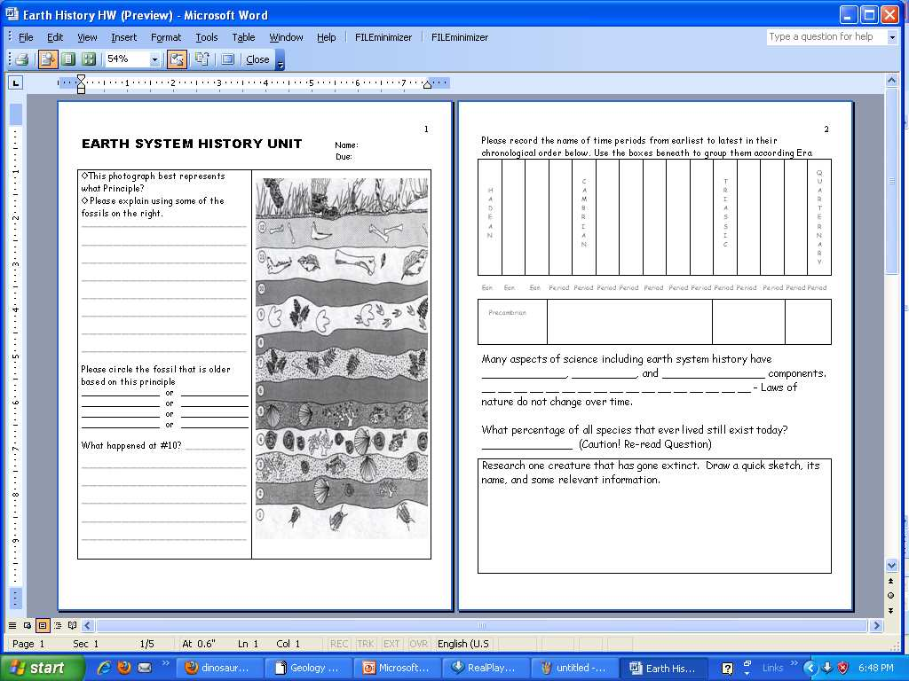
You should be close to page 3 of your Earth System History homework.

Slide 317
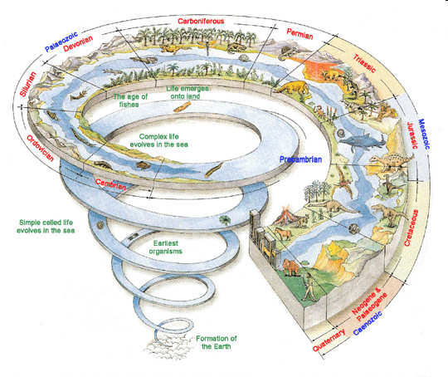

Activity! Timeline
  Please jot down pictures, descriptions, and words in all of the these time periods as they are covered.
Copyright © 2010 Ryan P. Murphy

Slide 318
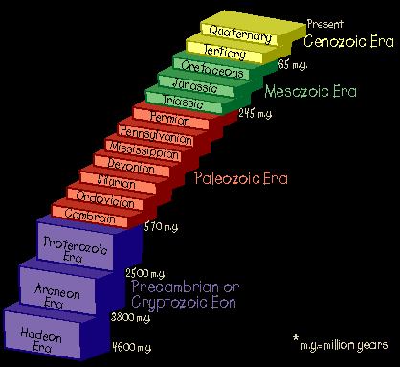

Slide 322

Activity! Making a timeline of Earth’s long history on a paper roll.

Slide 323
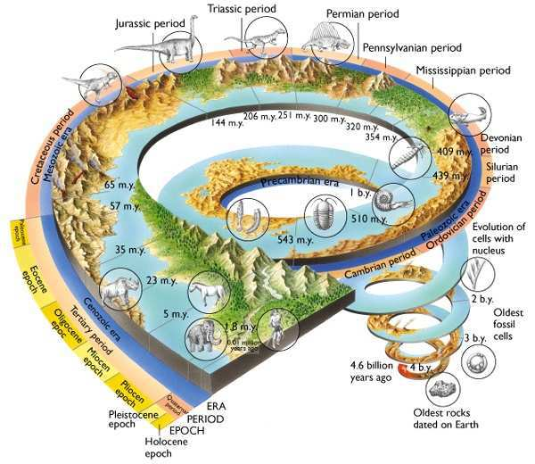
Activity: Making a timeline of Earth System History.
  http://serc.carleton.edu/quantskills/activities/calculatortape.html

Slide 324
4.56 meters

Slide 325
Start 4.65 b.y.a
4.56 meters

Slide 326
Start 4.65 b.y.a
Mark each meter from start.
4.56 meters

Slide 327
Start 4.65 b.y.a
Mark each meter from start.
4.56 meters

Slide 328
Start 4.65 b.y.a
Mark each meter from start.
4.56 meters

Slide 329
Start 4.65 b.y.a
Mark each meter from start.
4.56 meters
1 b.y.
2 b.y.
3 b.y.
4 b.y.
.56 b.y.

Slide 330
Start 4.65 b.y.a
Mark 500 m.y. every 50 cm
4.56 meters
500 m.y.
500 m.y
1 b.y.
2 b.y.
3 b.y.
4 b.y.
.56 b.y.

Slide 331
End of Preview
Hundreds of more
slides, activities,
video links,
homework, notes,
and much more
on the full version.

Slide 332
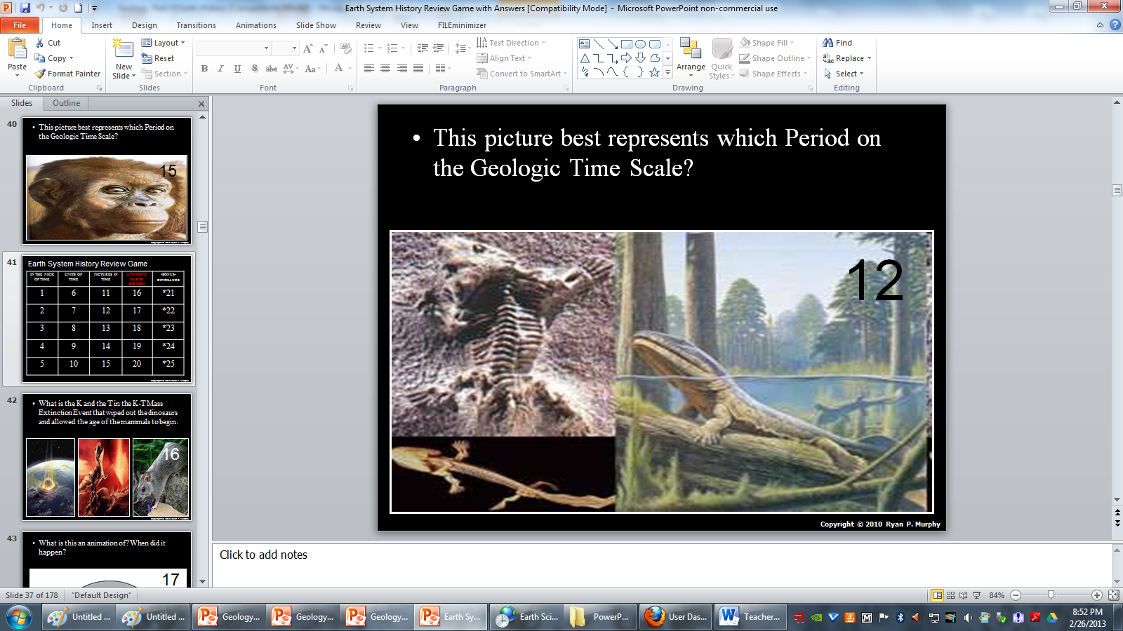
Earth System History Review Game
STUDY
Bring in your timeline sheet

Slide 333
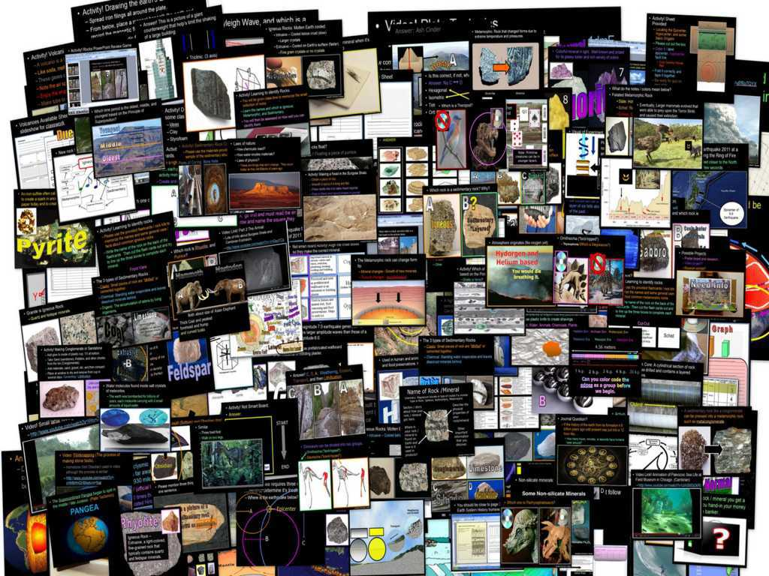
Geology Topics Unit

Slide 334
Geology Topics Unit
Areas of Focus within The Geology Topics Unit:
Plate Tectonics, Evidence for Plate Tectonics, Pangea, Energy Waves, Layers of the earth, Heat Transfer, Types of Crust, Plate Boundaries, Hot Spots, Volcanoes, Positives and Negatives of Volcanoes, Types of Volcanoes, Parts of a Volcano, Magma, Types of Lava, Viscosity, Earthquakes, Faults, Folds, Seismograph, Richter Scale, Seismograph, Tsunami’s, Rocks, Minerals, Crystals, Uses of Minerals, Types of
Crystals, Physical Properties of Minerals, Rock Cycle, CommonIgneous Rocks, Common Sedimentary Rocks, Common Metamorphic Rocks.
http://sciencepowerpoint.com/Geology_Unit.html

Slide 335
This was a very brief 5 mb tour. Please visit the links below to learn more about each of the units in this curriculum package.
  These units take me about four years to complete with my students in grades 5-10.
Earth Science Units | Extended Tour Link and Curriculum Guide
Geology Topics Unit | http://sciencepowerpoint.com/Geology_Unit.html
Astronomy Topics Unit | http://sciencepowerpoint.com/Astronomy_Unit.html
Weather and Climate Unit | http://sciencepowerpoint.com/Weather_Climate_Unit.html
Soil Science, Weathering, More | http://sciencepowerpoint.com/Soil_and_Glaciers_Unit.html
Water Unit | http://sciencepowerpoint.com/Water_Molecule_Unit.html
Rivers Unit | http://sciencepowerpoint.com/River_and_Water_Quality_Unit.html
= Easier = More Difficult = Most Difficult
5th – 7th grade 6th – 8th grade 8th – 10th grade

Slide 336
Physical Science Units | Extended Tour Link and Curriculum Guide
Science Skills Unit | http://sciencepowerpoint.com/Science_Introduction_Lab_Safety_Metric_Methods.html
Motion and Machines Unit | http://sciencepowerpoint.com/Newtons_Laws_Motion_Machines_Unit.html
Matter, Energy, Envs. Unit | http://sciencepowerpoint.com/Energy_Topics_Unit.html
Atoms and Periodic Table Unit | http://sciencepowerpoint.com/Atoms_Periodic_Table_of_Elements_Unit.html
Life Science Units | Extended Tour Link and Curriculum Guide
Human Body / Health Topics | http://sciencepowerpoint.com/Human_Body_Systems_and_Health_Topics_Unit.html
DNA and Genetics Unit | http://sciencepowerpoint.com/DNA_Genetics_Unit.html
Cell Biology Unit | http://sciencepowerpoint.com/Cellular_Biology_Unit.html
Infectious Diseases Unit | http://sciencepowerpoint.com/Infectious_Diseases_Unit.html
Taxonomy and Classification Unit | http://sciencepowerpoint.com/Taxonomy_Classification_Unit.html
Evolution / Natural Selection Unit | http://sciencepowerpoint.com/Evolution_Natural_Selection_Unit.html
Botany Topics Unit | http://sciencepowerpoint.com/Plant_Botany_Unit.html
Ecology Feeding Levels Unit | http://sciencepowerpoint.com/Ecology_Feeding_Levels_Unit.htm
Ecology Interactions Unit | http://sciencepowerpoint.com/Ecology_Interactions_Unit.html
Ecology Abiotic Factors Unit | http://sciencepowerpoint.com/Ecology_Abiotic_Factors_Unit.html

Slide 337

More Units Available at…
Earth Science: The Soil Science and Glaciers Unit, The Geology Topics Unit, The Astronomy Topics Unit, The Weather and Climate Unit, and The River Unit, The Water Molecule Unit.
Physical Science: The Laws of Motion and Machines Unit, The Atoms and Periodic Table Unit, The Energy and the Environment Unit, and The Introduction to Science / Metric Unit.
Life Science: The Diseases and Cells Unit, The DNA and Genetics Unit, The Life Topics Unit, The Plant Unit, The Taxonomy and Classification Unit, Ecology: Feeding Levels Unit, Ecology: Interactions Unit, Ecology: Abiotic Factors, The Evolution and Natural Selection Unit and The Human Body and Health Topics Unit.
Copyright © 2010 Ryan P. Murphy

Slide 338
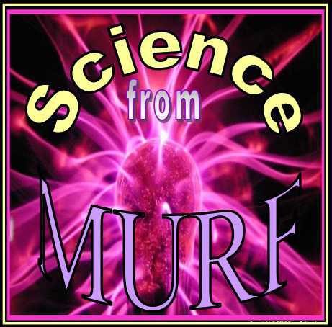
The entire four year curriculum can be found at... http://sciencepowerpoint.com/ Please feel free to contact me with any questions you may have. Thank you for your interest in this curriculum.
Sincerely,
Ryan Murphy M.Ed
www.sciencepowerpoint@gmail.com

