Slide 1
Cellular Organelles PowerPoint Review Game
NUKEM | I’M LOST | LAYERS OF EVIDENCE | ALL EQUAL | -BONUS- MAZES
1 | 6 | 11 | 16 | *21
2 | 7 | 12 | 17 | *22
3 | 8 | 13 | 18 | *23
4 | 9 | 14 | 19 | *24
5 | 10 | 15 | 20 | *25
Copyright © 2010 Ryan P. Murphy

Slide 2
How to play…
  Don’t play like Jeo_ _ _ _ y.
  Class should be divided into several small groups.
  Groups should use science journal (red slide notes), homework, and other available materials to assist you.
  Groups can communicate quietly with each other but no sharing answers between groups.
    Practice quietly communicating right now?
    Practice Communication Question:
    Your group gets to order one pizza and you can have two toppings. What does your group want?

Slide 3

Questions 1-20 = 5pts Each
Final Category (Bonus) = 1pt Each
Final Questions = 5 pt wager
If you wager 5 on the last question and get it wrong you lose 5 pts. Wager 5 and get it right you get 5 pts.
Find the Owl =
Secretly write “Owl” in the correct box worth 1pt.
“I’ll be about this big.”

Slide 4
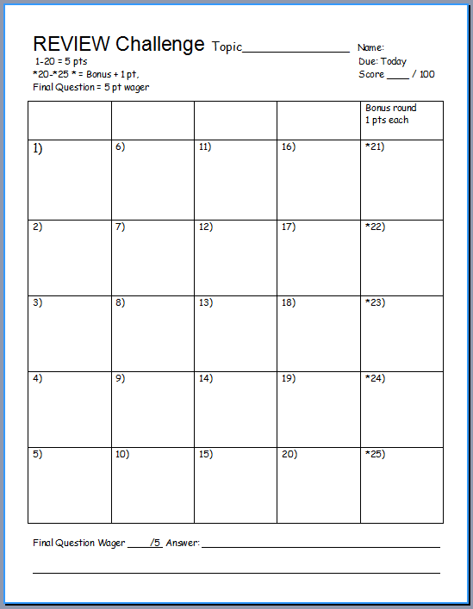
Is your name on the review sheet?
Name

Slide 5
Is your name on the review sheet?
Add the categories
along the top
on the next slide.

Slide 6
Cellular Organelles PowerPoint Review Game
NUKEM | I’M LOST | LAYERS OF EVIDENCE | ALL EQUAL | -BONUS- MAZES
1 | 6 | 11 | 16 | *21
2 | 7 | 12 | 17 | *22
3 | 8 | 13 | 18 | *23
4 | 9 | 14 | 19 | *24
5 | 10 | 15 | 20 | *25
Copyright © 2010 Ryan P. Murphy

Slide 7
Cellular Organelles PowerPoint Review Game
NUKEM | I’M LOST | LAYERS OF EVIDENCE | ALL EQUAL | -BONUS- MAZES
1 | 6 | 11 | 16 | *21
2 | 7 | 12 | 17 | *22
3 | 8 | 13 | 18 | *23
4 | 9 | 14 | 19 | *24
5 | 10 | 15 | 20 | *25
Copyright © 2010 Ryan P. Murphy

Slide 8
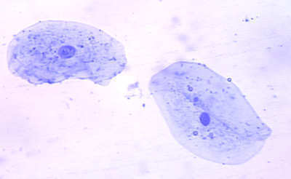
This is the largest organelle in the cell?
1

Slide 9
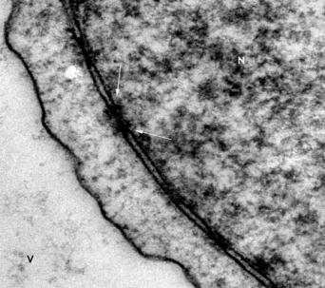
Name these openings.
2

Slide 10
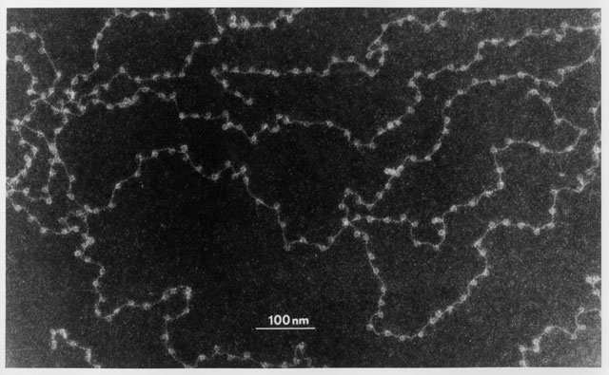
This genetic molecule is contained in the nucleus?
3

Slide 11
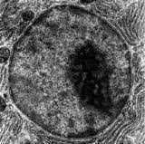
This important organelle is a…
  Round dark spot in center of nucleus
  Only visible when cell is not dividing
  Contains RNA for protein manufacturing
  Makes ribosomes that travel out of nucleus.
4

Slide 12
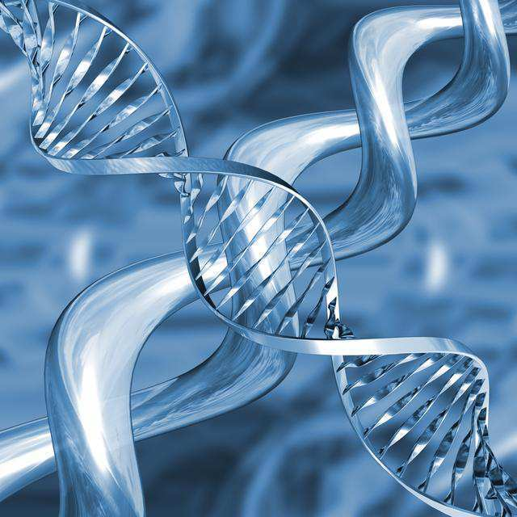
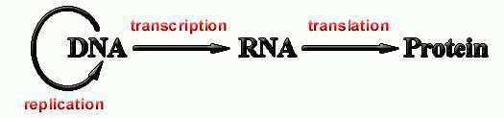
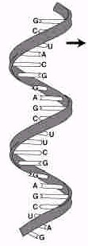

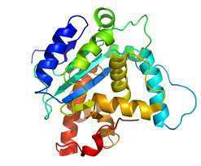
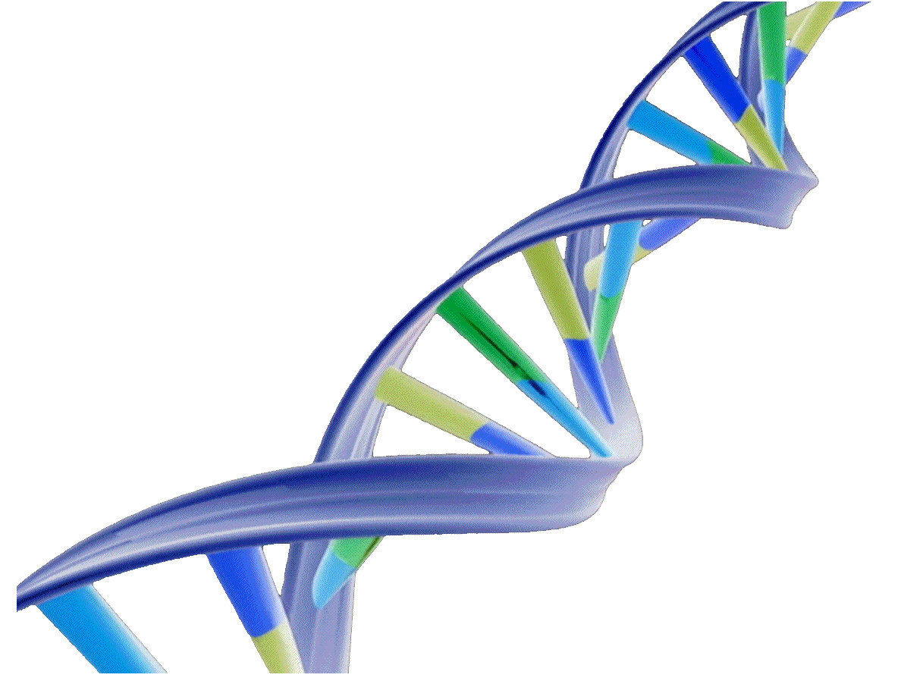
A
B
C
.
Ribosomes
Nuclear
Membrane
Name A, B, and C?
5
Copyright © 2010 Ryan P. Murphy

Slide 13
Cellular Organelles PowerPoint Review Game
NUKEM | I’M LOST | LAYERS OF EVIDENCE | ALL EQUAL | -BONUS- MAZES
1 | 6 | 11 | 16 | *21
2 | 7 | 12 | 17 | *22
3 | 8 | 13 | 18 | *23
4 | 9 | 14 | 19 | *24
5 | 10 | 15 | 20 | *25
Copyright © 2010 Ryan P. Murphy

Slide 14
Cellular Organelles PowerPoint Review Game
NUKEM | I’M LOST | LAYERS OF EVIDENCE | ALL EQUAL | -BONUS- MAZES
1 | 6 | 11 | 16 | *21
2 | 7 | 12 | 17 | *22
3 | 8 | 13 | 18 | *23
4 | 9 | 14 | 19 | *24
5 | 10 | 15 | 20 | *25
Copyright © 2010 Ryan P. Murphy

Slide 15
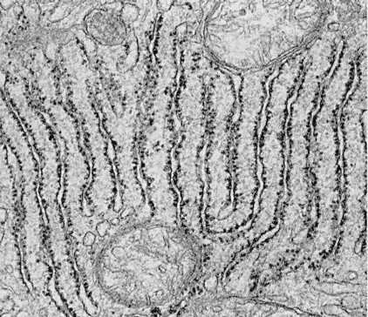
Name this organelle which is a series of folded membranes and site for protein synthesis?
6

Slide 16
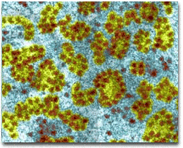
These very numerous and small organelles are mini protein synthesizing factories?
7

Slide 17
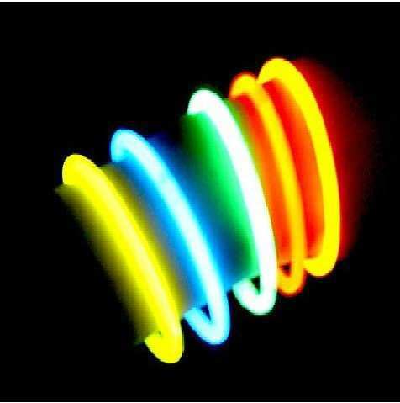
Name each of the boxes on the next slide when they light up.

Slide 18


Amino Acid
Protein
B
A
tRNA
codon
C
A
U
C
mRNA
G
D
Ribosome

Slide 19
Amino Acid
Protein
B
A
tRNA
This is what is produced?
codon
C
A
U
C
mRNA
G
D
Ribosome

Slide 20
Amino Acid
Protein
B
A
tRNA
Small molecule in cells that carries amino acids?
codon
C
A
U
C
mRNA
G
D
Ribosome

Slide 21
Amino Acid
Protein
B
A
tRNA
Molecule that conveys genetic information from DNA?
codon
C
A
U
C
mRNA
G
D
Ribosome

Slide 22
Amino Acid
Protein
B
A
tRNA
Protein synthesizers of the cell?
codon
C
A
U
C
mRNA
G
D
Ribosome

Slide 23
Amino Acid
Protein
B
A
tRNA
codon
C
A
U
C
mRNA
G
D
Ribosome

Slide 24
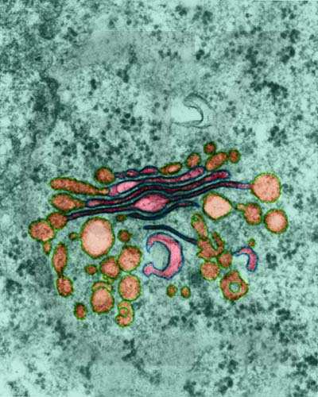
This organelle packages and transports proteins and other macromolecules?
9

Slide 25
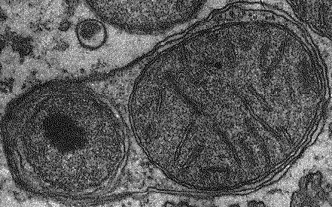
These have digestive enzymes to recycle cell parts and break down molecules?
10

Slide 26
Cellular Organelles PowerPoint Review Game
NUKEM | I’M LOST | LAYERS OF EVIDENCE | ALL EQUAL | -BONUS- MAZES
1 | 6 | 11 | 16 | *21
2 | 7 | 12 | 17 | *22
3 | 8 | 13 | 18 | *23
4 | 9 | 14 | 19 | *24
5 | 10 | 15 | 20 | *25
Copyright © 2010 Ryan P. Murphy

Slide 27
Cellular Organelles PowerPoint Review Game
NUKEM | I’M LOST | LAYERS OF EVIDENCE | ALL EQUAL | -BONUS- MAZES
1 | 6 | 11 | 16 | *21
2 | 7 | 12 | 17 | *22
3 | 8 | 13 | 18 | *23
4 | 9 | 14 | 19 | *24
5 | 10 | 15 | 20 | *25
Copyright © 2010 Ryan P. Murphy

Slide 28

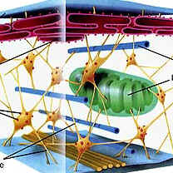
Which letter is which fiber?
  Microfilaments (thin fibers)
  Intermediate filaments (medium sized)
  Microtubules (Large hollow cylinders)
B
C
A

Slide 29
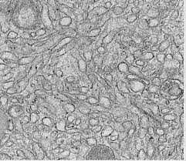
12
Which is not true of the Smooth E.R.
  A.) Makes lipids (fats) and steriods.
  B.) Makes RNA.
  C.) Synthesizes sugars “Gluconeogenesis”
  D.) Detoxifies drugs
  E.) Stores important enzymes

Slide 30
12
Which is not true of the Smooth E.R.
  A.) Makes lipids (fats) and steriods.
  B.) Makes RNA.
  C.) Synthesizes sugars “Gluconeogenesis”
  D.) Detoxifies drugs
  E.) Stores important enzymes

Slide 31
12
Which is not true of the Smooth E.R.
  A.) Makes lipids (fats) and steriods.
  B.) Makes RNA.
  C.) Synthesizes sugars “Gluconeogenesis”
  D.) Detoxifies drugs
  E.) Stores important enzymes

Slide 32
12
Which is not true of the Smooth E.R.
  A.) Makes lipids (fats) and steriods.
  B.) Makes RNA.
  C.) Synthesizes sugars “Gluconeogenesis”
  D.) Detoxifies drugs
  E.) Stores important enzymes

Slide 33
12
Which is not true of the Smooth E.R.
  A.) Makes lipids (fats) and steriods.
  B.) Makes RNA.
  C.) Synthesizes sugars “Gluconeogenesis”
  D.) Detoxifies drugs
  E.) Stores important enzymes

Slide 34
12
Which is not true of the Smooth E.R.
  A.) Makes lipids (fats) and steriods.
  B.) Makes RNA.
  C.) Synthesizes sugars “Gluconeogenesis”
  D.) Detoxifies drugs
  E.) Stores important enzymes

Slide 35
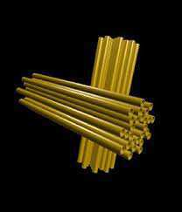
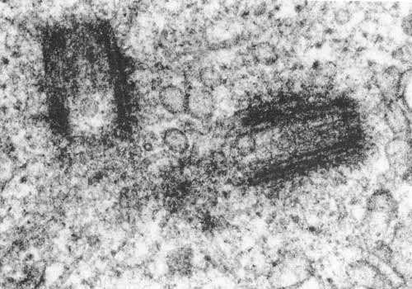
Centrioles
  Look like golden nuggets (Paired)
  Made of nine tubes
  Aid in cell division (Mitosis)
13

Slide 36
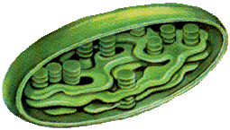
This organelle is found in plant cells and turns water, carbon dioxide and light energy into sugar?
14

Slide 37

Which of the following equations is the correct equation for photosynthesis?
A) 6O2 + 6H2O + light energy = C12H6O6 + 6O2
B) 6CO2 + 6H2O + sugar = C6H12O6 + 6O2
C) 6CO2 + 6O2 + light energy = C6H12O6 + 6H2O
D) 6CO2 + 6H2O + light energy = C6H12O6 + 6O2
E) 6CO2 + H2O + light energy = C6H12O6 + 6O2
F) 6CO2 + 6H2O + light energy = C6H2O6 + 6O2
G) 6CO2 + 6H2O + sugar = C6H12O6 + 6O2
H) 6CO2 + 6H2O + light energy = C6H12O3 + 6O2
I) 6CO2 + 6H2O + light energy = C6H12O6 + 6CO2
J) C6H12O6 = 6CO2 + 6H2O + light energy + 6O2
Copyright © 2010 Ryan P. Murphy

Slide 38
Cellular Organelles PowerPoint Review Game
NUKEM | I’M LOST | LAYERS OF EVIDENCE | ALL EQUAL | -BONUS- MAZES
1 | 6 | 11 | 16 | *21
2 | 7 | 12 | 17 | *22
3 | 8 | 13 | 18 | *23
4 | 9 | 14 | 19 | *24
5 | 10 | 15 | 20 | *25
Copyright © 2010 Ryan P. Murphy

Slide 39
Cellular Organelles PowerPoint Review Game
NUKEM | I’M LOST | LAYERS OF EVIDENCE | ALL EQUAL | -BONUS- MAZES
1 | 6 | 11 | 16 | *21
2 | 7 | 12 | 17 | *22
3 | 8 | 13 | 18 | *23
4 | 9 | 14 | 19 | *24
5 | 10 | 15 | 20 | *25
Copyright © 2010 Ryan P. Murphy

Slide 40
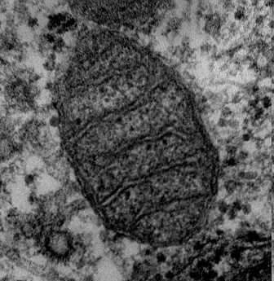
This organelle uses sugar and oxygen to make energy?
16
15

Slide 41

Which of the following equations is the correct one for the respiration equation?
A) C6H12O6 + 6H2O = Released energy + 6CO2 + 6H2O.
B) C6H12O6 + 6O2 = Released energy + 6CO2 + 6H2O.
C) C6H12O6 + 6O2 = Released energy + 6O2 + 6H2O.
D) C12H6O6 + 6O2 = Released energy + 6CO2 + 6H2O.
E) C6H12O6 + 6CO2 = Released energy + 6O2 + 6H2O.
F) C6H12O6 + 6CO2 = Released energy + 6CO2 + 6H2O.
G) C6H12O6 + 6O2 = Released energy + 6CO2 + 62O.
H) C6H12O6 + 6O2 = Light Energy + 6CO2 + 6H2O.
I) C6H12O6 + 6O2 = Released energy + 6O2 + 6H2O.
J) C6H12O8 + 6O2 = Released energy + 6CO2 + 6H2O.
K) C6H12O6 + 16O2 = Released energy + 6O2 + 6H2O.
L) Released energy + 6CO2 + 6H2O C6H12O6 + 6O2 = ☺
Copyright © 2010 Ryan P. Murphy

Slide 42
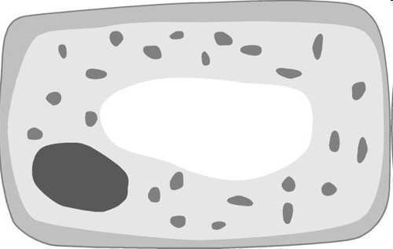

This is a membrane-bound sac for storage, digestion, and waste removal.
18

Slide 43
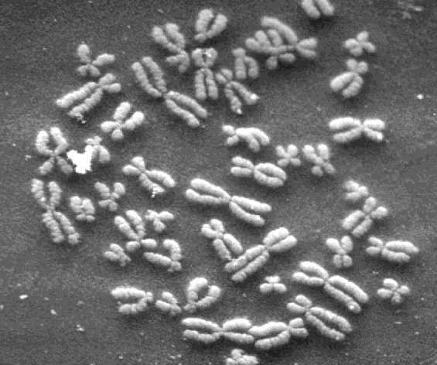
These form when the nucleus disappears and the cell is going to divide?
19

Slide 44
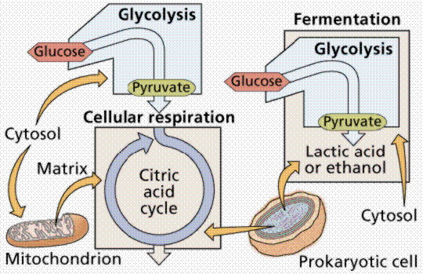
Name this processes whereby certain organisms obtain energy from organic molecules.
  Occurs in the folds of the Mitochondria
20
Copyright © 2010 Ryan P. Murphy

Slide 45
Cellular Organelles PowerPoint Review Game
NUKEM | I’M LOST | LAYERS OF EVIDENCE | ALL EQUAL | -BONUS- MAZES
1 | 6 | 11 | 16 | *21
2 | 7 | 12 | 17 | *22
3 | 8 | 13 | 18 | *23
4 | 9 | 14 | 19 | *24
5 | 10 | 15 | 20 | *25
Copyright © 2010 Ryan P. Murphy

Slide 46
Cellular Organelles PowerPoint Review Game
NUKEM | I’M LOST | LAYERS OF EVIDENCE | ALL EQUAL | -BONUS- MAZES
1 | 6 | 11 | 16 | *21
2 | 7 | 12 | 17 | *22
3 | 8 | 13 | 18 | *23
4 | 9 | 14 | 19 | *24
5 | 10 | 15 | 20 | *25
Copyright © 2010 Ryan P. Murphy

Slide 47
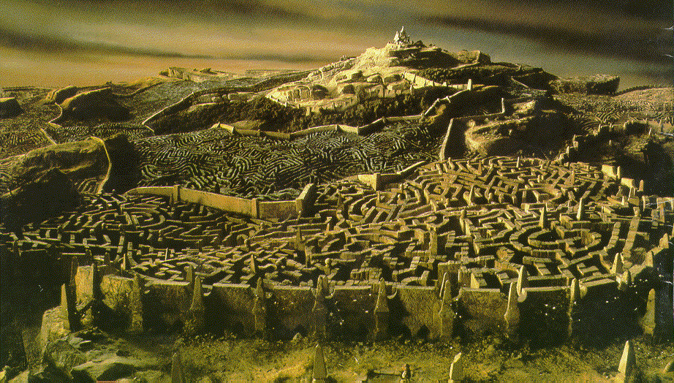

Name this maze movie like the Endoplasmic reticulum?
*21

Slide 48

What movie has this maze?
*22

Slide 49
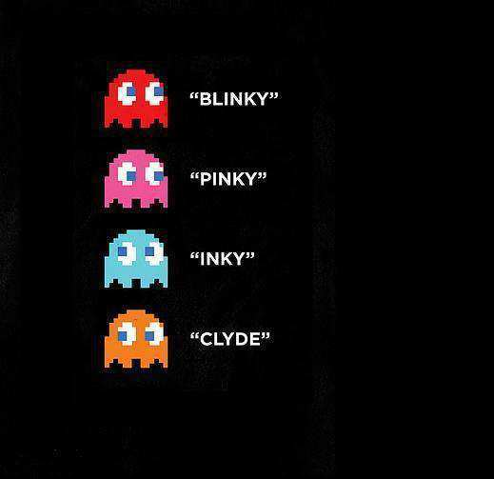

*23
Name the ghosts below?

Slide 50


*24

Slide 51
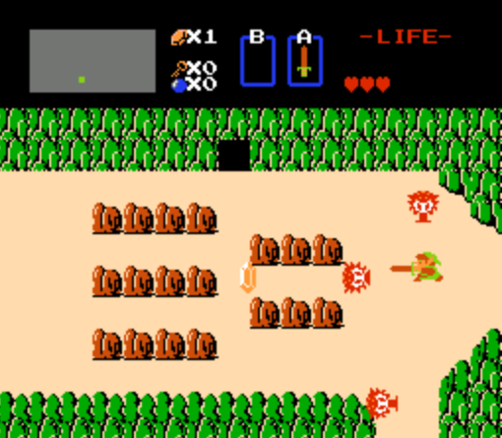
*25

Slide 52
Cellular Organelles PowerPoint Review Game
NUKEM | I’M LOST | LAYERS OF EVIDENCE | ALL EQUAL | -BONUS- MAZES
1 | 6 | 11 | 16 | *21
2 | 7 | 12 | 17 | *22
3 | 8 | 13 | 18 | *23
4 | 9 | 14 | 19 | *24
5 | 10 | 15 | 20 | *25
Final Question
Copyright © 2010 Ryan P. Murphy

Slide 53
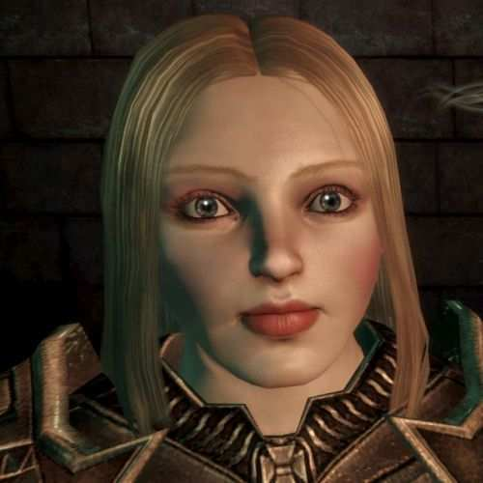
5 point wager question

Slide 54
5 point wager question

Slide 55
5 point wager question

Slide 56
5 point wager question
Name all 5

Slide 57
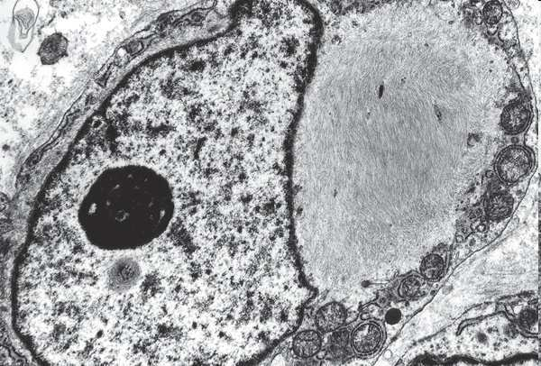
A
C
Nuclear
Membrane
Plasma Membrane
Nucleus
D
E
Cytoplasm
Nuclear Pores
B

Slide 58
Answer Key

Slide 59
Cellular Organelles PowerPoint Review Game
NUKEM | I’M LOST | LAYERS OF EVIDENCE | ALL EQUAL | -BONUS- MAZES
1 | 6 | 11 | 16 | *21
2 | 7 | 12 | 17 | *22
3 | 8 | 13 | 18 | *23
4 | 9 | 14 | 19 | *24
5 | 10 | 15 | 20 | *25
Copyright © 2010 Ryan P. Murphy

Slide 60
Cellular Organelles PowerPoint Review Game
NUKEM | I’M LOST | LAYERS OF EVIDENCE | ALL EQUAL | -BONUS- MAZES
1 | 6 | 11 | 16 | *21
2 | 7 | 12 | 17 | *22
3 | 8 | 13 | 18 | *23
4 | 9 | 14 | 19 | *24
5 | 10 | 15 | 20 | *25
Copyright © 2010 Ryan P. Murphy

Slide 61
This is the largest organelle in the cell?
1

Slide 62
This is the largest organelle in the cell?
1
and the answer is…

Slide 63
This is the largest organelle in the cell?
1
The Nucleus
and the answer is…

Slide 64
Name these openings.
2

Slide 65
Name these openings.
and the answer is…
2

Slide 66
Name these openings.
and the answer is…
2
Nuclear Pores /
Openings

Slide 67
This genetic molecule is contained in the nucleus?
3

Slide 68
This genetic molecule is contained in the nucleus?
3
and the answer is…

Slide 69
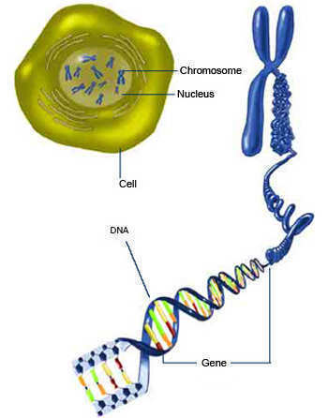
This genetic molecule is contained in the nucleus?
3
DNA / Chromatin
and the answer is…

Slide 70
This important organelle is a…
  Round dark spot in center of nucleus
  Only visible when cell is not dividing
  Contains RNA for protein manufacturing
  Makes ribosomes that travel out of nucleus.
4

Slide 71
This important organelle is a…
  Round dark spot in center of nucleus
  Only visible when cell is not dividing
  Contains RNA for protein manufacturing
  Makes ribosomes that travel out of nucleus.
4
and the answer is..

Slide 72
This important organelle is a…
  Round dark spot in center of nucleus
  Only visible when cell is not dividing
  Contains RNA for protein manufacturing
  Makes ribosomes that travel out of nucleus.
4
The Nucleolus
and the answer is..

Slide 73
A
B
C
.
Ribosomes
Nuclear
Membrane
Name A, B, and C?
5
Copyright © 2010 Ryan P. Murphy

Slide 74
A
B
C
.
Ribosomes
Nuclear
Membrane
Name A, B, and C?
5
Copyright © 2010 Ryan P. Murphy

Slide 75
A
B
C
.
Ribosomes
Nuclear
Membrane
Name A, B, and C?
5
Copyright © 2010 Ryan P. Murphy

Slide 76
A
B
C
.
Ribosomes
Nuclear
Membrane
Name A, B, and C?
5
Copyright © 2010 Ryan P. Murphy

Slide 77
A
B
C
.
Ribosomes
Nuclear
Membrane
Name A, B, and C?
5
Copyright © 2010 Ryan P. Murphy

Slide 78
A
B
C
.
Ribosomes
Nuclear
Membrane
Name A, B, and C?
5
Copyright © 2010 Ryan P. Murphy

Slide 79
A
B
C
.
Ribosomes
Nuclear
Membrane
Name A, B, and C?
5
Copyright © 2010 Ryan P. Murphy

Slide 80

A
B
C
.
Ribosomes
Nuclear
Membrane
Name A, B, and C?
5
Copyright © 2010 Ryan P. Murphy

Slide 81
A
B
C
.
Ribosomes
Nuclear
Membrane
Name A, B, and C?
5
Copyright © 2010 Ryan P. Murphy

Slide 82
Cellular Organelles PowerPoint Review Game
NUKEM | I’M LOST | LAYERS OF EVIDENCE | ALL EQUAL | -BONUS- MAZES
1 | 6 | 11 | 16 | *21
2 | 7 | 12 | 17 | *22
3 | 8 | 13 | 18 | *23
4 | 9 | 14 | 19 | *24
5 | 10 | 15 | 20 | *25
Copyright © 2010 Ryan P. Murphy

Slide 83
Cellular Organelles PowerPoint Review Game
NUKEM | I’M LOST | LAYERS OF EVIDENCE | ALL EQUAL | -BONUS- MAZES
1 | 6 | 11 | 16 | *21
2 | 7 | 12 | 17 | *22
3 | 8 | 13 | 18 | *23
4 | 9 | 14 | 19 | *24
5 | 10 | 15 | 20 | *25
Copyright © 2010 Ryan P. Murphy

Slide 84
Name this organelle which is a series of folded membranes and site for protein synthesis?
6

Slide 85
Name this organelle which is a series of folded membranes and site for protein synthesis?
6
and the answer is…

Slide 86
Name this organelle which is a series of folded membranes and site for protein synthesis?
6
Rough Endoplasmic Reticulum
and the answer is…

Slide 87
Name this organelle which is a series of folded membranes and site for protein synthesis?
6
Rough Endoplasmic Reticulum
F
F
F
and the answer is…

Slide 88
Name this organelle which is a series of folded membranes and site for protein synthesis?
6
Rough Endoplasmic Reticulum
Form
F
F
and the answer is…

Slide 89
Name this organelle which is a series of folded membranes and site for protein synthesis?
6
Rough Endoplasmic Reticulum
Form
Follows
F
and the answer is…

Slide 90
Name this organelle which is a series of folded membranes and site for protein synthesis?
6
Rough Endoplasmic Reticulum
Form
Follows
Function
and the answer is…

Slide 91
These very numerous and small organelles are mini protein synthesizing factories?
7

Slide 92
These very numerous and small organelles are mini protein synthesizing factories?
7
and the answer is…

Slide 93
These very numerous and small organelles are mini protein synthesizing factories?
7
Ribosomes
and the answer is…

Slide 94
Name each of the boxes on the next slide when they light up.

Slide 95
Amino Acid
Protein
B
A
tRNA
codon
C
A
U
C
mRNA
G
D
Ribosome

Slide 96
Amino Acid
Protein
B
A
tRNA
This is what is produced?
codon
C
A
U
C
mRNA
G
D
Ribosome

Slide 97
Amino Acid
Protein
B
A
tRNA
codon
C
A
U
C
mRNA
G
D
Ribosome

Slide 98
Amino Acid
Protein
B
A
tRNA
Small molecule in cells that carries amino acids?
codon
C
A
U
C
mRNA
G
D
Ribosome

Slide 99
Amino Acid
Protein
B
A
tRNA
Small molecule in cells that carries amino acids?
codon
C
A
U
C
mRNA
G
D
Ribosome

Slide 100
Amino Acid
Protein
B
A
tRNA
Molecule that conveys genetic information from DNA?
codon
C
A
U
C
mRNA
G
D
Ribosome

Slide 101
Amino Acid
Protein
B
A
tRNA
Molecule that conveys genetic information from DNA?
codon
C
A
U
C
mRNA
G
D
Ribosome

Slide 102
Amino Acid
Protein
B
A
tRNA
Protein synthesizers of the cell?
codon
C
A
U
C
mRNA
G
D
Ribosome

Slide 103
Amino Acid
Protein
B
A
tRNA
Protein synthesizers of the cell?
codon
C
A
U
C
mRNA
G
D
Ribosome

Slide 104
Amino Acid
Protein
B
A
tRNA
codon
C
A
U
C
mRNA
G
D
Ribosome

Slide 105
This organelle packages and transports proteins and other macromolecules?
9

Slide 106
This organelle packages and transports proteins and other macromolecules?
Golgi Apparatus
9

Slide 107
End of Preview
Hundreds of more slides,
activities, video links,
homework package, lesson
notes, review games,
rubrics, and much more
on the full version of this unit
and larger curriculum.

Slide 108
The Cellular Biology Unit Includes….
3 Part 2,200 slide PowerPoint roadmap
11 page bundled homework package that chronologically follows the PowerPoint slideshow. Modified version and answer keys provided.
16 pages of unit notes that follow slideshow for students who require assistance and support professionals.
3 PowerPoint review games with answers.
Available worksheets that follow slideshow, built-in quizzes, video links, rubrics, curriculum guide, and much more included.
file:///C:/Yahoo%20SiteBuilder/sites/sciencepowerpoint.com/sitebuilder/preview/Cellular_Biology_Unit.html

Slide 109
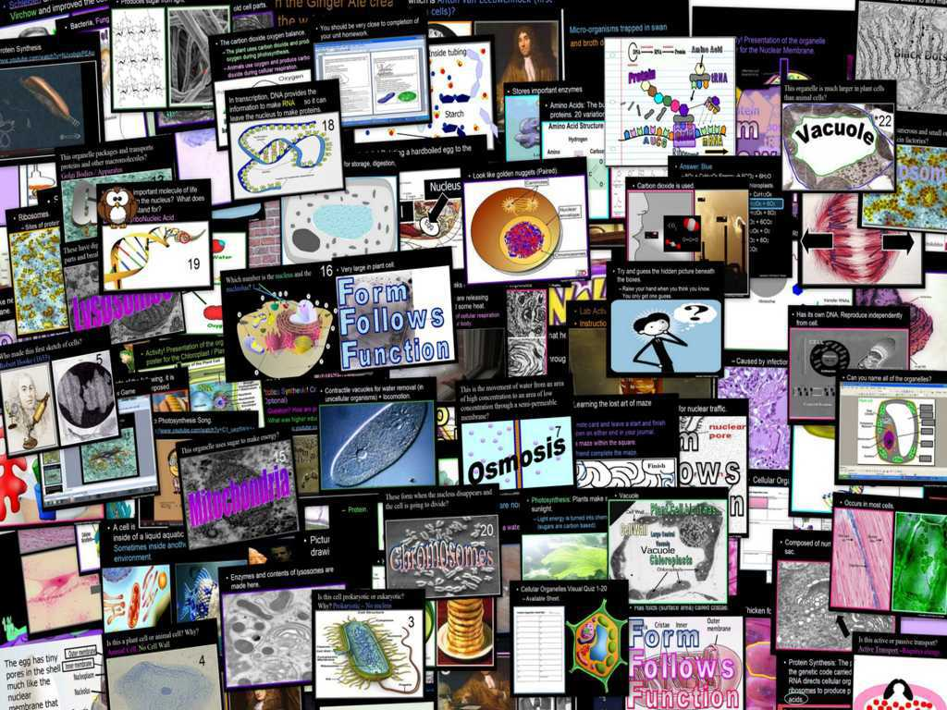
Cellular Biology Unit

Slide 110
Cellular Biology Unit
Areas of Focus within the Cellular Biology Unit
What is SPONCH?, Biologically Important Molecules, % of SPONCH in Living Things, What does it mean to be living?, Characteristics of Living Things, Needs of Living Things, Cellular Biology, History of Cellular Biology, Modern Cell Theory, Types of Cells, Prokaryotic Cells, Eukaryotic Cells, Cellular Organelles, Cell Wall, Plasma Membrane, Passive Transport, Diffusion, Osmosis, Active Transport, The Nucleus, Chromatin / Chromosomes, Nucleolus, Nuclear Membrane, Rough Endoplasmic Reticulum, Smooth Endoplasmic Reticulum, Ribosomes, Protein Synthesis, Golgi Apparatus, Lysosomes, Cytoskeleton / Mictrotubules / Microfilaments, Centrioles, Plastid, Mitochondria, Vacuoles, Organelles by real images, and much more.
http://sciencepowerpoint.com/Cellular_Biology_Unit.html

Slide 111

More Units Available at…
Earth Science: The Soil Science and Glaciers Unit, The Geology Topics Unit, The Astronomy Topics Unit, The Weather and Climate Unit, and The River Unit, The Water Molecule Unit.
Physical Science: The Laws of Motion and Machines Unit, The Atoms and Periodic Table Unit, The Energy and the Environment Unit, and The Introduction to Science / Metric Unit.
Life Science: The Infectious Diseases Unit, The Cellular Biology Unit, The DNA and Genetics Unit, The Plant Unit, The Taxonomy and Classification Unit, Ecology: Feeding Levels Unit, Ecology: Interactions Unit, Ecology: Abiotic Factors, The Evolution and Natural Selection Unit and the Human Body System and Health Topics Unit.
Copyright © 2010 Ryan P. Murphy

Slide 112

The entire four year curriculum can be found at... http://sciencepowerpoint.com/ Please feel free to contact me with any questions you may have. Thank you for your interest in this curriculum.
Sincerely,
Ryan Murphy M.Ed
www.sciencepowerpoint@gmail.com

