Slide 1
Cellular Biology Review Game
INSIDE AND OUT | INSANE IN THE MEMBRANE | UNCOMMON SOLUTIONS | BIG- GULP | -BONUS- SOLUTION FLICKS
1 | 6 | 11 | 16 | *21
2 | 7 | 12 | 17 | *22
3 | 8 | 13 | 18 | *23
4 | 9 | 14 | 19 | *24
5 | 10 | 15 | 20 | *25
Copyright © 2010 Ryan P. Murphy

Slide 2
How to play…
  Don’t play like Jeo_ _ _ _ y.
  Class should be divided into several small groups.
  Groups should use science journal (red slide notes), homework, and other available materials to assist you.
  Groups can communicate quietly with each other but no sharing answers between groups.
    Practice quietly communicating right now?
    Practice Communication Question:
    Your group gets to order one pizza and you can have two toppings. What does your group want?

Slide 3

Questions 1-20 = 5pts Each
Final Category (Bonus) = 1pt Each
Final Questions = 5 pt wager
If you wager 5 on the last question and get it wrong you lose 5 pts. Wager 5 and get it right you get 5 pts.
Find the Owl =
Secretly write “Owl” in the correct box worth 1pt.
“I’ll be about this big.”

Slide 4

Is your name on the review sheet?
Name

Slide 5
Is your name on the review sheet?
Add the categories
along the top
on the next slide.

Slide 6
Cellular Biology Review Game
INSIDE AND OUT | INSANE IN THE MEMBRANE | UNCOMMON SOLUTIONS | BIG- GULP | -BONUS- SOLUTION FLICKS
1 | 6 | 11 | 16 | *21
2 | 7 | 12 | 17 | *22
3 | 8 | 13 | 18 | *23
4 | 9 | 14 | 19 | *24
5 | 10 | 15 | 20 | *25
Copyright © 2010 Ryan P. Murphy

Slide 7
Cellular Biology Review Game
INSIDE AND OUT | INSANE IN THE MEMBRANE | UNCOMMON SOLUTIONS | BIG- GULP | -BONUS- SOLUTION FLICKS
1 | 6 | 11 | 16 | *21
2 | 7 | 12 | 17 | *22
3 | 8 | 13 | 18 | *23
4 | 9 | 14 | 19 | *24
5 | 10 | 15 | 20 | *25
Copyright © 2010 Ryan P. Murphy

Slide 8
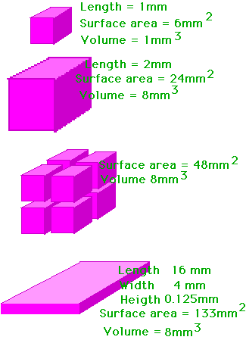
Which letter represents the shape of a typical cell? Why in two words?
A
1
B
C
D
Copyright © 2010 Ryan P. Murphy

Slide 9

2
This is the rich chemical fluid that helps breakdown molecules for use.
  Moves materials through cell (food and waste)

Slide 10
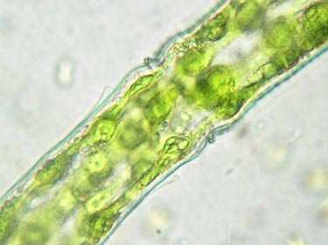
Name this cellular organelle?
3

Slide 11
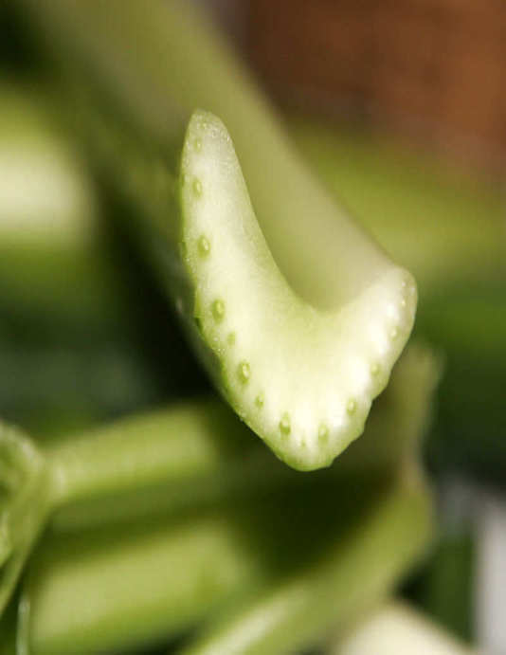
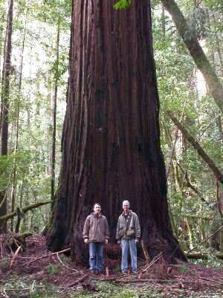
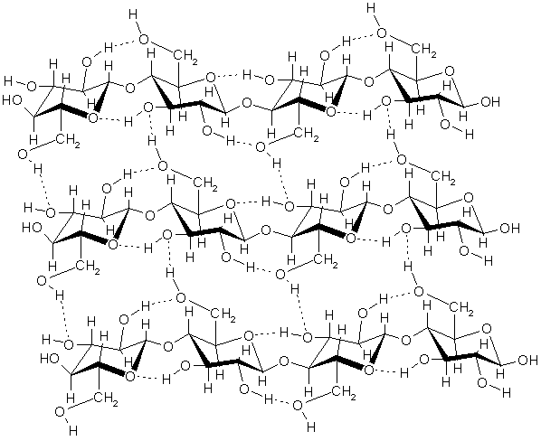
Cell Walls… (1 point each)
Found in plants, bacteria, and fungi
Made of cellulose sugar (permeable)
Supports and protects plants
4
Copyright © 2010 Ryan P. Murphy

Slide 12

5
Name A and B?
A
B
Copyright © 2010 Ryan P. Murphy

Slide 13
Cellular Biology Review Game
INSIDE AND OUT | INSANE IN THE MEMBRANE | UNCOMMON SOLUTIONS | BIG- GULP | -BONUS- SOLUTION FLICKS
1 | 6 | 11 | 16 | *21
2 | 7 | 12 | 17 | *22
3 | 8 | 13 | 18 | *23
4 | 9 | 14 | 19 | *24
5 | 10 | 15 | 20 | *25
Copyright © 2010 Ryan P. Murphy

Slide 14
Cellular Biology Review Game
INSIDE AND OUT | INSANE IN THE MEMBRANE | UNCOMMON SOLUTIONS | BIG- GULP | -BONUS- SOLUTION FLICKS
1 | 6 | 11 | 16 | *21
2 | 7 | 12 | 17 | *22
3 | 8 | 13 | 18 | *23
4 | 9 | 14 | 19 | *24
5 | 10 | 15 | 20 | *25
Copyright © 2010 Ryan P. Murphy

Slide 15
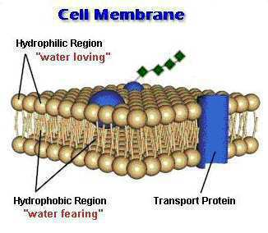
6
Outside Watery Environment
A
Hydrophilic
B
Hydrophobic
Hydrophobic
Hydrophilic
A
Inside Watery Environment

Slide 16

Name some things an animal cell would want to let in. (1 point each) The cell wants to let in...
  Oxygen.
  Water.
  Food.
    Molecules
  Protein.
  Minerals
  Vitamins
7
Copyright © 2010 Ryan P. Murphy

Slide 17

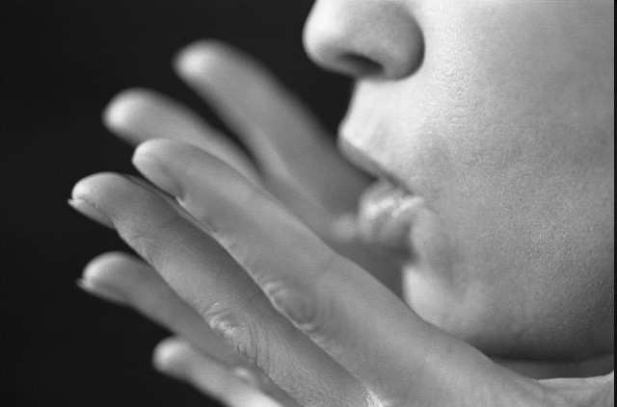
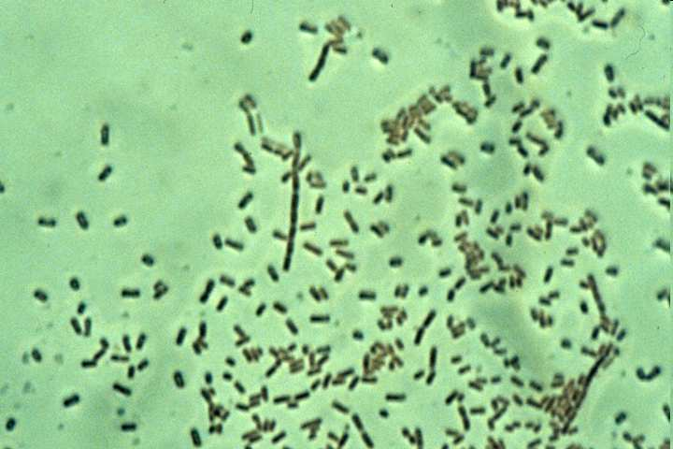
8
The cell doesn’t want to let in…
  Carbon Dioxide.
  Waste.
  Viruses.
  Bacteria.
Harmful bacteria
Copyright © 2010 Ryan P. Murphy

Slide 18
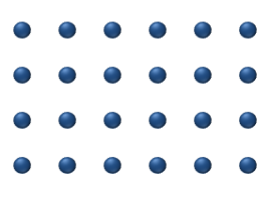
9
The animation below best represents…
  A.) Osmosis
  B.) Diffusion
  C.) Active Transport
  D.) An unbalanced gradient
  E.) A balanced gradient
Copyright © 2010 Ryan P. Murphy

Slide 19
9
The animation below best represents…
  A.) Osmosis
  B.) Diffusion
  C.) Active Transport
  D.) An unbalanced gradient
  E.) A balanced gradient
Copyright © 2010 Ryan P. Murphy

Slide 20
9
The animation below best represents…
  A.) Osmosis
  B.) Diffusion
  C.) Active Transport
  D.) An unbalanced gradient
  E.) A balanced gradient
Copyright © 2010 Ryan P. Murphy

Slide 21
9
The animation below best represents…
  A.) Osmosis
  B.) Diffusion
  C.) Active Transport
  D.) An unbalanced gradient
  E.) A balanced gradient
Copyright © 2010 Ryan P. Murphy

Slide 22
9
The animation below best represents…
  A.) Osmosis
  B.) Diffusion
  C.) Active Transport
  D.) An unbalanced gradient
  E.) A balanced gradient
Copyright © 2010 Ryan P. Murphy

Slide 23
9
The animation below best represents…
  A.) Osmosis
  B.) Diffusion
  C.) Active Transport
  D.) An unbalanced gradient
  E.) A balanced gradient
Copyright © 2010 Ryan P. Murphy

Slide 24
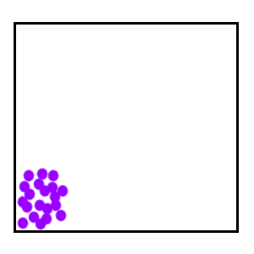
Molecules try to reach equilibrium.
  They go from areas of…(finish)
10
Copyright © 2010 Ryan P. Murphy

Slide 25
Cellular Biology Review Game
INSIDE AND OUT | INSANE IN THE MEMBRANE | UNCOMMON SOLUTIONS | BIG- GULP | -BONUS- SOLUTION FLICKS
1 | 6 | 11 | 16 | *21
2 | 7 | 12 | 17 | *22
3 | 8 | 13 | 18 | *23
4 | 9 | 14 | 19 | *24
5 | 10 | 15 | 20 | *25
Copyright © 2010 Ryan P. Murphy

Slide 26
Cellular Biology Review Game
INSIDE AND OUT | INSANE IN THE MEMBRANE | UNCOMMON SOLUTIONS | BIG- GULP | -BONUS- SOLUTION FLICKS
1 | 6 | 11 | 16 | *21
2 | 7 | 12 | 17 | *22
3 | 8 | 13 | 18 | *23
4 | 9 | 14 | 19 | *24
5 | 10 | 15 | 20 | *25
Copyright © 2010 Ryan P. Murphy

Slide 27
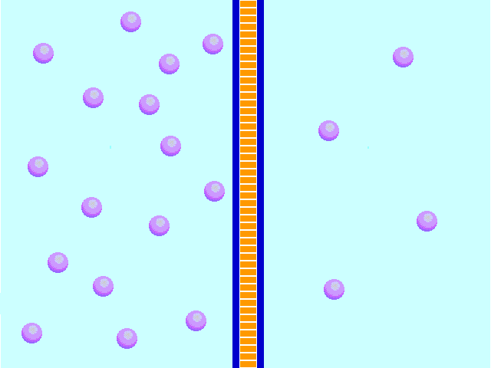
What process is this?
Semi permeable membrane
11
Copyright © 2010 Ryan P. Murphy

Slide 28
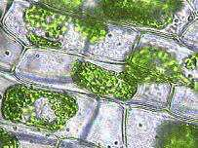
The Solution that these plants cells are in must be…
  A.) Hypotonic
  B.) Hypertonic
  C.) Isotonic
  D.) Facilitated
  E.) None of the
  above.
12

Slide 29
The Solution that these plants cells are in must be…
  A.) Hypotonic
  B.) Hypertonic
  C.) Isotonic
  D.) Facilitated
  E.) None of the
  above.
12

Slide 30
The Solution that these plants cells are in must be…
  A.) Hypotonic
  B.) Hypertonic
  C.) Isotonic
  D.) Facilitated
  E.) None of the
  above.
12

Slide 31
The Solution that these plants cells are in must be…
  A.) Hypotonic
  B.) Hypertonic
  C.) Isotonic
  D.) Facilitated
  E.) None of the
  above.
12

Slide 32
The Solution that these plants cells are in must be…
  A.) Hypotonic
  B.) Hypertonic
  C.) Isotonic
  D.) Facilitated
  E.) None of the
  above.
12

Slide 33
The Solution that these plants cells are in must be…
  A.) Hypotonic
  B.) Hypertonic
  C.) Isotonic
  D.) Facilitated
  E.) None of the
  above.
12

Slide 34
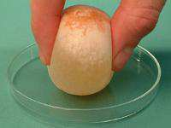

Slide 35
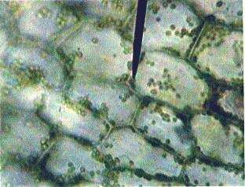
The Solution that these plants cells are in must be…
  A.) Hypotonic
  B.) Hypertonic
  C.) Isotonic
  D.) Facilitated
  E.) None of the
  above.
13

Slide 36
The Solution that these plants cells are in must be…
  A.) Hypotonic
  B.) Hypertonic
  C.) Isotonic
  D.) Facilitated
  E.) None of the
  above.
13

Slide 37
The Solution that these plants cells are in must be…
  A.) Hypotonic
  B.) Hypertonic
  C.) Isotonic
  D.) Facilitated
  E.) None of the
  above.
13

Slide 38
The Solution that these plants cells are in must be…
  A.) Hypotonic
  B.) Hypertonic
  C.) Isotonic
  D.) Facilitated
  E.) None of the
  above.
13

Slide 39
The Solution that these plants cells are in must be…
  A.) Hypotonic
  B.) Hypertonic
  C.) Isotonic
  D.) Facilitated
  E.) None of the
  above.
13

Slide 40
The Solution that these plants cells are in must be…
  A.) Hypotonic
  B.) Hypertonic
  C.) Isotonic
  D.) Facilitated
  E.) None of the
  above.
13

Slide 41

14
Isotonic Solution: The cell has an equal proportion of concentration with the area surrounding.
  Water continually flows in and out to keep concentration even.
Cell
Copyright © 2010 Ryan P. Murphy
Copyright © 2010 Ryan P. Murphy

Slide 42
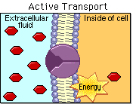
This uses energy to move molecules from areas of low concentration to areas of high concentration.
15
Copyright © 2010 Ryan P. Murphy

Slide 43
Cellular Biology Review Game
INSIDE AND OUT | INSANE IN THE MEMBRANE | UNCOMMON SOLUTIONS | BIG- GULP | -BONUS- SOLUTION FLICKS
1 | 6 | 11 | 16 | *21
2 | 7 | 12 | 17 | *22
3 | 8 | 13 | 18 | *23
4 | 9 | 14 | 19 | *24
5 | 10 | 15 | 20 | *25
Copyright © 2010 Ryan P. Murphy

Slide 44
Cellular Biology Review Game
INSIDE AND OUT | INSANE IN THE MEMBRANE | UNCOMMON SOLUTIONS | BIG- GULP | -BONUS- SOLUTION FLICKS
1 | 6 | 11 | 16 | *21
2 | 7 | 12 | 17 | *22
3 | 8 | 13 | 18 | *23
4 | 9 | 14 | 19 | *24
5 | 10 | 15 | 20 | *25
Copyright © 2010 Ryan P. Murphy

Slide 45
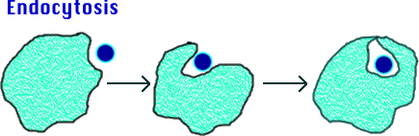
Name this process.
16
Copyright © 2010 Ryan P. Murphy

Slide 46
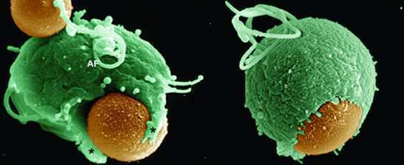
17
This is the process where the membrane surrounds large solid particles.
Copyright © 2010 Ryan P. Murphy

Slide 47
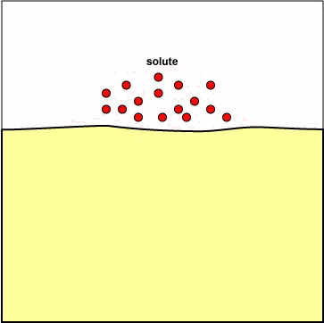
Process where the membrane surrounds a liquid.
18
Copyright © 2010 Ryan P. Murphy

Slide 48
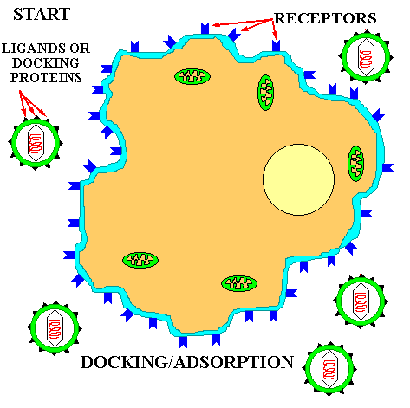
19
How did this virus enter the cell?
Copyright © 2010 Ryan P. Murphy

Slide 49
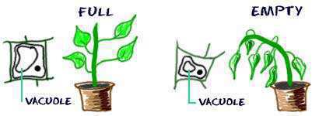
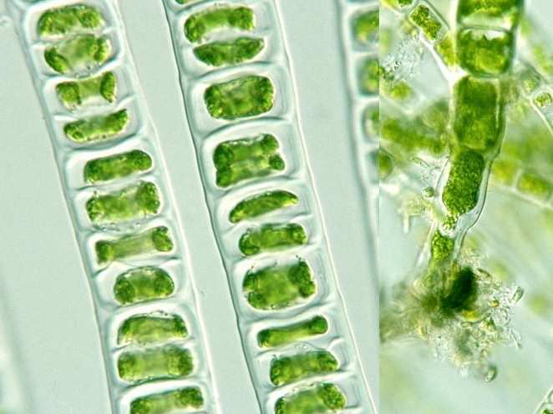
20
Why don’t
the plant
cells burst?

Slide 50
Cellular Biology Review Game
INSIDE AND OUT | INSANE IN THE MEMBRANE | UNCOMMON SOLUTIONS | BIG- GULP | -BONUS- SOLUTION FLICKS
1 | 6 | 11 | 16 | *21
2 | 7 | 12 | 17 | *22
3 | 8 | 13 | 18 | *23
4 | 9 | 14 | 19 | *24
5 | 10 | 15 | 20 | *25
Copyright © 2010 Ryan P. Murphy

Slide 51
Cellular Biology Review Game
INSIDE AND OUT | INSANE IN THE MEMBRANE | UNCOMMON SOLUTIONS | BIG- GULP | -BONUS- SOLUTION FLICKS
1 | 6 | 11 | 16 | *21
2 | 7 | 12 | 17 | *22
3 | 8 | 13 | 18 | *23
4 | 9 | 14 | 19 | *24
5 | 10 | 15 | 20 | *25
Copyright © 2010 Ryan P. Murphy

Slide 52

Name this movie with a hypertonic chocolate milk?
*21
Copyright © 2010 Ryan P. Murphy

Slide 53
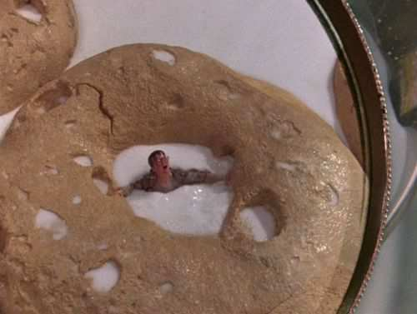
Name this movie with hypertonic milk?
*22
Copyright © 2010 Ryan P. Murphy

Slide 54

Name this movie with a hypotonic white blood cell?
*23
Copyright © 2010 Ryan P. Murphy

Slide 55

Name this movie with hypertonic slime?
*24
Copyright © 2010 Ryan P. Murphy

Slide 56

Name this movie with hypo and hypertonic solutions?
*25
Copyright © 2010 Ryan P. Murphy

Slide 57
Name this movie with hypo and hypertonic solutions?
*25
“You are hypotonic, and you….”
Copyright © 2010 Ryan P. Murphy

Slide 58
Name this movie with hypo and hypertonic solutions?
*25
“You are hypotonic, and you….”
Copyright © 2010 Ryan P. Murphy

Slide 59
Name this movie with hypo and hypertonic solutions?
*25
“You are hypertonic…”
Copyright © 2010 Ryan P. Murphy

Slide 60
Cellular Biology Review Game
INSIDE AND OUT | INSANE IN THE MEMBRANE | UNCOMMON SOLUTIONS | BIG- GULP | -BONUS- SOLUTION FLICKS
1 | 6 | 11 | 16 | *21
2 | 7 | 12 | 17 | *22
3 | 8 | 13 | 18 | *23
4 | 9 | 14 | 19 | *24
5 | 10 | 15 | 20 | *25
Final Question
Copyright © 2010 Ryan P. Murphy

Slide 61

5 pt Wager Question
(You can wager up to 5 pts)

Slide 62
  Fill beak with distilled water.
  Add corn syrup to dialysis tubing
  Align the corn syrup and water levels in the beaker.
  Visit tomorrow.
  What happened?
Tie

Slide 63
Time passes
Tie

Slide 64
Time passes
Tie

Slide 65
  The corn syrup was hypertonic (more solute). Water was hypotonic. The water moved into the dialysis tubing to equal the concentrations (isotonic ).
  The fluid in the tubing rose.
Tie

Slide 66
Answer Key

Slide 67
Cellular Biology Review Game
INSIDE AND OUT | INSANE IN THE MEMBRANE | UNCOMMON SOLUTIONS | BIG- GULP | -BONUS- SOLUTION FLICKS
1 | 6 | 11 | 16 | *21
2 | 7 | 12 | 17 | *22
3 | 8 | 13 | 18 | *23
4 | 9 | 14 | 19 | *24
5 | 10 | 15 | 20 | *25
Copyright © 2010 Ryan P. Murphy

Slide 68
Cellular Biology Review Game
INSIDE AND OUT | INSANE IN THE MEMBRANE | UNCOMMON SOLUTIONS | BIG- GULP | -BONUS- SOLUTION FLICKS
1 | 6 | 11 | 16 | *21
2 | 7 | 12 | 17 | *22
3 | 8 | 13 | 18 | *23
4 | 9 | 14 | 19 | *24
5 | 10 | 15 | 20 | *25
Copyright © 2010 Ryan P. Murphy

Slide 69
Which letter represents the shape of a typical cell? Why in two words?
A
1
B
C
D
Copyright © 2010 Ryan P. Murphy

Slide 70
Which letter represents the shape of a typical cell? Why in two words?
answer is…
A
1
B
C
D
Copyright © 2010 Ryan P. Murphy

Slide 71
Which letter represents the shape of a typical cell? Why in two words?
answer is…
A
1
B
C
D
Copyright © 2010 Ryan P. Murphy

Slide 72
Which letter represents the shape of a typical cell? Why in two words?
answer is…
A
1
B
C
Why?
D
Copyright © 2010 Ryan P. Murphy

Slide 73
Which letter represents the shape of a typical cell? Why in two words?
answer is…
A
1
B
C
Most Surface Area
Why?
D
Copyright © 2010 Ryan P. Murphy

Slide 74
2
This is the rich chemical fluid that helps breakdown molecules for use.
  Moves materials through cell (food and waste)

Slide 75
2
This is the rich chemical fluid that helps breakdown molecules for use.
  Moves materials through cell (food and waste)
and the answer is…

Slide 76
2
This is the rich chemical fluid that helps breakdown molecules for use.
  Moves materials through cell (food and waste)
Cytoplasm
and the answer is…

Slide 77
Name this cellular organelle?
3

Slide 78
Name this cellular organelle?
3
and the answer is…

Slide 79
Name this cellular organelle?
3
CELL WALL
and the answer is…

Slide 80
Cell Walls… (1 point each)
Found in plants, bacteria, and fungi
Made of cellulose sugar (permeable)
Supports and protects plants
4
Copyright © 2010 Ryan P. Murphy

Slide 81
Cell Walls… (1 point each)
Found in plants, bacteria, and fungi
Made of cellulose sugar (permeable)
Supports and protects plants
4
Copyright © 2010 Ryan P. Murphy

Slide 82
Cell Walls… (1 point each)
Found in plants, bacteria, and fungi
Made of cellulose sugar (permeable)
Supports and protects plants
4
Copyright © 2010 Ryan P. Murphy

Slide 83
Cell Walls… (1 point each)
Found in plants, bacteria, and fungi
Made of cellulose sugar (permeable)
Supports and protects plants
4
Copyright © 2010 Ryan P. Murphy

Slide 84
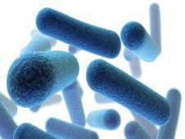
Cell Walls… (1 point each)
Found in plants, bacteria, and fungi
Made of cellulose sugar (permeable)
Supports and protects plants
4
Copyright © 2010 Ryan P. Murphy

Slide 85
Cell Walls… (1 point each)
Found in plants, bacteria, and fungi
Made of cellulose sugar (permeable)
Supports and protects plants
4
Copyright © 2010 Ryan P. Murphy

Slide 86
Cell Walls… (1 point each)
Found in plants, bacteria, and fungi
Made of cellulose sugar (permeable)
Supports and protects plants
4
Copyright © 2010 Ryan P. Murphy

Slide 87
Cell Walls… (1 point each)
Found in plants, bacteria, and fungi
Made of cellulose sugar (permeable)
Supports and protects plants
4
Copyright © 2010 Ryan P. Murphy

Slide 88
Cell Walls… (1 point each)
Found in plants, bacteria, and fungi
Made of cellulose sugar (permeable)
Supports and protects plants
4
Copyright © 2010 Ryan P. Murphy

Slide 89
Cell Walls… (1 point each)
Found in plants, bacteria, and fungi
Made of cellulose sugar (permeable)
Supports and protects plants
4
Copyright © 2010 Ryan P. Murphy

Slide 90
5
Name A and B?
A
B
Copyright © 2010 Ryan P. Murphy

Slide 91
5
Name A and B?
A
B
Copyright © 2010 Ryan P. Murphy

Slide 92
5
Name A and B?
A
B
Phosolipid
Bilayer
Copyright © 2010 Ryan P. Murphy

Slide 93
5
Name A and B?
A
B
Phosolipid
Bilayer
Copyright © 2010 Ryan P. Murphy

Slide 94
5
Name A and B?
A
B
Phosolipid
Bilayer
Membrane
Protein
Copyright © 2010 Ryan P. Murphy

Slide 95
Cellular Biology Review Game
INSIDE AND OUT | INSANE IN THE MEMBRANE | UNCOMMON SOLUTIONS | BIG- GULP | -BONUS- SOLUTION FLICKS
1 | 6 | 11 | 16 | *21
2 | 7 | 12 | 17 | *22
3 | 8 | 13 | 18 | *23
4 | 9 | 14 | 19 | *24
5 | 10 | 15 | 20 | *25
Copyright © 2010 Ryan P. Murphy

Slide 96
Cellular Biology Review Game
INSIDE AND OUT | INSANE IN THE MEMBRANE | UNCOMMON SOLUTIONS | BIG- GULP | -BONUS- SOLUTION FLICKS
1 | 6 | 11 | 16 | *21
2 | 7 | 12 | 17 | *22
3 | 8 | 13 | 18 | *23
4 | 9 | 14 | 19 | *24
5 | 10 | 15 | 20 | *25
Copyright © 2010 Ryan P. Murphy

Slide 97
6
Outside Watery Environment
A
Hydrophilic
B
Hydrophobic
Hydrophobic
Hydrophilic
A
Inside Watery Environment

Slide 98
6
Outside Watery Environment
A
Hydrophilic
B
Hydrophobic
Hydrophobic
Hydrophilic
A
Inside Watery Environment

Slide 99
6
Outside Watery Environment
philic = attraction to something
A
Hydrophilic
B
Hydrophobic
Hydrophobic
Hydrophilic
A
Inside Watery Environment

Slide 100
6
Outside Watery Environment
philic = attraction to something
A
Hydrophilic
B
Hydrophobic
Hydrophobic
Hydrophilic
A
Inside Watery Environment

Slide 101
6
Outside Watery Environment
philic = attraction to something
phobic = Afraid of / repelled
A
Hydrophilic
Hydrophobic
B
Hydrophobic
Hydrophilic
A
Inside Watery Environment

Slide 102
Name some things an animal cell would want to let in. (1 point each) The cell wants to let in...
  Oxygen.
  Water.
  Food.
    Molecules
  Protein.
  Minerals
  Vitamins
7
Copyright © 2010 Ryan P. Murphy

Slide 103
Name some things an animal cell would want to let in. (1 point each) The cell wants to let in...
  Oxygen.
  Water.
  Food.
    Molecules
  Protein.
  Minerals
  Vitamins
7
Copyright © 2010 Ryan P. Murphy

Slide 104
Name some things an animal cell would want to let in. (1 point each) The cell wants to let in...
  Oxygen.
  Water.
  Food.
    Molecules
  Protein.
  Minerals
  Vitamins
7
Copyright © 2010 Ryan P. Murphy

Slide 105
8
The cell doesn’t want to let in…
  Carbon Dioxide.
  Waste.
  Viruses.
  Bacteria.
Harmful bacteria
Copyright © 2010 Ryan P. Murphy

Slide 106
8
The cell doesn’t want to let in…
  Carbon Dioxide.
  Waste.
  Viruses.
  Bacteria.
Harmful bacteria
Copyright © 2010 Ryan P. Murphy

Slide 107
8
The cell doesn’t want to let in…
  Carbon Dioxide.
  Waste.
  Viruses.
  Bacteria.
Harmful bacteria
Copyright © 2010 Ryan P. Murphy

Slide 108
9
The animation below best represents…
  A.) Osmosis
  B.) Diffusion
  C.) Active Transport
  D.) An unbalanced gradient
  E.) A balanced gradient
Copyright © 2010 Ryan P. Murphy

Slide 109
9
The animation below best represents…
  A.) Osmosis
  B.) Diffusion
  C.) Active Transport
  D.) An unbalanced gradient
  E.) A balanced gradient
Copyright © 2010 Ryan P. Murphy

Slide 110
9
The animation below best represents…
  A.) Osmosis
  B.) Diffusion
  C.) Active Transport
  D.) An unbalanced gradient
  E.) A balanced gradient
Copyright © 2010 Ryan P. Murphy

Slide 111
9
The animation below best represents…
  A.) Osmosis
  B.) Diffusion
  C.) Active Transport
  D.) An unbalanced gradient
  E.) A balanced gradient
Copyright © 2010 Ryan P. Murphy

Slide 112
9
The animation below best represents…
  A.) Osmosis
  B.) Diffusion
  C.) Active Transport
  D.) An unbalanced gradient
  E.) A balanced gradient
Copyright © 2010 Ryan P. Murphy

Slide 113
9
The animation below best represents…
  A.) Osmosis
  B.) Diffusion
  C.) Active Transport
  D.) An unbalanced gradient
  E.) A balanced gradient
Copyright © 2010 Ryan P. Murphy

Slide 114
9
The animation below best represents…
  A.) Osmosis
  B.) Diffusion
  C.) Active Transport
  D.) An unbalanced gradient
  E.) A balanced gradient
and the answer is…
Copyright © 2010 Ryan P. Murphy

Slide 115
9
The animation below best represents…
  A.) Osmosis
  B.) Diffusion
  C.) Active Transport
  D.) An unbalanced gradient
  E.) A balanced gradient
and the answer is…
Copyright © 2010 Ryan P. Murphy

Slide 116
9
The animation below best represents…
  A.) Osmosis
  B.) Diffusion
  C.) Active Transport
  D.) An unbalanced gradient
  E.) A balanced gradient
Also called passive transport
and the answer is…
Copyright © 2010 Ryan P. Murphy

Slide 117
Molecules try to reach equilibrium.
  They go from areas of…(finish)
10
Copyright © 2010 Ryan P. Murphy

Slide 118
Molecules try to reach equilibrium.
  They go from areas of…(finish)
10
and the answer is…
Copyright © 2010 Ryan P. Murphy

Slide 119
Molecules try to reach equilibrium.
  They go from areas of…(finish)
10
high concentration
to areas of low
concentration
and the answer is…
Copyright © 2010 Ryan P. Murphy

Slide 120
Cellular Biology Review Game
INSIDE AND OUT | INSANE IN THE MEMBRANE | UNCOMMON SOLUTIONS | BIG- GULP | -BONUS- SOLUTION FLICKS
1 | 6 | 11 | 16 | *21
2 | 7 | 12 | 17 | *22
3 | 8 | 13 | 18 | *23
4 | 9 | 14 | 19 | *24
5 | 10 | 15 | 20 | *25
Copyright © 2010 Ryan P. Murphy

Slide 121
Cellular Biology Review Game
INSIDE AND OUT | INSANE IN THE MEMBRANE | UNCOMMON SOLUTIONS | BIG- GULP | -BONUS- SOLUTION FLICKS
1 | 6 | 11 | 16 | *21
2 | 7 | 12 | 17 | *22
3 | 8 | 13 | 18 | *23
4 | 9 | 14 | 19 | *24
5 | 10 | 15 | 20 | *25
Copyright © 2010 Ryan P. Murphy

Slide 122
What process is this?
Semi permeable membrane
11
Copyright © 2010 Ryan P. Murphy

Slide 123
What process is this?
Semi permeable membrane
11
Osmosis
Copyright © 2010 Ryan P. Murphy

Slide 124
The Solution that these plants cells are in must be…
  A.) Hypotonic
  B.) Hypertonic
  C.) Isotonic
  D.) Facilitated
  E.) None of the
  above.
12

Slide 125
The Solution that these plants cells are in must be…
  A.) Hypotonic
  B.) Hypertonic
  C.) Isotonic
  D.) Facilitated
  E.) None of the
  above.
12

Slide 126
The Solution that these plants cells are in must be…
  A.) Hypotonic
  B.) Hypertonic
  C.) Isotonic
  D.) Facilitated
  E.) None of the
  above.
12

Slide 127
The Solution that these plants cells are in must be…
  A.) Hypotonic
  B.) Hypertonic
  C.) Isotonic
  D.) Facilitated
  E.) None of the
  above.
12

Slide 128
The Solution that these plants cells are in must be…
  A.) Hypotonic
  B.) Hypertonic
  C.) Isotonic
  D.) Facilitated
  E.) None of the
  above.
12

Slide 129
The Solution that these plants cells are in must be…
  A.) Hypotonic
  B.) Hypertonic
  C.) Isotonic
  D.) Facilitated
  E.) None of the
  above.
12

Slide 130
The Solution that these plants cells are in must be…
  A.) Hypotonic
  B.) Hypertonic
  C.) Isotonic
  D.) Facilitated
  E.) None of the
  above.
12
And the answer is…

Slide 131
The Solution that these plants cells are in must be…
  A.) Hypotonic
  B.) Hypertonic
  C.) Isotonic
  D.) Facilitated
  E.) None of the
  above.
12
And the answer is…

Slide 132
The Solution that these plants cells are in must be…
  A.) Hypotonic
  B.) Hypertonic
  C.) Isotonic
  D.) Facilitated
  E.) None of the
  above.
Water moves out
12
And the answer is…

Slide 133
The Solution that these plants cells are in must be…
  A.) Hypotonic
  B.) Hypertonic
  C.) Isotonic
  D.) Facilitated
  E.) None of the
  above.
Water moves out
Cell Shrinks
12
And the answer is…

Slide 134
End of Preview
Hundreds of more slides,
activities, video links,
homework package, lesson
notes, review games,
rubrics, and much more
on the full version of this unit
and larger curriculum.

Slide 135
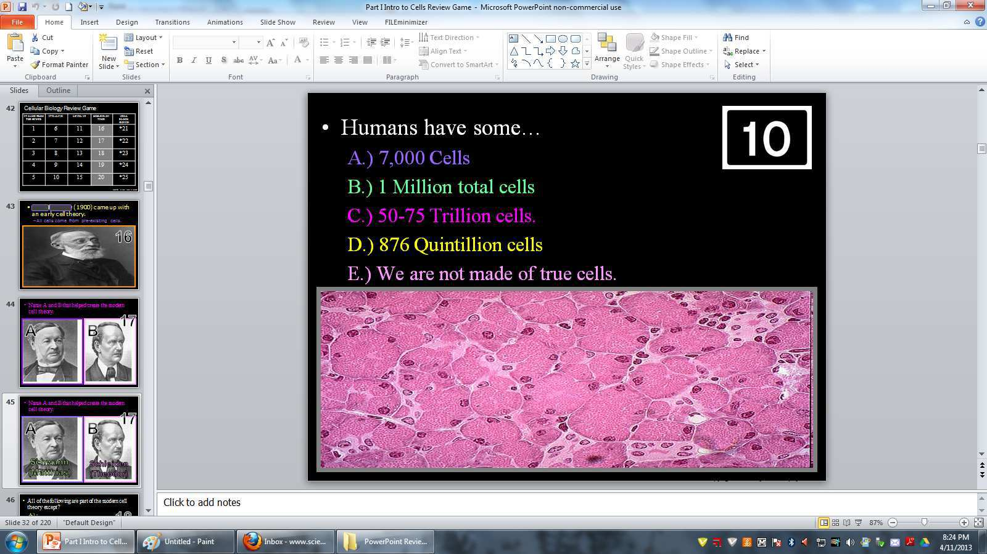
Introduction to Cells PowerPoint Review Game
Study

Slide 136
The Cellular Biology Unit Includes….
3 Part 2,200 slide PowerPoint roadmap
11 page bundled homework package that chronologically follows the PowerPoint slideshow. Modified version and answer keys provided.
16 pages of unit notes that follow slideshow for students who require assistance and support professionals.
3 PowerPoint review games with answers.
Available worksheets that follow slideshow, built-in quizzes, video links, rubrics, curriculum guide, and much more included.
file:///C:/Yahoo%20SiteBuilder/sites/sciencepowerpoint.com/sitebuilder/preview/Cellular_Biology_Unit.html

Slide 137
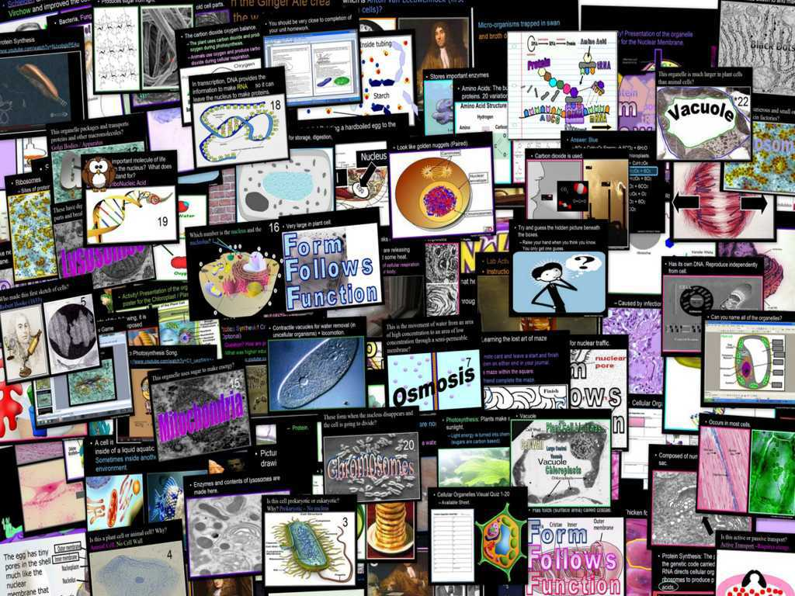
Cellular Biology Unit

Slide 138
Cellular Biology Unit
Areas of Focus within the Cellular Biology Unit
What is SPONCH?, Biologically Important Molecules, % of SPONCH in Living Things, What does it mean to be living?, Characteristics of Living Things, Needs of Living Things, Cellular Biology, History of Cellular Biology, Modern Cell Theory, Types of Cells, Prokaryotic Cells, Eukaryotic Cells, Cellular Organelles, Cell Wall, Plasma Membrane, Passive Transport, Diffusion, Osmosis, Active Transport, The Nucleus, Chromatin / Chromosomes, Nucleolus, Nuclear Membrane, Rough Endoplasmic Reticulum, Smooth Endoplasmic Reticulum, Ribosomes, Protein Synthesis, Golgi Apparatus, Lysosomes, Cytoskeleton / Mictrotubules / Microfilaments, Centrioles, Plastid, Mitochondria, Vacuoles, Organelles by real images, and much more.
http://sciencepowerpoint.com/Cellular_Biology_Unit.html

Slide 139

More Units Available at…
Earth Science: The Soil Science and Glaciers Unit, The Geology Topics Unit, The Astronomy Topics Unit, The Weather and Climate Unit, and The River Unit, The Water Molecule Unit.
Physical Science: The Laws of Motion and Machines Unit, The Atoms and Periodic Table Unit, The Energy and the Environment Unit, and The Introduction to Science / Metric Unit.
Life Science: The Infectious Diseases Unit, The Cellular Biology Unit, The DNA and Genetics Unit, The Plant Unit, The Taxonomy and Classification Unit, Ecology: Feeding Levels Unit, Ecology: Interactions Unit, Ecology: Abiotic Factors, The Evolution and Natural Selection Unit and the Human Body System and Health Topics Unit.
Copyright © 2010 Ryan P. Murphy

Slide 140

The entire four year curriculum can be found at... http://sciencepowerpoint.com/ Please feel free to contact me with any questions you may have. Thank you for your interest in this curriculum.
Sincerely,
Ryan Murphy M.Ed
www.sciencepowerpoint@gmail.com

