Slide 1
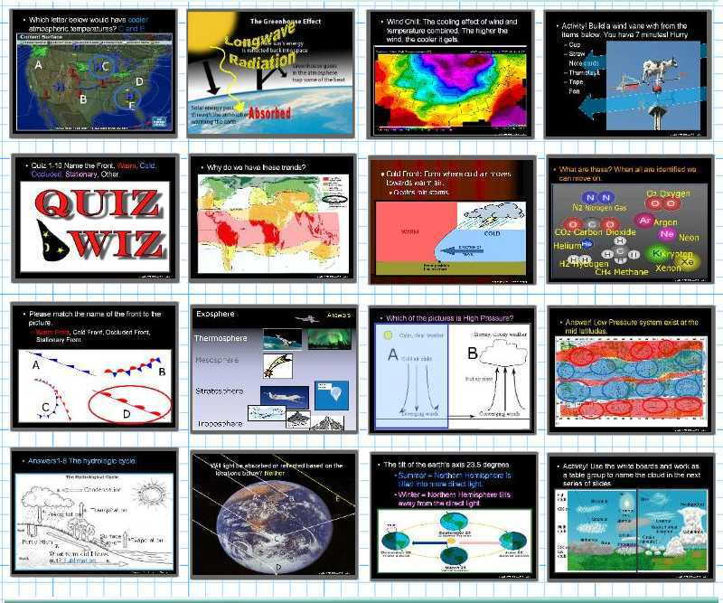
Weather and Climate Unit

Slide 2
Weather and Climate Unit
Areas of Focus within The Weather and Climate Unit:
What is weather?, Climate, Importance of the Atmosphere, Components of the Atmosphere, Layers of the Atmosphere, Air Quality and Pollution, Carbon Monoxide, Ozone Layer, Ways to Avoid Skin Cancer, Air Pressure, Barometer, Air Pressure and Wind, Fronts, Wind, Global Wind, Coriolis Force, Jet Stream, Sea Breeze / Land Breeze, Mountain Winds, Mountain Rain Shadow, Wind Chill, Flight, Dangerous Weather Systems, Light, Albedo, Temperature, Thermometers, Seasons, Humidity / Water, Oceans, Roles of Oceans, El Nino, La Nina Cycle, Dew Points, Clouds, Types of Clouds, Meteorology, Weather Tools, Isotherms, Ocean Currents, Enhanced Global Warming, Greenhouse Effect, The Effects of Global Warming, Biomes, Types of Biomes.
http://sciencepowerpoint.com/Weather_Climate_Unit.html

Slide 3
The Weather and Climate Unit includes…
5 Part 2,800 slide PowerPoint unit roadmap.
16 page bundled homework package, modified version that chronologically follows the unit slideshow. Also included are answer keys and homework rubric.
20 pages of unit notes that chronologically follow slideshow.
2 PowerPoint Review Games
8 Available worksheets that follow slideshow, crossword, flash card set, rubrics, and much more.
http://www.sciencepowerpoint.com/Weather_Climate_Unit.html

Slide 4
How to play…
  Don’t play like Jeo_ _ _ _ y.
  Class should be divided into several small groups.
  Groups should use science journal (red slide notes), homework, and other available materials to assist you.
  Groups can communicate quietly with each other but no sharing answers between groups.
    Practice quietly communicating right now?
    Practice Communication Question:
    Your group gets to order one pizza, and you can have two toppings. What does your group want?

Slide 5
Weather, Climate, Atmosphere, Air Pollution, Air Pressure Review Game
AT MOST | LOTSA LAYERS | PEE YOO | PRESS FOR SURE | -BONUS- WEATHER MOVIES
1 | 6 | 11 | 16 | *21
2 | 7 | 12 | 17 | *22
3 | 8 | 13 | 18 | *23
4 | 9 | 14 | 19 | *24
5 | 10 | 15 | 20 | *25
Copyright © 2010 Ryan P. Murphy

Slide 6

Questions 1-20 = 5pts Each
Final Category (Bonus) = 1pt Each
Final Questions = 5 pt wager
If you wager 5 on the last question and get it wrong you lose 5 pts. Wager 5 and get it right you get 5 pts.
Find the Owl =
Secretly write “Owl” in the correct box worth 1pt.
“I’ll be about this big.”

Slide 7

Is your name on the review sheet?
Name

Slide 8
Is your name on the review sheet?
Add the categories
along the top
on the next slide.

Slide 9
Weather, Climate, Atmosphere, Air Pollution, Air Pressure Review Game
AT MOST | LOTSA LAYERS | PEE YOO | PRESS FOR SURE | -BONUS- WEATHER MOVIES
1 | 6 | 11 | 16 | *21
2 | 7 | 12 | 17 | *22
3 | 8 | 13 | 18 | *23
4 | 9 | 14 | 19 | *24
5 | 10 | 15 | 20 | *25
Copyright © 2010 Ryan P. Murphy

Slide 10
Weather, Climate, Atmosphere, Air Pollution, Air Pressure Review Game
AT MOST | LOTSA LAYERS | PEE YOO | PRESS FOR SURE | -BONUS- WEATHER MOVIES
1 | 6 | 11 | 16 | *21
2 | 7 | 12 | 17 | *22
3 | 8 | 13 | 18 | *23
4 | 9 | 14 | 19 | *24
5 | 10 | 15 | 20 | *25
Copyright © 2010 Ryan P. Murphy

Slide 11
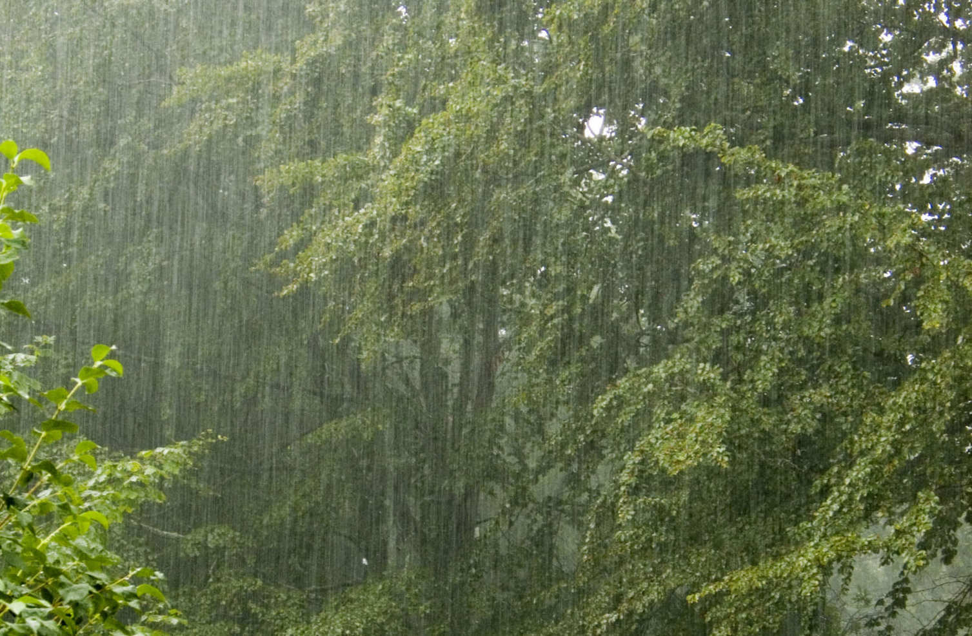
True or False? Climate is the state of the atmosphere at a given time and place?
1
2
Copyright © 2010 Ryan P. Murphy
Notes:
Category 1 - 20

Slide 12
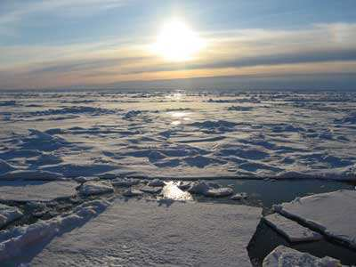
Water exists in what three states of matter on earth?
2
Copyright © 2010 Ryan P. Murphy
Notes:
Category 1 - 20

Slide 13

This process is not possible without oxygen?
3
3
Copyright © 2010 Ryan P. Murphy

Slide 14

78% of our atmosphere is composed of this gas?
4
Copyright © 2010 Ryan P. Murphy

Slide 15
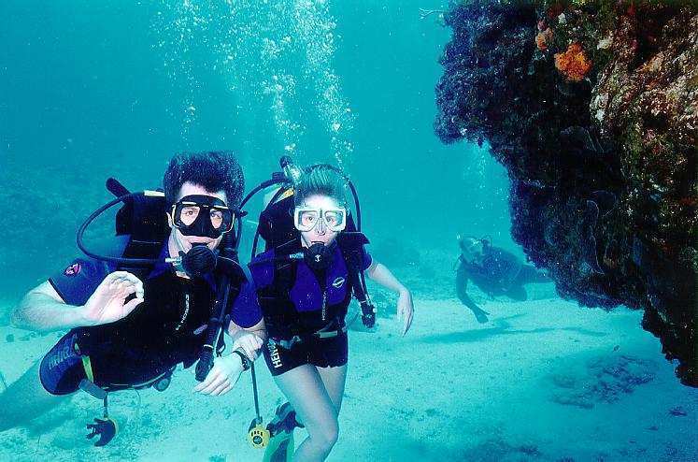
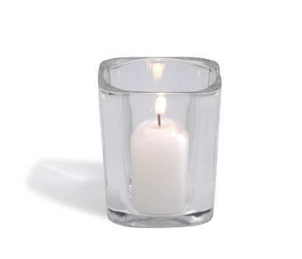

Most of the other 21% of our atmosphere consists of this gas?
5
Copyright © 2010 Ryan P. Murphy

Slide 16
Weather, Climate, Atmosphere, Air Pollution, Air Pressure Review Game
AT MOST | LOTSA LAYERS | PEE YOO | PRESS FOR SURE | -BONUS- WEATHER MOVIES
1 | 6 | 11 | 16 | *21
2 | 7 | 12 | 17 | *22
3 | 8 | 13 | 18 | *23
4 | 9 | 14 | 19 | *24
5 | 10 | 15 | 20 | *25
Copyright © 2010 Ryan P. Murphy

Slide 17
Weather, Climate, Atmosphere, Air Pollution, Air Pressure Review Game
AT MOST | LOTSA LAYERS | PEE YOO | PRESS FOR SURE | -BONUS- WEATHER MOVIES
1 | 6 | 11 | 16 | *21
2 | 7 | 12 | 17 | *22
3 | 8 | 13 | 18 | *23
4 | 9 | 14 | 19 | *24
5 | 10 | 15 | 20 | *25
Copyright © 2010 Ryan P. Murphy

Slide 18
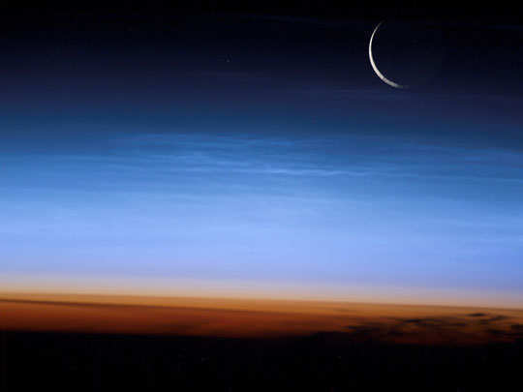
6
Meteors burn up in this layer of the atmosphere?
Copyright © 2010 Ryan P. Murphy

Slide 19
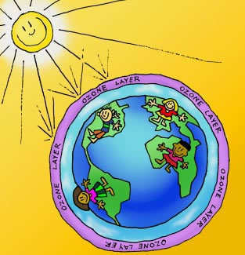
The protective ozone layer is found here?
7
Copyright © 2010 Ryan P. Murphy

Slide 20
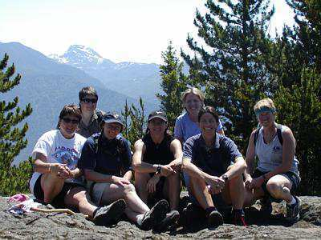
We live in this layer of the atmosphere?
8
Copyright © 2010 Ryan P. Murphy

Slide 21
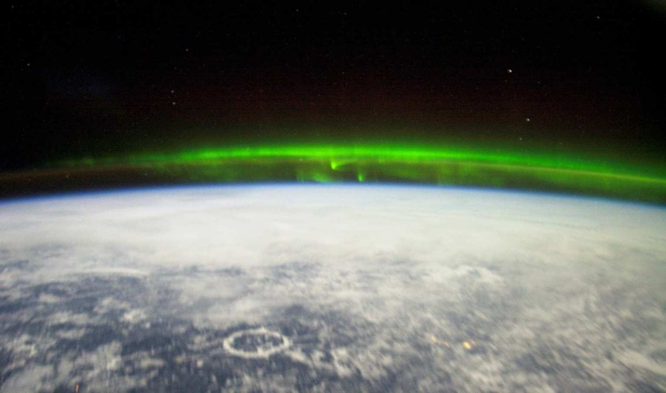
The space shuttle orbits in this layer of the atmosphere?
9
Copyright © 2010 Ryan P. Murphy

Slide 22
The space shuttle orbits in this layer of the atmosphere?
9
Name this layer for + 1pt
Copyright © 2010 Ryan P. Murphy

Slide 23

This layer of atmosphere merges with space?
10
Copyright © 2010 Ryan P. Murphy

Slide 24
Weather, Climate, Atmosphere, Air Pollution, Air Pressure Review Game
AT MOST | LOTSA LAYERS | PEE YOO | PRESS FOR SURE | -BONUS- WEATHER MOVIES
1 | 6 | 11 | 16 | *21
2 | 7 | 12 | 17 | *22
3 | 8 | 13 | 18 | *23
4 | 9 | 14 | 19 | *24
5 | 10 | 15 | 20 | *25
Copyright © 2010 Ryan P. Murphy

Slide 25
Weather, Climate, Atmosphere, Air Pollution, Air Pressure Review Game
AT MOST | LOTSA LAYERS | PEE YOO | PRESS FOR SURE | -BONUS- WEATHER MOVIES
1 | 6 | 11 | 16 | *21
2 | 7 | 12 | 17 | *22
3 | 8 | 13 | 18 | *23
4 | 9 | 14 | 19 | *24
5 | 10 | 15 | 20 | *25
Copyright © 2010 Ryan P. Murphy

Slide 26
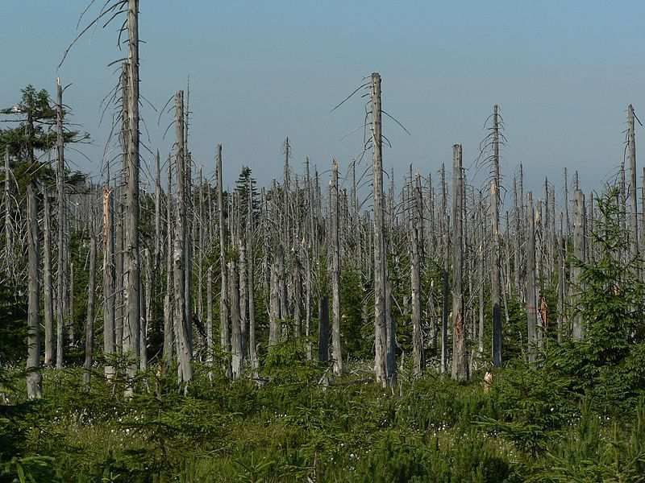
What regional weather problem is evident here?
11
Copyright © 2010 Ryan P. Murphy

Slide 27

What type of poisoning can occur if incomplete combustion occurs indoors?
12
Copyright © 2010 Ryan P. Murphy

Slide 28
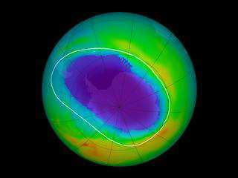
This layer of the atmosphere which currently has a hole protects the earth from harmful UV rays.
13
Copyright © 2010 Ryan P. Murphy

Slide 29
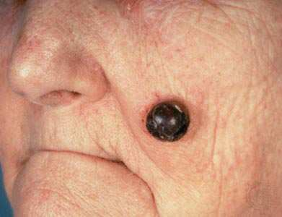
This can occur from too much sun exposure?
14
Copyright © 2010 Ryan P. Murphy

Slide 30
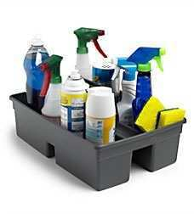
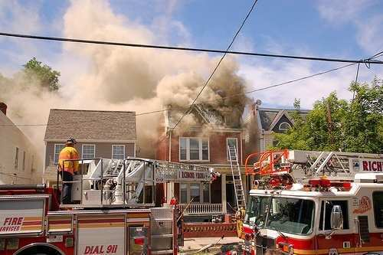
Volatile Organic Compounds (VOC’s), such as hydrocarbon fuel vapors and solvents are a form of air pollution and contribute to ground level ozone.
15
Copyright © 2010 Ryan P. Murphy

Slide 31
Weather, Climate, Atmosphere, Air Pollution, Air Pressure Review Game
AT MOST | LOTSA LAYERS | PEE YOO | PRESS FOR SURE | -BONUS- WEATHER MOVIES
1 | 6 | 11 | 16 | *21
2 | 7 | 12 | 17 | *22
3 | 8 | 13 | 18 | *23
4 | 9 | 14 | 19 | *24
5 | 10 | 15 | 20 | *25
Copyright © 2010 Ryan P. Murphy

Slide 32
Weather, Climate, Atmosphere, Air Pollution, Air Pressure Review Game
AT MOST | LOTSA LAYERS | PEE YOO | PRESS FOR SURE | -BONUS- WEATHER MOVIES
1 | 6 | 11 | 16 | *21
2 | 7 | 12 | 17 | *22
3 | 8 | 13 | 18 | *23
4 | 9 | 14 | 19 | *24
5 | 10 | 15 | 20 | *25
Copyright © 2010 Ryan P. Murphy

Slide 33
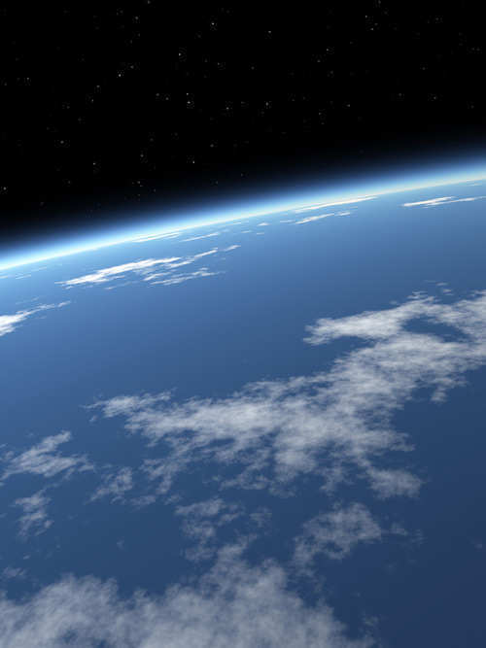

1 Point Each

Slide 34

1 Point Each

Slide 35


1 Point Each

Slide 36

1 Point Each

Slide 37

1 Point Each

Slide 38

1 Point Each

Slide 39
1 Point Each
And understanding it
holds the key to the past,
present, and future

Slide 40
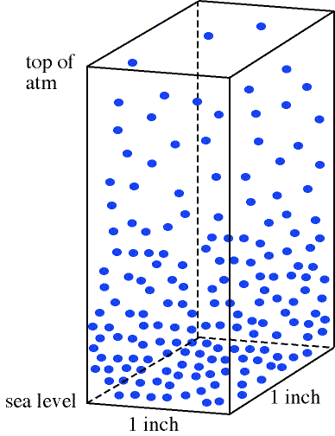
17
As elevation increases…. Air pressure…
  A.) Increases
  B.) Decreases
  C.) Remains Constant
  D.) Ionizes
  E.) All of the Above

Slide 41
17
As elevation increases…. Air pressure…
  A.) Increases
  B.) Decreases
  C.) Remains Constant
  D.) Ionizes
  E.) All of the Above

Slide 42
17
As elevation increases…. Air pressure…
  A.) Increases
  B.) Decreases
  C.) Remains Constant
  D.) Ionizes
  E.) All of the Above

Slide 43
17
As elevation increases…. Air pressure…
  A.) Increases
  B.) Decreases
  C.) Remains Constant
  D.) Ionizes
  E.) All of the Above

Slide 44
17
As elevation increases…. Air pressure…
  A.) Increases
  B.) Decreases
  C.) Remains Constant
  D.) Ionizes
  E.) All of the Above

Slide 45
17
As elevation increases…. Air pressure…
  A.) Increases
  B.) Decreases
  C.) Remains Constant
  D.) Ionizes
  E.) All of the Above

Slide 46
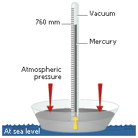
This instrument measures air pressure?
1 atm = 760 mm of Mercury
18
Copyright © 2010 Ryan P. Murphy

Slide 47
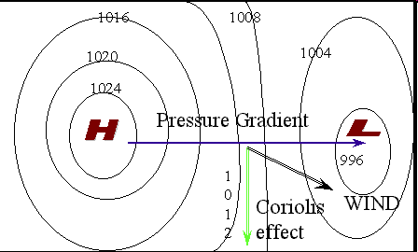
19
Warm air rises while cool air sinks, this causes differences in air pressure, wind and weather change.
Which has warmer temps?
A
B
Copyright © 2010 Ryan P. Murphy

Slide 48
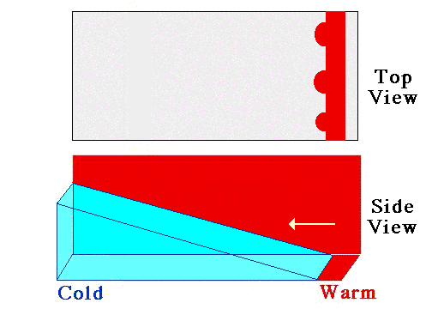

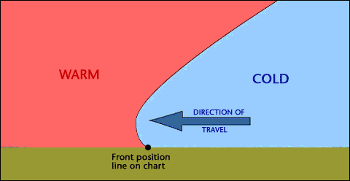
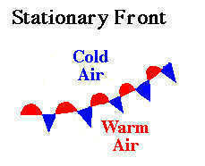
20
Name each front
A
B
C
D
Copyright © 2010 Ryan P. Murphy

Slide 49
Weather, Climate, Atmosphere, Air Pollution, Air Pressure Review Game
AT MOST | LOTSA LAYERS | PEE YOO | PRESS FOR SURE | -BONUS- WEATHER MOVIES
1 | 6 | 11 | 16 | *21
2 | 7 | 12 | 17 | *22
3 | 8 | 13 | 18 | *23
4 | 9 | 14 | 19 | *24
5 | 10 | 15 | 20 | *25
Copyright © 2010 Ryan P. Murphy

Slide 50
Weather, Climate, Atmosphere, Air Pollution, Air Pressure Review Game
AT MOST | LOTSA LAYERS | PEE YOO | PRESS FOR SURE | -BONUS- WEATHER MOVIES
1 | 6 | 11 | 16 | *21
2 | 7 | 12 | 17 | *22
3 | 8 | 13 | 18 | *23
4 | 9 | 14 | 19 | *24
5 | 10 | 15 | 20 | *25
Copyright © 2010 Ryan P. Murphy

Slide 51
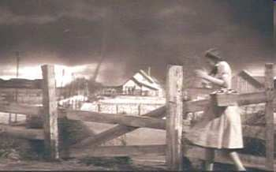
Name this Movie?
*21

Slide 52
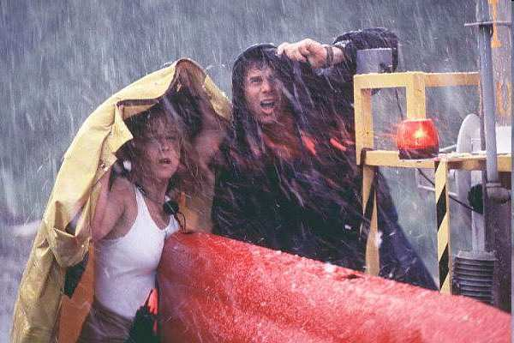
Name this Movie Starring Bill Paxton and Helen Hunt?
*22

Slide 53
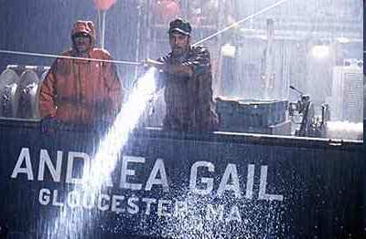
What movie is this based on the best seller by Sebastin Junger?
*23

Slide 54
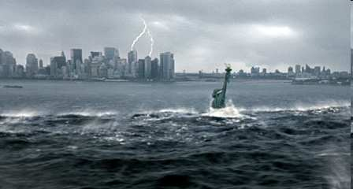
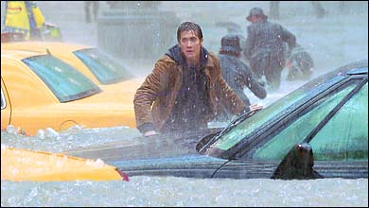
Crazy weather hits the world in this movie starring Dennis Quaid and Jake Gyllenhaal?
*24

Slide 55
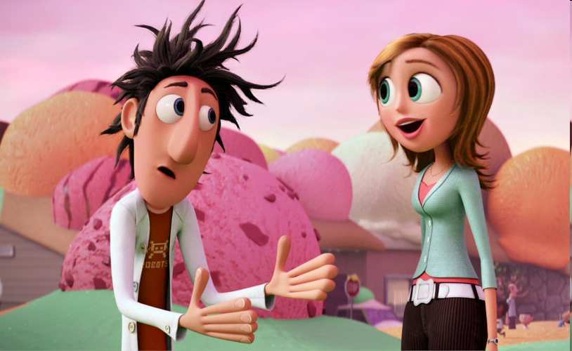
What is my name from the movie Cloudy With A Chance of Meatballs (2009)?
*25

Slide 56
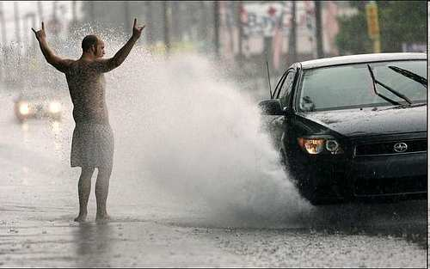
“You could wager up to 5 pts for this final question.”
“Please make your wager now.”

Slide 57
Weather, Climate, Atmosphere, Air Pollution, Air Pressure Review Game
AT MOST | LOTSA LAYERS | PEE YOO | PRESS FOR SURE | -BONUS- WEATHER MOVIES
1 | 6 | 11 | 16 | *21
2 | 7 | 12 | 17 | *22
3 | 8 | 13 | 18 | *23
4 | 9 | 14 | 19 | *24
5 | 10 | 15 | 20 | *25
Final Question
Copyright © 2010 Ryan P. Murphy

Slide 58
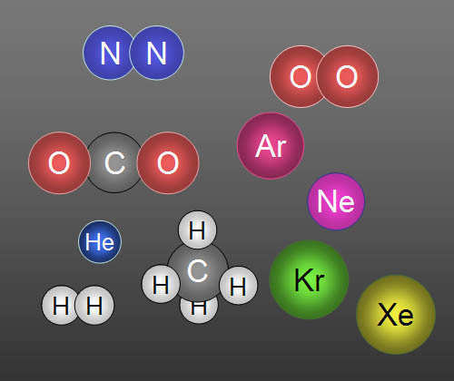
Final Question.
  Name A, B, C, and D.
C
A
D
B
Copyright © 2010 Ryan P. Murphy

Slide 59
ANSWER KEY

Slide 60
Weather, Climate, Atmosphere, Air Pollution, Air Pressure Review Game
AT MOST | LOTSA LAYERS | PEE YOO | PRESS FOR SURE | -BONUS- WEATHER MOVIES
1 | 6 | 11 | 16 | *21
2 | 7 | 12 | 17 | *22
3 | 8 | 13 | 18 | *23
4 | 9 | 14 | 19 | *24
5 | 10 | 15 | 20 | *25
Copyright © 2010 Ryan P. Murphy

Slide 61
Weather, Climate, Atmosphere, Air Pollution, Air Pressure Review Game
AT MOST | LOTSA LAYERS | PEE YOO | PRESS FOR SURE | -BONUS- WEATHER MOVIES
1 | 6 | 11 | 16 | *21
2 | 7 | 12 | 17 | *22
3 | 8 | 13 | 18 | *23
4 | 9 | 14 | 19 | *24
5 | 10 | 15 | 20 | *25
Copyright © 2010 Ryan P. Murphy

Slide 62
True or False? Climate is the state of the atmosphere at a given time and place?
1
2
Copyright © 2010 Ryan P. Murphy
Notes:
Category 1 - 20

Slide 63
True or False? Climate is the state of the atmosphere at a given time and place?
False
1
2
Copyright © 2010 Ryan P. Murphy
Notes:
Category 1 - 20

Slide 64
True or False? Weather is the state of the atmosphere at a given time and place?
False
1
2
Copyright © 2010 Ryan P. Murphy
Notes:
Category 1 - 20

Slide 65
Water exists in what three states of matter on the earth?
2
Copyright © 2010 Ryan P. Murphy
Notes:
Category 1 - 20

Slide 66
Water exists in what three states of matter on the earth? Solid,
2
Solid
Copyright © 2010 Ryan P. Murphy
Notes:
Category 1 - 20

Slide 67
Water exists in what three states of matter on the earth? Solid, Liquid,
2
Liquid
Solid
Copyright © 2010 Ryan P. Murphy
Notes:
Category 1 - 20

Slide 68
Water exists in what three states of matter on the earth? Solid, Liquid, Gas.
Gas
2
Liquid
Solid
Copyright © 2010 Ryan P. Murphy
Notes:
Category 1 - 20

Slide 69
This process is not possible without oxygen?
3
3
Copyright © 2010 Ryan P. Murphy

Slide 70
This process is not possible without oxygen?
3
3
Combustion
Copyright © 2010 Ryan P. Murphy

Slide 71
78% of our atmosphere is composed of this gas?
4
Copyright © 2010 Ryan P. Murphy

Slide 72
78% of our atmosphere is composed of this gas?
4
Nitrogen Gas
Copyright © 2010 Ryan P. Murphy

Slide 73
Most of the other 21% of our atmosphere consists of this gas?
5
Copyright © 2010 Ryan P. Murphy

Slide 74
Most of the other 21% of our atmosphere consists of this gas? Oxygen
Oxygen Gas
5
Copyright © 2010 Ryan P. Murphy

Slide 75

Most of the other 21% of our atmosphere consists of this gas? Oxygen
Oxygen Gas
5
Copyright © 2010 Ryan P. Murphy

Slide 76
Most of the other 21% of our atmosphere consists of this gas? Oxygen
Oxygen Gas
5
Copyright © 2010 Ryan P. Murphy

Slide 77
Weather, Climate, Atmosphere, Air Pollution, Air Pressure Review Game
AT MOST | LOTSA LAYERS | PEE YOO | PRESS FOR SURE | -BONUS- WEATHER MOVIES
1 | 6 | 11 | 16 | *21
2 | 7 | 12 | 17 | *22
3 | 8 | 13 | 18 | *23
4 | 9 | 14 | 19 | *24
5 | 10 | 15 | 20 | *25
Copyright © 2010 Ryan P. Murphy

Slide 78
Weather, Climate, Atmosphere, Air Pollution, Air Pressure Review Game
AT MOST | LOTSA LAYERS | PEE YOO | PRESS FOR SURE | -BONUS- WEATHER MOVIES
1 | 6 | 11 | 16 | *21
2 | 7 | 12 | 17 | *22
3 | 8 | 13 | 18 | *23
4 | 9 | 14 | 19 | *24
5 | 10 | 15 | 20 | *25
Copyright © 2010 Ryan P. Murphy

Slide 79
6
Meteors burn up in this layer of the atmosphere?
Copyright © 2010 Ryan P. Murphy

Slide 80
6
Meteors burn up in this layer of the atmosphere?
Mesosphere
Copyright © 2010 Ryan P. Murphy

Slide 81
The protective ozone layer is found here?
7
Copyright © 2010 Ryan P. Murphy

Slide 82
The protective ozone layer is found here?
7
Stratosphere
Copyright © 2010 Ryan P. Murphy

Slide 83
We live in this layer of the atmosphere?
8
Copyright © 2010 Ryan P. Murphy

Slide 84
We live in this layer of the atmosphere?
Troposphere
8
Copyright © 2010 Ryan P. Murphy

Slide 85
The Space shuttle orbits in this layer of the atmosphere?
9
Copyright © 2010 Ryan P. Murphy

Slide 86
The Space shuttle orbits in this layer of the atmosphere?
9
Thermosphere
Copyright © 2010 Ryan P. Murphy

Slide 87
The Space shuttle orbits in this layer of the atmosphere?
9
Thermosphere
Name this layer for + 1pt
Copyright © 2010 Ryan P. Murphy

Slide 88
The Space shuttle orbits in this layer of the atmosphere?
9
Thermosphere
Name this layer for + 1pt
Ionosphere
Copyright © 2010 Ryan P. Murphy

Slide 89
This layer of atmosphere merges with space?
10
Copyright © 2010 Ryan P. Murphy

Slide 90
This layer of atmosphere merges with space?
10
Exosphere
Copyright © 2010 Ryan P. Murphy

Slide 91
Weather, Climate, Atmosphere, Air Pollution, Air Pressure Review Game
AT MOST | LOTSA LAYERS | PEE YOO | PRESS FOR SURE | -BONUS- WEATHER MOVIES
1 | 6 | 11 | 16 | *21
2 | 7 | 12 | 17 | *22
3 | 8 | 13 | 18 | *23
4 | 9 | 14 | 19 | *24
5 | 10 | 15 | 20 | *25
Copyright © 2010 Ryan P. Murphy

Slide 92
Weather, Climate, Atmosphere, Air Pollution, Air Pressure Review Game
AT MOST | LOTSA LAYERS | PEE YOO | PRESS FOR SURE | -BONUS- WEATHER MOVIES
1 | 6 | 11 | 16 | *21
2 | 7 | 12 | 17 | *22
3 | 8 | 13 | 18 | *23
4 | 9 | 14 | 19 | *24
5 | 10 | 15 | 20 | *25
Copyright © 2010 Ryan P. Murphy

Slide 93
What regional weather problem is evident here?
11
Copyright © 2010 Ryan P. Murphy

Slide 94
What regional weather problem is evident here?
11
Acid Rain
Copyright © 2010 Ryan P. Murphy

Slide 95
What type of poisoning can occur if incomplete combustion occurs indoors?
12
Copyright © 2010 Ryan P. Murphy

Slide 96
What type of poisoning can occur if incomplete combustion occurs indoors?
12
Carbon Monoxide
Poisoning
Copyright © 2010 Ryan P. Murphy

Slide 97
This layer of the atmosphere which currently has a hole protects the earth from harmful UV rays.
13
Copyright © 2010 Ryan P. Murphy

Slide 98
This layer of the atmosphere which currently has a hole protects the earth from harmful UV rays.
Ozone Layer
13
Copyright © 2010 Ryan P. Murphy

Slide 99
This can occur from too much sun exposure?
14
Copyright © 2010 Ryan P. Murphy

Slide 100

This can occur from too much sun exposure? Skin Cancer - Melanoma
Skin Cancer
14
Copyright © 2010 Ryan P. Murphy

Slide 101
Volatile Organic Compounds (VOC’s), such as hydrocarbon fuel vapors and solvents are a form of air pollution and contribute to ground level ozone.
15
Copyright © 2010 Ryan P. Murphy

Slide 102
Volatile Organic Compounds (VOC’s), such as hydrocarbon fuel vapors and solvents are a form of air pollution and contribute to ground level ozone.
15
Copyright © 2010 Ryan P. Murphy

Slide 103
Volatile Organic Compounds (VOC’s), such as hydrocarbon fuel vapors and solvents are a form of air pollution and contribute to ground level ozone.
15
Copyright © 2010 Ryan P. Murphy

Slide 104
Volatile Organic Compounds (VOC’s), such as hydrocarbon fuel vapors and solvents are a form of air pollution and contribute to ground level ozone.
15
Copyright © 2010 Ryan P. Murphy

Slide 105
Volatile Organic Compounds (VOC’s), such as hydrocarbon fuel vapors and solvents are a form of air pollution and contribute to ground level ozone.
15
Copyright © 2010 Ryan P. Murphy

Slide 106
Volatile Organic Compounds (VOC’s), such as hydrocarbon fuel vapors and solvents are a form of air pollution and contribute to ground level ozone.
15
Copyright © 2010 Ryan P. Murphy

Slide 107
Volatile Organic Compounds (VOC’s), such as hydrocarbon fuel vapors and solvents are a form of air pollution and contribute to ground level ozone.
15
Copyright © 2010 Ryan P. Murphy

Slide 108
Weather, Climate, Atmosphere, Air Pollution, Air Pressure Review Game
AT MOST | LOTSA LAYERS | PEE YOO | PRESS FOR SURE | -BONUS- WEATHER MOVIES
1 | 6 | 11 | 16 | *21
2 | 7 | 12 | 17 | *22
3 | 8 | 13 | 18 | *23
4 | 9 | 14 | 19 | *24
5 | 10 | 15 | 20 | *25
Copyright © 2010 Ryan P. Murphy

Slide 109
Weather, Climate, Atmosphere, Air Pollution, Air Pressure Review Game
AT MOST | LOTSA LAYERS | PEE YOO | PRESS FOR SURE | -BONUS- WEATHER MOVIES
1 | 6 | 11 | 16 | *21
2 | 7 | 12 | 17 | *22
3 | 8 | 13 | 18 | *23
4 | 9 | 14 | 19 | *24
5 | 10 | 15 | 20 | *25
Copyright © 2010 Ryan P. Murphy

Slide 110
1 Point Each

Slide 111
1 Point Each

Slide 112
1 Point Each

Slide 113
1 Point Each

Slide 114
1 Point Each

Slide 115
1 Point Each

Slide 116
1 Point Each
And understanding it
holds the key to the past,
present, and future

Slide 117
1 Point Each
And understanding it
holds the key to the past,
present, and future

Slide 118
1 Point Each
And understanding it
holds the key to the past,
present, and future

Slide 119
1 Point Each
And understanding it
holds the key to the past,
present, and future

Slide 120
1 Point Each
And understanding it
holds the key to the past,
present, and future

Slide 121
1 Point Each
And understanding it
holds the key to the past,
present, and future

Slide 122
1 Point Each
And understanding it
holds the key to the past,
present, and future

Slide 123
1 Point Each
And understanding it
holds the key to the past,
present, and future

Slide 124
1 Point Each
And understanding it
holds the key to the past,
present, and future

Slide 125
1 Point Each
And understanding it
holds the key to the past,
present, and future

Slide 126
1 Point Each
And understanding it
holds the key to the past,
present, and future

Slide 127
1 Point Each
And understanding it
holds the key to the past,
present, and future

Slide 128
17
As elevation increases…. Air pressure…
  A.) Increases
  B.) Decreases
  C.) Remains Constant
  D.) Ionizes
  E.) All of the Above

Slide 129
17
As elevation increases…. Air pressure…
  A.) Increases
  B.) Decreases
  C.) Remains Constant
  D.) Ionizes
  E.) All of the Above

Slide 130
17
As elevation increases…. Air pressure…
  A.) Increases
  B.) Decreases
  C.) Remains Constant
  D.) Ionizes
  E.) All of the Above

Slide 131
17
As elevation increases…. Air pressure…
  A.) Increases
  B.) Decreases
  C.) Remains Constant
  D.) Ionizes
  E.) All of the Above

Slide 132
17
As elevation increases…. Air pressure…
  A.) Increases
  B.) Decreases
  C.) Remains Constant
  D.) Ionizes
  E.) All of the Above

Slide 133
17
As elevation increases…. Air pressure…
  A.) Increases
  B.) Decreases
  C.) Remains Constant
  D.) Ionizes
  E.) All of the Above

Slide 134
17
As elevation increases…. Air pressure…
  A.) Increases
  B.) Decreases
  C.) Remains Constant
  D.) Ionizes
  E.) All of the Above
answer is…

Slide 135
End of Preview
Hundreds of more slides,
activities, video links,
homework package, lesson
notes, review games,
rubrics, and much more
on the full version of this unit
and larger curriculum.

Slide 136
Weather and Climate Unit

Slide 137
Weather and Climate Unit
Areas of Focus within The Weather and Climate Unit:
What is weather?, Climate, Importance of the Atmosphere, Components of the Atmosphere, Layers of the Atmosphere, Air Quality and Pollution, Carbon Monoxide, Ozone Layer, Ways to Avoid Skin Cancer, Air Pressure, Barometer, Air Pressure and Wind, Fronts, Wind, Global Wind, Coriolis Force, Jet Stream, Sea Breeze / Land Breeze, Mountain Winds, Mountain Rain Shadow, Wind Chill, Flight, Dangerous Weather Systems, Light, Albedo, Temperature, Thermometers, Seasons, Humidity / Water, Oceans, Roles of Oceans, El Nino, La Nina Cycle, Dew Points, Clouds, Types of Clouds, Meteorology, Weather Tools, Isotherms, Ocean Currents, Enhanced Global Warming, Greenhouse Effect, The Effects of Global Warming, Biomes, Types of Biomes.
http://sciencepowerpoint.com/Weather_Climate_Unit.html

Slide 138
The Weather and Climate Unit includes…
5 Part 2,800 slide PowerPoint unit roadmap.
16 page bundled homework package, modified version that chronologically follows the unit slideshow. Also included are answer keys and homework rubric.
20 pages of unit notes that chronologically follow slideshow.
2 PowerPoint Review Games
8 Available worksheets that follow slideshow, crossword, flash card set, rubrics, and much more.
http://www.sciencepowerpoint.com/Weather_Climate_Unit.html

Slide 139

More Units Available at…
Earth Science: The Soil Science and Glaciers Unit, The Geology Topics Unit, The Astronomy Topics Unit, The Weather and Climate Unit, and The Rivers and Water Quality Unit, The Water Molecule Unit.
Physical Science: The Laws of Motion and Machines Unit, The Atoms and Periodic Table Unit, The Energy and the Environment Unit, and Science Skills Unit.
Life Science: The Infectious Diseases Unit, Cellular Biology Unit, The DNA and Genetics Unit, The Life Topics Unit, The Plant Unit, The Taxonomy and Classification Unit, Ecology: Feeding Levels Unit, Ecology: Interactions Unit, Ecology: Abiotic Factors, The Evolution and Natural Selection Unit and The Human Body Systems and Health Topics Unit
Copyright © 2010 Ryan P. Murphy

Slide 140

The entire four year curriculum can be found at... http://sciencepowerpoint.com/ Please feel free to contact me with any questions you may have. Thank you for your interest in this curriculum.
Sincerely,
Ryan Murphy M.Ed
www.sciencepowerpoint@gmail.com

