Slide 1
Rockin Review Game
AROUND AND AROUND | MOLTEN HOT | SEDIMENTARY THOUGHT | CHANGING FORMS | -BONUS- FAMOUS ROCKS
1 | 6 | 11 | 16 | *21
2 | 7 | 12 | 17 | *22
3 | 8 | 13 | 18 | *23
4 | 9 | 14 | 19 | *24
5 | 10 | 15 | 20 | *25
Copyright © 2010 Ryan P. Murphy

Slide 2
How to play…
  Don’t play like Jeo_ _ _ _ y.
  Class should be divided into several small groups.
  Groups should use science journal (red slide notes), homework, and other available materials to assist you.
  Groups can communicate quietly with each other but no sharing answers between groups.
    Practice quietly communicating right now?
    Practice Communication Question:
    Your group gets to order one pizza, and you can have two toppings. What does your group want?

Slide 3

Questions 1-20 = 5pts Each
Final Category (Bonus) = 1pt Each
Final Questions = 5 pt wager
If you wager 5 on the last question and get it wrong you lose 5 pts. Wager 5 and get it right you get 5 pts.
Find the Owl =
Secretly write “Owl” in the correct box worth 1pt.
“I’ll be about this big.”

Slide 4
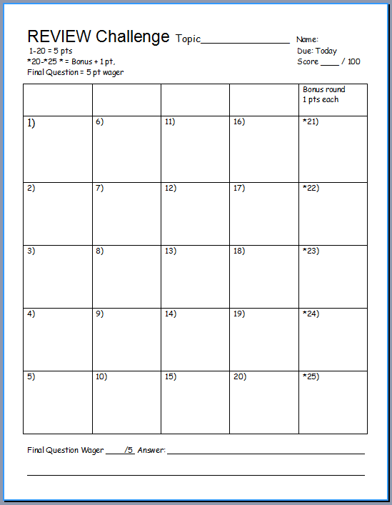
Is your name on the review sheet?
Name

Slide 5
Is your name on the review sheet?
Add the categories
along the top
on the next slide.

Slide 6
Rockin Review Game
AROUND AND AROUND | MOLTEN HOT | SEDIMENTARY THOUGHT | CHANGING FORMS | -BONUS- FAMOUS ROCKS
1 | 6 | 11 | 16 | *21
2 | 7 | 12 | 17 | *22
3 | 8 | 13 | 18 | *23
4 | 9 | 14 | 19 | *24
5 | 10 | 15 | 20 | *25
Copyright © 2010 Ryan P. Murphy

Slide 7
Rockin Review Game
AROUND AND AROUND | MOLTEN HOT | SEDIMENTARY THOUGHT | CHANGING FORMS | -BONUS- FAMOUS ROCKS
1 | 6 | 11 | 16 | *21
2 | 7 | 12 | 17 | *22
3 | 8 | 13 | 18 | *23
4 | 9 | 14 | 19 | *24
5 | 10 | 15 | 20 | *25
Copyright © 2010 Ryan P. Murphy

Slide 8
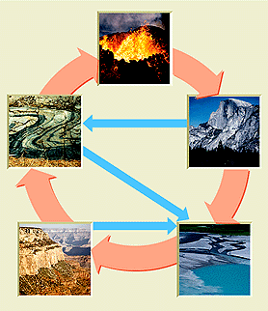
This is the general name for how one rock changes into another?
1

Slide 9
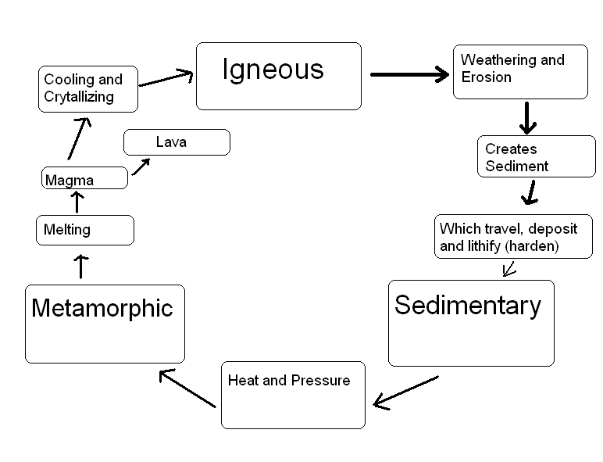
Please name the three types of rocks from the diagram below.
2

Slide 10
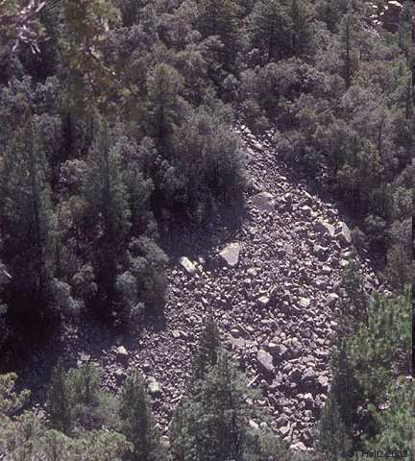
Which letter best represents the picture below ?
A
B
E
3
C
D

Slide 11

New Question

Slide 12
Which rock type below results from cooled magma or lava?
4

Slide 13
New Question

Slide 14
Which rock type below results from small particles compacting and hardening?
5

Slide 15
Rockin Review Game
AROUND AND AROUND | MOLTEN HOT | SEDIMENTARY THOUGHT | CHANGING FORMS | -BONUS- FAMOUS ROCKS
1 | 6 | 11 | 16 | *21
2 | 7 | 12 | 17 | *22
3 | 8 | 13 | 18 | *23
4 | 9 | 14 | 19 | *24
5 | 10 | 15 | 20 | *25
Copyright © 2010 Ryan P. Murphy

Slide 16
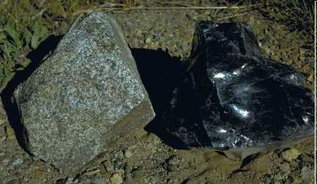
Which of the rocks below cooled quickly (Extrusive) and which cooled slowly (Intrusive)?
6
A
B

Slide 17
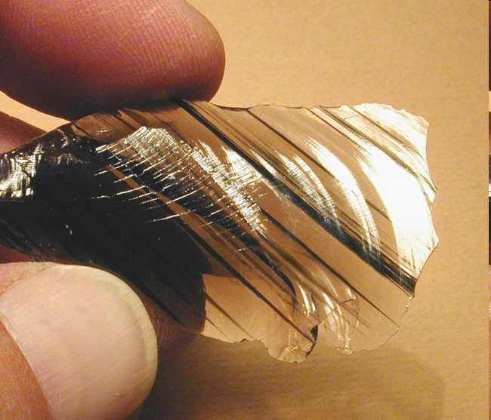
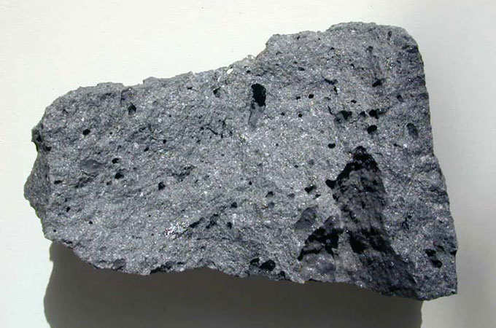
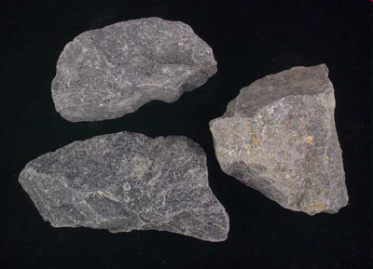
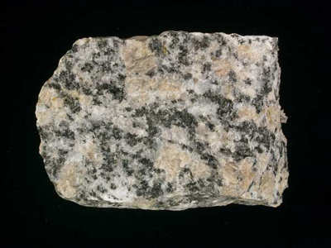
Which of the rocks below has large crystals?
A
B
7
C
D

Slide 18
Name this Igneous Rock?
Is it Felsic or Mafic?
8
8

Slide 19
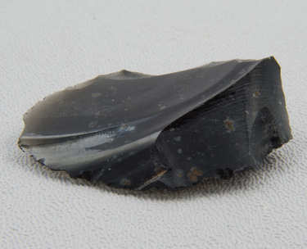

Name this Igneous Rock?
9
Is it Felsic or Mafic?

Slide 20
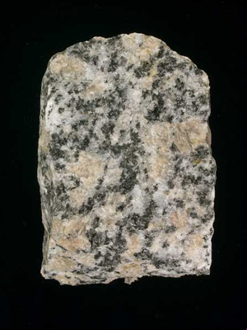
Name this Igneous Rock?
Is it Felsic or Mafic?
10

Slide 21
Rockin Review Game
AROUND AND AROUND | MOLTEN HOT | SEDIMENTARY THOUGHT | CHANGING FORMS | -BONUS- FAMOUS ROCKS
1 | 6 | 11 | 16 | *21
2 | 7 | 12 | 17 | *22
3 | 8 | 13 | 18 | *23
4 | 9 | 14 | 19 | *24
5 | 10 | 15 | 20 | *25
Copyright © 2010 Ryan P. Murphy

Slide 22
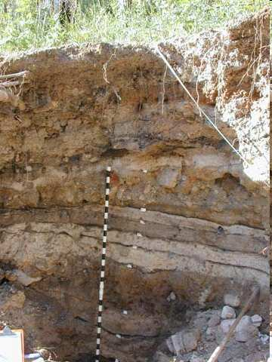
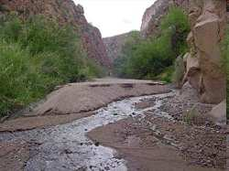
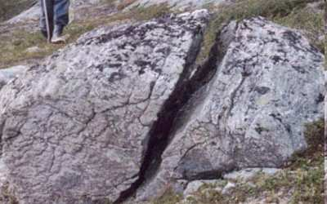
A
B
C
11
Copyright © 2010 Ryan P. Murphy

Slide 23
Which letter is weathering,
A
B
C
11
Copyright © 2010 Ryan P. Murphy

Slide 24
Which letter is weathering, which letter is erosion / transport,
A
B
C
11
Copyright © 2010 Ryan P. Murphy

Slide 25
Which letter is weathering, which letter is erosion / transport, and which letter deposition / lithification.
A
B
C
11
Copyright © 2010 Ryan P. Murphy

Slide 26








Which two terms should be switched?
12
START
END

Slide 27
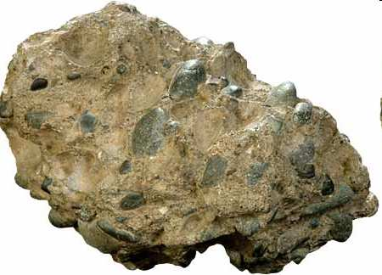
Dolostone
A
Conglomerate

Slide 28
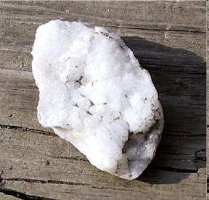
A
B
Conglomerate
Dolostone

Slide 29
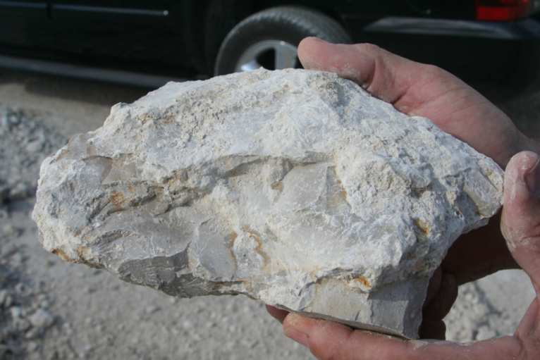
B
C
A
Conglomerate
Limestone with shells in it
Dolostone

Slide 30
Which rock is formed clastic, chemical, organic
13
B
C
A
Conglomerate
Limestone with shells in it
Dolostone

Slide 31
Which rock is formed clastic, chemical, organic
  Chemical: Standing water evaporates and leaves dissolved minerals behind.
13
B
C
A
Conglomerate
Limestone with shells in it
Dolostone

Slide 32
Which rock is formed clastic, chemical, organic
  Chemical: Standing water evaporates and leaves dissolved minerals behind.
  Clastic: Small pieces of rock are “lithified” or cemented together.
13
B
C
A
Conglomerate
Limestone with shells in it
Dolostone

Slide 33
Which rock is formed clastic, chemical, organic
  Chemical: Standing water evaporates and leaves dissolved minerals behind.
  Clastic: Small pieces of rock are “lithified” or cemented together.
  Organic: The accumulation of debris by living organisms.
13
B
C
A
Conglomerate
Limestone with shells in it
Dolostone

Slide 34
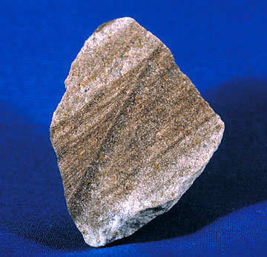

What sedimentary rock is shown below?
14

Slide 35
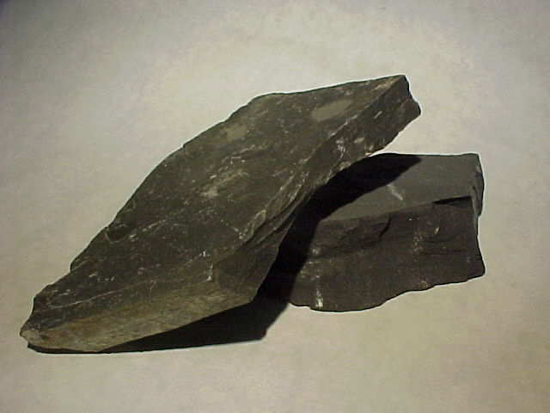
What sedimentary rock is shown below?
15

Slide 36
Rockin Review Game
AROUND AND AROUND | MOLTEN HOT | SEDIMENTARY THOUGHT | CHANGING FORMS | -BONUS- FAMOUS ROCKS
1 | 6 | 11 | 16 | *21
2 | 7 | 12 | 17 | *22
3 | 8 | 13 | 18 | *23
4 | 9 | 14 | 19 | *24
5 | 10 | 15 | 20 | *25
Copyright © 2010 Ryan P. Murphy

Slide 37
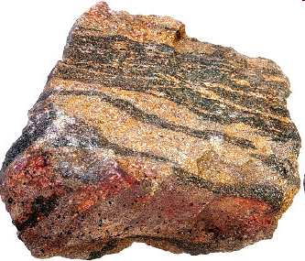

Metamorphic rocks are rocks that change forms due to extreme temperatures and pressures.
16

Slide 38
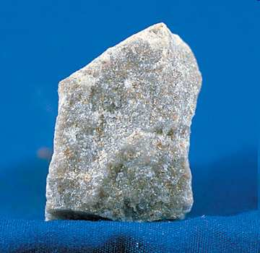
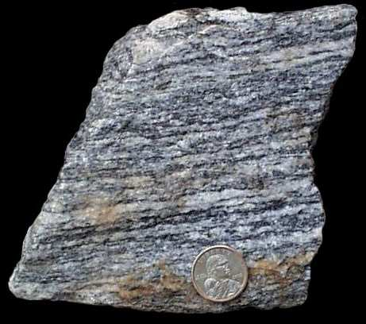
Metamorphic rocks can be divided into two categories. Which is…
  Foliated:
  Non-foliated:
17
A
B

Slide 39
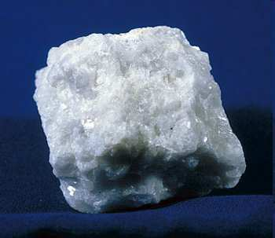
Name this common metamorphic rock?
18

Slide 40
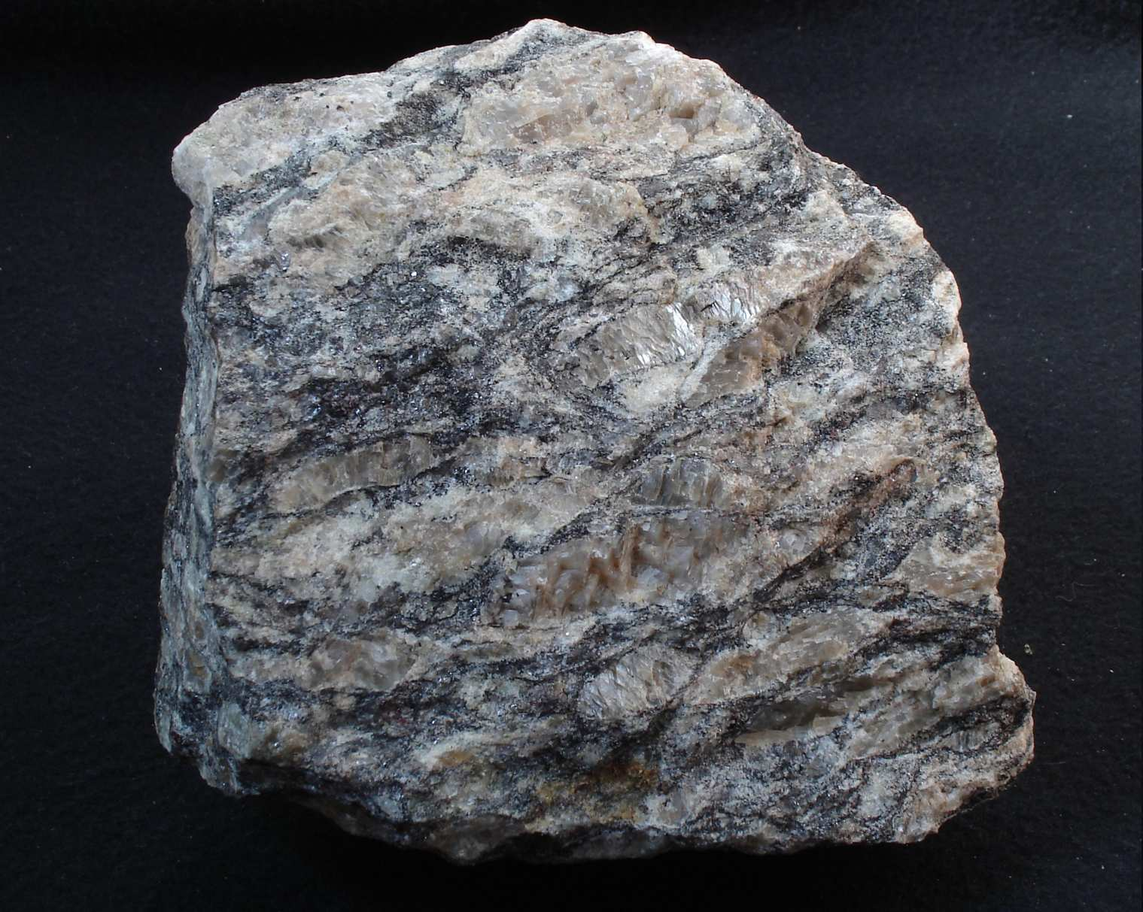
Name this common metamorphic rock?
19

Slide 41
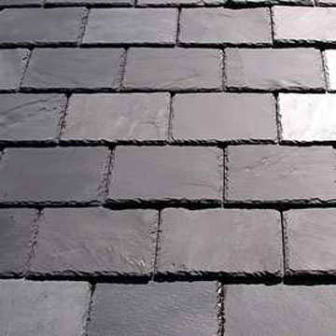
Shale becomes this common metamorphic rock?
20

Slide 42
End of Preview
Hundreds of more
slides, activities,
video links,
homework, notes,
and much more
on the full version.

Slide 43

Geology Topics Unit

Slide 44
Geology Topics Unit
Areas of Focus within The Geology Topics Unit:
Plate Tectonics, Evidence for Plate Tectonics, Pangea, Energy Waves,
Layers of the earth, Heat Transfer, Types of Crust, Plate Boundaries, Hot Spots, Volcanoes, Positives and Negatives of Volcanoes, Types of
Volcanoes, Parts of a Volcano, Magma, Types of Lava, Viscosity,
Earthquakes, Faults, Folds, Seismograph, Richter Scale,Seismograph,
Tsunami’s, Rocks, Minerals, Crystals, Uses of Minerals, Types of
Crystals, Physical Properties of Minerals, Rock Cycle, Common Igneous Rocks, Common Sedimentary Rocks, Common Metamorphic Rocks.
http://sciencepowerpoint.com/Geology_Unit.html

Slide 45

More Units Available at…
Earth Science: The Soil Science and Glaciers Unit, The Geology Topics Unit, The Astronomy Topics Unit, The Weather and Climate Unit, and The River Unit, The Water Molecule Unit.
Physical Science: The Laws of Motion and Machines Unit, The Atoms and Periodic Table Unit, The Energy and the Environment Unit, and The Introduction to Science / Metric Unit.
Life Science: The Diseases and Cells Unit, The DNA and Genetics Unit, The Life Topics Unit, The Plant Unit, The Taxonomy and Classification Unit, Ecology: Feeding Levels Unit, Ecology: Interactions Unit, Ecology: Abiotic Factors, The Evolution and Natural Selection Unit and The Human Body and Health Topics Unit.
Copyright © 2010 Ryan P. Murphy

Slide 46

The entire four year curriculum can be found at... http://sciencepowerpoint.com/ Please feel free to contact me with any questions you may have. Thank you for your interest in this curriculum.
Sincerely,
Ryan Murphy M.Ed
www.sciencepowerpoint@gmail.com

