Slide 1
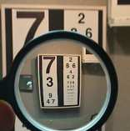
Science Skills Unit
Review Game

Slide 2
Introduction to Science Review Game
LA B SAFETY | TO MAGNIFY | THE METRIC SYSTEM | BASE UNITS | BONUS THINGS MEASURED
1 | 6 | 11 | 16 | *21
2 | 7 | 12 | 17 | *22
3 | 8 | 13 | 18 | *23
4 | 9 | 14 | 19 | *24
5 | 10 | 15 | 20 | *25
Copyright © 2010 Ryan P. Murphy

Slide 3
How to play…
Don’t play like Jeo_ _ _ _ y.
Class should be divided into several small groups.
Groups should use science journal (red slide notes), homework, and other available materials to assist you.
Groups can communicate quietly with each other but no sharing answers between groups.
Practice quietly communicating right now?
Practice Communication Question:
Your group gets to order one pizza and you can have two toppings. What does your group want?

Slide 4
Questions 1-20 = 5pts Each
Final Category (Bonus) = 1pt Each
Final Questions = 5 pt wager
If you wager 5 on the last question and get it wrong you lose 5 pts. Wager 5 and get it right you get 5 pts.
Find the Owl =
Secretly write “Owl” in the correct box worth 1pt.
“I’ll be about this big.”

Slide 5
Introduction to Science Review Game
LA B SAFETY | TO MAGNIFY | THE METRIC SYSTEM | BASE UNITS | BONUS THINGS MEASURED
1 | 6 | 11 | 16 | *21
2 | 7 | 12 | 17 | *22
3 | 8 | 13 | 18 | *23
4 | 9 | 14 | 19 | *24
5 | 10 | 15 | 20 | *25
Copyright © 2010 Ryan P. Murphy

Slide 6
Introduction to Science Review Game
LA B SAFETY | TO MAGNIFY | THE METRIC SYSTEM | BASE UNITS | BONUS THINGS MEASURED
1 | 6 | 11 | 16 | *21
2 | 7 | 12 | 17 | *22
3 | 8 | 13 | 18 | *23
4 | 9 | 14 | 19 | *24
5 | 10 | 15 | 20 | *25
Copyright © 2010 Ryan P. Murphy

Slide 7
What does this mean!
1
Copyright © 2010 Ryan P. Murphy

Slide 8
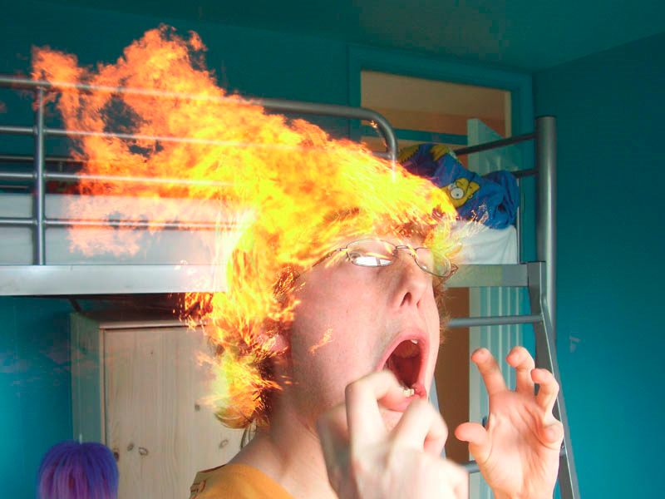
How could this have been avoided?
A.) Keep flammable materials away from flame.
B.) Keep your hair back.
C.) Avoid spontaneous combustion.
D.) A and B.
E.) All the above.
F.) None of the above.
2
2
Copyright © 2010 Ryan P. Murphy

Slide 9
How could this have been avoided?
A.) Keep flammable materials away from flame.
B.) Keep your hair back.
C.) Avoid spontaneous combustion.
D.) A and B.
E.) All the above.
F.) None of the above.
2
2
Copyright © 2010 Ryan P. Murphy

Slide 10
How could this have been avoided?
A.) Keep flammable materials away from flame.
B.) Keep your hair back.
C.) Avoid spontaneous combustion.
D.) A and B.
E.) All the above.
F.) None of the above.
2
2
Copyright © 2010 Ryan P. Murphy

Slide 11
How could this have been avoided?
A.) Keep flammable materials away from flame.
B.) Keep your hair back.
C.) Avoid spontaneous combustion.
D.) A and B.
E.) All the above.
F.) None of the above.
2
2
Copyright © 2010 Ryan P. Murphy

Slide 12
How could this have been avoided?
A.) Keep flammable materials away from flame.
B.) Keep your hair back.
C.) Avoid spontaneous combustion.
D.) A and B.
E.) All the above.
F.) None of the above.
2
2
Copyright © 2010 Ryan P. Murphy

Slide 13
How could this have been avoided?
A.) Keep flammable materials away from flame.
B.) Keep your hair back.
C.) Avoid spontaneous combustion.
D.) A and B.
E.) All the above.
F.) None of the above.
2
2
Copyright © 2010 Ryan P. Murphy

Slide 14
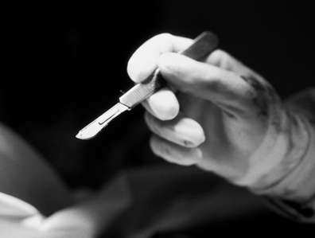
Never cut toward yourself or others.
3
Copyright © 2010 Ryan P. Murphy

Slide 15
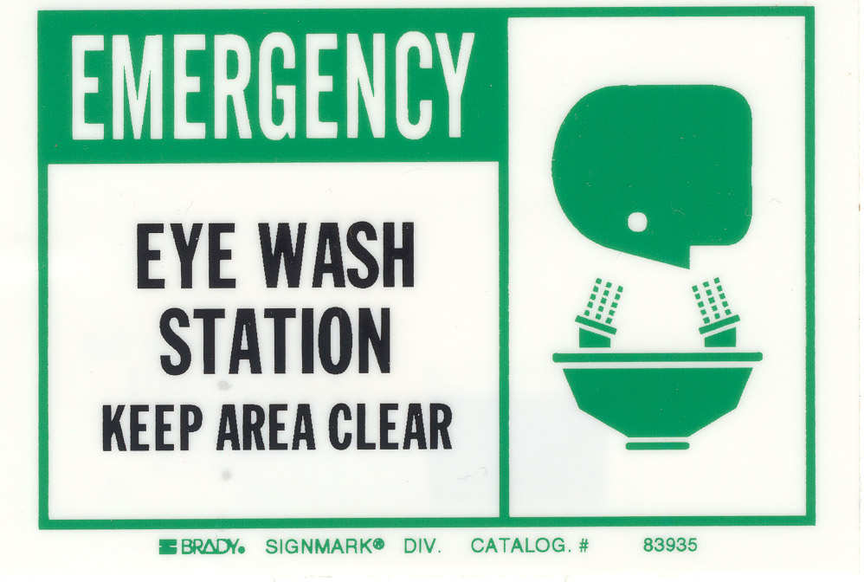
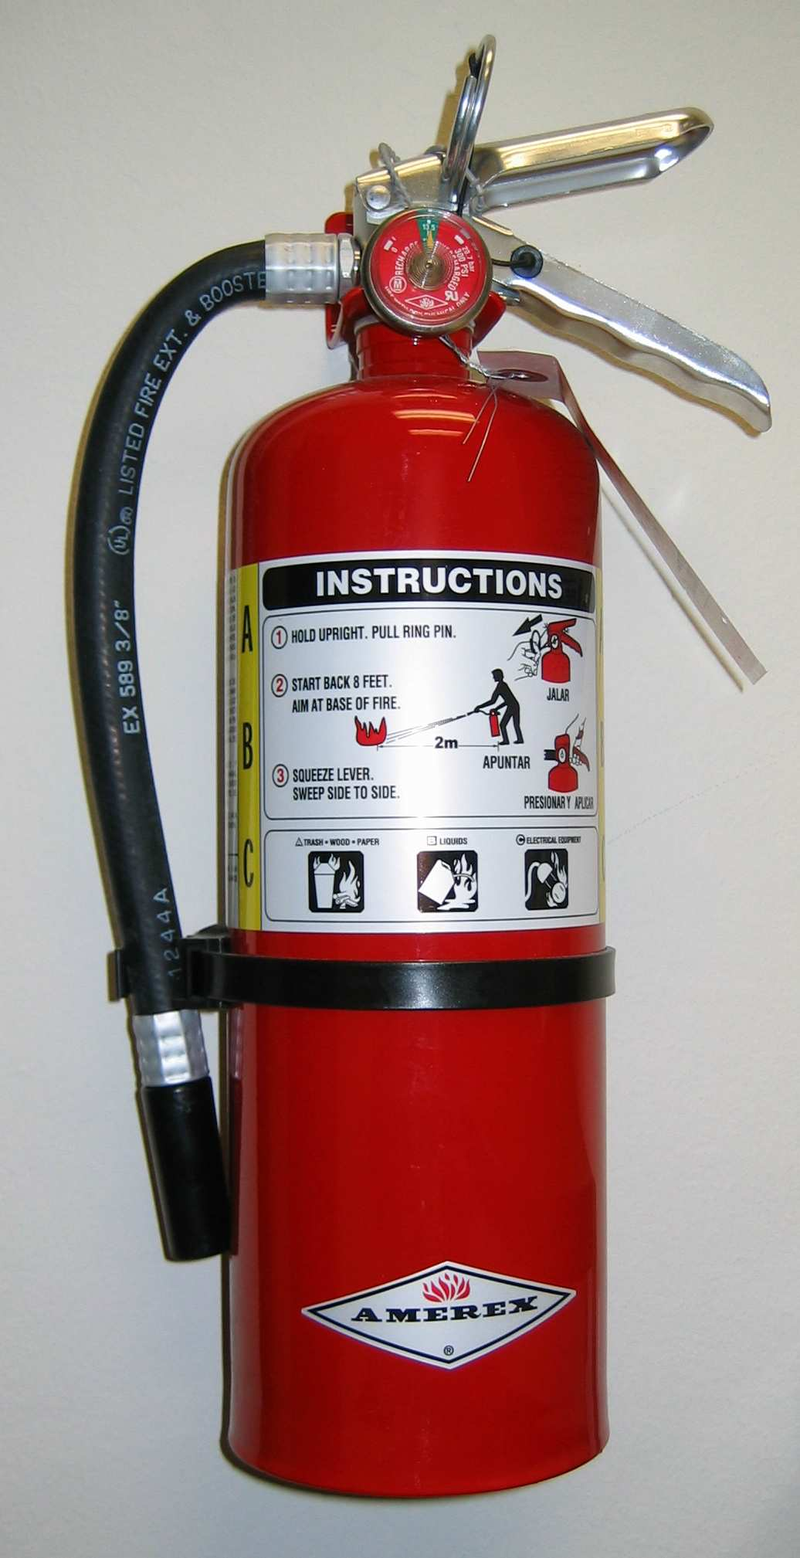
Where are these two items located in the lab?
4
Copyright © 2010 Ryan P. Murphy

Slide 16
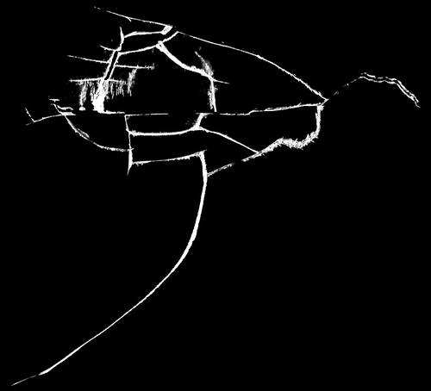
Please check glassware for cracks and to make sure it is clean.
5
Please check glassware for cracks or chips prior to use.
Copyright © 2010 Ryan P. Murphy

Slide 17
Introduction to Science Review Game
LA B SAFETY | TO MAGNIFY | THE METRIC SYSTEM | BASE UNITS | BONUS THINGS MEASURED
1 | 6 | 11 | 16 | *21
2 | 7 | 12 | 17 | *22
3 | 8 | 13 | 18 | *23
4 | 9 | 14 | 19 | *24
5 | 10 | 15 | 20 | *25
Copyright © 2010 Ryan P. Murphy

Slide 18
This is the term for making an object look smaller? Demagnification
6
Copyright © 2010 Ryan P. Murphy

Slide 19
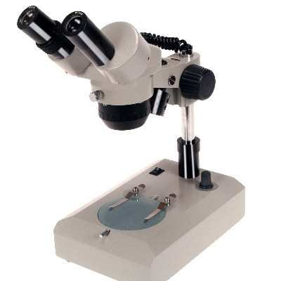
This type of microscope is best for viewing larger objects that light cannot pass through.
7
Copyright © 2010 Ryan P. Murphy

Slide 20
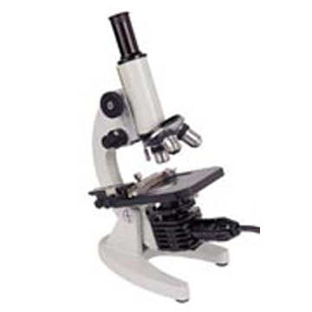
This type of microscope lets you look at small specimens that light can pass through. You need to use a glass slide and cover slip.
8
Copyright © 2010 Ryan P. Murphy

Slide 21
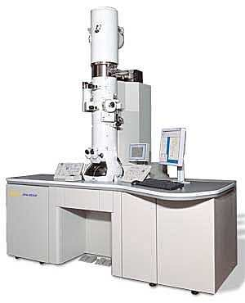
What type of microscope is shown below.
This microscope doesn’t normally view living specimens or cells.
9
Copyright © 2010 Ryan P. Murphy

Slide 22
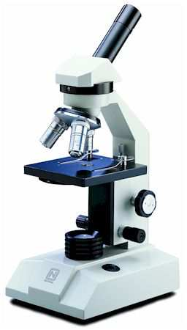
Name the parts of the microscope below
1) Revolving Nose piece, 2) Eyepiece 3)Base
4) Coarse adjustment, 5) Light Source.
2
1
4
5
3
Copyright © 2010 Ryan P. Murphy

Slide 23
Introduction to Science Review Game
LA B SAFETY | TO MAGNIFY | THE METRIC SYSTEM | BASE UNITS | BONUS THINGS MEASURED
1 | 6 | 11 | 16 | *21
2 | 7 | 12 | 17 | *22
3 | 8 | 13 | 18 | *23
4 | 9 | 14 | 19 | *24
5 | 10 | 15 | 20 | *25
Copyright © 2010 Ryan P. Murphy

Slide 24
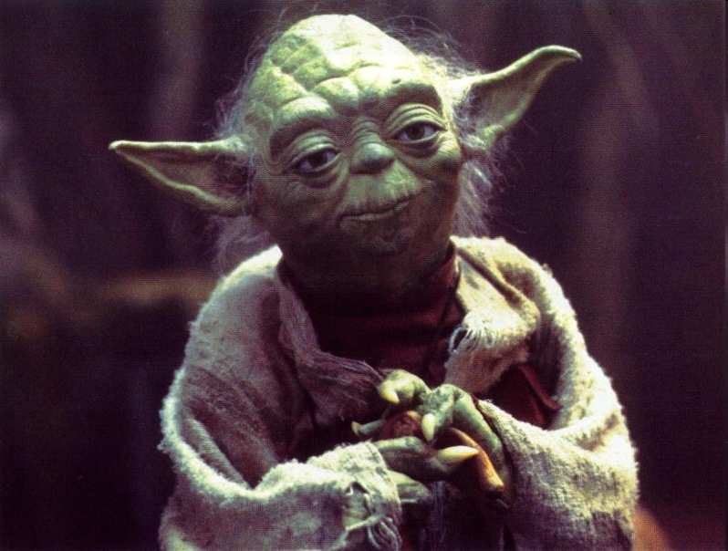
11
“Based on this number the metric system is?”
Copyright © 2010 Ryan P. Murphy

Slide 25
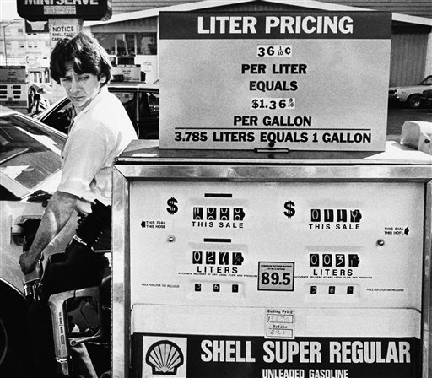
The Metric system is also called the SI system. What does the SI system stand for?
12
12
Copyright © 2010 Ryan P. Murphy

Slide 26
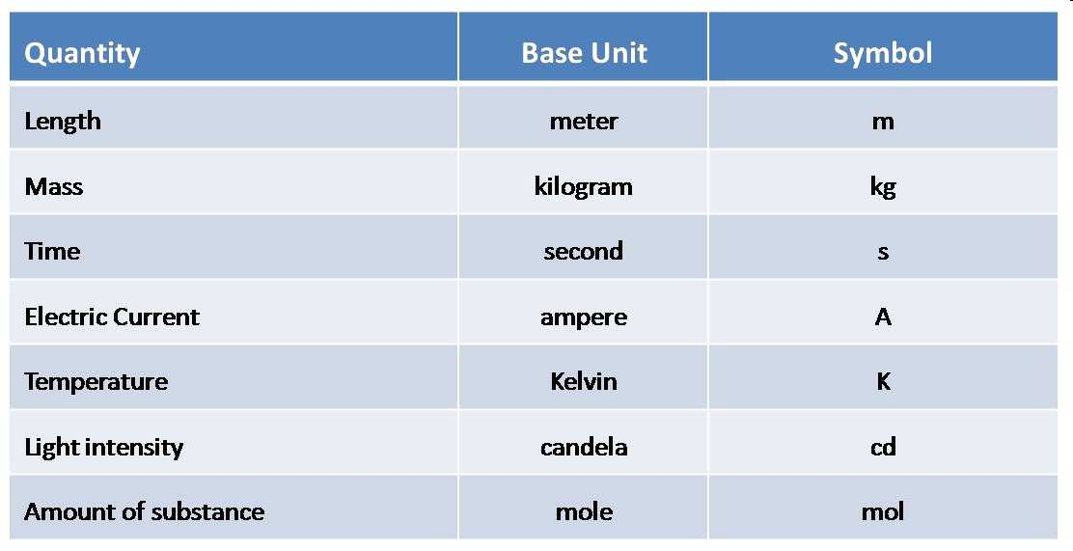
Please record the base units for each quantity represented below.
13
Copyright © 2010 Ryan P. Murphy

Slide 27
Convert the following 1.25 meters into the following.
Millimeters 1250
Centimeters 125
Kilometers .00125
14
14
Copyright © 2010 Ryan P. Murphy

Slide 28
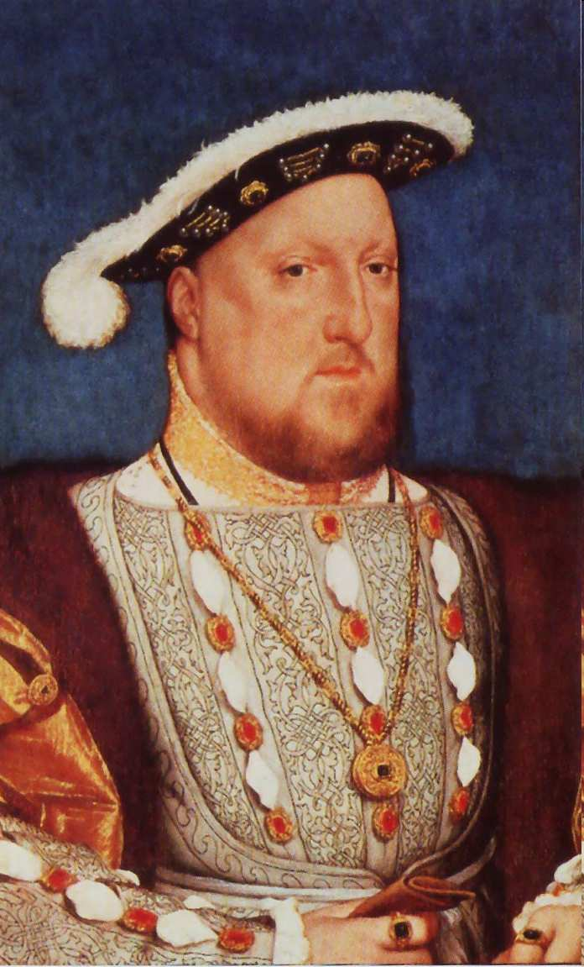
What does this acronym stand for?
15
King Kilometer
Hector - Hectometer
Died - Decameter
While - Standard
Drinking - Decimeter
Chocolate - Centimeter .
Milk - Millimeter
Copyright © 2010 Ryan P. Murphy

Slide 29
Introduction to Science Review Game
LA B SAFETY | TO MAGNIFY | THE METRIC SYSTEM | BASE UNITS | BONUS THINGS MEASURED
1 | 6 | 11 | 16 | *21
2 | 7 | 12 | 17 | *22
3 | 8 | 13 | 18 | *23
4 | 9 | 14 | 19 | *24
5 | 10 | 15 | 20 | *25
Copyright © 2010 Ryan P. Murphy

Slide 30
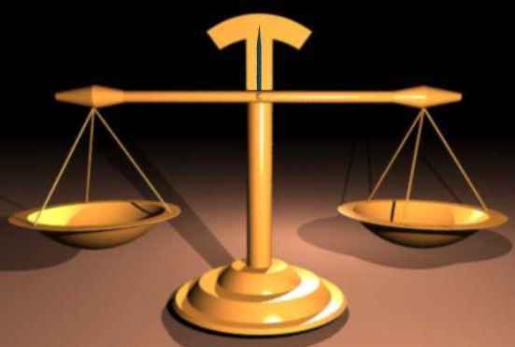
What is the base unit associated with weight?
16
Copyright © 2010 Ryan P. Murphy

Slide 31
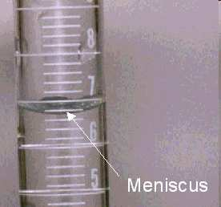
What base unit is shown here? Please measure this unit based on the fluid in this graduated cylinder.
17
Copyright © 2010 Ryan P. Murphy

Slide 32
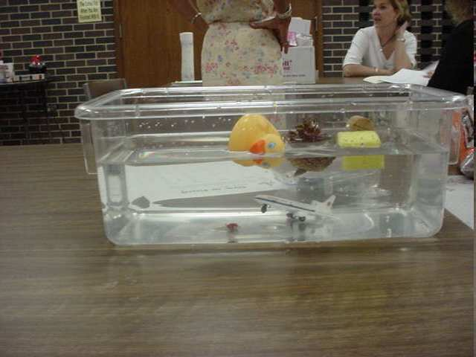
Which of the objects in this tank has a density of more than 1 g/cm3?
18
Copyright © 2010 Ryan P. Murphy

Slide 33
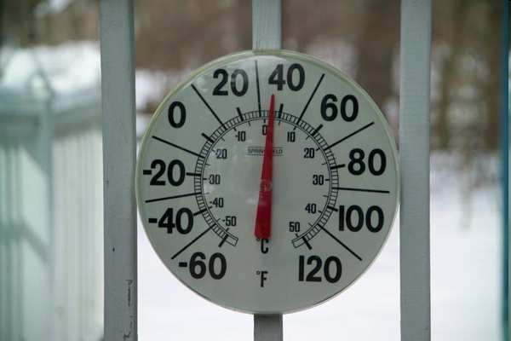
Caution!
Don’t answer quickly. What is the temperature outside in degrees Celsius?
2-4 degrees Celsius
19
Copyright © 2010 Ryan P. Murphy

Slide 34
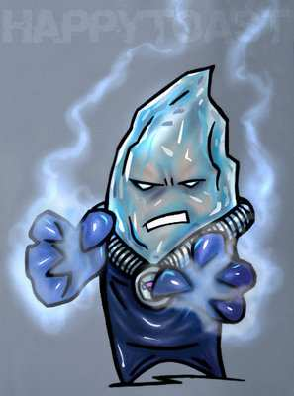
What is the coldest something can be? That is, what is the temperature when…
20
Copyright © 2010 Ryan P. Murphy

Slide 35
What is the coldest something can be? That is, what is the temperature when… all molecular motion stops?
20
Copyright © 2010 Ryan P. Murphy

Slide 36
Introduction to Science Review Game
LA B SAFETY | TO MAGNIFY | THE METRIC SYSTEM | BASE UNITS | -BONUS- THINGS MEASURED
1 | 6 | 11 | 16 | *21
2 | 7 | 12 | 17 | *22
3 | 8 | 13 | 18 | *23
4 | 9 | 14 | 19 | *24
5 | 10 | 15 | 20 | *25
Copyright © 2010 Ryan P. Murphy

Slide 37
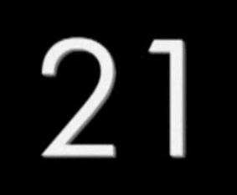
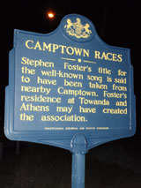
De Camptown ladies sing dis song, Doo-dah! Doo - dah!
De Camptown race-track 5 miles long, Oh, doo -dah day!
I come down dah wid my hat caved in, Doo-dah! doo-dah!
I go back home wid a pocket full of tin, Oh, doo-dah day!
Copyright © 2010 Ryan P. Murphy

Slide 38
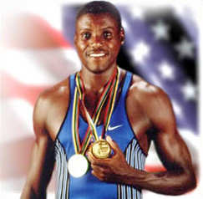
This famous U.S. Track and Field Star has won 10 Olympic medals including 9 gold? Many in the 100meter dash.
Carl L_ _ _ _
*22
Copyright © 2010 Ryan P. Murphy

Slide 39
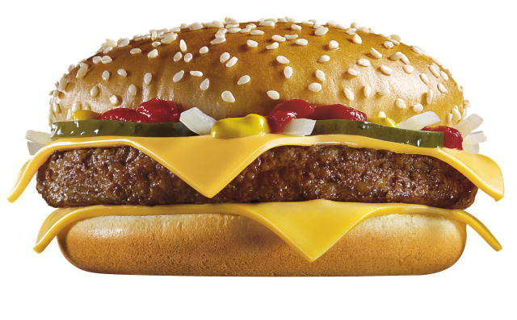
This is called a Royal with Cheese because the French use the Metric System?
*23
Copyright © 2010 Ryan P. Murphy

Slide 40
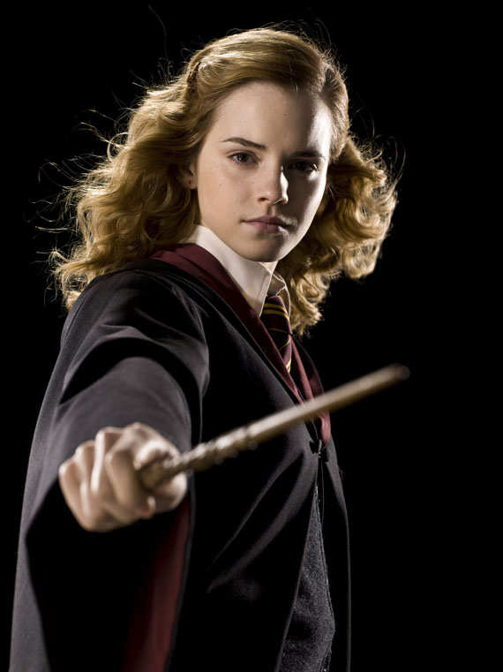
“Who am I?”
“I come from a country that uses the Metric System”
*24
Copyright © 2010 Ryan P. Murphy

Slide 41
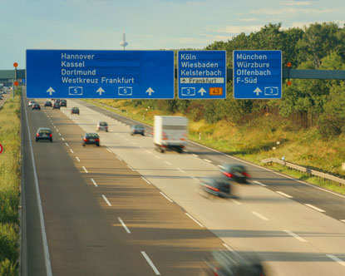
What is the name of this famous Highway system in Germany that uses the metric system?
*25
Copyright © 2010 Ryan P. Murphy

Slide 42
Introduction to Science Review Game
LA B SAFETY | TO MAGNIFY | THE METRIC SYSTEM | BASE UNITS | BONUS THINGS MEASURED
1 | 6 | 11 | 16 | *21
2 | 7 | 12 | 17 | *22
3 | 8 | 13 | 18 | *23
4 | 9 | 14 | 19 | *24
5 | 10 | 15 | 20 | *25
Final Question___________
Copyright © 2010 Ryan P. Murphy

Slide 43
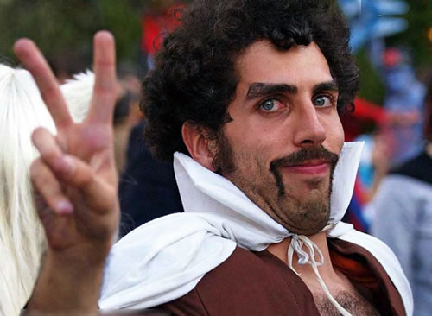
“You may wager up to 5pts for this final question”

Slide 44
“Please make your
wager now”

Slide 45
“ Peace, Love, and the Metric System”

Slide 46
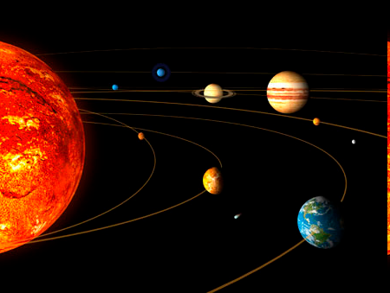
Final Question.
Jupiter is about 629,000,000 Kilometers from Earth. Please put the above distance into scientific notation.

Slide 47
Questions 1-20 = 5pts Each
Final Category (Bonus) = 1pt Each
Final Questions = 5 pt wager
Find the Owl = + 1pt
Secretly write “Owl” in the correct box worth 1pt.

Slide 48
ANSWER KEY

Slide 49
Questions 1-20 = 5pts Each
Final Category (Bonus) = 1pt Each
Final Questions = 5 pt wager
Find the Owl = + 1pt
Secretly write “Owl” in the correct box worth 1pt.

Slide 50
Introduction to Science Review Game
LA B SAFETY | TO MAGNIFY | THE METRIC SYSTEM | BASE UNITS | BONUS THINGS MEASURED
1 | 6 | 11 | 16 | *21
2 | 7 | 12 | 17 | *22
3 | 8 | 13 | 18 | *23
4 | 9 | 14 | 19 | *24
5 | 10 | 15 | 20 | *25
Copyright © 2010 Ryan P. Murphy

Slide 51
What does this mean!
1
Copyright © 2010 Ryan P. Murphy

Slide 52
What does this mean!
No food or drink in the lab.
1
Copyright © 2010 Ryan P. Murphy

Slide 53
How could this have been avoided?
A.) Keep flammable materials away from flame.
B.) Keep your hair back.
C.) Avoid spontaneous combustion.
D.) A and B.
E.) All the above.
F.) None of the above.
2
2
Copyright © 2010 Ryan P. Murphy

Slide 54
How could this have been avoided?
A.) Keep flammable materials away from flame.
B.) Keep your hair back.
C.) Avoid spontaneous combustion.
D.) A and B.
E.) All the above.
F.) None of the above.
2
2
Copyright © 2010 Ryan P. Murphy

Slide 55
How could this have been avoided?
A.) Keep flammable materials away from flame.
B.) Keep your hair back.
C.) Avoid spontaneous combustion.
D.) A and B.
E.) All the above.
F.) None of the above.
2
2
Copyright © 2010 Ryan P. Murphy

Slide 56
How could this have been avoided?
A.) Keep flammable materials away from flame.
B.) Keep your hair back.
C.) Avoid spontaneous combustion.
D.) A and B.
E.) All the above.
F.) None of the above.
2
2
Copyright © 2010 Ryan P. Murphy

Slide 57
How could this have been avoided?
A.) Keep flammable materials away from flame.
B.) Keep your hair back.
C.) Avoid spontaneous combustion.
D.) A and B.
E.) All the above.
F.) None of the above.
2
2
Copyright © 2010 Ryan P. Murphy

Slide 58
How could this have been avoided?
A.) Keep flammable materials away from flame.
B.) Keep your hair back.
C.) Avoid spontaneous combustion.
D.) A and B.
E.) All the above.
F.) None of the above.
2
2
Copyright © 2010 Ryan P. Murphy

Slide 59
How could this have been avoided?
A.) Keep flammable materials away from flame.
B.) Keep your hair back.
C.) Avoid spontaneous combustion.
D.) A and B.
E.) All the above.
F.) None of the above.
2
2
Copyright © 2010 Ryan P. Murphy

Slide 60
How could this have been avoided?
A.) Keep flammable materials away from flame.
B.) Keep your hair back.
C.) Avoid spontaneous combustion.
D.) A and B.
E.) All the above.
F.) None of the above.
2
2
Copyright © 2010 Ryan P. Murphy

Slide 61
Never cut toward yourself or others.
3
Copyright © 2010 Ryan P. Murphy

Slide 62
Never cut toward yourself or others.
3
Copyright © 2010 Ryan P. Murphy

Slide 63
Never cut toward yourself or others.
3
Copyright © 2010 Ryan P. Murphy

Slide 64
Where are these two items located in the lab?
4
Copyright © 2010 Ryan P. Murphy

Slide 65
Where are these two items located in the lab? Near the door to the hallway.
4
Copyright © 2010 Ryan P. Murphy

Slide 66
Please check glassware for cracks and to make sure it is clean.
5
Please check glassware for cracks or chips prior to use.
Copyright © 2010 Ryan P. Murphy

Slide 67
Please check glassware for cracks and to make sure it is clean.
5
Please check glassware for cracks or chips prior to use.
Copyright © 2010 Ryan P. Murphy

Slide 68
Please check glassware for cracks and to make sure it is clean.
5
Please check glassware for cracks or chips prior to use.
Copyright © 2010 Ryan P. Murphy

Slide 69
Introduction to Science Review Game
LA B SAFETY | TO MAGNIFY | THE METRIC SYSTEM | BASE UNITS | BONUS THINGS MEASURED
1 | 6 | 11 | 16 | *21
2 | 7 | 12 | 17 | *22
3 | 8 | 13 | 18 | *23
4 | 9 | 14 | 19 | *24
5 | 10 | 15 | 20 | *25
Copyright © 2010 Ryan P. Murphy

Slide 70
This is the term for making an object look smaller? Demagnification
6
Copyright © 2010 Ryan P. Murphy

Slide 71
This is the term for making an object look smaller? Demagnification
6
Copyright © 2010 Ryan P. Murphy

Slide 72
This type of microscope is best for viewing larger objects that light cannot pass through.
7
Copyright © 2010 Ryan P. Murphy

Slide 73
This type of microscope is best for viewing larger objects that light cannot pass through. Stereoscopic microscope
7
Copyright © 2010 Ryan P. Murphy

Slide 74
This type of microscope lets you look at small specimens that light can pass through. You need to use a glass slide and cover slip.
8
Copyright © 2010 Ryan P. Murphy

Slide 75
This type of microscope lets you look at small specimens that light can pass through. You need to use a glass slide and cover slip.
Compound Light Microscope.
8
Copyright © 2010 Ryan P. Murphy

Slide 76
What type of microscope is shown below.
This microscope doesn’t normally view living specimens or cells.
9
Copyright © 2010 Ryan P. Murphy

Slide 77
What type of microscope is shown below.
This microscope doesn’t normally view living specimens or cells.
Electron Microscope
9
Copyright © 2010 Ryan P. Murphy

Slide 78
Name the parts of the microscope below
1) Revolving Nose piece, 2) Eyepiece 3)Base
4) Coarse adjustment, 5) Light Source.
2
1
4
5
3
Copyright © 2010 Ryan P. Murphy

Slide 79
Name the parts of the microscope below
1) Revolving Nose piece, 2) Eyepiece 3)Base
4) Coarse adjustment, 5) Light Source.
2
1
4
5
3
Copyright © 2010 Ryan P. Murphy

Slide 80
Name the parts of the microscope below
1) Revolving Nose piece, 2) Eyepiece 3)Base
4) Coarse adjustment, 5) Light Source.
2
1
4
5
3
Copyright © 2010 Ryan P. Murphy

Slide 81
Name the parts of the microscope below
1) Revolving Nose piece, 2) Eyepiece 3)Base
4) Coarse adjustment, 5) Light Source.
2
1
4
5
3
Copyright © 2010 Ryan P. Murphy

Slide 82
Name the parts of the microscope below
1) Revolving Nose piece, 2) Eyepiece 3)Base
4) Coarse adjustment, 5) Light Source.
2
1
4
5
3
Copyright © 2010 Ryan P. Murphy

Slide 83
Name the parts of the microscope below
1) Revolving Nose piece, 2) Eyepiece 3)Base
4) Coarse adjustment, 5) Light Source.
2
1
4
5
3
Copyright © 2010 Ryan P. Murphy

Slide 84
Name the parts of the microscope below
1) Revolving Nose piece, 2) Eyepiece 3)Base
4) Coarse adjustment, 5) Light Source.
2
1
4
5
3
Copyright © 2010 Ryan P. Murphy

Slide 85
Name the parts of the microscope below
1) Revolving Nose piece, 2) Eyepiece 3)Base
4) Coarse adjustment, 5) Light Source.
2
1
4
5
3
Copyright © 2010 Ryan P. Murphy

Slide 86
Name the parts of the microscope below
1) Revolving Nose piece, 2) Eyepiece 3)Base
4) Coarse adjustment, 5) Light Source.
2
1
4
5
3
Copyright © 2010 Ryan P. Murphy

Slide 87
Name the parts of the microscope below
1) Revolving Nose piece, 2) Eyepiece 3)Base
4) Coarse adjustment, 5) Light Source.
2
1
4
5
3
Copyright © 2010 Ryan P. Murphy

Slide 88
Introduction to Science Review Game
LA B SAFETY | TO MAGNIFY | THE METRIC SYSTEM | BASE UNITS | BONUS THINGS MEASURED
1 | 6 | 11 | 16 | *21
2 | 7 | 12 | 17 | *22
3 | 8 | 13 | 18 | *23
4 | 9 | 14 | 19 | *24
5 | 10 | 15 | 20 | *25
Copyright © 2010 Ryan P. Murphy

Slide 89
11
“Based on this number the metric system is?”
Copyright © 2010 Ryan P. Murphy

Slide 90
11
“Right you are, if ten you guessed.”
10
Copyright © 2010 Ryan P. Murphy

Slide 91
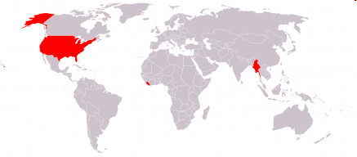
The Metric system is also called the SI system. What does the SI system stand for?
12
Copyright © 2010 Ryan P. Murphy

Slide 92
The Metric system is also called the SI system. What does the SI system stand for?
International System of Units (SI)
12
Copyright © 2010 Ryan P. Murphy

Slide 93
Please record the base units for each quantity represented below.
13
Copyright © 2010 Ryan P. Murphy

Slide 94
Please record the base units for each quantity represented below.
13
Copyright © 2010 Ryan P. Murphy

Slide 95
Convert the following 1.25 meters into the following.
Millimeters 1250
Centimeters 125
Kilometers .00125
14
14
Copyright © 2010 Ryan P. Murphy

Slide 96
Convert the following 1.25 meters into the following.
Millimeters 1250
Centimeters 125
Kilometers .00125
14
14
Copyright © 2010 Ryan P. Murphy

Slide 97
Convert the following 1.25 meters into the following.
Millimeters 1250
Centimeters 125
Kilometers .00125
14
14
Copyright © 2010 Ryan P. Murphy

Slide 98
Convert the following 1.25 meters into the following.
Millimeters 1250
Centimeters 125
Kilometers .00125
14
14
Copyright © 2010 Ryan P. Murphy

Slide 99
Convert the following 1.25 meters into the following.
Millimeters 1250
Centimeters 125
Kilometers .00125
14
14
Copyright © 2010 Ryan P. Murphy

Slide 100
Convert the following 1.25 meters into the following.
Millimeters 1250
Centimeters 125
Kilometers .00125
14
14
Copyright © 2010 Ryan P. Murphy

Slide 101
Convert the following 1.25 meters into the following.
Millimeters 1250
Centimeters 125
Kilometers .00125
14
14
Copyright © 2010 Ryan P. Murphy

Slide 102
Convert the following 1.25 meters into the following.
Millimeters 1250
Centimeters 125
Kilometers .00125
14
14
Copyright © 2010 Ryan P. Murphy

Slide 103
What does this acronym stand for?
15
King Kilometer
Hector - Hectometer
Died - Decameter
While - Standard
Drinking - Decimeter
Chocolate - Centimeter .
Milk - Millimeter
Copyright © 2010 Ryan P. Murphy

Slide 104
What does this acronym stand for?
15
OWL +1pt
King Kilometer
Hector - Hectometer
Died - Decameter
While - Standard
Drinking - Decimeter
Chocolate - Centimeter .
Milk - Millimeter
Copyright © 2010 Ryan P. Murphy

Slide 105
What does this acronym stand for?
15
OWL +1pt
King Kilometer
Hector - Hectometer
Died - Decameter
While - Standard
Drinking - Decimeter
Chocolate - Centimeter .
Milk - Millimeter
Copyright © 2010 Ryan P. Murphy

Slide 106
What does this acronym stand for?
15
King Kilometer
Hector - Hectometer
Died - Decameter
While - Standard
Drinking - Decimeter
Chocolate - Centimeter .
Milk - Millimeter
Copyright © 2010 Ryan P. Murphy

Slide 107
What does this acronym stand for?
15
King Kilometer
Hector - Hectometer
Died - Decameter
While - Standard
Drinking - Decimeter
Chocolate - Centimeter .
Milk - Millimeter
Copyright © 2010 Ryan P. Murphy

Slide 108
What does this acronym stand for?
15
King Kilometer
Hector - Hectometer
Died - Decameter
While - Standard
Drinking - Decimeter
Chocolate - Centimeter .
Milk - Millimeter
Copyright © 2010 Ryan P. Murphy

Slide 109
What does this acronym stand for?
15
King Kilometer
Hector - Hectometer
Died - Decameter
While - Standard
Drinking - Decimeter
Chocolate - Centimeter .
Milk - Millimeter
Copyright © 2010 Ryan P. Murphy

Slide 110
What does this acronym stand for?
15
King Kilometer
Hector - Hectometer
Died - Decameter
While - Standard
Drinking - Decimeter
Chocolate - Centimeter .
Milk - Millimeter
Copyright © 2010 Ryan P. Murphy

Slide 111
What does this acronym stand for?
15
King Kilometer
Hector - Hectometer
Died - Decameter
While - Standard
Drinking - Decimeter
Chocolate - Centimeter .
Milk - Millimeter
Copyright © 2010 Ryan P. Murphy

Slide 112
What does this acronym stand for?
15
King Kilometer
Hector - Hectometer
Died - Decameter
While - Standard
Drinking - Decimeter
Chocolate - Centimeter .
Milk - Millimeter
Copyright © 2010 Ryan P. Murphy

Slide 113
What does this acronym stand for?
15
King Kilometer
Hector - Hectometer
Died - Decameter
While - Standard
Drinking - Decimeter
Chocolate - Centimeter .
Milk - Millimeter
Copyright © 2010 Ryan P. Murphy

Slide 114
What does this acronym stand for?
15
King Kilometer
Hector- Hectometer
Died - Decameter
While - Standard
Drinking - Decimeter
Chocolate - Centimeter .
Milk - Millimeter
Copyright © 2010 Ryan P. Murphy

Slide 115
What does this acronym stand for?
15
King Kilometer
Hector - Hectometer
Died - Decameter
While - Standard
Drinking - Decimeter
Chocolate - Centimeter .
Milk - Millimeter
Copyright © 2010 Ryan P. Murphy

Slide 116
What does this acronym stand for?
15
King Kilometer
Hector - Hectometer
Died - Decameter
While - Standard
Drinking - Decimeter
Chocolate - Centimeter .
Milk - Millimeter
Copyright © 2010 Ryan P. Murphy

Slide 117
What does this acronym stand for?
15
King Kilometer
Hector- Hectometer
Died - Decameter
While - Standard
Drinking - Decimeter
Chocolate - Centimeter .
Milk - Millimeter
Copyright © 2010 Ryan P. Murphy

Slide 118
What does this acronym stand for?
15
King Kilometer
Hector - Hectometer
Died - Decameter
While - Standard
Drinking - Decimeter
Chocolate - Centimeter
Milk - Millimeter
Copyright © 2010 Ryan P. Murphy

Slide 119
What does this acronym stand for?
15
King Kilometer
Hector - Hectometer
Died - Decameter
While - Standard
Drinking - Decimeter
Chocolate - Centimeter
Milk - Millimeter
Copyright © 2010 Ryan P. Murphy

Slide 120
What does this acronym stand for?
15
King Kilometer
Hector - Hectometer
Died - Decameter
While - Standard
Drinking - Decimeter
Chocolate - Centimeter
Milk - Millimeter
Copyright © 2010 Ryan P. Murphy

Slide 121
Introduction to Science Review Game
LA B SAFETY | TO MAGNIFY | THE METRIC SYSTEM | BASE UNITS | BONUS THINGS MEASURED
1 | 6 | 11 | 16 | *21
2 | 7 | 12 | 17 | *22
3 | 8 | 13 | 18 | *23
4 | 9 | 14 | 19 | *24
5 | 10 | 15 | 20 | *25
Copyright © 2010 Ryan P. Murphy

Slide 122
What is the base unit associated with weight?
16
Copyright © 2010 Ryan P. Murphy

Slide 123
What is the base unit associated with weight? Grams
16
Copyright © 2010 Ryan P. Murphy

Slide 124
What base unit is shown here? Please measure this unit based on the fluid in this graduated cylinder.
17
Copyright © 2010 Ryan P. Murphy

Slide 125
What base unit is shown here? Please measure this unit based on the fluid in this graduated cylinder. Liters
17
Copyright © 2010 Ryan P. Murphy

Slide 126
What base unit is shown here? Please measure this unit based on the fluid in this graduated cylinder. Liters / 6.8 milliliters
17
Copyright © 2010 Ryan P. Murphy

Slide 127
Which of the objects in this tank has a density of more than 1 g/cm3?
18
Copyright © 2010 Ryan P. Murphy

Slide 128
Which of the objects in this tank has a density of more than 1 g/cm3? Toy airplane
18
Copyright © 2010 Ryan P. Murphy

Slide 129
Caution!
Don’t answer quickly. What is the temperature outside in degrees Celsius?
2-4 degrees Celsius
19
Copyright © 2010 Ryan P. Murphy

Slide 130
Caution!
Don’t answer quickly. What is the temperature outside in degrees Celsius?
2-4 degrees Celsius
19
Copyright © 2010 Ryan P. Murphy

Slide 131
What is the coldest something can be? That is, what is the temperature when all molecular motion stops?
20
Copyright © 2010 Ryan P. Murphy

Slide 132
What is the coldest something can be? That is, what is the temperature when all molecular motion stops?
Absolute zero or zero degrees Kelvin.
20
Copyright © 2010 Ryan P. Murphy

Slide 133
What is the coldest something can be? That is, what is the temperature when all molecular motion stops?
Warm Again
20
Copyright © 2010 Ryan P. Murphy

Slide 134
What is the coldest something can be? That is, what is the temperature when all molecular motion stops?
Absolute zero or zero degrees Kelvin.
20
Copyright © 2010 Ryan P. Murphy

Slide 135
What is the coldest something can be? That is, what is the temperature when all molecular motion stops?
Warm Again
20
Copyright © 2010 Ryan P. Murphy

Slide 136
What is the coldest something can be? That is, what is the temperature when all molecular motion stops?
Absolute zero or zero degrees Kelvin.
20
Copyright © 2010 Ryan P. Murphy

Slide 137
Introduction to Science Review Game
LA B SAFETY | TO MAGNIFY | THE METRIC SYSTEM | BASE UNITS | -BONUS- THINGS MEASURED
1 | 6 | 11 | 16 | *21
2 | 7 | 12 | 17 | *22
3 | 8 | 13 | 18 | *23
4 | 9 | 14 | 19 | *24
5 | 10 | 15 | 20 | *25
Copyright © 2010 Ryan P. Murphy

Slide 138
De Camptown ladies sing dis song, Doo-dah! Doo - dah!
De Camptown race-track 5 miles long, Oh, doo -dah day!
I come down dah wid my hat caved in, Doo-dah! doo-dah!
I go back home wid a pocket full of tin, Oh, doo-dah day!
Copyright © 2010 Ryan P. Murphy

Slide 139
De Camptown ladies sing dis song, Doo-dah! Doo - dah!
De Camptown race-track 5 miles long, Oh, doo -dah day!
I come down dah wid my hat caved in, Doo-dah! doo-dah!
I go back home wid a pocket full of tin, Oh, doo-dah day!
Copyright © 2010 Ryan P. Murphy

Slide 140
De Camptown ladies sing dis song, Doo-dah! Doo - dah!
De Camptown race-track 5 miles long, Oh, doo -dah day!
I come down dah wid my hat caved in, Doo-dah! doo-dah!
I go back home wid a pocket full of tin, Oh, doo-dah day!
Copyright © 2010 Ryan P. Murphy

Slide 141
De Camptown ladies sing dis song, Doo-dah! Doo - dah!
De Camptown race-track 5 miles long, Oh, doo -dah day!
I come down dah wid my hat caved in, Doo-dah! doo-dah!
I go back home wid a pocket full of tin, Oh, doo-dah day!
Copyright © 2010 Ryan P. Murphy

Slide 142
This famous U.S. Track and Field Star has won 10 Olympic medals including 9 gold? Many in the 100meter dash.
Carl L_ _ _ _
*22
Copyright © 2010 Ryan P. Murphy

Slide 143
This famous U.S. Track and Field Star has won 10 Olympic medals including 9 gold? Many in the 100meter dash.
ewis
Carl L_ _ _ _
*22
Copyright © 2010 Ryan P. Murphy

Slide 144
This is called a Royal with Cheese because the French use the Metric System?
*23
Copyright © 2010 Ryan P. Murphy

Slide 145
This is called a Royal with Cheese because the French use the Metric System?
Quarter Pounder with Cheese
*23
Copyright © 2010 Ryan P. Murphy

Slide 146
“Who am I?”
“I come from a country that uses the Metric System”
*24
Copyright © 2010 Ryan P. Murphy

Slide 147
“I’m Hermione Granger.” granger
*24
Copyright © 2010 Ryan P. Murphy

Slide 148
“A metricus a bettericus!”
granger
*24
Copyright © 2010 Ryan P. Murphy

Slide 149
What is the name of this famous Highway system in Germany that uses the metric system?
*25
Copyright © 2010 Ryan P. Murphy

Slide 150
What is the name of this famous Highway system in Germany that uses the metric system?
Autobahn
*25
Copyright © 2010 Ryan P. Murphy

Slide 151
Introduction to Science Review Game
LA B SAFETY | TO MAGNIFY | THE METRIC SYSTEM | BASE UNITS | BONUS THINGS MEASURED
1 | 6 | 11 | 16 | *21
2 | 7 | 12 | 17 | *22
3 | 8 | 13 | 18 | *23
4 | 9 | 14 | 19 | *24
5 | 10 | 15 | 20 | *25
Final Question___________
Copyright © 2010 Ryan P. Murphy

Slide 152
“You could wager up to 5pts for this final question”

Slide 153
“ Peace, Love, and the Metric System”

Slide 154
Final Question.
Jupiter is about 629,000,000 Kilometers from Earth. Please put the above distance into scientific notation.

Slide 155
Final Question.
Jupiter is about 629,000,000 Kilometers from Earth. Please put the above distance into scientific notation. 6.29 x 108

Slide 156
Questions 1-20 = 5pts Each
Final Category (Bonus) = 1pt Each
Final Questions = 5 pt wager
Find the Owl = + 1pt
Secretly write “Owl” in the correct box worth 1pt.

Slide 157
Science Skills Unit
Part 1, 2, 3 Review Game

Slide 158
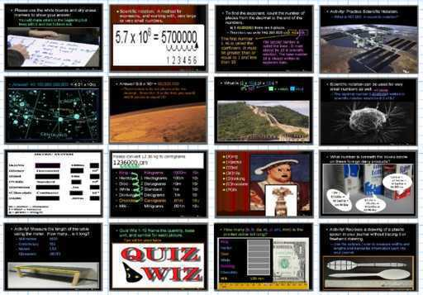
Science Skills Unit

Slide 159
Science Skills Unit
Areas of Focus within The Science Skills Unit: Lab Safety, Lab Safety Equipment, Magnification, Microscopes, Stereoscopes, Hand Lenses, Electron Microscopes, Compound Light Microscopes, Parts of a Compound Microscope, Metric System, International System of Units, Scientific Notation, Base Units, Mass, Volume, Density, Temperature, Time, Other SI Units, Observation, Inferences, Scientific Method, What is Science? What makes a good scientist? Types of Scientists, Branches of Science, Scientific Method, Hypothesis, Observations, Inferences.
Science Skills Unit on TpT
Hundreds of PowerPoint samples, the bundled homework package, unit notes, and much more can be previewed at…
Science Skills Unit Preview Link

Slide 160
Science Skills Unit
Areas of Focus within The Science Skills Unit: Lab Safety, Lab Safety Equipment, Magnification, Microscopes, Stereoscopes, Hand Lenses, Electron Microscopes, Compound Light Microscopes, Parts of a Compound Microscope, Metric System, International System of Units, Scientific Notation, Base Units, Mass, Volume, Density, Temperature, Time, Other SI Units, Observation, Inferences, Scientific Method, What is Science? What makes a good scientist? Types of Scientists, Branches of Science, Scientific Method, Hypothesis, Observations, Inferences.
Lab Safety Lesson Bundle
Microscopes and Magnification Lesson Bundle
Metric System / SI Lesson Bundle
Scientific Notation Lesson Bundle
Volume and Density Lesson Bundle
Scientific Method, Observation Skills Lesson Bundle
Science Skills Unit Flash Cards
Science Skills Unit Crossword Puzzle
Science Skills Unit Review Game
Science Skills Unit Preview, Homework Bundle, Notes
Science Skills Unit Notes, Standards and Curriculum

Slide 162
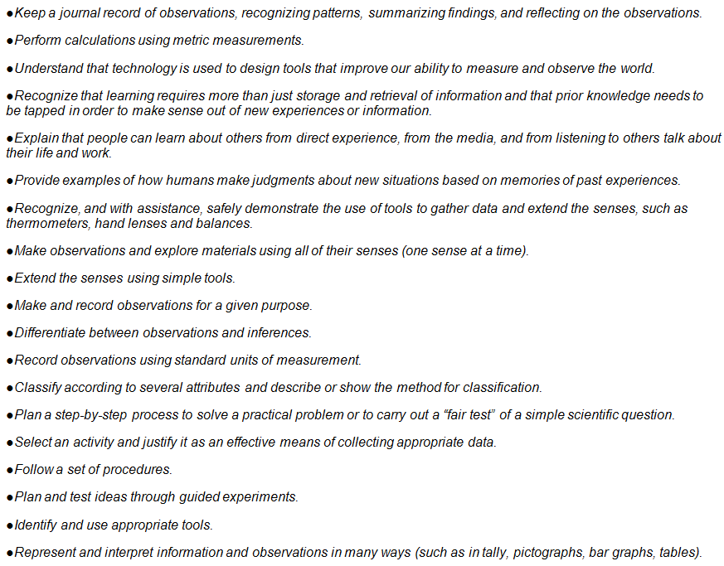
Additional Standards Addressed

Slide 163
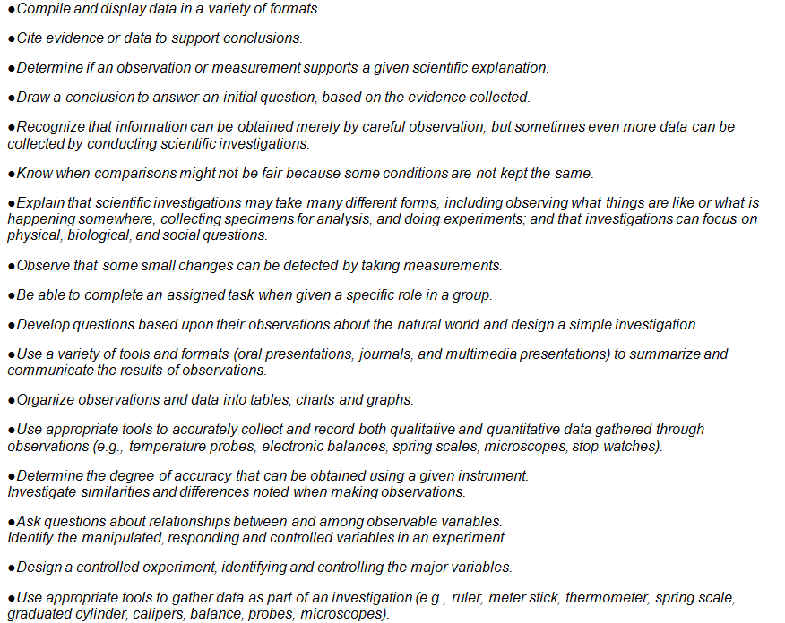

Slide 164
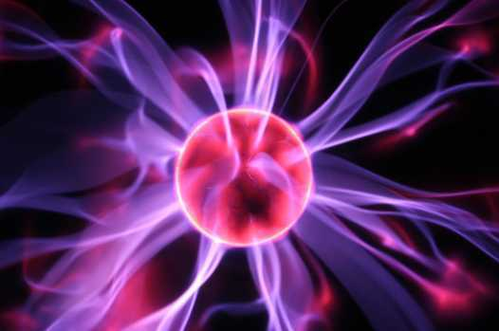
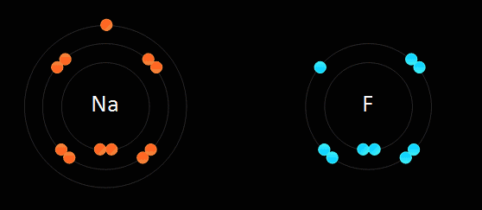
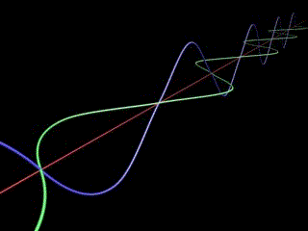
Physical Science Curriculum
Physical Science Curriculum Link
Newton's Laws of Motion, Forces in Motion and Simple Machines Unit
Laws of Motion and Simple Machines Unit Preview Link
Matter, Energy, and the Environment Unit
Matter, Energy, and the Environment Unit Preview
Atoms and Periodic Table of the Elements Unit on TpT
Atoms and Periodic Table of the Elements Unit Preview Link
Science Skills Unit on TpT
Science Skills Unit Preview Link

Slide 167
NGSS Standards HS

Slide 168
Additional Standards Addressed

Slide 169
Life Science Curriculum Link
Physical Science Curriculum Link
Earth Science Curriculum Link

Slide 170
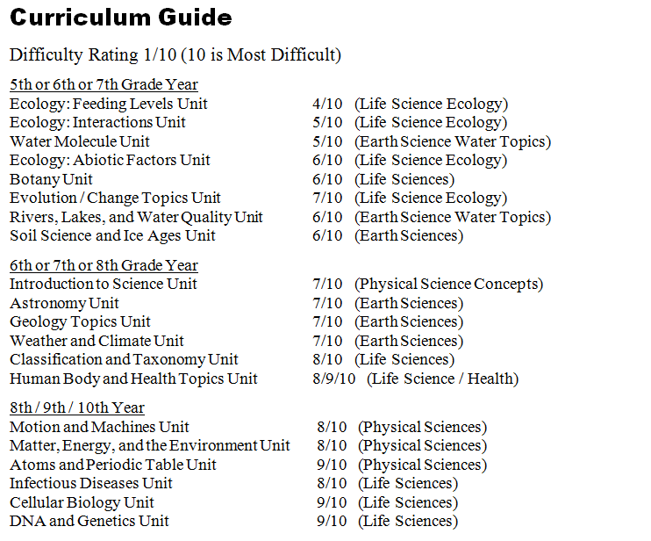

Slide 171
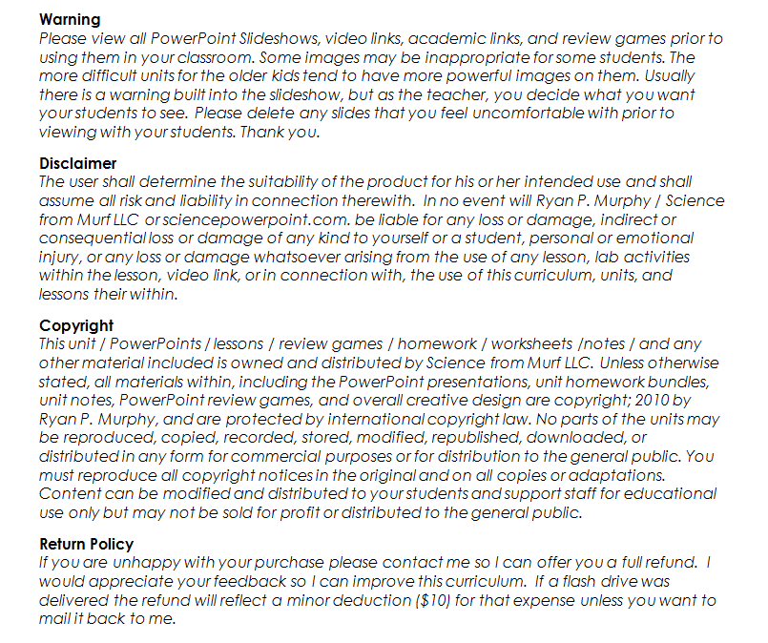

Slide 172
Earth Science Curriculum
Earth Science Curriculum Link
Earth Science Units | Purchase Individual Unit Link on TpT
Geology Topics Unit | Geology Unit on TpT
Astronomy Topics Unit | Astronomy Unit on TpT
Weather and Climate Unit | Weather and Climate Unit on TpT
Soil Science, Weathering, More | Weathering, Soil Science, Ice-Ages, Glaciers Unit on TpT
Water Unit | Water Unit on TpT
Rivers Unit | Rivers, Lakes, and Water Quality Unit on TpT

Slide 173
Life Science Curriculum
Life Science Curriculum Link
Life Science Units | Purchase Individual Unit Link on TpT
DNA and Genetics Unit | DNA and Genetics Unit on TpT
Cell Biology Unit | Cell Biology Unit on TpT
Infectious Diseases Unit | Virus, Bacteria, Parasites, Diseases Unit
Taxonomy and Classification Unit | Taxonomy and Classification Unit
Evolution / Natural Selection Unit | Evolution and Natural Selection Unit on TpT
Botany Topics Unit | Botany Unit
Ecology Feeding Levels Unit | Ecology Feeding Levels Unit on TpT
Ecology Interactions Unit | Ecology Interactions Unit on TpT
Ecology Abiotic Factors Unit | Ecology Abiotic Factors Unit on TpT
Anatomy, Human Body Systems | Human Body Systems and Health Topics Unit

Slide 174
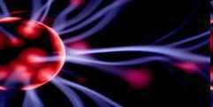
Physical Science Curriculum
Physical Science Units | Purchase Individual Unit Link on TpT
Science Skills Unit | Science Skills Unit on TpT
Motion and Machines Unit | Newton's Laws of Motion, Forces in Motion and Simple Machines Unit
Matter, Energy, Envs. Unit | Matter, Energy, and the Environment Unit
Atoms and Periodic Table Unit | Atoms and Periodic Table of the Elements Unit on TpT
Physical Science Curriculum Link

Slide 175
Follow my TpT store, get notifications about flash freebies, curriculum updates, great classroom ideas, pins, and much more by following me on Facebook , Twitter, and Pinterest.

Slide 176
Curriculum Tour Link (190mb)
Thank you for your time and interest in this curriculum. The link above will take you to my curriculum tour that includes many PowerPoint previews, unit notes, bundled homework packages, curriculum information and much more. Please feel free to contact me with questions. Thanks again and best wishes.
Sincerely,
Ryan Murphy M.Ed
ryemurf@gmail.com

Slide 177
Science Curriculum TpT Link
sciencepowerpoint.com

