Slide 1
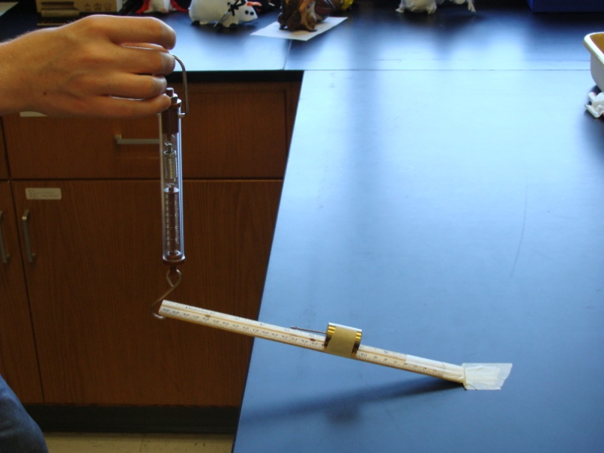
Machines Review Game
Part III

Slide 2
Machines Review Game
PULL OVER | ARE YOU CLEVER ENOUGH | ON A JET PLANE | WHEELIN and DEALIN | -BONUS- GREEN MACHINE
1 | 6 | 11 | 16 | *21
2 | 7 | 12 | 17 | *22
3 | 8 | 13 | 18 | *23
4 | 9 | 14 | 19 | *24
5 | 10 | 15 | 20 | *25
Copyright © 2010 Ryan P. Murphy

Slide 3
How to play…
Don’t play like Jeo_ _ _ _ y.
Class should be divided into several small groups.
Groups should use science journal (red slide notes), homework, and other available materials to assist you.
Groups can communicate quietly with each other but no sharing answers between groups.
Practice quietly communicating right now?
Practice Communication Question:
Your group gets to order one pizza, and you can have two toppings. What does your group want?

Slide 4
Questions 1-20 = 5pts Each
Final Category (Bonus) = 1pt Each
Final Questions = 5 pt wager
If you wager 5 on the last question and get it wrong you lose 5 pts. Wager 5 and get it right you get 5 pts.
Find the Owl =
Secretly write “Owl” in the correct box worth 1pt.
“I’ll be about this big.”

Slide 5
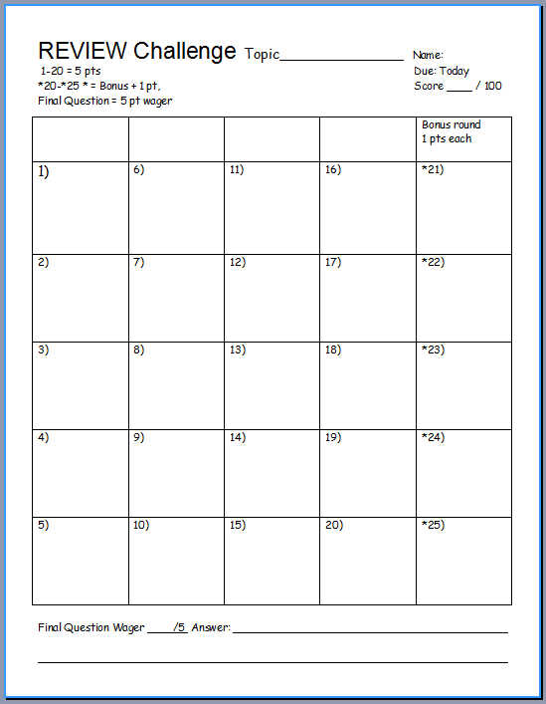
Is your name on the review sheet?
Name

Slide 6
Is your name on the review sheet?
Add the categories
along the top
on the next slide.

Slide 7
Machines Review Game
PULL OVER | ARE YOU CLEVER ENOUGH | ON A JET PLANE | WHEELIN and DEALIN | -BONUS- GREEN MACHINE
1 | 6 | 11 | 16 | *21
2 | 7 | 12 | 17 | *22
3 | 8 | 13 | 18 | *23
4 | 9 | 14 | 19 | *24
5 | 10 | 15 | 20 | *25
Copyright © 2010 Ryan P. Murphy

Slide 8
Machines Review Game
PULL OVER | ARE YOU CLEVER ENOUGH | ON A JET PLANE | WHEELIN and DEALIN | -BONUS- GREEN MACHINE
1 | 6 | 11 | 16 | *21
2 | 7 | 12 | 17 | *22
3 | 8 | 13 | 18 | *23
4 | 9 | 14 | 19 | *24
5 | 10 | 15 | 20 | *25
Copyright © 2010 Ryan P. Murphy

Slide 9
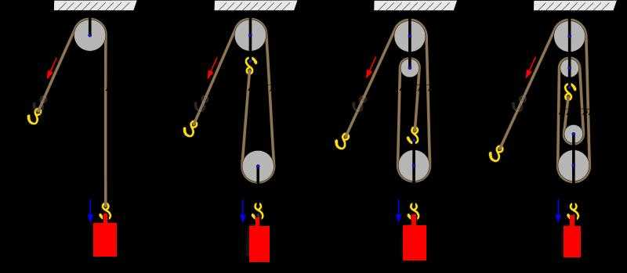
What is the MA of each pulley below?
1
A
B
C
D

Slide 10
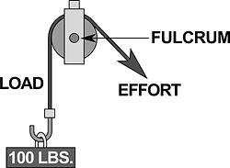
Name this type of pulley?
2
Copyright © 2010 Ryan P. Murphy

Slide 11
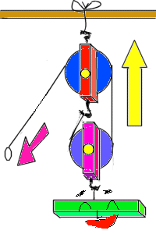
What is this type of pulley?
3
Copyright © 2010 Ryan P. Murphy

Slide 12
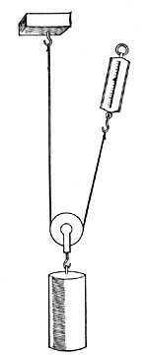
What type of pulley is this?
4
Copyright © 2010 Ryan P. Murphy

Slide 13
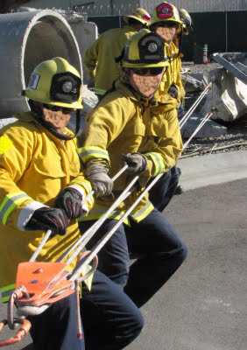
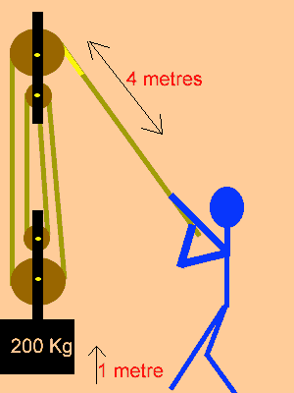
A pulley makes work seem easier, it changes the direction of motion to work with gravity.
Uses your body weight against the resistance.
5
Copyright © 2010 Ryan P. Murphy

Slide 14
Machines Review Game
PULL OVER | ARE YOU CLEVER ENOUGH | ON A JET PLANE | WHEELIN and DEALIN | -BONUS- GREEN MACHINE
1 | 6 | 11 | 16 | *21
2 | 7 | 12 | 17 | *22
3 | 8 | 13 | 18 | *23
4 | 9 | 14 | 19 | *24
5 | 10 | 15 | 20 | *25
Copyright © 2010 Ryan P. Murphy

Slide 15
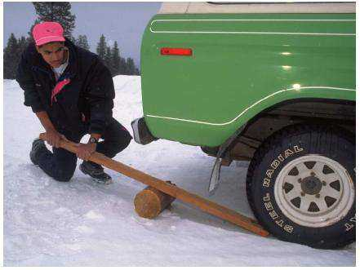
What class of levers is this picture?
6
Copyright © 2010 Ryan P. Murphy

Slide 16
What class of levers is this picture?
Force
6
Load
Fulcrum
Copyright © 2010 Ryan P. Murphy

Slide 17
What is the MA of this lever?
MA = length of effort arm ÷ length of resistance arm.
2 meters
4 meters
7
Copyright © 2010 Ryan P. Murphy

Slide 18
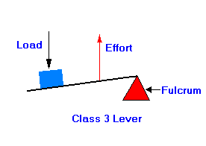
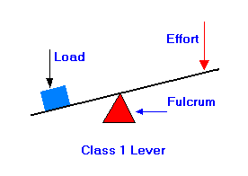
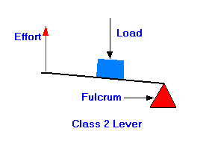
Which is a first, second, and third class lever.?
A
B
C
8

Slide 19
9
and name the class of lever?
B
C
A

Slide 20
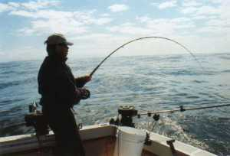
and name the class of lever?
10
C
B
A

Slide 21
Machines Review Game
PULL OVER | ARE YOU CLEVER ENOUGH | ON A JET PLANE | WHEELIN and DEALIN | -BONUS- GREEN MACHINE
1 | 6 | 11 | 16 | *21
2 | 7 | 12 | 17 | *22
3 | 8 | 13 | 18 | *23
4 | 9 | 14 | 19 | *24
5 | 10 | 15 | 20 | *25
Copyright © 2010 Ryan P. Murphy

Slide 22
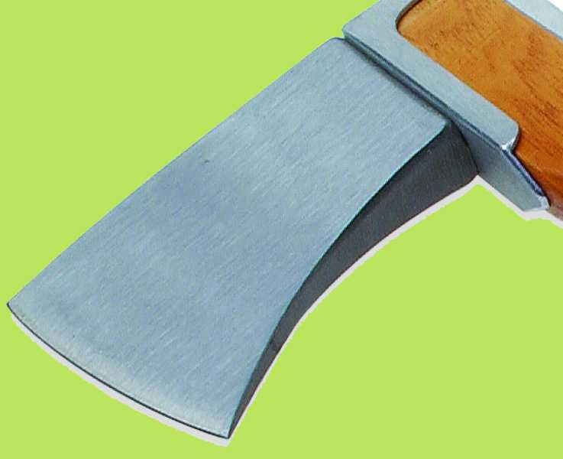
What simple machine is this and what’s the mechanical advantage?
11
15 cm
3 cm

Slide 23
Please find the MA of the shapes below?
12
15
3
5
2
8
8
D
4
4

Slide 24
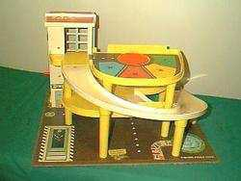
What simple machine is represented below?
13

Slide 25
Name this simple machine and find the MA.
Divide circumference by the pitch to get MA.
14
2 cm
6 cm
Copyright © 2010 Ryan P. Murphy

Slide 26
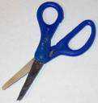
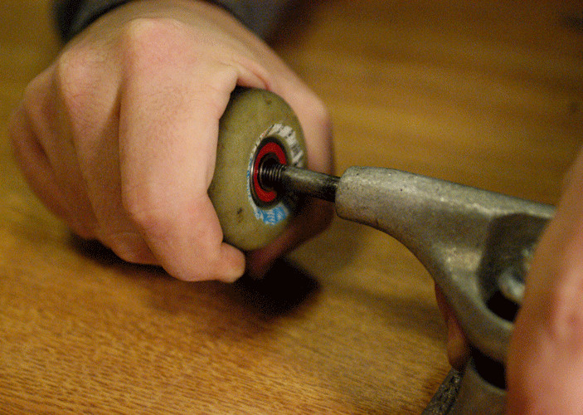
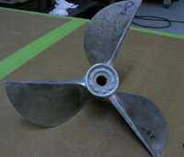
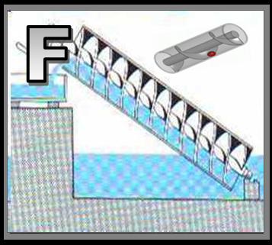
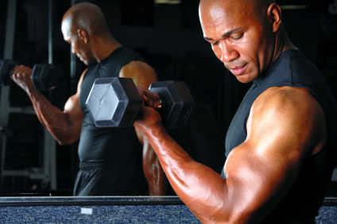
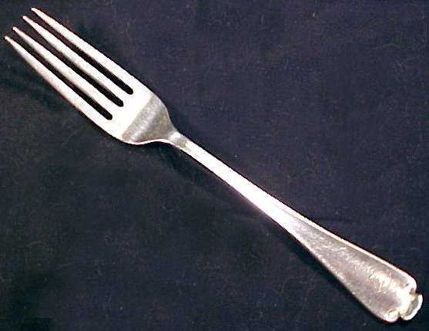
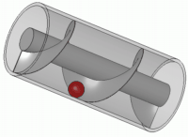
15
Name each simple machine below
A
B
C
D
E
F

Slide 27
Machines Review Game
PULL OVER | ARE YOU CLEVER ENOUGH | ON A JET PLANE | WHEELIN and DEALIN | -BONUS- GREEN MACHINE
1 | 6 | 11 | 16 | *21
2 | 7 | 12 | 17 | *22
3 | 8 | 13 | 18 | *23
4 | 9 | 14 | 19 | *24
5 | 10 | 15 | 20 | *25
Copyright © 2010 Ryan P. Murphy

Slide 28
The mechanical advantage of a wheel and axle is the ratio of the radius of the wheel divided by the radius of the axle.
16
Copyright © 2010 Ryan P. Murphy

Slide 29
New Question

Slide 30
What’s the mechanical advantage of this wheel and axle?
17
Copyright © 2010 Ryan P. Murphy

Slide 31
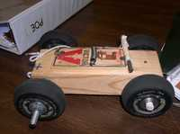
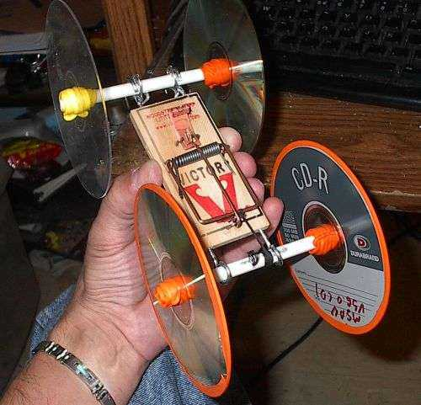
Which wheel and axle will be best for a mouse trap car? Best Mechanical Advantage
18
A
B

Slide 32
Machines…
A.) Transfer force from one place to another.
B.) Change direction of a force.
C.) Increase the magnitude of a force.
D.) Increase the distance or speed of a force.
19

Slide 33
20

Slide 34
Machines Review Game
PULL OVER | ARE YOU CLEVER ENOUGH | ON A JET PLANE | WHEELIN and DEALIN | -BONUS- GREEN MACHINE
1 | 6 | 11 | 16 | *21
2 | 7 | 12 | 17 | *22
3 | 8 | 13 | 18 | *23
4 | 9 | 14 | 19 | *24
5 | 10 | 15 | 20 | *25
Copyright © 2010 Ryan P. Murphy

Slide 35
Check out the WEDGE from this movie?
*21
Copyright © 2010 Ryan P. Murphy

Slide 36
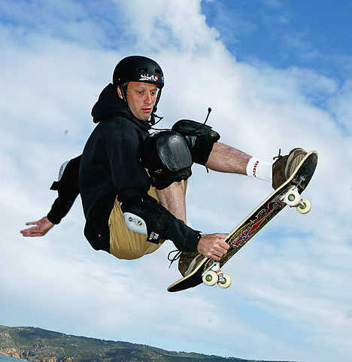
Who is this person and what two machines is he working?
*22
Copyright © 2010 Ryan P. Murphy

Slide 37
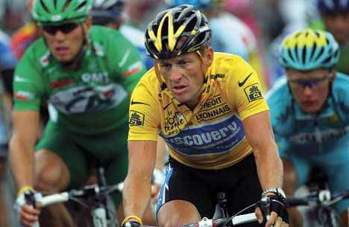
Who am I?
*23
23
Copyright © 2010 Ryan P. Murphy

Slide 38
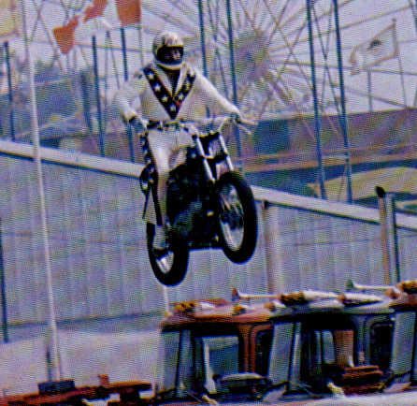
Who is this?
*24

Slide 39
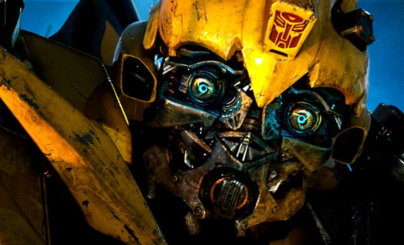
Name this machine?
25

Slide 40
Machines Review Game
PULL OVER | ARE YOU CLEVER ENOUGH | ON A JET PLANE | WHEELIN and DEALIN | -BONUS- GREEN MACHINE
1 | 6 | 11 | 16 | *21
2 | 7 | 12 | 17 | *22
3 | 8 | 13 | 18 | *23
4 | 9 | 14 | 19 | *24
5 | 10 | 15 | 20 | *25
Final Question:_________________
Copyright © 2010 Ryan P. Murphy

Slide 41
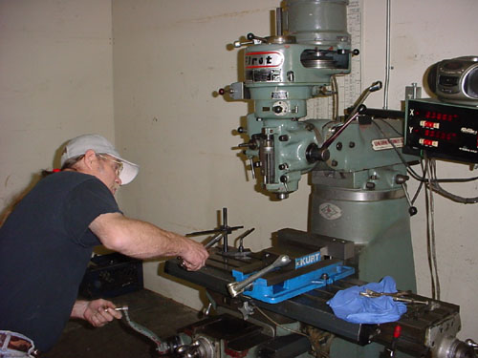
“You may wager up to
5 pts for this final Question.” “Please make your wager now.”

Slide 42
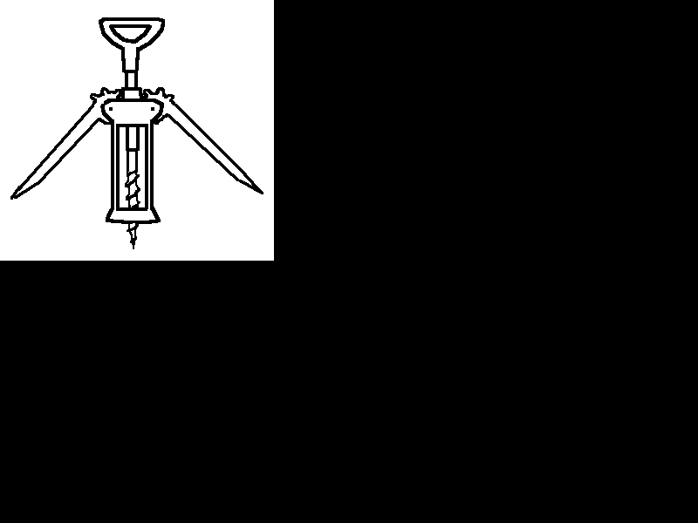
Final Question?
Name all of the simple machines below.
Copyright © 2010 Ryan P. Murphy

Slide 43
Answer Key

Slide 44
Machines Review Game
PULL OVER | ARE YOU CLEVER ENOUGH | ON A JET PLANE | WHEELIN and DEALIN | -BONUS- GREEN MACHINE
1 | 6 | 11 | 16 | *21
2 | 7 | 12 | 17 | *22
3 | 8 | 13 | 18 | *23
4 | 9 | 14 | 19 | *24
5 | 10 | 15 | 20 | *25
Copyright © 2010 Ryan P. Murphy

Slide 45
Machines Review Game
PULL OVER | ARE YOU CLEVER ENOUGH | ON A JET PLANE | WHEELIN and DEALIN | -BONUS- GREEN MACHINE
1 | 6 | 11 | 16 | *21
2 | 7 | 12 | 17 | *22
3 | 8 | 13 | 18 | *23
4 | 9 | 14 | 19 | *24
5 | 10 | 15 | 20 | *25
Copyright © 2010 Ryan P. Murphy

Slide 46
What is the MA of each pulley below?
1
A
B
C
D

Slide 47
What is the MA of each pulley below?
1
A
B
C
D

Slide 48
What is the MA of each pulley below?
1
A
1
B
C
D

Slide 49
What is the MA of each pulley below?
1
A
1
B
C
D

Slide 50
What is the MA of each pulley below?
1
A
1
B
C
D

Slide 51
What is the MA of each pulley below?
1
A
1
B
C
D

Slide 52
What is the MA of each pulley below?
1
A
1
B
C
D

Slide 53
What is the MA of each pulley below?
1
A
1
B
C
D

Slide 54
What is the MA of each pulley below?
1
A
1
B
C
D

Slide 55
Name this type of pulley?
2
Copyright © 2010 Ryan P. Murphy

Slide 56
Name this type of pulley?
FIXED PULLEY
2
Copyright © 2010 Ryan P. Murphy

Slide 57
What is this type of pulley?
3
Copyright © 2010 Ryan P. Murphy

Slide 58
What is this type of pulley? COMBINED PULLEY OR BLOCK AND TACKLE
3
Copyright © 2010 Ryan P. Murphy

Slide 59
What type of pulley is this?
4
Copyright © 2010 Ryan P. Murphy

Slide 60
What type of pulley is this? MOVABLE PULLEY
4
Copyright © 2010 Ryan P. Murphy

Slide 61
A pulley makes work seem easier, it changes the direction of motion to work with gravity.
Uses your body weight against the resistance.
5
Copyright © 2010 Ryan P. Murphy

Slide 62
A pulley makes work seem easier, it changes the direction of motion to work with gravity.
Uses your body weight against the resistance.
5
Copyright © 2010 Ryan P. Murphy

Slide 63
A pulley makes work seem easier, it changes the direction of motion to work with gravity.
Uses your body weight against the resistance.
Direction
5
Copyright © 2010 Ryan P. Murphy

Slide 64
Machines Review Game
PULL OVER | ARE YOU CLEVER ENOUGH | ON A JET PLANE | WHEELIN and DEALIN | -BONUS- GREEN MACHINE
1 | 6 | 11 | 16 | *21
2 | 7 | 12 | 17 | *22
3 | 8 | 13 | 18 | *23
4 | 9 | 14 | 19 | *24
5 | 10 | 15 | 20 | *25
Copyright © 2010 Ryan P. Murphy

Slide 65
What class of levers is this picture?
6
Copyright © 2010 Ryan P. Murphy

Slide 66
What class of levers is this picture?
Force
6
Load
Fulcrum
Copyright © 2010 Ryan P. Murphy

Slide 67
What class of levers is this picture?
FIRST CLASS LEVER
Force
6
Load
Fulcrum
Copyright © 2010 Ryan P. Murphy

Slide 68
What is the MA of this lever?
MA = length of effort arm ÷ length of resistance arm.
2 meters
4 meters
7
Copyright © 2010 Ryan P. Murphy

Slide 69
What is the MA of this lever?
MA = length of effort arm ÷ length of resistance arm.
2 meters
4 meters
7
Copyright © 2010 Ryan P. Murphy

Slide 70
What is the MA of this lever?
MA = length of effort arm ÷ length of resistance arm.
2 meters
4 meters
4 meters / 2 meters =
7
Copyright © 2010 Ryan P. Murphy

Slide 71
What is the MA of this lever?
MA = length of effort arm ÷ length of resistance arm.
2 meters
4 meters
4 meters / 2 meters = MA 2
7
Copyright © 2010 Ryan P. Murphy

Slide 72
Which is a first, second, and third class lever.?
A
B
C
8

Slide 73
Which is a first, second, and third class lever.?
A
B
C
8

Slide 74
Which is a first, second, and third class lever.?
A
B
C
Third Class
8

Slide 75
Which is a first, second, and third class lever.?
A
B
C
Third Class
8

Slide 76
Which is a first, second, and third class lever.?
A
B
C
Third Class
First Class
8

Slide 77
Which is a first, second, and third class lever.?
A
B
C
Third Class
First Class
8

Slide 78
Which is a first, second, and third class lever.?
A
B
C
Third Class
First Class
Second Class
8

Slide 79
9
and name the class of lever?
B
C
A

Slide 80
9
and name the class of lever?
B
C
A

Slide 81
9
and name the class of lever?
Effort
B
C
A

Slide 82
9
and name the class of lever?
Effort
B
C
A

Slide 83
9
and name the class of lever?
Effort
Load
B
C
A

Slide 84
9
and name the class of lever?
Effort
Load
B
C
A

Slide 85
9
and name the class of lever?
Effort
Load
Fulcrum
B
C
A

Slide 86
9
and name the class of lever?
Effort
Load
Fulcrum
B
C
A

Slide 87
9
Second Class Lever
Effort
Load
Fulcrum
B
C
A

Slide 88
and name the class of lever?
10
C
B
A

Slide 89
and name the class of lever?
10
C
B
A

Slide 90
and name the class of lever?
10
C
B
A
Fulcrum

Slide 91
and name the class of lever?
10
C
B
A
Fulcrum

Slide 92
and name the class of lever?
10
C
Force
B
A
Fulcrum

Slide 93
and name the class of lever?
10
C
Force
B
A
Fulcrum

Slide 94
and name the class of lever?
10
C
Force
B
Load
A
Fulcrum

Slide 95
and name the class of lever?
10
C
Force
B
Load
A
Fulcrum

Slide 96
Third Class Lever
10
C
Force
B
Load
A
Fulcrum

Slide 97
Machines Review Game
PULL OVER | ARE YOU CLEVER ENOUGH | ON A JET PLANE | WHEELIN and DEALIN | -BONUS- GREEN MACHINE
1 | 6 | 11 | 16 | *21
2 | 7 | 12 | 17 | *22
3 | 8 | 13 | 18 | *23
4 | 9 | 14 | 19 | *24
5 | 10 | 15 | 20 | *25
Copyright © 2010 Ryan P. Murphy

Slide 98
What simple machine is this and what’s the mechanical advantage?
11
15 cm
3 cm

Slide 99
What simple machine is this and what’s the mechanical advantage?
11
15 cm
3 cm

Slide 100
What simple machine is this and what’s the mechanical advantage?
11
15 cm
3 cm
Wedge

Slide 101
What simple machine is this and what’s the mechanical advantage?
11
15 cm
3 cm
Wedge

Slide 102
What simple machine is this and what’s the mechanical advantage?
11
15 / 3 =
15 cm
3 cm
Wedge

Slide 103
What simple machine is this and what’s the mechanical advantage?
11
15 / 3 =
5 MA
15 cm
3 cm
Wedge

Slide 104
Please find the MA of the shapes below?
12
15
3
5
2
8
8
D
4
4

Slide 105
Please find the MA of the shapes below?
12
15
3
5
2
8
8
D
4
4

Slide 106
Please find the MA of the shapes below?
12
15
3
5
2
8
8
D
MA = 2
4
4

Slide 107
Please find the MA of the shapes below?
12
15
3
5
2
8
8
D
MA = 2
4
4

Slide 108
Please find the MA of the shapes below?
12
15
3
MA = 5
5
2
8
8
D
MA = 2
4
4

Slide 109
Please find the MA of the shapes below?
12
15
3
MA = 5
5
2
8
8
D
MA = 2
4
4

Slide 110
Please find the MA of the shapes below?
12
15
3
MA = 5
5
2
8
MA = 2.5
8
D
MA = 2
4
4

Slide 111
Please find the MA of the shapes below?
12
15
3
MA = 5
5
2
8
MA = 2.5
8
D
MA = 2
4
4

Slide 112
Please find the MA of the shapes below?
12
15
3
MA = 5
5
2
8
MA = 2.5
8
MA = 2
MA = 2
4
4

Slide 113
What simple machine is represented below?
13

Slide 114
What simple machine is represented below?
13
Inclined Plane

Slide 115
Name this simple machine and find the MA.
Divide circumference by the pitch to get MA.
14
2 cm
6 cm
Copyright © 2010 Ryan P. Murphy

Slide 116
Name this simple machine and find the MA.
Divide circumference by the pitch to get MA.
14
2 cm
6 cm
Copyright © 2010 Ryan P. Murphy

Slide 117
Name this simple machine and find the MA.
Divide circumference by the pitch to get MA.
14
Screw
2 cm
6 cm
Copyright © 2010 Ryan P. Murphy

Slide 118
Name this simple machine and find the MA.
Divide circumference by the pitch to get MA.
14
Screw
2 cm
6 cm
Copyright © 2010 Ryan P. Murphy

Slide 119
Name this simple machine and find the MA.
Divide circumference by the pitch to get MA.
14
Screw
2 cm
6 cm
Copyright © 2010 Ryan P. Murphy

Slide 120
Name this simple machine and find the MA.
Divide circumference by the pitch to get MA.
14
Screw
6 = 18.84
3.14
2 cm
6 cm
Copyright © 2010 Ryan P. Murphy

Slide 121
Name this simple machine and find the MA.
Divide circumference by the pitch to get MA.
14
Screw
6 = 18.84
3.14
2 cm
18.84 / 2 =
6 cm
Copyright © 2010 Ryan P. Murphy

Slide 122
Name this simple machine and find the MA.
Divide circumference by the pitch to get MA.
14
Screw
6 = 18.84
3.14
2 cm
18.84 / 2 =
9.42 MA
6 cm
Copyright © 2010 Ryan P. Murphy

Slide 123
15
Name each simple machine below
A
B
C
D
E
F

Slide 124
15
Name each simple machine below
A
B
C
D
E
F

Slide 125
15
Name each simple machine below
A
B
C
Wedge
D
E
F

Slide 126
15
Name each simple machine below
A
B
C
Wedge
D
E
F

Slide 127
15
Name each simple machine below
A
B
C
Wheel
Screw?
Wedge
Axle
D
E
F

Slide 128
15
Name each simple machine below
A
B
C
Wheel
Wedge
Axle
D
E
F

Slide 129
15
Name each simple machine below
A
B
C
Wheel
Inclined Plane
Wedge
Axle
D
E
F

Slide 130
15
Name each simple machine below
A
B
C
Wheel
Inclined Plane
Wedge
Axle
D
E
F

Slide 131
15
Name each simple machine below
A
B
C
Wheel
Inclined Plane
Wedge
Axle
D
E
F
Lever

Slide 132
15
Name each simple machine below
A
B
C
Wheel
Inclined Plane
Wedge
Axle
D
E
F
Lever

Slide 133
15
Name each simple machine below
A
B
C
Wheel
Inclined Plane
Wedge
Axle
D
E
F
Lever
Pulley

Slide 134
15
Name each simple machine below
A
B
C
Wheel
Inclined Plane
Wedge
Axle
D
E
F
Lever
Pulley

Slide 135
15
Name each simple machine below
A
B
C
Wheel
Inclined Plane
Wedge
Axle
D
E
F
Lever
Pulley
Screw

Slide 136
Machines Review Game
PULL OVER | ARE YOU CLEVER ENOUGH | ON A JET PLANE | WHEELIN and DEALIN | -BONUS- GREEN MACHINE
1 | 6 | 11 | 16 | *21
2 | 7 | 12 | 17 | *22
3 | 8 | 13 | 18 | *23
4 | 9 | 14 | 19 | *24
5 | 10 | 15 | 20 | *25
Copyright © 2010 Ryan P. Murphy

Slide 137
The mechanical advantage of a wheel and axle is the ratio of the radius of the wheel divided by the radius of the axle.
16
Copyright © 2010 Ryan P. Murphy

Slide 138
The mechanical advantage of a wheel and axle is the ratio of the radius of the wheel divided by the radius of the axle.
16
Copyright © 2010 Ryan P. Murphy

Slide 139
The mechanical advantage of a wheel and axle is the ratio of the radius of the wheel divided by the radius of the axle.
16
Radius
Radius
Copyright © 2010 Ryan P. Murphy

Slide 140
New Question

Slide 141
What’s the mechanical advantage of this wheel and axle?
17
Copyright © 2010 Ryan P. Murphy

Slide 142
What’s the mechanical advantage of this wheel and axle?
17
5/1 = 5 MA
Copyright © 2010 Ryan P. Murphy

Slide 143
Which wheel and axle will be best for a mouse trap car?
18
A
B

Slide 144
Which wheel and axle will be best for a mouse trap car?
18
A
B
Good

Slide 145
Which wheel and axle will be best for a mouse trap car?
18
A
B
Good
Not so good

Slide 146
Which wheel and axle will be best for a mouse trap car? (Owl +1pt)
18
A
B
Good
Not so good

Slide 147
Which wheel and axle will be best for a mouse trap car? (Owl +1pt)
18
A
B
Good
Not so good

Slide 148
Machines…
A.) Transfer force from one place to another.
B.) Change direction of a force.
C.) Increase the magnitude of a force.
D.) Increase the distance or speed of a force.
19

Slide 149
Machines…
A.) Transfer force from one place to another.
B.) Change direction of a force.
C.) Increase the magnitude of a force.
D.) Increase the distance or speed of a force.
19

Slide 150
Machines…
A.) Transfer force from one place to another.
B.) Change direction of a force.
C.) Increase the magnitude of a force.
D.) Increase the distance or speed of a force.
19

Slide 151
Machines…
A.) Transfer force from one place to another.
B.) Change direction of a force.
C.) Increase the magnitude of a force.
D.) Increase the distance or speed of a force.
19

Slide 152
Machines…
A.) Transfer force from one place to another.
B.) Change direction of a force.
C.) Increase the magnitude of a force.
D.) Increase the distance or speed of a force.
19

Slide 153
Machines…
A.) Transfer force from one place to another.
B.) Change direction of a force.
C.) Increase the magnitude of a force.
D.) Increase the distance or speed of a force.
19

Slide 154
Machines…
A.) Transfer force from one place to another.
B.) Change direction of a force.
C.) Increase the magnitude of a force.
D.) Increase the distance or speed of a force.
19

Slide 155
Machines…
A.) Transfer force from one place to another.
B.) Change direction of a force.
C.) Increase the magnitude of a force.
D.) Increase the distance or speed of a force.
19

Slide 156
Machines…
A.) Transfer force from one place to another.
B.) Change direction of a force.
C.) Increase the magnitude of a force.
D.) Increase the distance or speed of a force.
19

Slide 157
Machines…
A.) Transfer force from one place to another.
B.) Change direction of a force.
C.) Increase the magnitude of a force.
D.) Increase the distance or speed of a force.
19

Slide 158
Machines…
A.) Transfer force from one place to another.
B.) Change direction of a force.
C.) Increase the magnitude of a force.
D.) Increase the distance or speed of a force.
19

Slide 159
Machines…
A.) Transfer force from one place to another.
B.) Change direction of a force.
C.) Increase the magnitude of a force.
D.) Increase the distance or speed of a force.
19

Slide 160
20

Slide 161
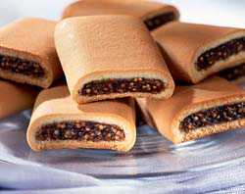
20

Slide 162
20

Slide 163
Machines Review Game
PULL OVER | ARE YOU CLEVER ENOUGH | ON A JET PLANE | WHEELIN and DEALIN | -BONUS- GREEN MACHINE
1 | 6 | 11 | 16 | *21
2 | 7 | 12 | 17 | *22
3 | 8 | 13 | 18 | *23
4 | 9 | 14 | 19 | *24
5 | 10 | 15 | 20 | *25
Copyright © 2010 Ryan P. Murphy

Slide 164
Check out the WEDGE from this movie?
21
Copyright © 2010 Ryan P. Murphy

Slide 165
Check out the WEDGE from this movie?
The Last Samurai (2003)
21
Copyright © 2010 Ryan P. Murphy

Slide 166
Who is this person and what two machines is he working?
22
Copyright © 2010 Ryan P. Murphy

Slide 167
Who is this person and what two machines is he working?
Tony Hawk,
22
Copyright © 2010 Ryan P. Murphy

Slide 168
Who is this person and what two machines is he working?
Tony Hawk, Wheel and Axle,
22
Copyright © 2010 Ryan P. Murphy

Slide 169
Who is this person and what two machines is he working?
Tony Hawk, Wheel and Axle, Lever
22
Copyright © 2010 Ryan P. Murphy

Slide 170
Who am I?
*23
23
Copyright © 2010 Ryan P. Murphy

Slide 171
Who am I?
*23
23
The Green Goblin
Copyright © 2010 Ryan P. Murphy

Slide 172
Who is this?
24

Slide 173
Who is this?
24
Evel Knievel

Slide 174
Name this machine?
25

Slide 175
Name this machine?
25

Slide 176
Name this machine?
25

Slide 177
Name this machine?
25

Slide 178
Name this machine?
25

Slide 179
Name this machine?
25
Bumblebee

Slide 180
Machines Review Game
PULL OVER | ARE YOU CLEVER ENOUGH | ON A JET PLANE | WHEELIN and DEALIN | -BONUS- GREEN MACHINE
1 | 6 | 11 | 16 | *21
2 | 7 | 12 | 17 | *22
3 | 8 | 13 | 18 | *23
4 | 9 | 14 | 19 | *24
5 | 10 | 15 | 20 | *25
Final Question:_________________
Copyright © 2010 Ryan P. Murphy

Slide 181
“You may wager up to
5 pts for this final Question.” “Please make your wager now.”

Slide 182
Final Question? Name all of the simple machines below.
Copyright © 2010 Ryan P. Murphy

Slide 183
Final Question? Name all of the simple machines below.
WHEEL AND AXLE
Copyright © 2010 Ryan P. Murphy

Slide 184
Final Question? Name all of the simple machines below.
WHEEL AND AXLE
Copyright © 2010 Ryan P. Murphy

Slide 185
Final Question? Name all of the simple machines below.
WHEEL AND AXLE, SCREW,
Copyright © 2010 Ryan P. Murphy

Slide 186
Final Question? Name all of the simple machines below.
WHEEL AND AXLE, SCREW, LEVER
Gears area a special form of a lever..
Copyright © 2010 Ryan P. Murphy

Slide 187
Questions 1-20 = 5pts Each
Final Category (Bonus) = 1pt Each
Final Questions = 5 pt wager
Find the Owl =
Secretly write “Owl” in the correct box worth 1pt.

Slide 188
Machines Review Game
Part III

Slide 189
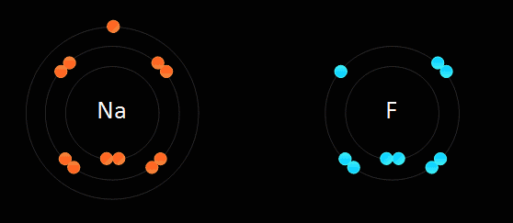
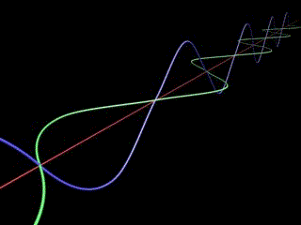
Physical Science Curriculum
Physical Science Curriculum Link
Newton's Laws of Motion, Forces in Motion and Simple Machines Unit
Laws of Motion and Simple Machines Unit Preview Link
Matter, Energy, and the Environment Unit
Matter, Energy, and the Environment Unit Preview
Atoms and Periodic Table of the Elements Unit on TpT
Atoms and Periodic Table of the Elements Unit Preview Link
Science Skills Unit on TpT
Science Skills Unit Preview Link

Slide 190
Laws of Motion and
Simple Machines Unit

Slide 191
Laws of Motion and
Simple Machines Unit

Slide 192
Laws of Motion and
Simple Machines Unit
Areas of Focus within The Motion and Machines Unit: Newton’s First Law, Inertia, Friction, Four Types of Friction, Negatives and Positives of Friction, Newton’s Third Law, Newton’s Second Law, Potential Energy, Kinetic Energy, Mechanical Energy, Forms of Potential to Kinetic Energy, Speed, Velocity, Acceleration, Deceleration, Momentum, Work, Machines (Joules), Catapults, Trajectory, Force, Simple Machines, Pulley / (MA Mechanical Advantage), Lever / (MA), Wedge / (MA), Wheel and Axle (MA), Inclined Plane / (MA), Screw / (MA) - Mousetrap Cars.
Newton's Laws of Motion, Forces in Motion and Simple Machines Unit
Hundreds of PowerPoint previews, the bundled homework package, unit notes, and much more can be previewed at…
Laws of Motion and Simple Machines Unit Preview Link

Slide 193
Laws of Motion and
Simple Machines Unit
Areas of Focus within The Motion and Machines Unit: Newton’s First Law, Inertia, Friction, Four Types of Friction, Negatives and Positives of Friction, Newton’s Third Law, Newton’s Second Law, Potential Energy, Kinetic Energy, Mechanical Energy, Forms of Potential to Kinetic Energy, Speed, Velocity, Acceleration, Deceleration, Momentum, Work, Machines (Joules), Catapults, Trajectory, Force, Simple Machines, Pulley / (MA Mechanical Advantage), Lever / (MA), Wedge / (MA), Wheel and Axle (MA), Inclined Plane / (MA), Screw / (MA) - Mousetrap Cars.
Newton's Three Laws of Motion
Newton's Laws of Motion Review Game
Friction Lesson, Types of Friction
Kinetic and Potential Energy Lesson
Newton's Laws and Forces in Motion
Forces in Motion Review Game
Catapults and Trajectory Lesson
Simple Machines Lesson
Simple Machines Review Game
Laws of Motion and Simple Machines Unit Flashcards
Laws of Motion and Simple Machines Crossword Puzzle
Laws of Motion, Forces in Motion, Simple Machines Unit Preview, Homework, Notes
Links

Slide 196
NGSS Standards HS

Slide 197
Additional Standards Addressed

Slide 198
Life Science Curriculum Link
Physical Science Curriculum Link
Earth Science Curriculum Link

Slide 199
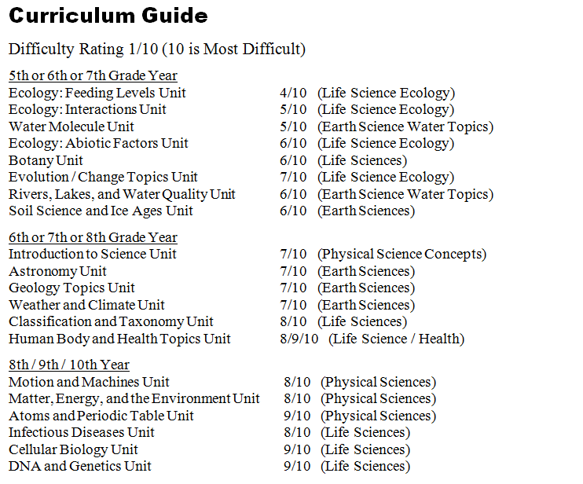

Slide 200
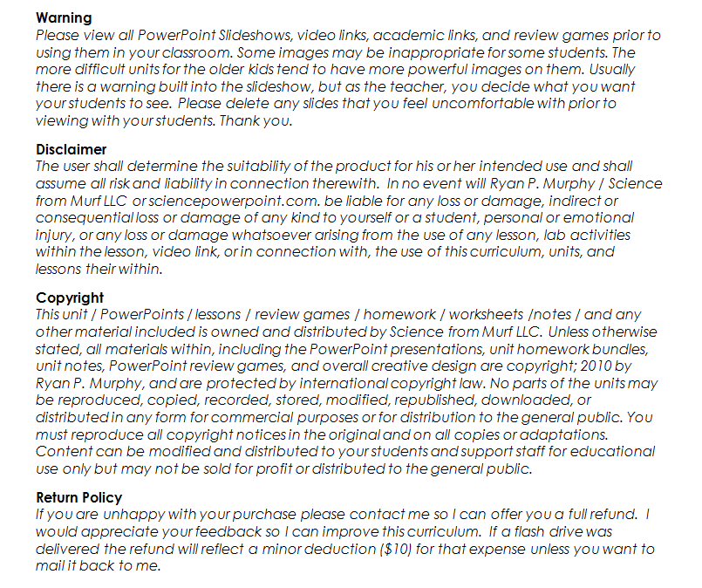

Slide 201
Earth Science Curriculum
Earth Science Curriculum Link
Earth Science Units | Purchase Individual Unit Link on TpT
Geology Topics Unit | Geology Unit on TpT
Astronomy Topics Unit | Astronomy Unit on TpT
Weather and Climate Unit | Weather and Climate Unit on TpT
Soil Science, Weathering, More | Weathering, Soil Science, Ice-Ages, Glaciers Unit on TpT
Water Unit | Water Unit on TpT
Rivers Unit | Rivers, Lakes, and Water Quality Unit on TpT

Slide 202
Life Science Curriculum
Life Science Curriculum Link
Life Science Units | Purchase Individual Unit Link on TpT
DNA and Genetics Unit | DNA and Genetics Unit on TpT
Cell Biology Unit | Cell Biology Unit on TpT
Infectious Diseases Unit | Virus, Bacteria, Parasites, Diseases Unit
Taxonomy and Classification Unit | Taxonomy and Classification Unit
Evolution / Natural Selection Unit | Evolution and Natural Selection Unit on TpT
Botany Topics Unit | Botany Unit
Ecology Feeding Levels Unit | Ecology Feeding Levels Unit on TpT
Ecology Interactions Unit | Ecology Interactions Unit on TpT
Ecology Abiotic Factors Unit | Ecology Abiotic Factors Unit on TpT
Anatomy, Human Body Systems | Human Body Systems and Health Topics Unit

Slide 203
Physical Science Curriculum
Physical Science Units | Purchase Individual Unit Link on TpT
Science Skills Unit | Science Skills Unit on TpT
Motion and Machines Unit | Newton's Laws of Motion, Forces in Motion and Simple Machines Unit
Matter, Energy, Envs. Unit | Matter, Energy, and the Environment Unit
Atoms and Periodic Table Unit | Atoms and Periodic Table of the Elements Unit on TpT
Physical Science Curriculum Link

Slide 204
Follow my TpT store, get notifications about flash freebies, curriculum updates, great classroom ideas, pins, and much more by following me on Facebook , Twitter, and Pinterest.

Slide 205
Curriculum Tour Link (190mb)
Thank you for your time and interest in this curriculum. The link above will take you to my curriculum tour that includes many PowerPoint previews, unit notes, bundled homework packages, curriculum information and much more. Please feel free to contact me with questions. Thanks again and best wishes.
Sincerely,
Ryan Murphy M.Ed
ryemurf@gmail.com

Slide 206
Science Curriculum TpT Link
sciencepowerpoint.com

